Slide 1
Resource Integration & On-going Operations - Resources Services
(RIOO-RS)
Project Update
19 April 2022

Slide 2
RIOO System is live
All updates required to be submitted in RIOO-RS starting 11/13/2020
  RARFs for updates to Resource Registration data are not accepted unless an exception is granted.
New Resources, SODGs, or Load Resources will continue to use the RARF spreadsheet and submit as a Service Request through the MIS.
The RIOO Create phase effort has been initiated – this will allow new generators to submit their data via the on-line application
Added capability to RIOO-IS to accept interconnection requests from generation less than 10MWs and DGRs on 12/20/2021.
Added payment capability in the system for generation less than 10MWs and DGRs.

Slide 3
RIOO-RS & RIOO-IS Updates - 2022
02/04 RIOO-IS Release – added payment feature for Small Generators & DGRs in the system
3/11 RIOO-IS Release – added missing Additional Generation flow
5/27 RIOO-IS and RIOO-RS Releases - Defect fixes
  RIOO-IS – Payment issues, RARF attestation
  RIOO-RS – Updated validation rules

Slide 4
Future Effort
Currently working on timeline for future releases for the following capability:
  Create data for a new generator
  Generator modifications
  SOG
  Load Resources
Targeting a 4Q2022 release

Slide 5
Potential Data Export Change
Recent security testing recommendation to change the format of the exported file
Add a single quote, ‘ , to the beginning of some of the worksheet cells to mitigate the risk of bad actors inserting malicious data into the export file
If your company uses the exported file in any automated process, this could impact the processing of the data
Please send info to RIOO-HELP@ercot.com if this would impact your processes

Slide 6

RIOO- RS FAQ
What is the link to RIOO-RS?
  The link for RIOO-RS is located on ercot.com and is: https://sa.ercot.com/rioo-rs/
Does RIOO-RS use a digital certificate?
  No.
What role do I need and how do I get it?
  Your company USA should provide the RIOO_M_Operator in order to gain access to RIOO-RS.

Slide 7
RIOO-RS FAQ
Why do I have errors on things I did not change?
  May have errors on first Change Request in the system
  Caused by update validation rules and migrated data
What do I do if I can’t see my resources?
  Check with your USA, ensure RIOO_M_Operator role has been added to desired DUNS
  May need to use two emails if have more than 15-20 DUNs numbers
  Still can’t see? Send info to RIOO-HELP@ercot.com
    Email used for accessing RIOO-RS
    DUNS number of missing resource
    We can also set up a WebEx to trouble-shoot the issue
  New generators will not see their information in RIOO-RS until the model date

Slide 8
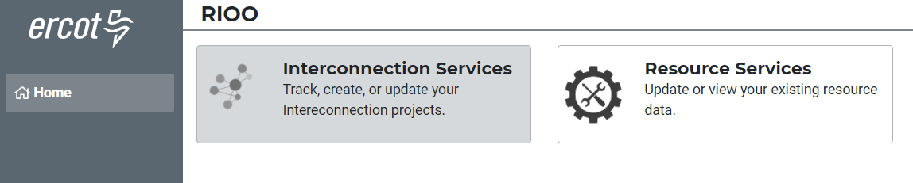
RIOO-RS FAQ
How do I know if I have access?
  This user only has access to RIOO-RS since RIOO-IS is greyed out.
I have multiple email addresses, how should my access be set up?
  If you intend to use multiple addresses then your USA has to provide the RIOO_M_Operator for each email address in addition to associating the DUNs for each Resource with the email address. Once this is done, each email account must go through the verification process.
Can Dynamic Model files be submitted via RIOO?
  Yes, RIOO has a section that accepts attachments.

Slide 9
RIOO-RS FAQ
  I have not been able to set up access, what do I do?
  Can’t access the system: Contact the Help Desk
  Questions: RIOO-HELP@ercot.com
  We can also set up a WebEx to trouble-shoot the issue
  My phone number has changed, what do I do?
  Send an email to RIOO-HELP@ercot.com; let us know your number has changed. You may also reach out to your account manager.
  The Multi-Factor Authentication (MFA) associated with your phone number will need to be re-set.
  Once MFA is reset, you will receive an email with an ENROLL YOUR DEVICE button that you click to display the ERCOT Authentication Method page and set up your MFA app and device again.
I’m getting a weird error?
  Please send a screen shot to RIOO-HELP@ercot.com.

Slide 10
RIOO Demo
Demo

Slide 11
Discussion
or
Questions
Backup slides follow

Slide 12
RIOO-IS and RIOO-RS
RIOO-IS – Interconnection Services (sa.ercot.com/ginr/)
  Allows users to start the interconnection process.
  Access – email / password and MFA
    Interconnecting Entities (IEs) must self-register
RIOO-RS – Resource Service (sa.ercot.com/rioo-rs/)
  Allows REs to update data for generators that are already interconnected to the ERCOT grid.
  Access - email / password and MFA (NOT a digital certificate)
    REs – Role from USA: RIOO_M_Operator

Slide 13
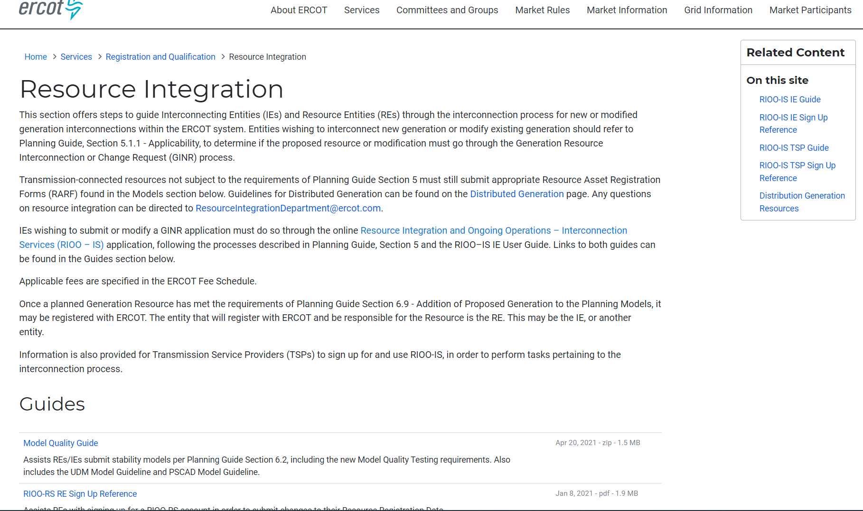
RIOO- RS is live – how do I get access?
The RIOO-RS sign-up reference is available here: http://www.ercot.com/services/rq/integration

Slide 14
How to get access - Checklist
The user:
  Gets the role “RIOORS_M_OPERATOR” from his/her USA
  Gets an email
    Clicks on “Verify my account” button
  Types in URL for the system
    Clicks “Don’t remember your password” button
  Gets a change password email
    Clicks on change my password button
  Changes his/her password
  Types in URL for the system, sign with user-id / password
  Setups authentication
    Scans code or enter mobile phone for SMS
    Saves Recovery code
    Confirms authorization method
    (Google Authenticator/ Auth0 guardian/SMS)
  Get an email
  Click on verify my account button
  Access the RIOO-RS, sign with user-id / password

