Slide 1
VSS & Reactive Study requirement for Co-located Resources
Jenifer Fernandes
ERCOT
Resource Integration Working Group
April 19, 2022

Slide 2
VSS Requirement
NPRR1005-Clarifying the definition of POI and POIB was implemented on Feb 1st, 2022.
Nodal Protocol 2- Point of Interconnection Bus (POIB):
Electric Bus at the TSP substation that is electrically closest to the Generation Resource’s POI or any electrically equivalent Electrical Bus at that station.
Nodal Protocol 3.15 (4): VSS requirement is at the POIB.
Reactive Study should account for the gen-tie line regardless of ownership.
Part 3 Test: VSS requirement is calculated at the POIB.

Slide 3
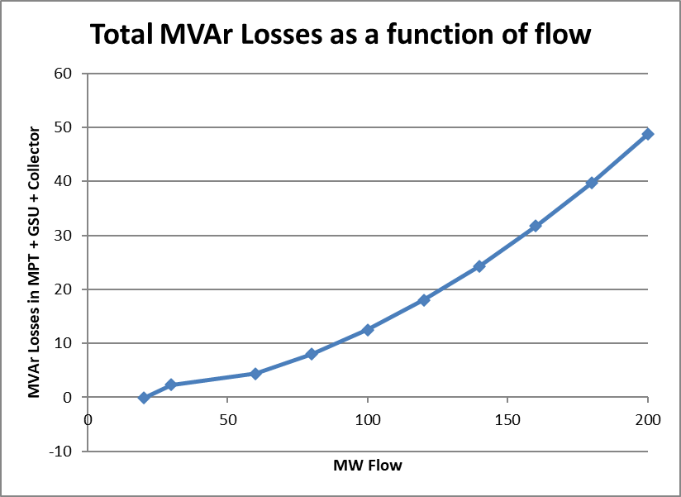
Reactive Study: Co-located Resources behind the same POI
Co-located resources with different operating regimes should evaluate each resource independently and jointly to ensure the entire plant will be able to meet VSS.
E.g. Solar +Energy Storage. Reactive study should evaluate three scenarios i.e Solar, Storage and Solar + Storage.
Reactive deficiencies identified in the Solar + Storage scenario must be addressed to meet VSS.
Reactive losses depends on MW flow. MVAr losses are non-linear I²X.
Additional shunts may be required.

Slide 4
Part 3 Tests: Co-located Resources behind the same POI
Reactive Test- Each Resource (solar, storage) is tested individually to meet requirement per NOG 3.3.2.2
VSS: Each Resource independently and combined must meet VSS per NP 3.15.
Solar
Storage
Solar + Storage
AVR Test- Test three scenarios
Solar
Storage
Solar + Storage: the combined test is to verify that the plant can control the voltage at the POIB with both Resources online.

Slide 5
Questions?
Thank you!

