Slide 1
Alternative Default Uplift Methodology
Austin Rosel
ERCOT
CWG / MCWG
ERCOT Public
May 18, 2022

Slide 2
Request for Data
Data request update from the March CWG.
Impact to QSEs and CRRAHs uplift exposure based on changes to the Default Uplift Methodology.
In the following slides:
The impact of removal of CRR Auction activity and multiplying CRRs owned (DAOPT & DAOBL) by a scalar with 50%, 60%, 70%, 80% and 90% multipliers at QSE/CRRAH and CP level.
The impact of removal of CRR Auction activity and multiplying CRRs and PTPs owned (DAOPT, DAOBL, RTOBL, RTOBLLO) by a scalar with 50%, 60%, 70%, 80% and 90% multipliers at QSE/CRRAH and CP level.

Slide 3
Formula Change NP 9.19.1 Option 1

Slide 4
Formula Change NP 9.19.1 Option 1

Slide 5
Jan- 50%, 60%, 70%, 80% & 90% Scalar Scenarios
QSE/CRRAH Level
January 2021 UDAOPT & UDAOBL Adjustment
Segment | Original | Remove Auctions | 90 Percent adj. | 80 Percent adj. | 70 Percent adj. | 60 Percent adj. | 50 Percent adj.
Gen | 2.29% | 2.50% | 3.01% | 3.15% | 3.77% | 3.94% | 4.10%
Load | 13.17% | 14.39% | 15.06% | 15.76% | 16.58% | 17.31% | 17.99%
Load and Gen | 9.08% | 9.92% | 13.15% | 13.76% | 15.29% | 22.07% | 22.94%
Trader | 24.82% | 27.87% | 29.17% | 30.51% | 31.95% | 33.84% | 35.18%
CRRAH Only | 50.65% | 45.33% | 39.61% | 36.83% | 32.40% | 22.84% | 19.79%
Total | 100.00% | 100.00% | 100.00% | 100.00% | 100.00% | 100.00% | 100.00%
MMATOT | 218,577,111 | 200,056,047 | 191,101,534 | 182,692,772 | 174,481,586 | 167,148,115 | 160,784,260
Counter Party Level
January 2021 UDAOPT & UDAOBL Adjustment
Segment | Original | Remove Auctions | 90 Percent adj. | 80 Percent adj. | 70 Percent adj. | 60 Percent adj. | 50 Percent adj.
Gen | 2.34% | 2.17% | 2.13% | 2.08% | 2.08% | 2.07% | 2.05%
Load | 5.39% | 5.88% | 6.14% | 6.42% | 6.71% | 7.01% | 7.28%
Load and Gen | 43.19% | 46.96% | 47.66% | 48.59% | 49.60% | 50.96% | 52.65%
Trader | 45.75% | 41.74% | 41.00% | 40.06% | 39.00% | 37.63% | 35.99%
CRRAH Only | 3.34% | 3.26% | 3.07% | 2.85% | 2.61% | 2.34% | 2.03%
Total | 100.00% | 100.00% | 100.00% | 100.00% | 100.00% | 100.00% | 100.00%
MMATOT | 218,577,111 | 200,056,047 | 191,101,534 | 182,692,772 | 174,481,586 | 167,148,115 | 160,784,260

Slide 6
Aug- 50%, 60%, 70%, 80% & 90% Scalar Scenarios
QSE/CRRAH Level
August 2021 UDAOPT & UDAOBL Adjustment
Segment | Original | Remove Auctions | 90 Percent adj. | 80 Percent adj. | 70 Percent adj. | 60 Percent adj. | 50 Percent adj.
Gen | 2.58% | 2.79% | 2.91% | 3.42% | 3.58% | 3.73% | 3.87%
Load | 16.67% | 18.04% | 19.06% | 19.90% | 20.82% | 21.68% | 22.48%
Load and Gen | 11.83% | 12.81% | 14.13% | 14.84% | 15.89% | 24.53% | 25.43%
Trader | 21.65% | 24.36% | 25.42% | 26.54% | 27.76% | 28.92% | 29.97%
CRRAH Only | 47.28% | 42.01% | 38.48% | 35.29% | 31.95% | 21.14% | 18.26%
Total | 100.00% | 100.00% | 100.00% | 100.00% | 100.00% | 100.00% | 100.00%
MMATOT | 222,159,396 | 205,270,370 | 196,731,372 | 188,397,997 | 180,151,515 | 172,941,685 | 166,848,476
Counter Party Level
August 2021 UDAOPT & UDAOBL Adjustment
Segment | Original | Remove Auctions | 90 Percent adj. | 80 Percent adj. | 70 Percent adj. | 60 Percent adj. | 50 Percent adj.
Gen | 3.52% | 3.20% | 3.14% | 3.09% | 3.05% | 2.99% | 2.91%
Load | 6.39% | 6.91% | 7.20% | 7.52% | 7.87% | 8.20% | 8.49%
Load and Gen | 47.01% | 50.64% | 51.39% | 52.22% | 53.14% | 54.43% | 56.12%
Trader | 38.59% | 34.82% | 34.11% | 33.30% | 32.41% | 31.23% | 29.75%
CRRAH Only | 4.49% | 4.42% | 4.15% | 3.86% | 3.53% | 3.15% | 2.72%
Total | 100.00% | 100.00% | 100.00% | 100.00% | 100.00% | 100.00% | 100.00%
MMATOT | 222,159,396 | 205,270,370 | 196,731,372 | 188,397,997 | 180,151,515 | 172,941,685 | 166,848,476

Slide 7
Formula Change NP 9.19.1 Option 2

Slide 8
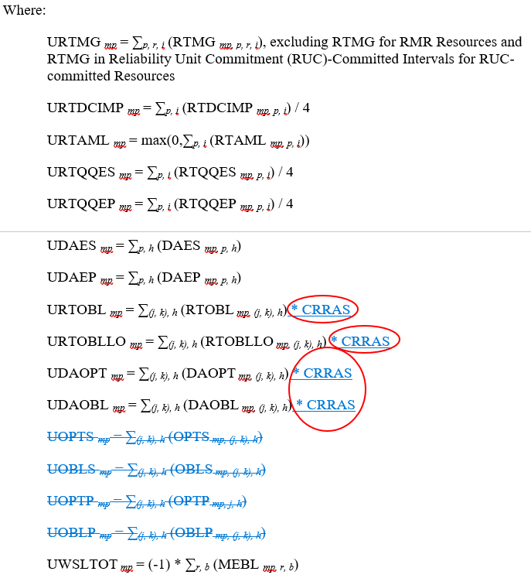
Formula Change NP 9.19.1 Option 2

Slide 9
Jan- 50%, 60%, 70%, 80% & 90% Scalar Scenarios
QSE/CRRAH Level
January UDAOPT, UDAOBL, RTOBL, RTOBLLO Adjustment
Segment | Original | Remove Auctions | 90 Percent adj. | 80 Percent adj. | 70 Percent adj. | 60 Percent adj. | 50 Percent adj.
Gen | 2.29% | 2.50% | 3.39% | 3.57% | 4.27% | 4.51% | 4.79%
Load | 13.17% | 14.39% | 14.55% | 15.34% | 16.28% | 17.23% | 18.29%
Load and Gen | 9.08% | 9.92% | 13.28% | 14.00% | 15.60% | 16.59% | 17.61%
Trader | 24.82% | 27.87% | 28.78% | 29.62% | 30.52% | 31.52% | 32.63%
CRRAH Only | 50.65% | 45.33% | 40.00% | 37.47% | 33.33% | 30.15% | 26.67%
Total | 100.00% | 100.00% | 100.00% | 100.00% | 100.00% | 100.00% | 100.00%
MMATOT | 218,577,111 | 200,056,047 | 189,241,072 | 179,549,110 | 170,036,491 | 160,670,765 | 151,334,981
Counter Party Level
January UDAOPT, UDAOBL, RTOBL, RTOBLLO Adjustment
Segment | Original | Remove Auctions | 90 Percent adj. | 80 Percent adj. | 70 Percent adj. | 60 Percent adj. | 50 Percent adj.
Gen | 2.34% | 2.17% | 2.15% | 2.11% | 2.13% | 2.16% | 2.18%
Load | 5.39% | 5.88% | 6.20% | 6.53% | 6.89% | 7.29% | 7.74%
Load and Gen | 43.19% | 46.96% | 47.83% | 49.12% | 50.55% | 52.17% | 54.00%
Trader | 45.75% | 41.74% | 40.73% | 39.34% | 37.75% | 35.95% | 33.93%
CRRAH Only | 3.34% | 3.26% | 3.10% | 2.90% | 2.68% | 2.43% | 2.15%
Total | 100.00% | 100.00% | 100.00% | 100.00% | 100.00% | 100.00% | 100.00%
MMATOT | 218,577,111 | 200,056,047 | 189,241,072 | 179,549,110 | 170,036,491 | 160,670,765 | 151,334,981

Slide 10
Aug- 50%, 60%, 70%, 80% & 90% Scalar Scenarios
QSE/CRRAH Level
August 2021 UDAOPT, UDAOBL, RTOBL, RTOBLLO Adjustment
Segment | Original | Remove Auctions | 90 Percent adj. | 80 Percent adj. | 70 Percent adj. | 60 Percent adj. | 50 Percent adj.
Gen | 2.58% | 2.79% | 2.95% | 3.53% | 3.85% | 4.08% | 4.34%
Load | 16.67% | 18.04% | 18.66% | 19.09% | 19.73% | 20.90% | 22.21%
Load and Gen | 11.83% | 12.81% | 14.33% | 15.28% | 16.52% | 17.50% | 18.59%
Trader | 21.65% | 24.36% | 25.04% | 25.77% | 26.52% | 27.22% | 28.02%
CRRAH Only | 47.28% | 42.01% | 39.02% | 36.33% | 33.39% | 30.31% | 26.85%
Total | 100.00% | 100.00% | 100.00% | 100.00% | 100.00% | 100.00% | 100.00%
MMATOT | 222,159,396 | 205,270,370 | 194,010,691 | 182,977,832 | 172,423,362 | 162,784,960 | 153,164,681
Counter Party Level
August 2021 UDAOPT, UDAOBL, RTOBL, RTOBLLO Adjustment
Segment | Original | Remove Auctions | 90 Percent adj. | 80 Percent adj. | 70 Percent adj. | 60 Percent adj. | 50 Percent adj.
Gen | 3.52% | 3.20% | 3.18% | 3.19% | 3.19% | 3.18% | 3.17%
Load | 6.39% | 6.91% | 7.29% | 7.73% | 8.20% | 8.69% | 9.23%
Load and Gen | 47.01% | 50.64% | 51.46% | 52.38% | 53.54% | 55.10% | 56.85%
Trader | 38.59% | 34.82% | 33.86% | 32.73% | 31.38% | 29.69% | 27.79%
CRRAH Only | 4.49% | 4.42% | 4.21% | 3.97% | 3.69% | 3.35% | 2.96%
Total | 100.00% | 100.00% | 100.00% | 100.00% | 100.00% | 100.00% | 100.00%
MMATOT | 222,159,396 | 205,270,370 | 194,010,691 | 182,977,832 | 172,423,362 | 162,784,960 | 153,164,681

