Slide 1
System Protection Working Group
(SPWG)
Update to ROS
April 7, 2022
Chair: Bret Burford, P.E.

Slide 2
SPWG Meeting Overview
1st SPWG Meeting of 2022 was held on March 2, 2022
Topics Discussed:
  Texas RE 2021 Q4 Misoperation Data (included)
  NERC SPCWG Activities
    PRC-019-2 – still working and expect to be re-submitted early 2023
    PRC-023 SAR – to be posted for industry comment soon
    PRC-002 SARs – 1st effort involving Notification requirements is getting close to being submitted for industry comment; 2nd effort involving DME for IBR locations has not started
  Reviewed latest version of NOGRR226 – UFLS change for 59.4 Hz
  Reviewed ERCOT IBR Task Force charter and meeting notes

Slide 3
Settlement Only Distributed Generation (SODG) Modeling in ASPEN
ERCOT has added 259 SODG aggregate generator models into the ASPEN case, modeled at the transmission level bus
SPWG majority is that SODG should be modeled on the LV bus of the distribution transformer if it is to be included in ASPEN
ERCOT agreed to model SODG with infinite impedance and offline as a temporary stop gap until we come to a resolution
SODG modeled at the transmission voltage level will lead to inaccurate fault studies, and potential misoperations
Distribution transformers need to be accounted for when developing line relay settings on lines with tapped loads
SPWG will continue working towards resolving these modelling concerns

Slide 4
Inverter Based Resource (IBR) Modeling in ASPEN
There are critical issues with the way IBRs are being modeled in ASPEN
  Generator models missing current limits
    Can lead to fictitiously high fault currents or convergence errors
  2-winding instead of 3-winding main power transformers
    This causes zero sequence fault current errors in the models
    This has been an ongoing issue for many years
  IBR models aggregated to 34.5kV and not including padmount transformers
    ASPEN recommends modeling IBR at the low voltage bus (typically ~400V-800V)
  As it stands, the ASPEN models do not converge when running fault studies
ASPEN has developed newer IBR models in conjunction with EPRI
SPWG plans to propose modeling guidelines for IBRs later this year

Slide 5
Protection System Misoperations
2021 Q4

Slide 6
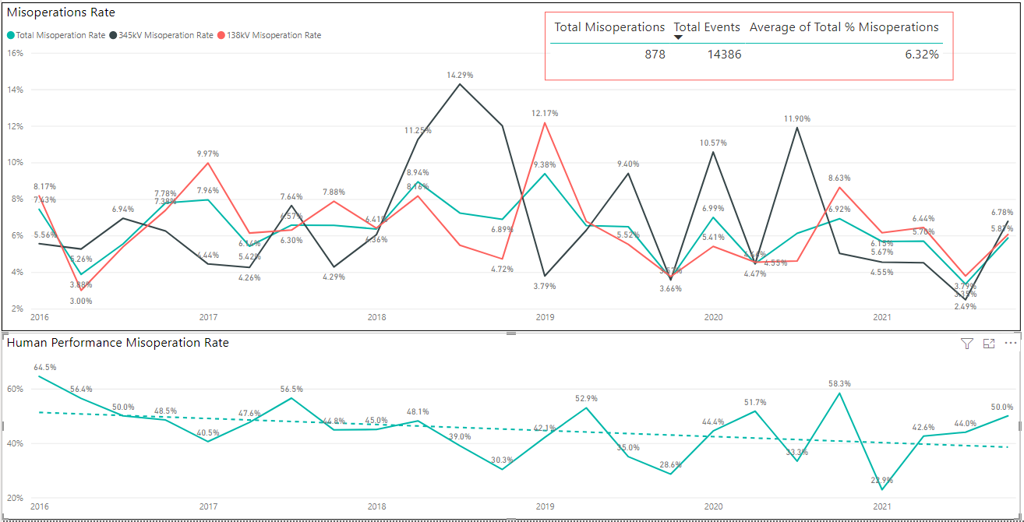
Protection System Misoperations: 2016-2021 Q4
2021 Q4 Misop rate – 5.87%
2021 Annual Misop rate – 5.20%

Slide 7
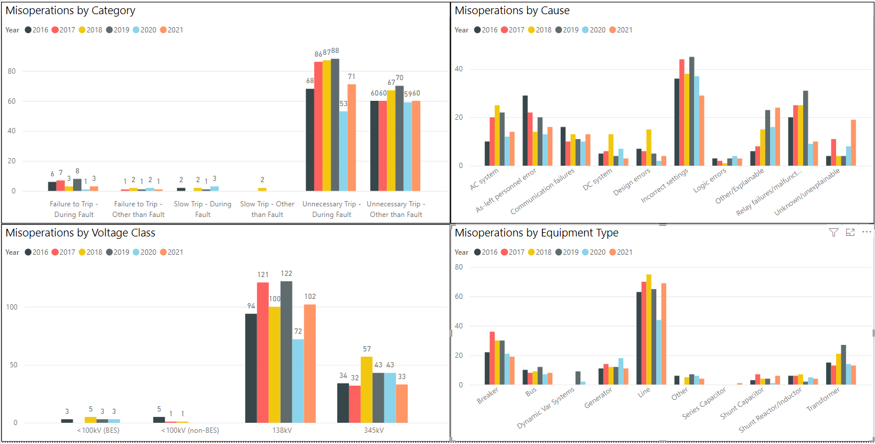
Protection System Misoperations: 2016-2021 Q4
Misop count due to incorrect settings decreased in 2021
Misop counts due to other/explainable and unknown increased in 2021

Slide 8
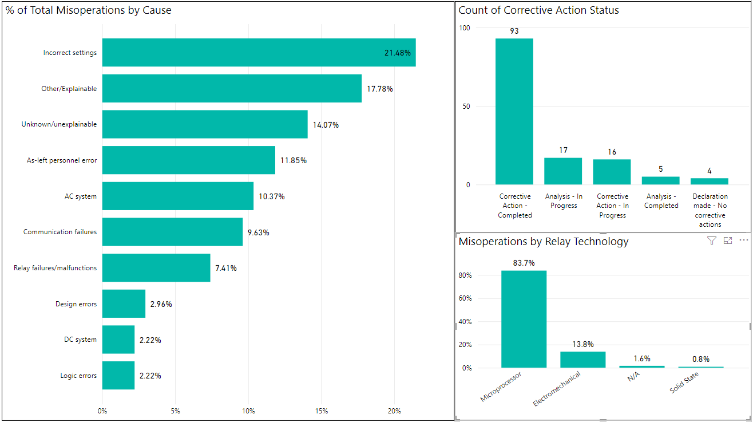
Protection System Misoperations: 2021

Slide 9
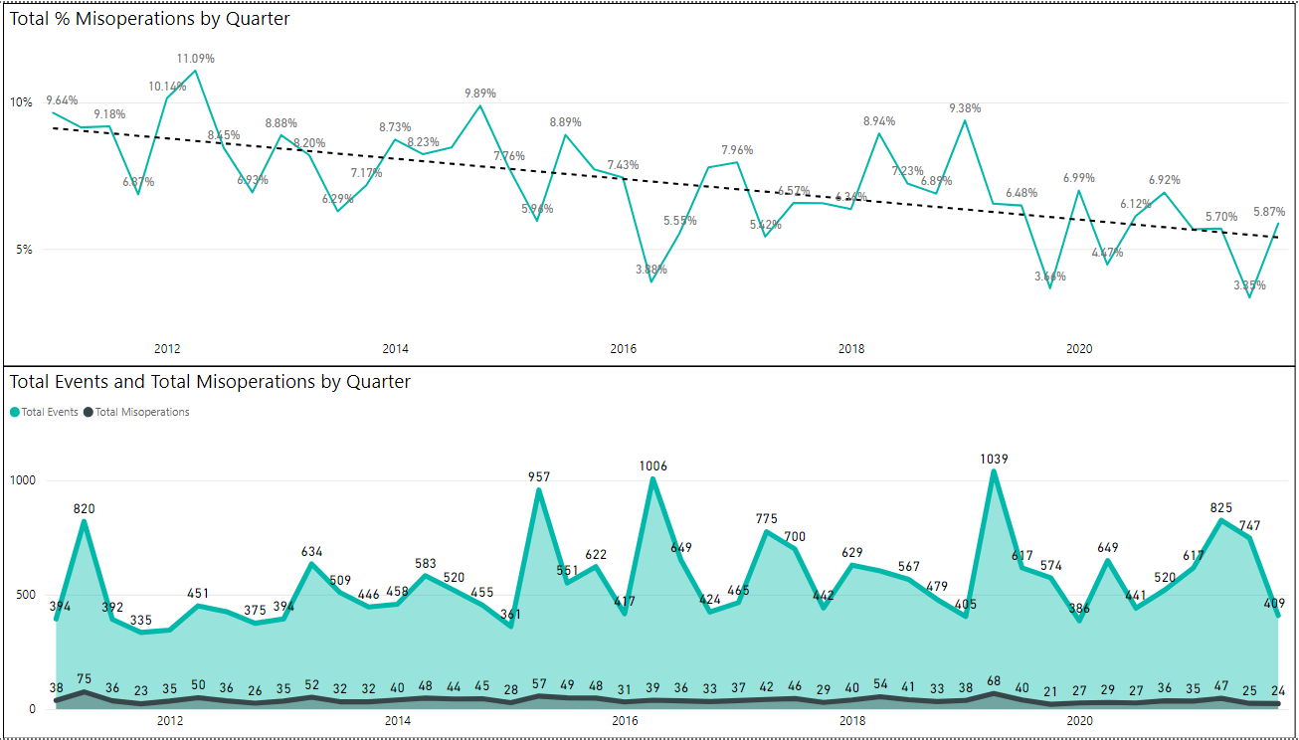
Protection System Misoperations: 2016-2021 Q4

Slide 10
Protection System Misoperations – 2021 Q4
 |  | Q4 | 2021
# of Misoperations | Total | 24 | 135
 | 345 kV | 8 | 33
 | 138 kV | 16 | 102
 | < 100 kV | 0 | 0
By Category | Failure to Trip | 0 | 4
 | Slow Trip | 0 | 0
 | Unnecessary Trip during Fault | 10 | 71
 | Unnecessary Trip – Non Fault | 14 | 60
 | SPS | 0 | 0
By Relay System Type | Electromechanical | 1 | 17
 | Solid State | 0 | 1
 | Microprocessor | 22 | 103
 | Other/ N/A | 1 | 14
By Equipment Protected | Line | 13 | 69
 | Transformer | 3 | 13
 | Generator | 4 | 11
 | Shunt/Series Capacitor | 0 | 7
 | Shunt/Series Reactor | 2 | 4
 | Dynamic VAR system | 0 | 0
 | Bus | 1 | 8
 | Breaker | 1 | 19
 | Other | 0 | 4

Slide 11
Protection System Misoperations 2021 Q4
Summary of Human Performance Issues noted for 2021 Q4:
138kV line misoperated due to incorrectly wired CT polarity at the breaker CT terminal block
138kV line tripped due to incorrectly set phase instantaneous overcurrent element
138kV line tripped due to incorrect CT ratio
138kV line tripped due to temporary protection scheme left in service after completion of construction
Generator trip due to V/Hz trip logic
Generator trip due to incorrect settings being uploaded to the differential relay
345kV bus tripped due to a wiring error
Failure to Trip/Slow Trip Misoperations in 2021 Q4:
None

Slide 13
Definitions
Protection System –
  Protective relays which respond to electrical quantities,
  Communications systems necessary for correct operation of protective functions
  Voltage and current sensing devices providing inputs to protective relays,
  Station dc supply associated with protective functions (including station batteries, battery chargers, and non-battery-based dc supply), and
  Control circuitry associated with protective functions through the trip coil(s) of the circuit breakers or other interrupting devices

Slide 14
Definitions
Composite Protection System - The total complement of Protection System(s) that function collectively to protect an Element. Backup protection provided by a different Element’s Protection System(s) is excluded.
Misoperation – The failure a Composite Protection System to operate as intended for protection purposes. Any of the following is a Misoperation:
  Failure to Trip – During Fault – A failure of a Composite Protection system to operate for a Fault condition for which it is designed.
  Failure to Trip – Other than Fault - A failure of a Composite Protection system to operate for a non-Fault condition for which it is designed, such as a power swing, undervoltage, overexcitation, or loss of excitation.

Slide 15
Definitions
Misoperation – The failure a Composite Protection System to operate as intended for protection purposes. Any of the following is a Misoperation:
  Slow Trip – During Fault – A Composite Protection system that is slower than required for a Fault condition if the duration of its operating time resulted in the operation of at least one other Element’s Composite Protection System.
  Slow Trip – Other than Fault - A Composite Protection system that is slower than required for a non-Fault condition, such as a power swing, undervoltage, overexcitation, or loss of excitation, if the duration of its operating time resulted in the operation of at least one other Element’s Composite Protection System.

Slide 16
Definitions
Misoperation – The failure a Composite Protection System to operate as intended for protection purposes. Any of the following is a Misoperation:
  Unnecessary Trip – During Fault – An unnecessary Composite Protection system operation for a Fault condition on another Element.
  Unnecessary Trip – Other than Fault - An unnecessary Composite Protection system operation for a non-Fault condition. A Composite Protection System operation that is caused by personnel during on-site maintenance, testing, inspection, construction, or commissioning activities is not a Misoperation.

Slide 17
End of SPWG Presentation
Next Meeting Scheduled for July 20-21, 2022
Next ERCOT ROS Update will be Provided on August 4th, 2022
Thank You
Any Questions?

