Slide 1
PDCWG Report to ROS
Chair: Jimmy Jackson, CPS
Vice Chair: Vacant
ROS
April 07, 2022

Slide 2
Report Overview & Notes
Report Overview
Meeting Minutes
BAL-001-TRE-2 FMEs and IMFR
1 FME in the month of February
Frequency Control Report

Slide 3
Meeting Minutes
PDCWG Meeting 3/16/2022
ERCOT Inertia Analysis
Overview of the ROS meeting
ERCOT Reports

Slide 4
Frequency Measurable Events Performance

Slide 5
Frequency Measurable Events
There was 1 FME in February
2/22/2022 6:18:28
Loss of 764 MW generation
Interconnection Frequency Response: 1,698 MW/0.1 Hz
37 Resources were evaluated. These includes,
35 Generation Resources
2 Controllable Load Resources
0 Energy Storage Resources
3 of 35 Evaluated Generation Resources had less than 75% of their expected Initial Primary Frequency Response.
5 of 35 Evaluated Generation Resources had less than 75% of their expected Sustained Primary Frequency Response.

Slide 6
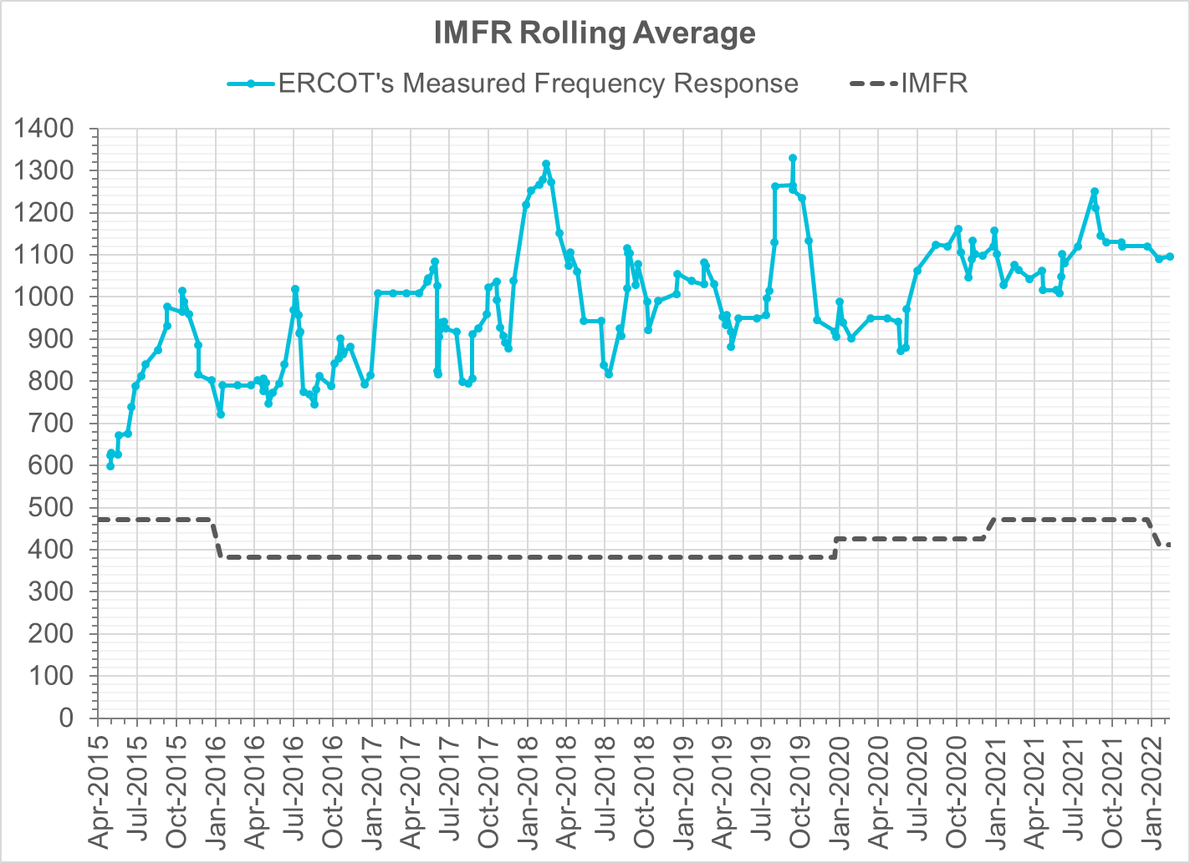
Interconnection Minimum Frequency Response (IMFR) Performance
IMFR Performance currently
1096.30 MW/0.1HZ
Frequency Response Obligation (FRO): 412 MW/0.1 Hz

Slide 7
Questions?

Slide 8
Frequency Control Report
February 2022

Slide 9
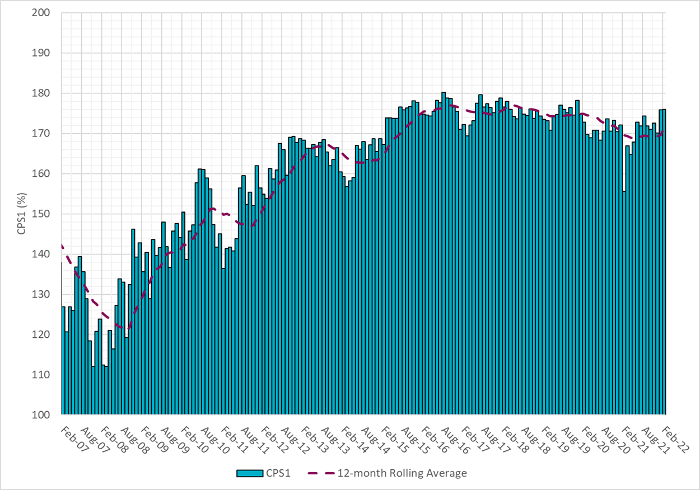
CPS1 Performance
Current 12-Month Rolling Average: 171.30%

Slide 10
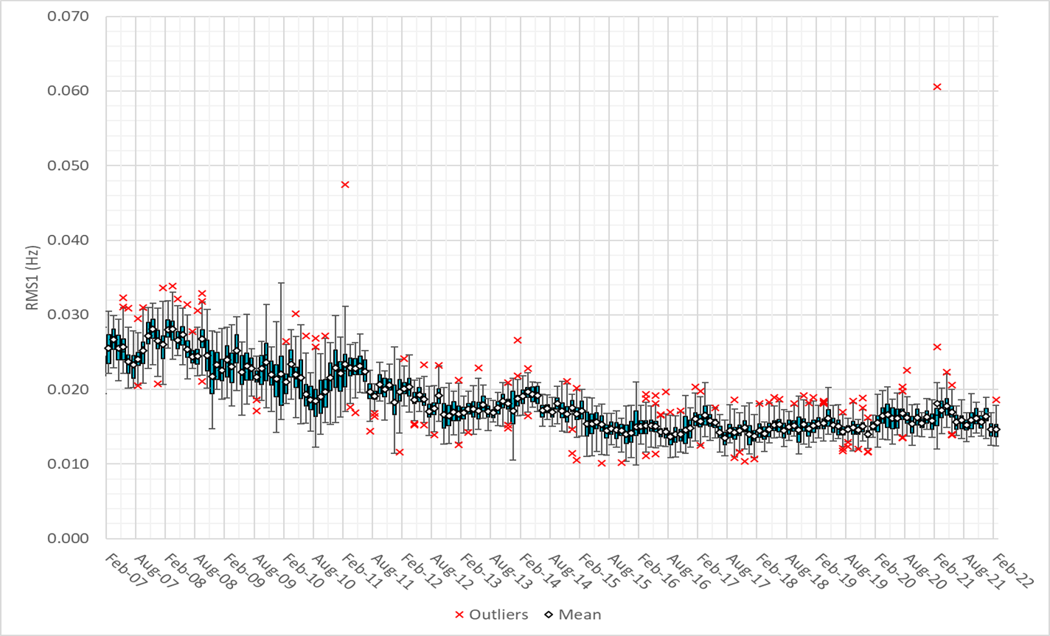
RMS1 Performance of ERCOT Frequency

Slide 11
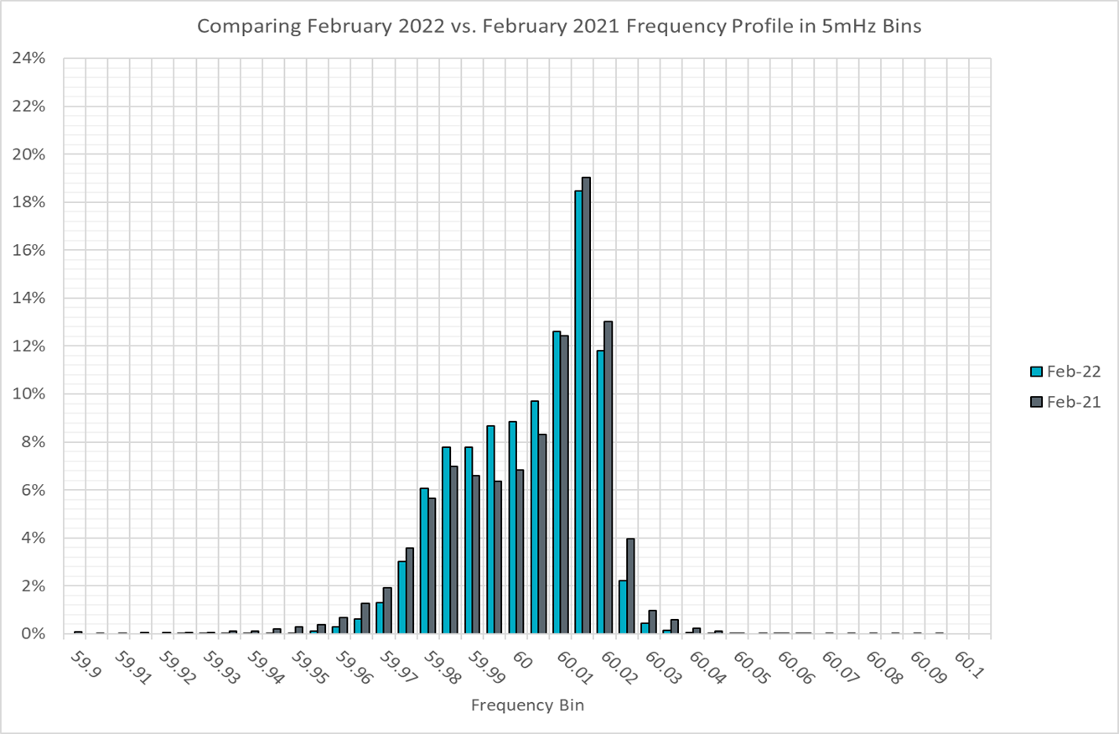
Frequency Profile Analysis

Slide 12
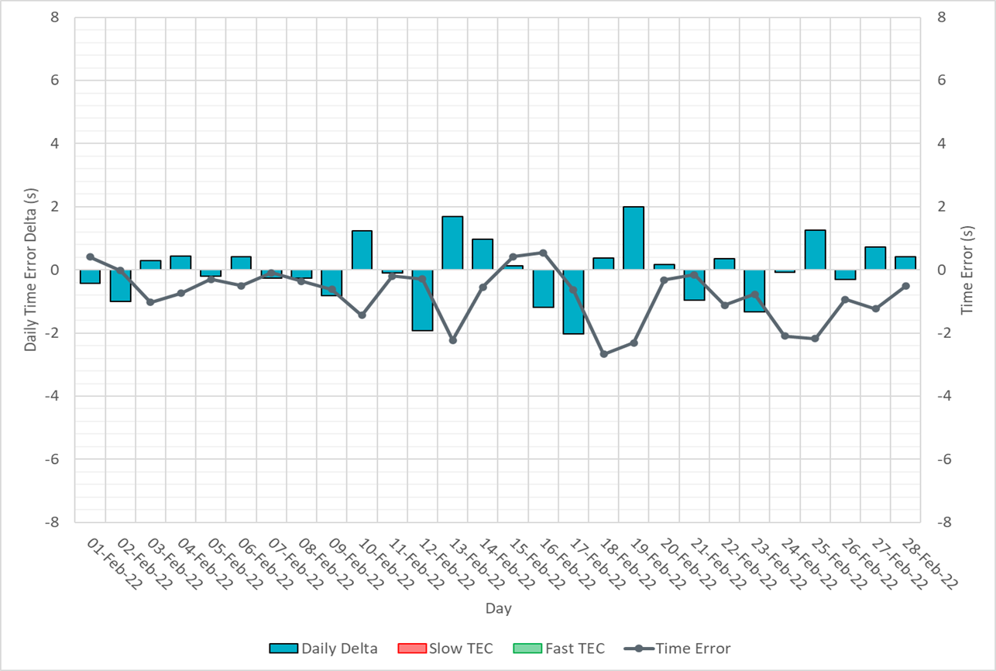
Time Error Corrections

Slide 13
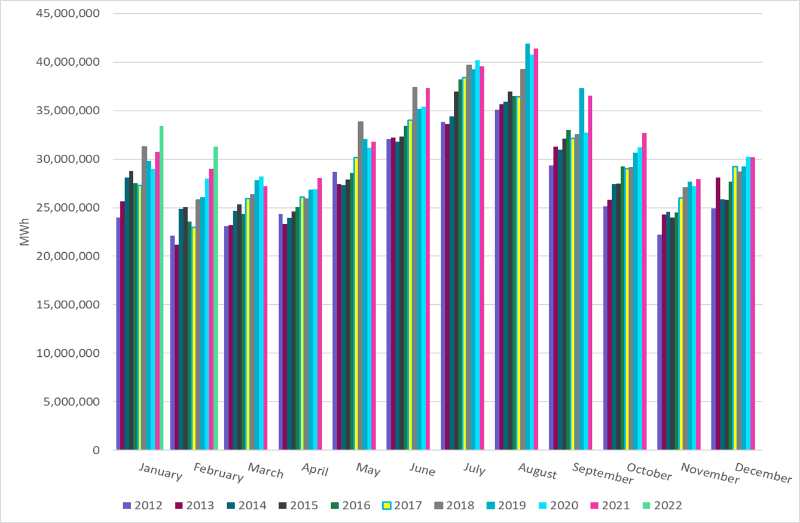
ERCOT Total Energy
Notes:
31,284,898 MWh

Slide 14
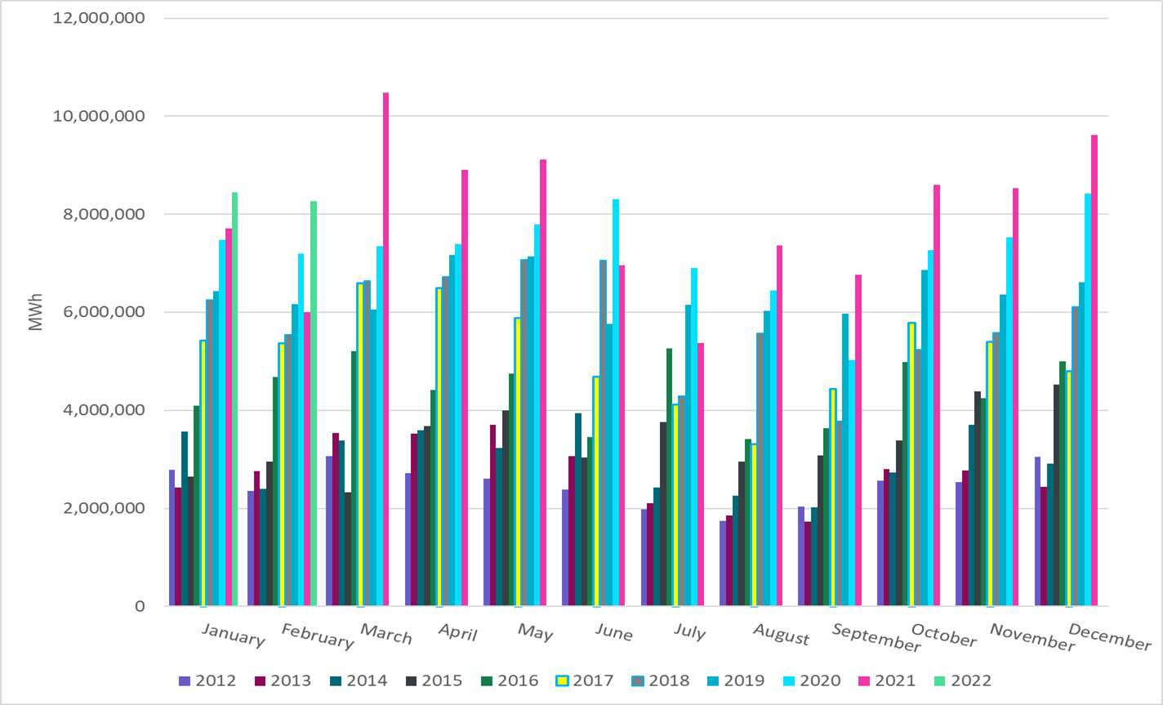
ERCOT Total Energy from Wind Generation
Notes:
8,261,666 MWh

Slide 15
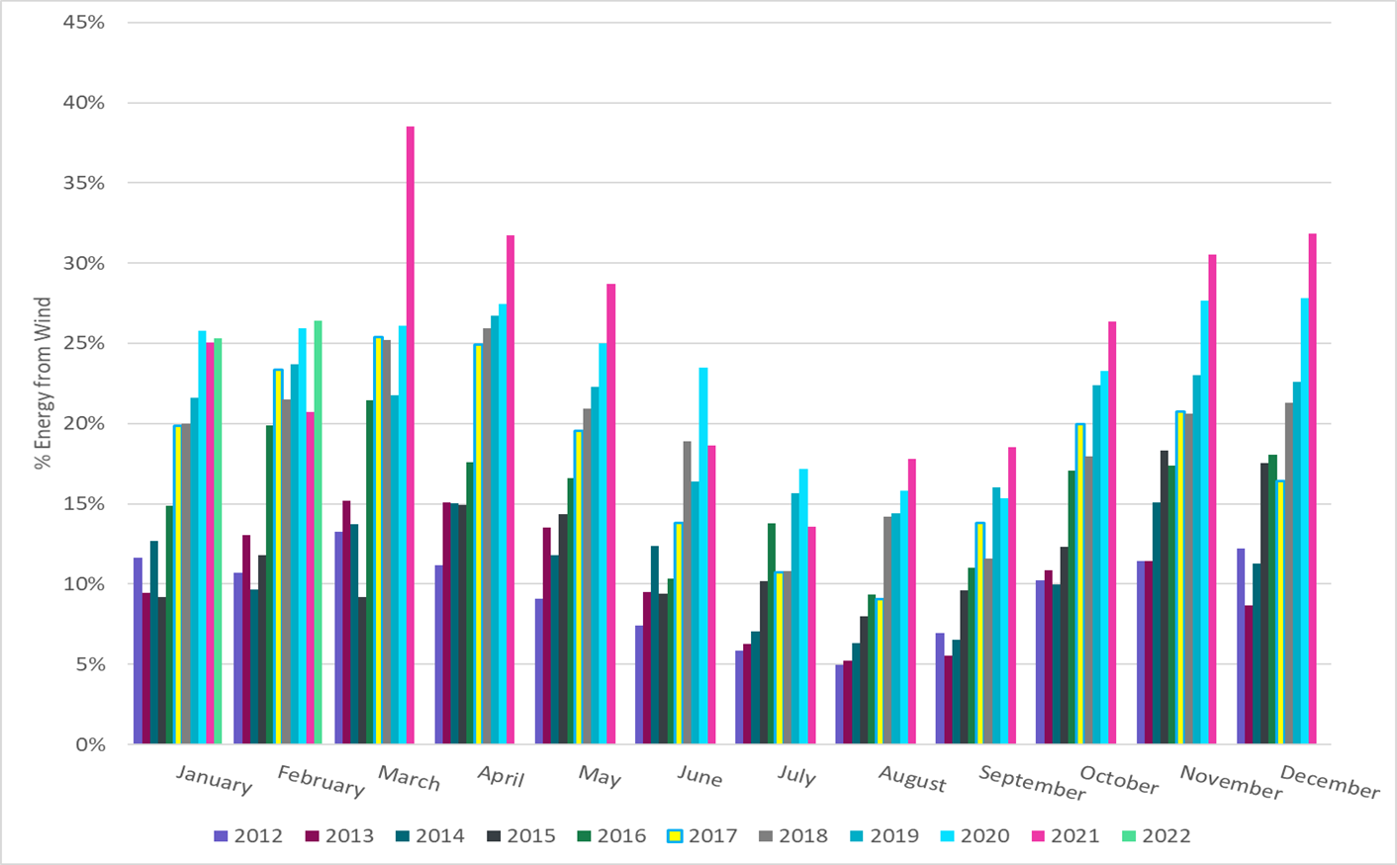
ERCOT % Energy from Wind Generation
Notes:
26.41%

Slide 16
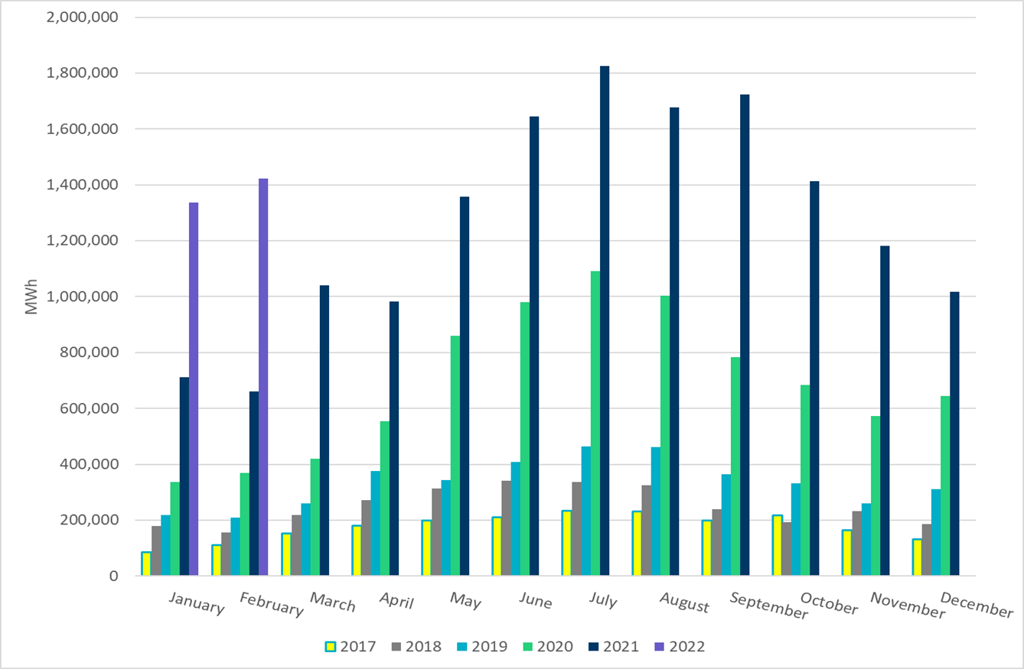
ERCOT Total Energy from Solar Generation
Notes:
1,423,230 MWh

Slide 17
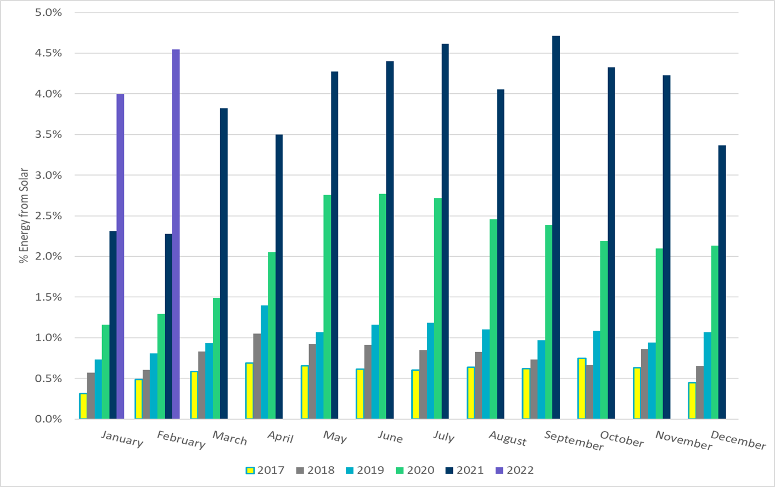
ERCOT % Energy from Solar Generation
Notes:
4.55 %

