Slide 1
Supply Analysis Working Group Update
April 4, 2022, report to WMS
Caitlin Smith, Chair
Pete Warnken, Vice Chair
Ian Haley, Returning/Acting Co-Vice Chair

Slide 2
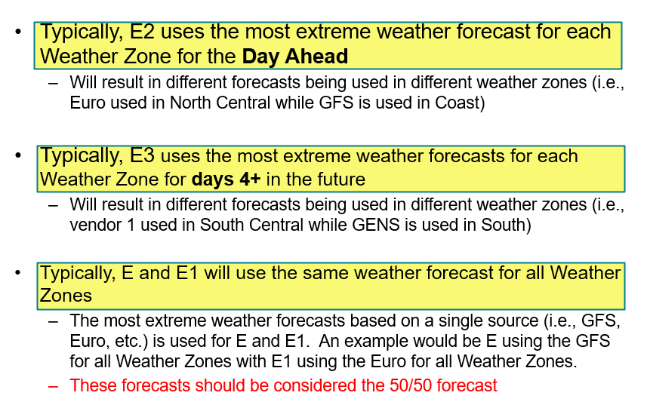
1. Mid-Term Load Forecast Presentation
Review
All internally developed forecasts (E, E1, E2, and E3) are configured exactly the same:
Same exact model
Same application of error correction
Same application of tuning
The only difference is the weather forecast that is used in each forecast model
Model Update
On a seasonal basis or when weather patterns change, the internally developed forecasts (E, E1, E2, and E3) will be updated with a model that is appropriate for the conditions

Slide 3
1. Mid-Term Load Forecast Presentation
Using the coldest weather forecast during Winter Storm Landon resulted in a high forecast error for February 4
The actual load exceeded the forecast even though the coldest weather forecast was being used in the selected forecast during the second cold event
Winter weather is more unpredictable, has more variability than other seasons
Selecting the coldest weather forecast reduces the risk of the actual load exceeding the forecasted load but does not eliminate it

Slide 4
2. Planned Project Success Factor Analysis
New Planned Report
Success rates of planned generation projects
Development cycle trends for planned projects (from initial request to operational)
Delays to the in-service dates for planned projects
Demo
https://public.tableau.com/app/profile/ercot.resource.adequacy/viz/ERCOTInterconnectionQueueTrends/SuccessRatesDashboard

Slide 5
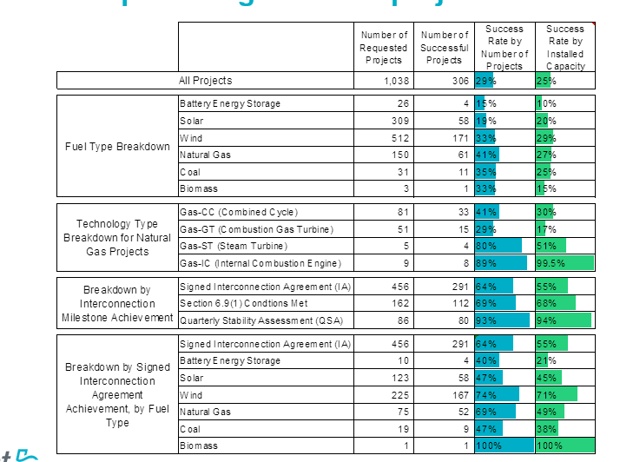
2. Planned Project Success Factor Analysis
Success Rates and Development Cycle Analysis
limited to projects requested between 2002 and 2018 into the ERCOT queue
Successful projects are defined as a planned generation projects that have become operational resources
only projects with a Full Interconnection Study (FIS) requested included

Slide 6
2. Planned Project Success Factor Analysis
Success Rates and Development Cycle Analysis
limited to projects requested between 2002 and 2018 into the ERCOT queue
Successful projects are defined as a planned generation projects that have become operational resources
only projects with a Full Interconnection Study (FIS) requested included

Slide 7
3. Revamping the SARA Report
Goals
Increase release frequency for more timely resource updates and fine-tuning of capacity forecasts and scenario assumptions for seasonal peak demand hours
Discussing rolling monthly reporting with the PUCT
Incorporate probabilistic risk assessment metrics
Report multi-hour capacity reserve information to acknowledge net load risks
Implement online interactive dashboard with data visualization tools
Next Steps
This will be a standing discussion item at SAWG
Would like to progress on the new report by the end of the year
Plan is to keep releasing the seasonal SARA the rest of the year, while working on the revamp

Slide 8
4. Resource Adequacy Modeling Projects for 2022
ELCC:
Overview:
probability-based measure of the reliability benefit of a resource type (or combination of resource types) for the system during periods that have the highest risk of capacity reserve shortfalls
estimation is based on probabilistic system simulations, the most common being Monte Carlo
forward-looking
Objectives:
Use SERVM Monte Carlo simulations to do the following:
Determine renewable and battery storage ELCC values for individual high-risk hours by season
Conduct sensitivity analysis of ELCC values with respect to resource penetration levels, alternative technology types (solar), and grid location
Intent is to lay the groundwork for specifying the recommended ELCC methodology for resource adequacy and planning studies
Key Milestones:
Project completion targeted for 7/30/2022
Study report and SAWG presentation expected in September
Next step is to develop Protocol revision request language to integrate into a broader NPRR on revised CDR methodologies

Slide 9
4. Resource Adequacy Modeling Projects for 2022
Zonal Study:
Objectives:
Determine the system reliability and reserve margin impacts of a zonal SERVM model as compared to the current single-zone model design
Study Tasks
Define load zones in the SERVM model and establish zonal transfer limits
Convert the current ERCOT Long-Term Load Forecast into zonal load profiles and assign generating units to load zones
Run SERVM simulations for two study years: 2023 and 2026
Compare reliability and reserve margins results to the original single-zone model
Key Milestones:
Targeting study completion by mid-to-late June
Will keep SAWG apprised of the study project
Study report and SAWG presentation expected in July

Slide 10
4. Resource Adequacy Modeling Projects for 2022
NERC Probabilistic Assessment (ProbA) Study:
Overview:
Complements NERC’s Long Term Reliability Assessment (LTRA) by providing probabilistic reliability statistics of the forecasted resource portfolios reported in the LTRA data submissions
ProbA conducted every even-numbered year
Two study years: 2024, 2026
NERC Probabilistic Assessment Working Group oversees ProbA scheduling, data submission and reporting procedures
The study must include at least one risk scenario
Key Milestones
Base Case study completion in early August; PAWG peer review of Base Case results completed by 8/23/2022
Summary of ProbA study and Base Case results to be included in NERC LTRA report to be release in mid-December 2022
Scenario risk results due 1/11/2023 for all Assessment Areas
ProbA Risk Scenario report released in June 2023

Slide 11
5. Additional Study Updates
CONE Study NPRR and Study
Previous effort to implement a study and methodology to use when a change or update is needed to the Cost of New Entry (CONE) value paused after Winter Storm Uri
Will resume discussing NPRR draft at next SAWG meeting
Plan to begin study with consultant at the end of 2022
Reserve Margin Study
Typically every even numbered year to estimate Economically Optimum and Market Equilibrium Reserve Margins (EORM and MERM), also paused after Winter Storm Uri
ERCOT to resume process of procuring consultant for study now
Study results expected in mid-2023

Slide 12
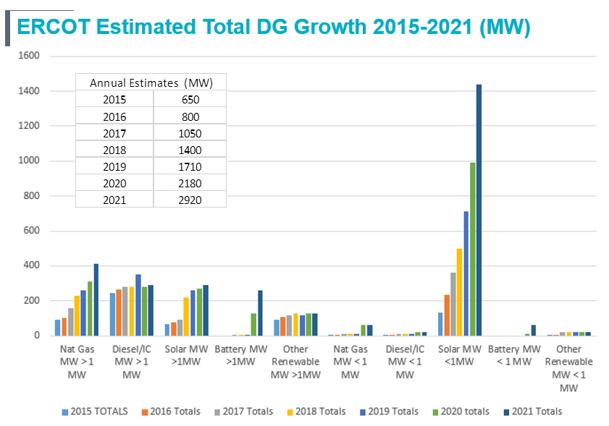
6. Annual DG Report
Major areas of DG growth in ERCOT (Total DG as of 2021= 2920 MW)
Solar PV <1 MW
Natural gas > 1 MW (co-located with load)
DGR Energy Storage> 1 MW

Slide 13
SAWG News!!
New leadership nomination:
Co-Vice Chair: Ian Haley, Luminant Generation
Vote at May WMS
Next Meeting:
May 13th
In person + WebEx

