Slide 1
Distributed Generation Review
Includes Registered and Unregistered DG
Apr 4, 2022

Slide 2
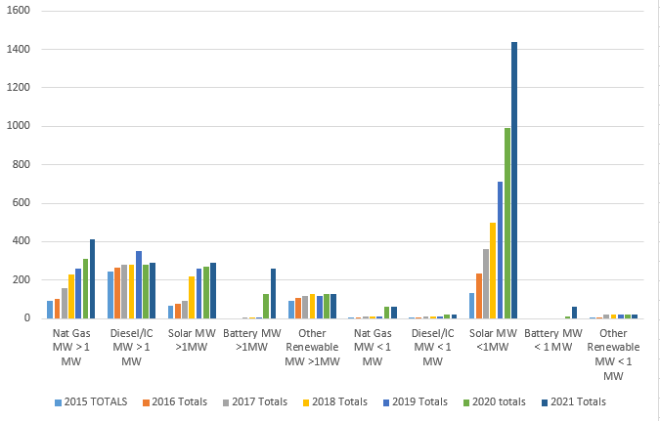
ERCOT Estimated Total DG Growth 2015-2021 (MW)
181%
31%
Notes:
Major areas of DG growth in ERCOT
Solar PV <1 MW
Natural gas > 1 MW (co-located with load)
DGR Energy Storage> 1 MW
Detail for Systems > 1 MW
New applications for Energy Storage
Continuation of upward trend for Nat Gas
Decreased growth for solar > 1 MW
Stagnant Diesel growth
Declining Landfill Gas, Hydro, Wind
Detail for Systems < 1 MW
Accelerating Solar PV trend (even during Covid!)
Increased small energy storage and Nat Gas (some registered as SODG)
Note that there seems to be a significant increase in interest for systems providing resiliency since Winter Event.
Nat gas
Batteries

Slide 3
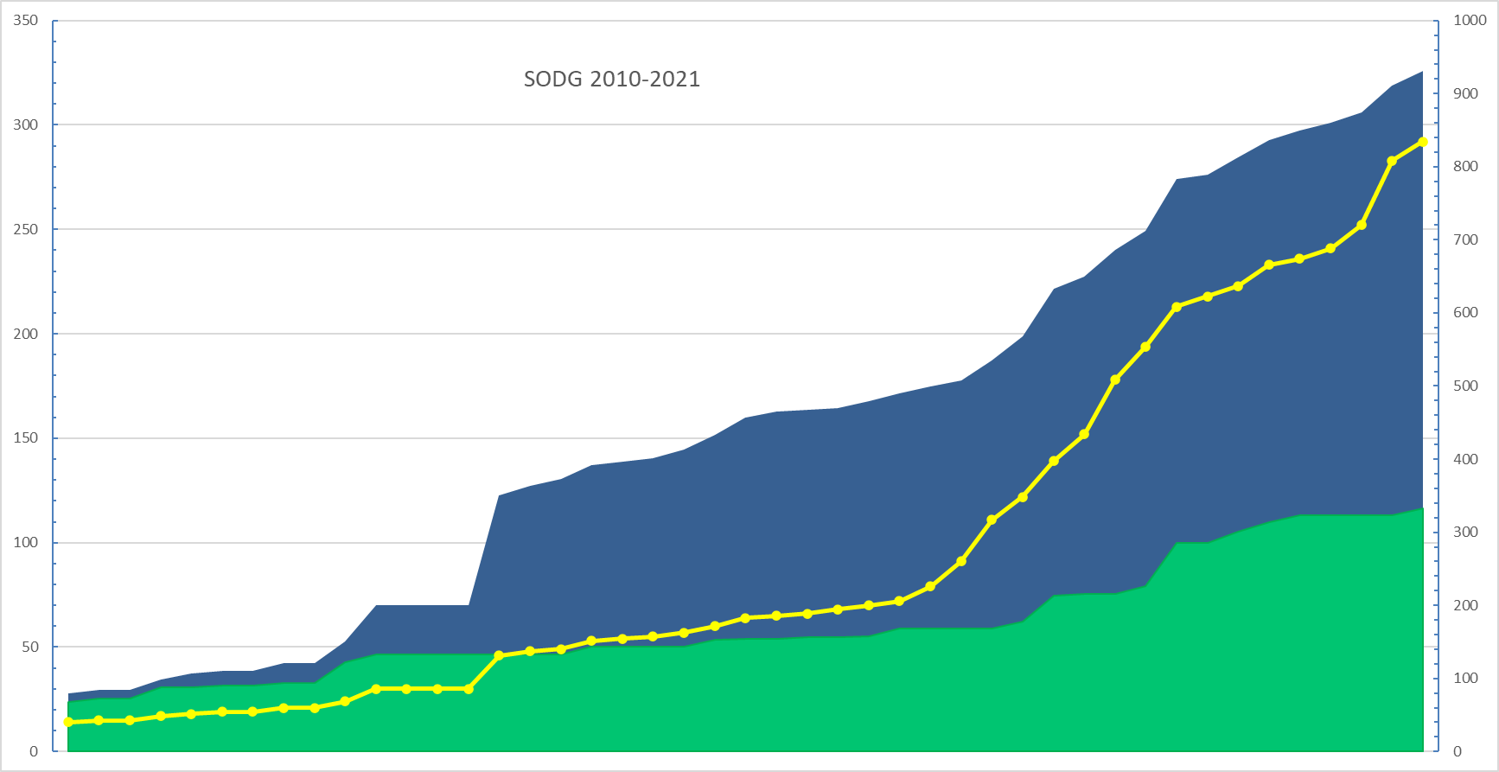
Settlement-Only Distributed Generation in ERCOT 2010-2021
SODGs | # Units | MW
Non-Renewable | 267 | 599
Renewable + Storage | 60 | 348
TOTALS | 327 | 947
Accumulated Count
SODGs are:
<10 MW
If >1 MW and inject to grid, must register with ERCOT
If <1 MW, registration optional
Non-renewables
Renewables

