Slide 1
Retiring Legacy MIS Public Report Functionality
Leo Angele
ERCOT IT
ERCOT Public
March 31, 2022

Slide 2
Target Audience
Who is affected by these changes?
All users (Public and Market Participants) that access the ERCOT Public Reports available via ERCOT’s Public (Market Information System) MIS and ERCOT.com websites

Slide 3
Why Are We Changing?
ERCOT is changing the Legacy Public Report download process in order to provide users a more consistent, user friendly, and time-saving experience.
ERCOT introduced a new look and feel for the ERCOT.com website in November of 2021. This changes the download process and URL aligns with the improved user experience. All Public Reports are
On ERCOT.com for easy access to both Market Participants and General Public
Searchable in the new ERCOT Market Information List (EMIL) interface format which mirrors MIS
Available via new technology stack
Available with one click download, which expedites report access
Available in current standalone URL formats until July
Available via new EMIL URLs

Slide 4
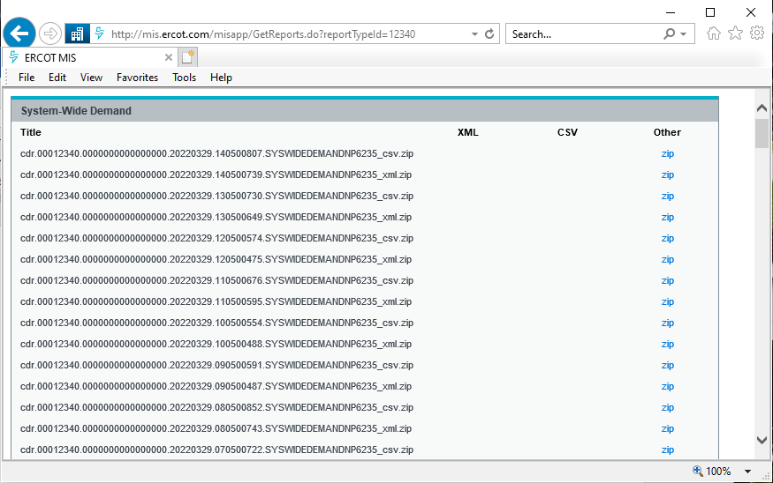
Legacy MIS Public Report ‘pop-ups’

Slide 5
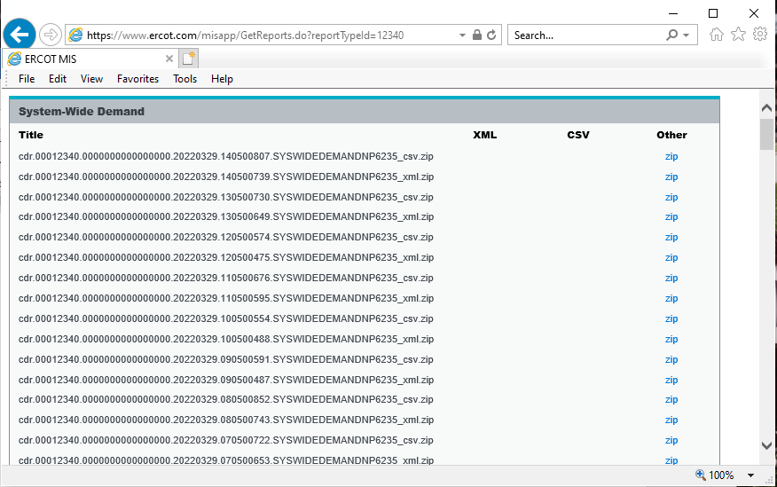
Legacy ERCOT.com Public Report ‘pop-ups’

Slide 6
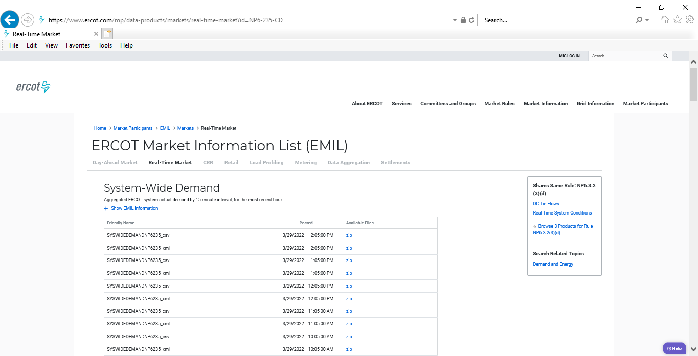
ERCOT.com EMIL Public Report List

Slide 7
Timeline
What is the timeline for the Upgrade?
ERCOT will update all reference links on ERCOT.com to point to the new EMIL Report locations by April 30, 2022
ERCOT will remove access to the legacy MIS and ERCOT.com Public Report ‘pop-up’ pages by July 31, 2022
Market Notices will be sent for each milestone

Slide 8
Discussion

