Slide 1
Monthly Review of Reliability Unit Commitment Market Impacts - February 2022
ERCOT Staff
WMWG
March 25, 2022
ERCOT Public

Slide 2
RUC Resource-Hours in February 2022
February 2022 | Total | Opt-Out | Non-Opt-Out
Instructed Resource-Hours
Total Count | 1014.0 | 64.0 | 950.0
Effective Resource-Hours*
Total Count | 991.8 | 62.5 | 929.4
Average LSL | 110.5 | 109.0 | 110.6
Average LDL | 113.9 | 164.8 | 110.5
Average BP | 115.7 | 190.6 | 110.6
Average HSL | 303.3 | 283.7 | 304.7
* The difference between “Instructed” and “Effective” values is a result of Resources starting up, shutting down, receiving partial hour instructions, or otherwise not being dispatchable by SCED.

Slide 3
RUC Instruction Reasons
February 2022
991.8 effective RUC Resource-hours in February 2022.
991.2 Resource-hours (99.94%) for capacity concerns.
0.6 Resource-hours (0.06%) for congestion concerns.
62.5 effective Resource-hours (6.3%) were successfully bought back.

Slide 4
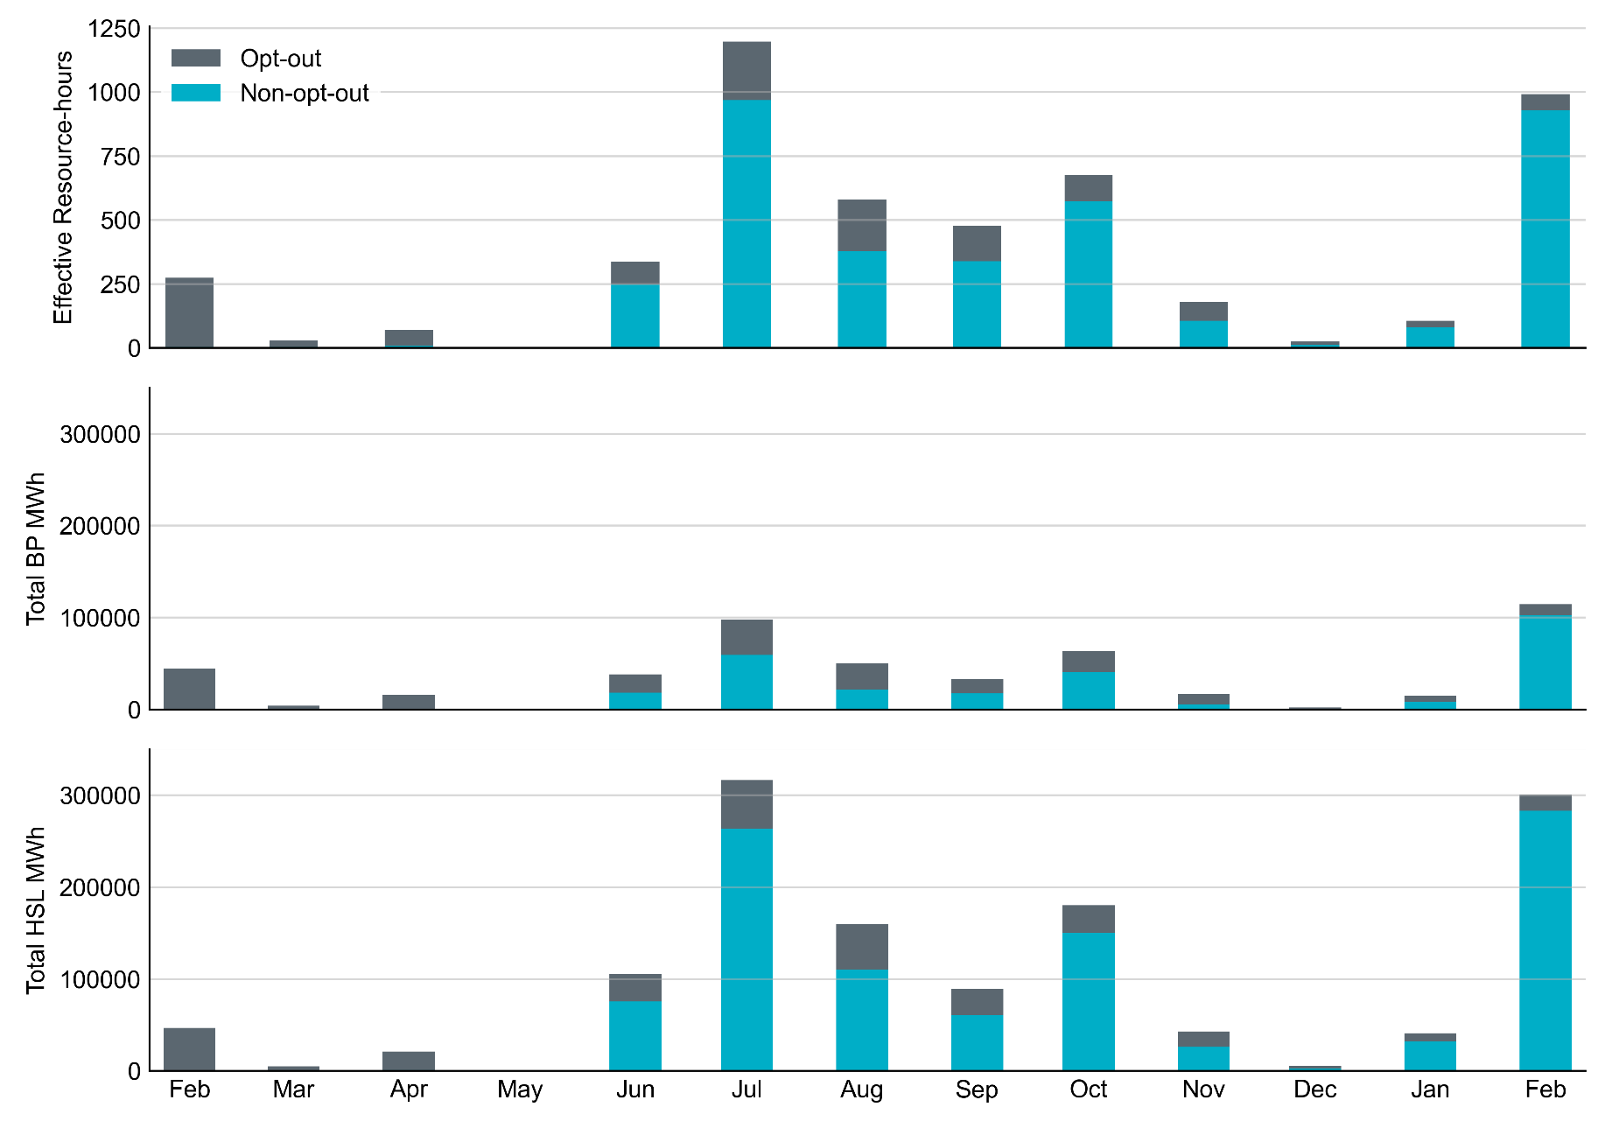
Non-opt-out and Opt-out Totals: Last 13 Months February 2022 has a total of 929.4 non-opt-out effective Resource-hours and 62.5 opt-out effective Resource-hours. Its total BP MWh and HSL MWh were highest since July 2021.

Slide 5
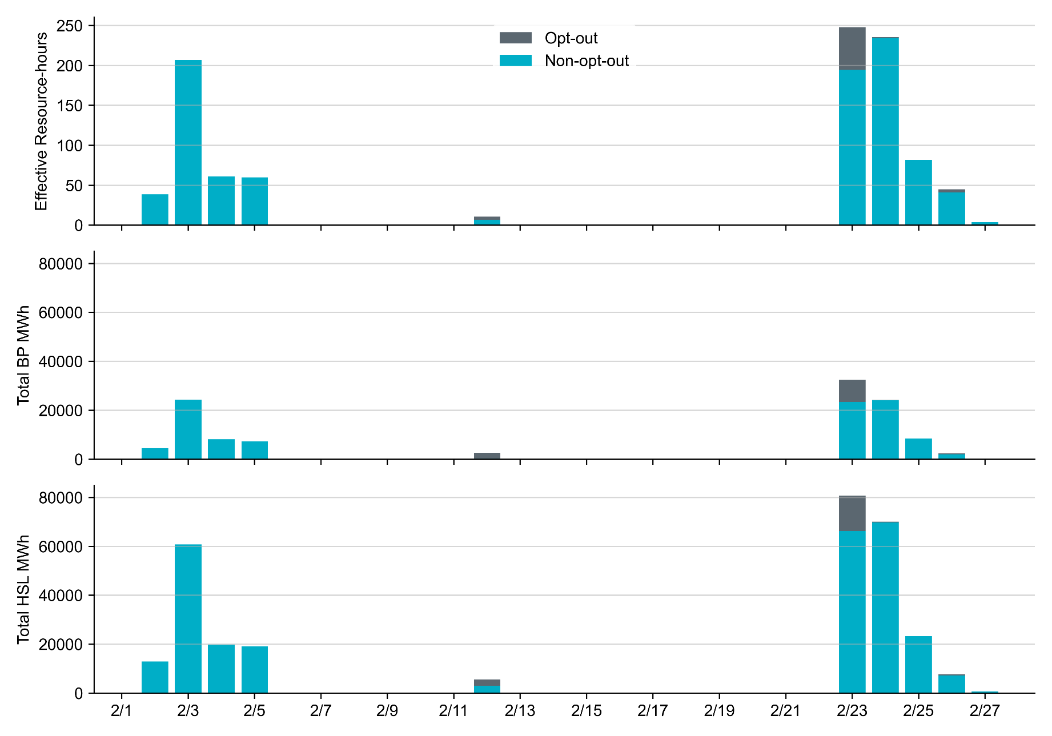
Non-opt-out and Opt-out Totals: February 2022 RUC in February 2022 were primarily driven by two separate cold events. Most Opt-out Resource-hours occurred on Operating Day 2/23/2022.

Slide 6
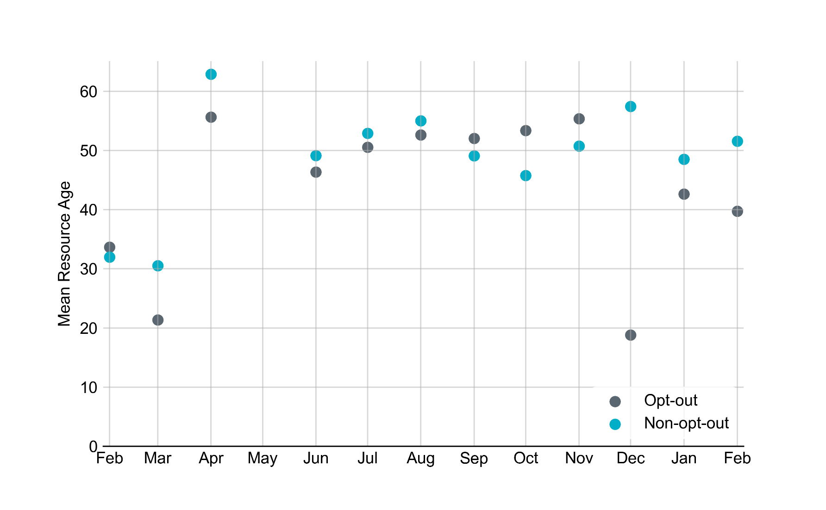
Average Resource Age In February 2022, mean opt-out Resource age is 52 years, and mean non-opt-out Resource age is 40 years.
Note: For Resource configurations with multiple physical generators, the age of the oldest generator is used.

Slide 7
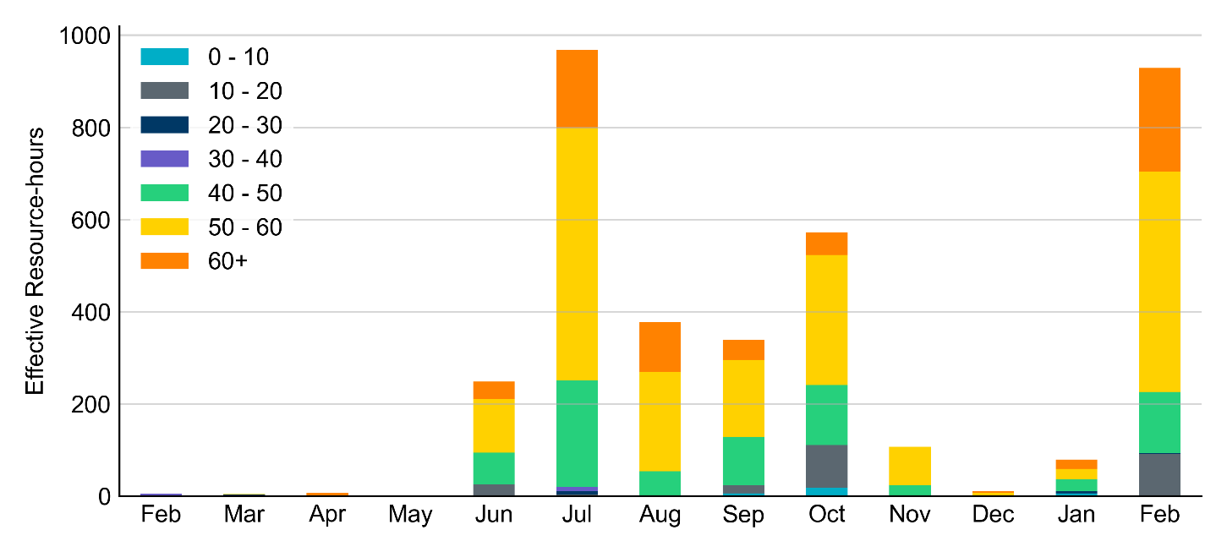
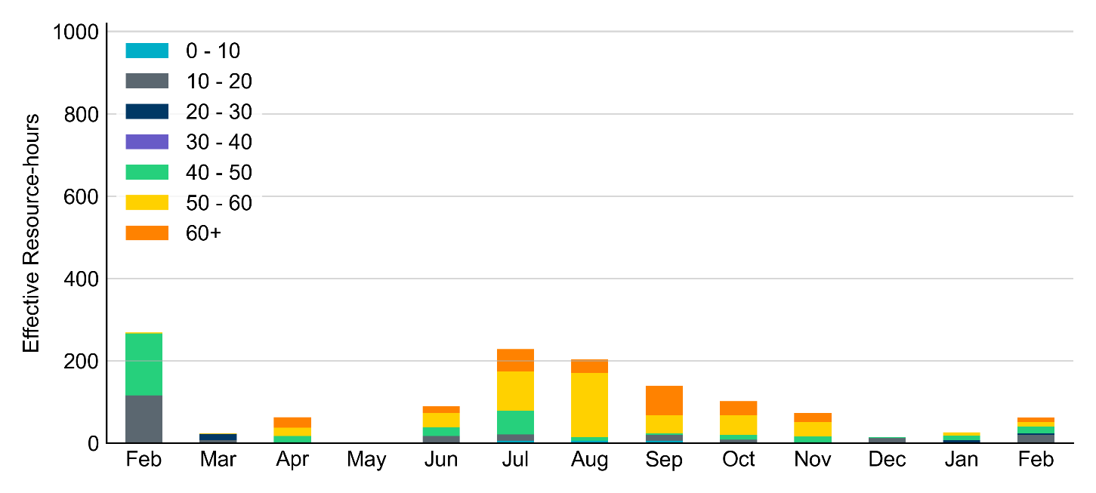
Age Category Majority of RUC Committed Resources in February 2022 were older than 40 years.
Non-opt-out
Opt-out

Slide 8
RUC-Instructed Resource Dispatch above LDL
February 2022
When Resources did not successfully opt out, there were 2.4 effective Resource-hours for which the Resource was dispatched above its LDL.
For all these Resource-hours, the RUC-instructed Resource was mitigated.

Slide 9
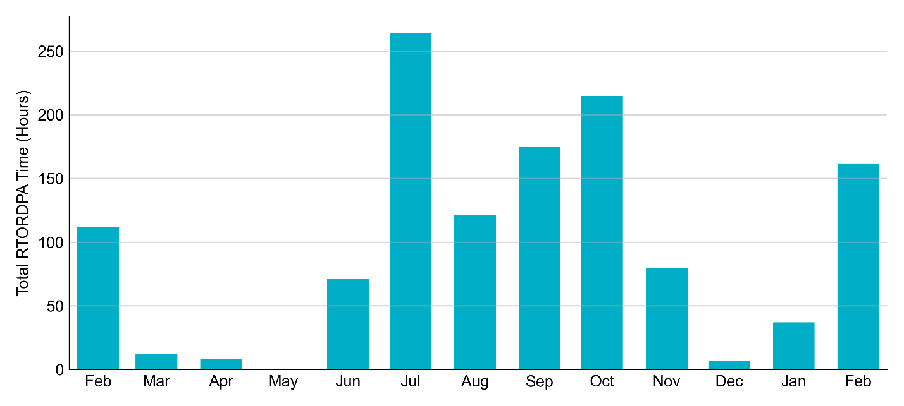
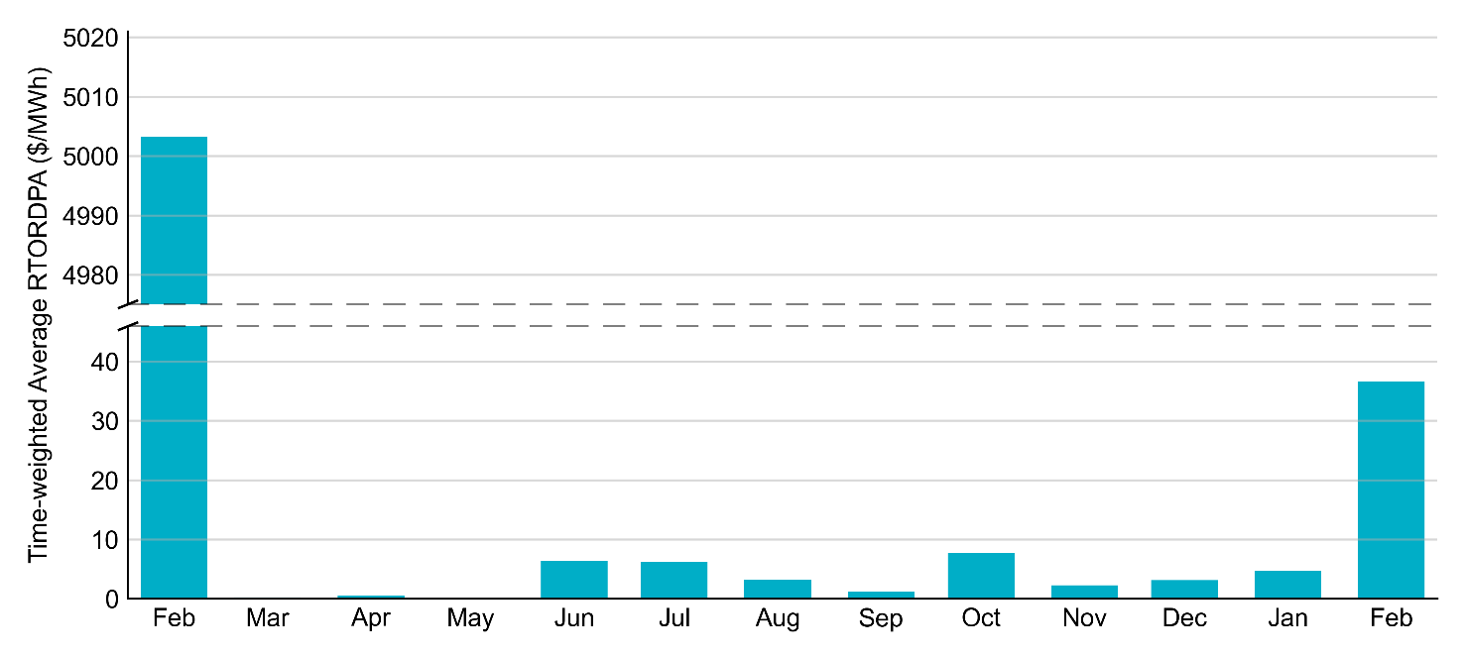
Reliability Deployment Price Adder: Last 13 Months - February 2022 has the highest average monthly RTORDPA since winter storm Uri in 2021

Slide 10
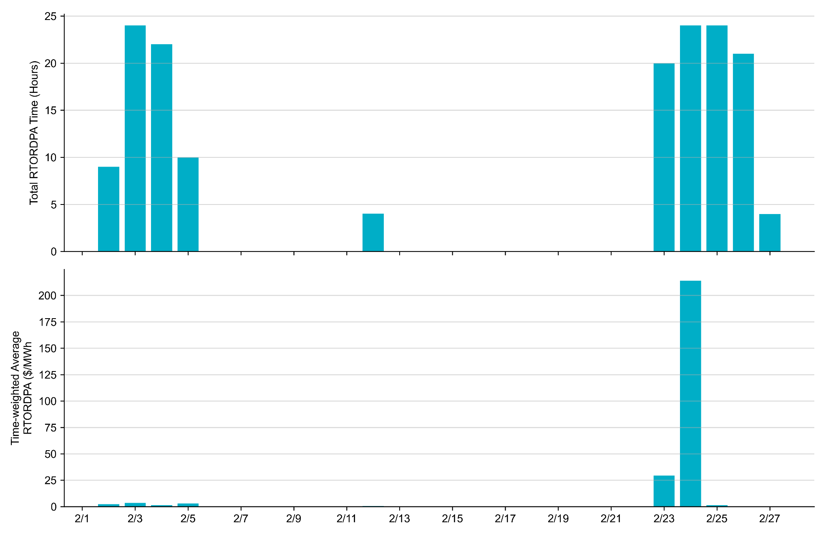
Reliability Deployment Price Adder: February 2022 - OD February 24th has the highest daily average RTORDPA within the month

Slide 11
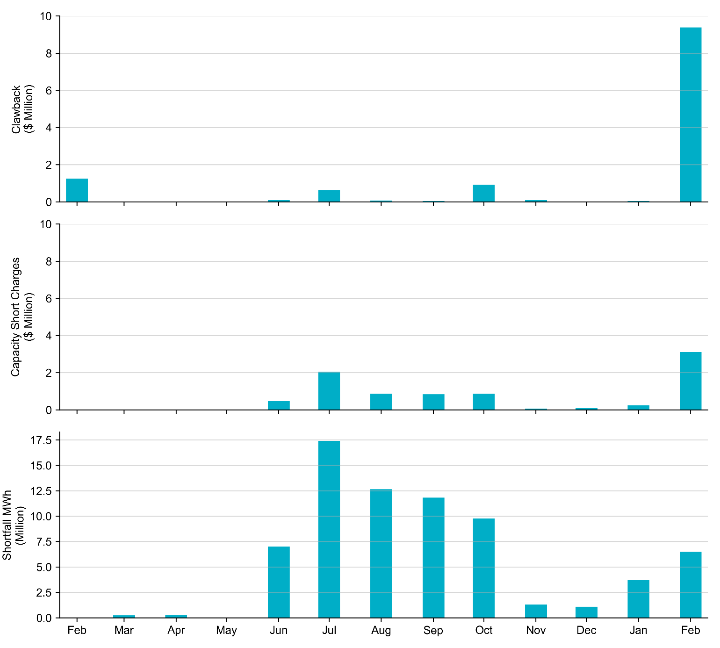
RUC Clawback, Capacity Short Charges, and Shortfall For February 2022, the total Clawback charge was $9.4 million, and the total Capacity Short Charge was $3.1 million. The Capacity Short Charge was nearly fully covered by Make-whole payment.
 | February 2022
Make-whole ($ Million) | 3.102
Uplift to Load ($) | 2.01

Slide 12
Additional Information for RUC in February 2022
At the previous meeting, stakeholders requested additional information regarding load forecast and reserves used in RUC.
The following slides show HASL margin and Real-Time headroom margin data for two RUC execution:
A non-cold day: RUC Execution at 08:03 on 2/12/2022 for OD 2/12/2022;
A cold day from the extreme weather: RUC Execution at 17:03 on 2/23/2022 for OD 2/24/2022.
Additional hourly level data and Real-Time Price data are included for OD 2/24.

Slide 13
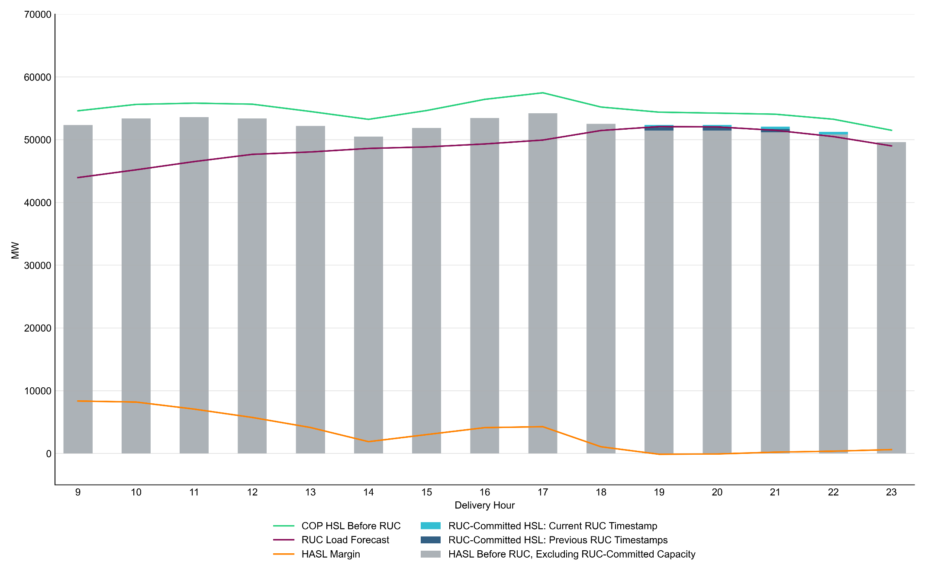
RUC Execution at 08:03 on 2/12/2022 for OD 2/12/2022
Note: HASL Margin = HASL Before RUC (Including RUC-Committed Capacity from previous timestamp)
– RUC Load Forecast (Including DC-Tie schedule)

Slide 14
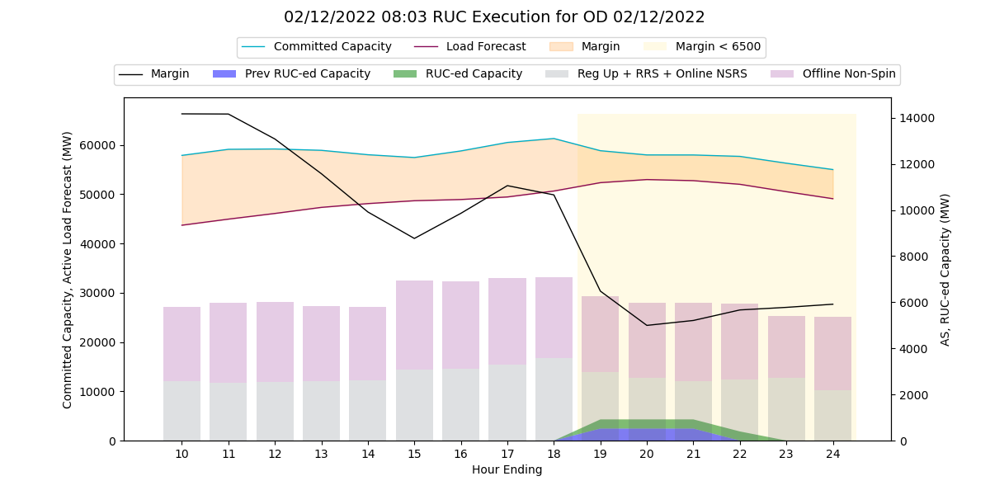
RUC Execution at 08:03 on 2/12/2022 for OD 2/12/2022

Slide 15
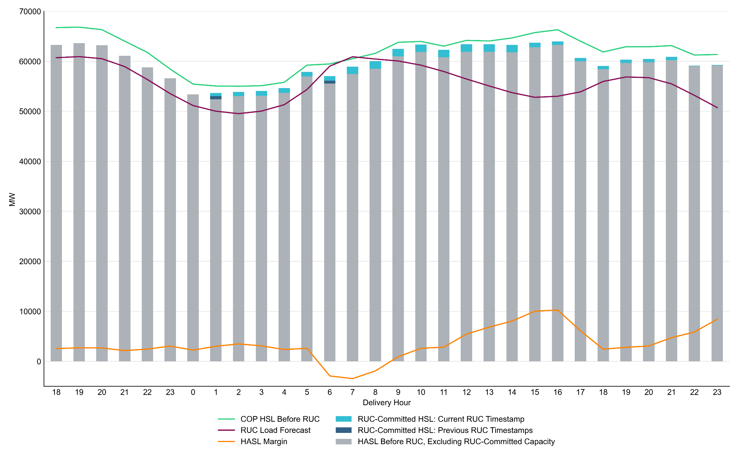
RUC Execution at 17:03 on 2/23/2022 for OD 2/24/2022
Note: HASL Margin = HASL Before RUC (Including RUC-Committed Capacity from previous timestamp)
– RUC Load Forecast (Including DC-Tie schedule)

Slide 16
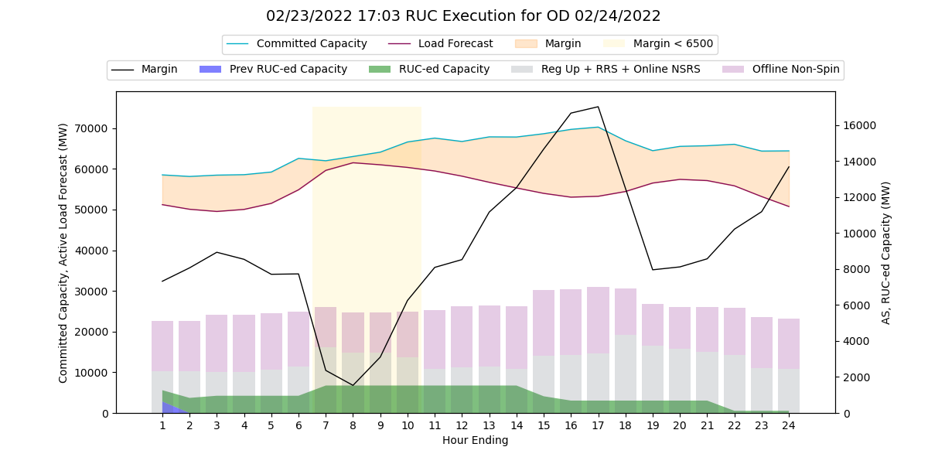
RUC Execution at 17:03 on 2/23/2022 for OD 2/24/2022

Slide 17
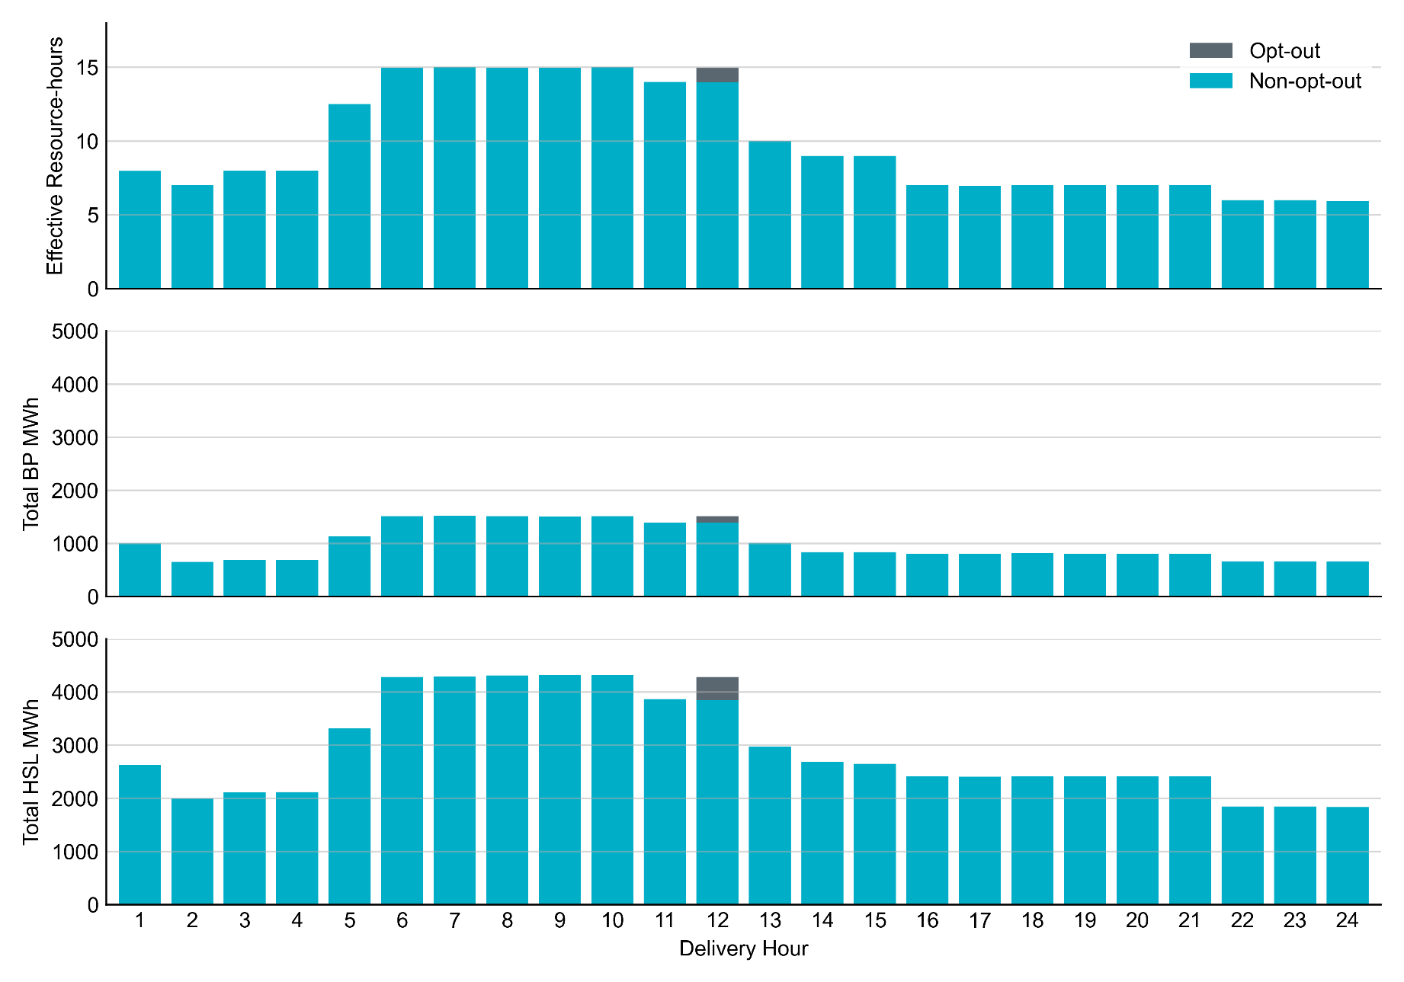
Non-opt-out and Opt-out Totals: February 24, 2022 One Resource did opt-out for HE 12

Slide 18
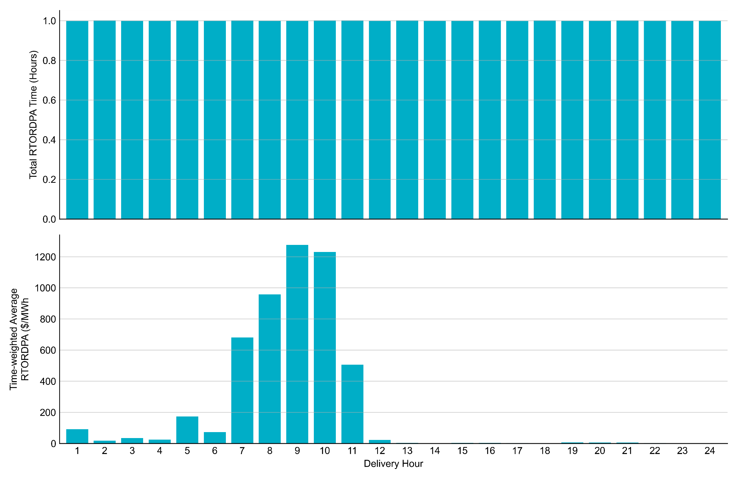
Reliability Deployment Price Adder: February 24, 2022 High RTORDPA occurred during the morning peak; The average hourly RTORDPA went above $1,200/MWh for HE9 and HE10.

Slide 19
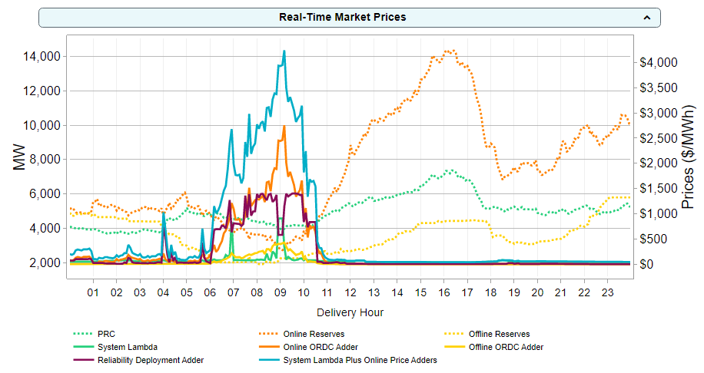
Real-Time Prices on February 24, 2022

Slide 20
Review ONRUC Units in ORDC – a four-bus example
Status: ON
HSL: 100MW
BP: 60MW
Status: ON
HSL: 100MW
BP: 100MW
S
S
G1
G3
120MW Load
120MW Load
Status: ON
HSL: 100MW
BP: 80MW
Status: OFF
S
S
G2
G4
Resource | Status | RTOLHSL | RTBP | RTOLCAP contribution
G1 | ON | 100 | 100 | 0
G2 | ON | 100 | 80 | 20
G3 | ON | 100 | 60 | 40
G4 | OFF | 0 | 0 | 0
Eligible Resources with ON status contribute HSL-BP to RTOLCAP
Total RTOLCAP is 60MW
G4 capacity is included in RTOFFCAP if its cold start time is less than 30 minutes
Reference: Methodology for Implementing ORDC to Calculate Real-Time Reserve Price Adder

Slide 21
Review ONRUC Units in ORDC – a four-bus example
Status: ON
HSL: 100MW
BP: 50MW
Status: ON
HSL: 100MW
BP: 100MW
S
S
G1
G3
120MW Load
120MW Load
Status: ON
HSL: 100MW
BP: 70MW
Status: ONRUC
HSL: 100MW
BP: 20MW
S
S
G2
G4
Resource | Status | RTOLHSL | RTBP | RTOLCAP contribution
G1 | ON | 100 | 100 | 0
G2 | ON | 100 | 70 | 30
G3 | ON | 100 | 50 | 50
G4 | ONRUC | 0 | 20 | -20
Eligible Resources with ON status contribute HSL-BP to RTOLCAP
ONRUC Resource contributes -BP to RTOLCAP
Total RTOLCAP is still 60MW
G4 capacity is included in RTOFFCAP if its cold start time is less than 30 minutes
Reference: Methodology for Implementing ORDC to Calculate Real-Time Reserve Price Adder

Slide 22
Forecast Selection process

Slide 23
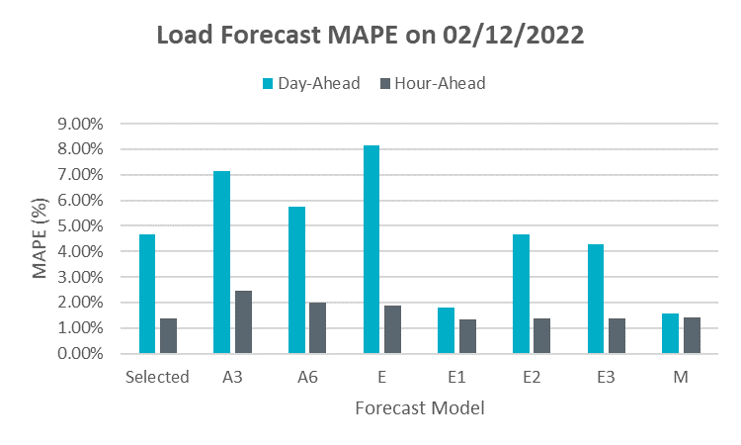
Load Forecast Performance for Feb. 12, 2022
The load forecast model E2 was used throughout Feb. 12, 2022.
Background
ERCOT has a variety of load forecasting models (A3, A6, E, E1, E2, E3, M), each of which is tuned to account for a specific weather phenomena or season.
ERCOT had shared details about the various MTLF models at the Sep 21, 2021 WMWG meeting.
Per Section 3.1 in Reliability Unit Commitment Desk Operating Procedure (See slide 8), ERCOT Control Room periodically monitor the Load Forecast performance and may make forecast selection changes prior to RUC execution, if necessary.
Typically, a Load Forecast model that has better historical performance (MAPE and bias) for the anticipated weather phenomena or other influencing factors is selected.

Slide 24
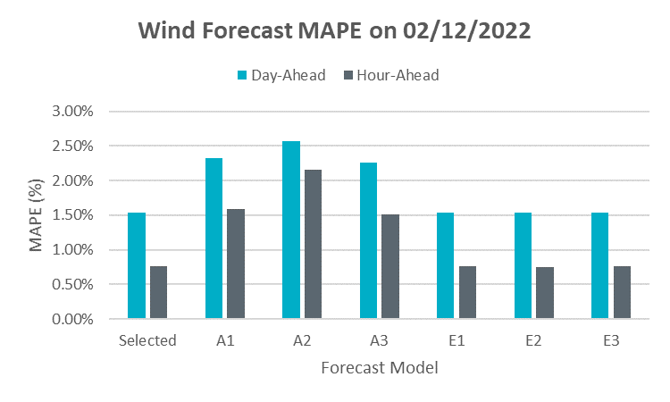
Wind Forecast Performance for Feb. 12, 2022
The wind forecast model E1 was used throughout Feb. 12, 2022.
E1 is the STWPF from Vendor 2.
*Difference between A1, A2 and A3 indicate that some icing impact was predicted in the models this vendor uses.
Background
ERCOT has 2 vendors (A* & E*) for forecasting wind generation. ERCOT receives STWPF which is a 50th percentile wind forecast w/o icing impact (A1, E1), extreme impact icing forecast (A2, E2) and middle-of-way icing forecast (A3, E3).
Per Section 3.1 in Reliability Unit Commitment Desk Operating Procedure and Section 4.0 in Reliability Risk Deck Operating Procedure (See slide 8, 9), ERCOT Control Room periodically monitor the wind forecast performance and may make forecast selection changes prior to RUC execution, if necessary.
For non-icing days typically E1, which is a Wind Forecast model that has consistently had better historical performance (MAPE and bias) is selected.
For icing days, the active wind forecast model selection is based on using meteorological information and inputs from Meteorologists (both at ERCOT and the vendors end) to gauge the potential for icing impacts

Slide 25
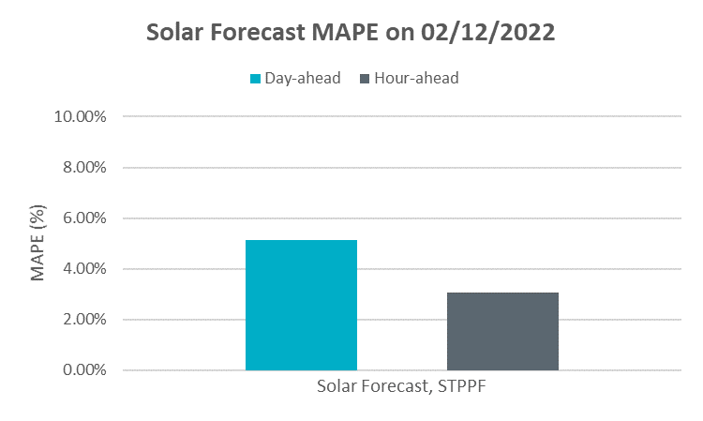
Solar Forecast Performance for Feb 12
STPPF from vendor 1 was used throughout Feb. 12, 2022 with no changes.
Background
ERCOT has 1 active vendor for forecasting solar generation*. ERCOT receives STPPF which is a 50th percentile wind forecast w/o icing impact. ERCOT has the ability to manually override the solar forecast generate a forecast that accurately reflects Real-Time conditions as they progress.
Per Section 4.6 in Reliability Risk Deck Operating Procedure (See slide 10), ERCOT Control Room periodically monitor the solar forecast performance and may ask for solar forecast to be overridden, if necessary.
*ERCOT is in the process of procuring and integrating a second vendor for solar forecasting.

Slide 26
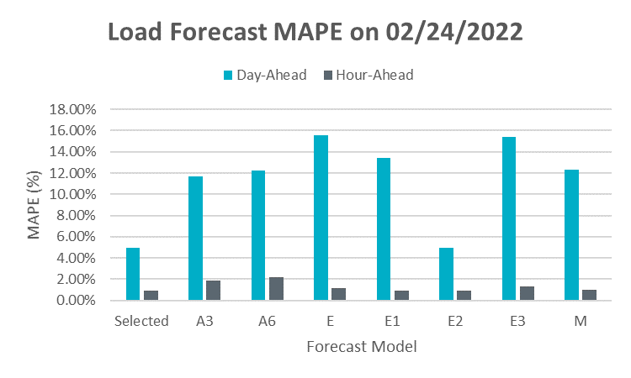
Load Forecast Performance for Feb. 24, 2022
The load forecast model E2 was used throughout Feb. 24, 2022.
Background
ERCOT has a variety of load forecasting models (A3, A6, E, E1, E2, E3, M), each of which is tuned to account for a specific weather phenomena or season.
ERCOT had shared details about the various MTLF models at the Sep 21, 2021 WMWG meeting.
Per Section 3.1 in Reliability Unit Commitment Desk Operating Procedure (See slide 8), ERCOT Control Room periodically monitor the Load Forecast performance and may make forecast selection changes prior to RUC execution, if necessary.
Typically, a Load Forecast model that has better historical performance (MAPE and bias) for the anticipated weather phenomena or other influencing factors is selected.

Slide 27
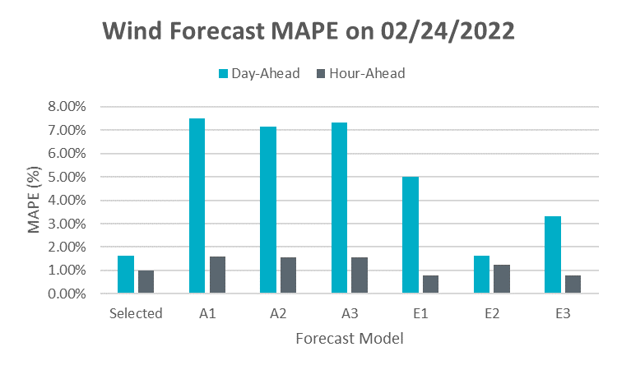
Wind Forecast Performance for Feb. 24, 2022
Feb 20: ERCOT received a warning for a severe icing event from both its forecast vendors.
Feb 20 @2300: Wind forecast model E2 selected for Operating Day (OD) Feb 23 - Feb 25.
Feb 23 @0430: First wind icing outage reported
Feb 23 @0800: Overall actual icing impact was ~2,690 MW which was lower than forecast. Wind forecast model E3 selected for OD Feb 23 - Feb 25.
Feb 24 @0500: Icing forecast outlook worsened. Wind forecast model E2 selected for OD Feb 24 - Feb 25.
Feb 24 @1300: IRR forced outage and derated reached peak magnitude ~7,409 MW
Feb 25 @1100: Icing forecast outlook improved, icing related outages on IRR reduced to ~5,254 MW. Wind forecast model E3 selected for OD Feb 25.
Background
ERCOT has 2 vendors (A* & E*) for forecasting wind generation. ERCOT receives STWPF which is a 50th percentile wind forecast w/o icing impact (A1, E1), extreme impact icing forecast (A2, E2) and middle-of-way icing forecast (A3, E3).
Per Section 3.1 in Reliability Unit Commitment Desk Operating Procedure and Section 4.1 in Reliability Risk Deck Operating Procedure (See slide 8, 9), ERCOT Control Room periodically monitor the wind forecast performance and may make forecast selection changes prior to RUC execution, if necessary.
For non-icing days typically E1, which is a Wind Forecast model that has consistently had better historical performance (MAPE and bias) is selected.
For icing days, the active wind forecast model selection is based on using meteorological information and inputs from Meteorologists (both at ERCOT and the vendors end) to gauge the potential for icing impacts

Slide 28
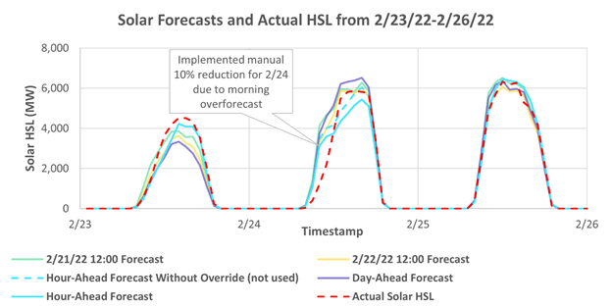
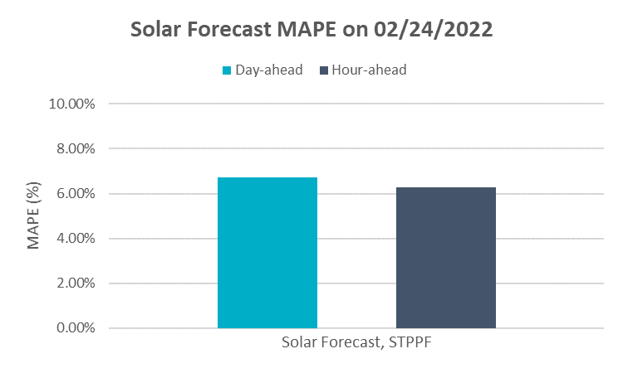
Solar Forecast Performance for Feb 24
Feb 24 @1000: A override to reduce the solar forecast by 10% was applied for OD Feb 24.
Background
ERCOT has 1 active vendor for forecasting solar generation*. ERCOT receives STPPF which is a 50th percentile wind forecast w/o icing impact. ERCOT has the ability to manually override the solar forecast generate a forecast that accurately reflects Real-Time conditions as they progress.
Per Section 4.6 in Reliability Risk Deck Operating Procedure (See slide 10), ERCOT Control Room periodically monitor the solar forecast performance and may ask for solar forecast to be overridden, if necessary.
*ERCOT is in the process of procuring and integrating a second vendor for solar forecasting.

Slide 29
Appendix
Snippets from Relevant Desk Procedures

Slide 30
Section 3.1 RUC Desk Operating Procedure
Link

Slide 31
Section 4.1, 4.2 Reliability Risk Desk Procedure
Link

Slide 32
Section 4.1, 4.2 Reliability Risk Desk Procedure
Link

