Slide 1
IBR Ride through failure Event Reporting Process Draft and Update >100 MW
ERCOT
Stephen Solis – Principal, System Operations Improvement
March 18, 2021

Slide 2
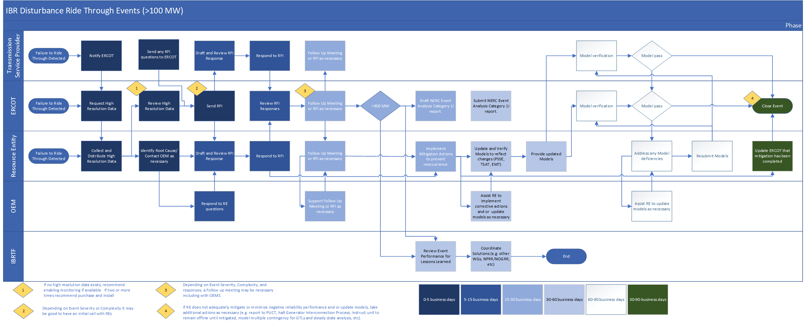
Draft Process

Slide 3
Key Events of 2022
The following events were identified as loss of solar generation after a system fault or voltage disturbance seen in RT PMU data. RFIs were sent on 3/10 with due date of 4/1.
Event #1 – 1/20 @ 9:40 AM
2 units at same plant lost a combined 123 MW (Unit 1 – 110 MW; Unit 2 – 13 MW)
Event #2 – 2/9 @ 2:14 PM
Single unit trip while generating 116 MW
Unit 1 fell to 0MW and began ramp up in 15 sec. and reached ½ output in 1.5 min.
Same inverters as other plants tripping on AC overvoltage
Event #3 – 2/11 @ 2:33 PM
Began ramping up 3 min. later but only reached 35% output. Full output following day.
Unit tripped during 6/26/2021 event while in commissioning process. Inverter type not found in any other events.
Single unit run back and trip over ~25 sec. while generating 98.6 MW
Unit began ramping 3 min. later and full output reached < 4 min. after fault
Unit 2 reduced 15% output and came back to full in 15 sec.
No identified forced outages in FOD during event (Same for events #1-5)
Unit came online in Jan. 2022 and inverter type not seen in other events

Slide 4
Key Events of 2022
Event #4 – 2/12 @ 9:07 AM
Single unit trip while generating 123 MW; did not generate until next day
Event #5 – 2/17 @ 4:52 PM
3 units at 2 different sites with same POI
Plant E from NERC table of 5/9 unit reductions that had feeder breakers trip on underfrequency
Single unit in 1st site tripped while generating 180.5 MW. Began ramping 10 sec. later and reached 78% output 1.5 min. after trip.
Unit 1 at 2nd site reduced from 132 MW to 116 MW and returned to full output ~10 sec. later
Unit 2 at 2nd site reduced from 124 MW to 111.5 MW and returned to full output ~10 sec. later
2nd site same as Event # 1
All three units same inverter type as other plants tripping on AC overvoltage
Same inverter as other plants tripping on AC overvoltage

Slide 5
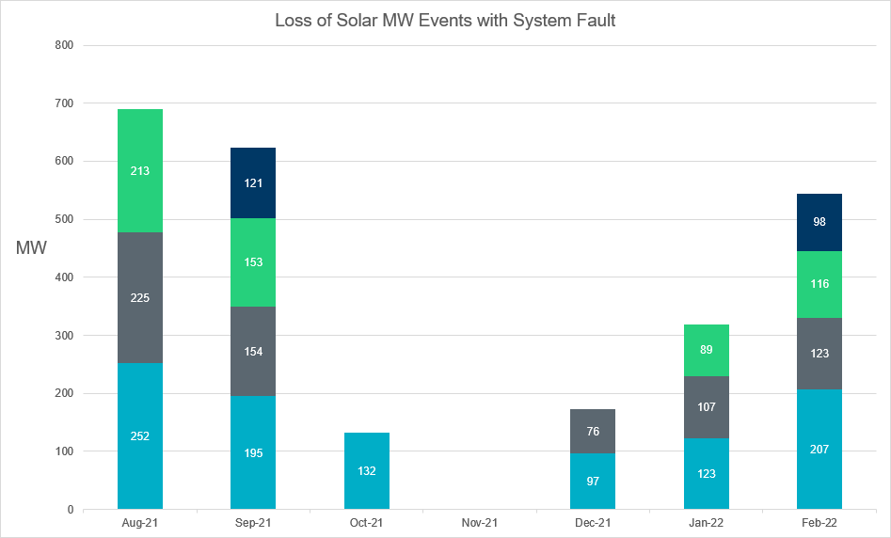
Events of Interest Since August 2021
The following chart shows events with significant loss of solar generation accompanied by a system fault shown in PMU data. Events known to have tripped off the line from POI to the plant were excluded. Similar events will have RFIs sent to REs to analyze inverter performance moving forward.

Slide 6
Other Events
Two events with loss of solar generation and associated fault in which lines to POI tripped offline
One event involved two sites sharing same POI; lines to both farms tripped offline
Did not send RFIs for these two events
One solar farm had several events from November 2021 – present which included loss of generation for all 4 units at site and often involved multiple large active power swings
Not associated with system faults and have not identified common system conditions between events
Sent an RFI on 3/9

