Slide 1
Status Update on Odessa Disturbance
ERCOT
Stephen Solis – Principal, System Operations Improvement
March 18, 2021

Slide 2
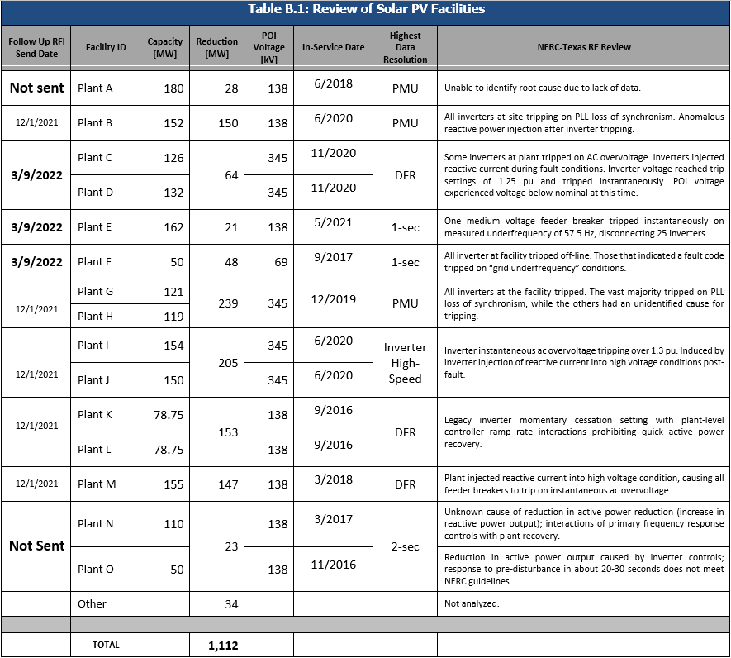
Follow up RFIs for May 9 Event
Table B.1 from NERC’s Odessa Disturbance Report

Slide 3
Follow up RFIs for May 9 Event
Three additional follow up RFIs sent on 3/9
Plant C/D – Reduction of 64 MW. Inverters tripped on AC overvoltage. Same inverters as Plant I/J which stated protection settings could not be relaxed.
Plant E – Reduction of 21 MW. Generation lost due to medium voltage feeder breakers tripping on underfrequency measured below 57.5 Hz. Follow up to inquire if erroneous measurement was corrected.
Plant F – Reduction of 48 MW. Inverters tripped on grid underfrequency measurement of 58.2 Hz or below. Follow up to inquire if erroneous measurement was corrected.
No follow up yet on final two plants
Combined MW reduction of 51 MW
Unable to determine root cause due to lack of data
Will continue to observe response to future events

