Slide 1
NERC Inverter-Based Resource Performance Subcommittee Update
Julia Matevosyan
Chief Engineer, ESIG
Vice-chair of IRPS (former IRPWG)
IBRTF March 2022 Meeting

Slide 2
Background: Inverter-Based Resource Performance Subcommittee
The purpose of the Inverter-Based Resource Performance Subcommittee is to explore the performance characteristics of utility-scale inverter-based resources (IBR) directly connected to the bulk power system (BPS).
The subcommittee builds off of the experience and lessons learned from technology developments and disturbance events, including additional system analysis, modeling, and review of IBR behavior under abnormal system conditions.
Recommended performance characteristics are developed along with other recommendations related to IBR performance, analysis, and modeling.
The technical materials are intended to support the utility industry, Generator Owners with IBRs, and equipment manufacturers by clearly articulating recommended performance characteristics, ensuring reliability through detailed system studies, and ensuring dynamic modeling capability and practices that support BPS reliability.

Slide 3
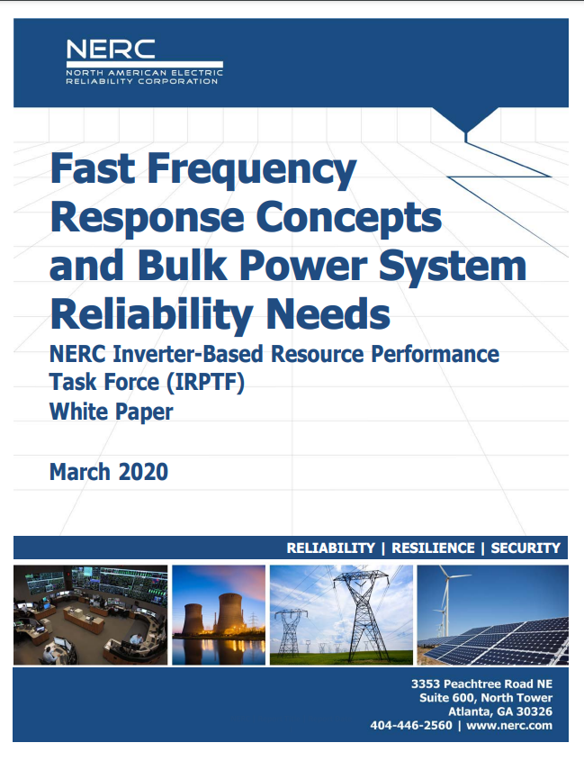
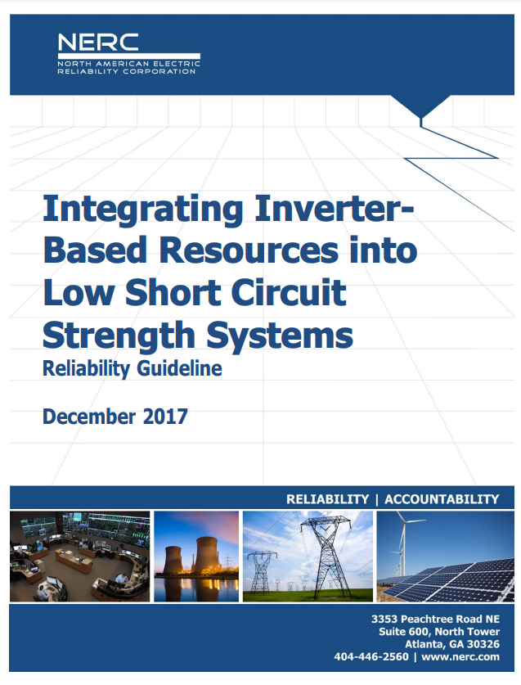
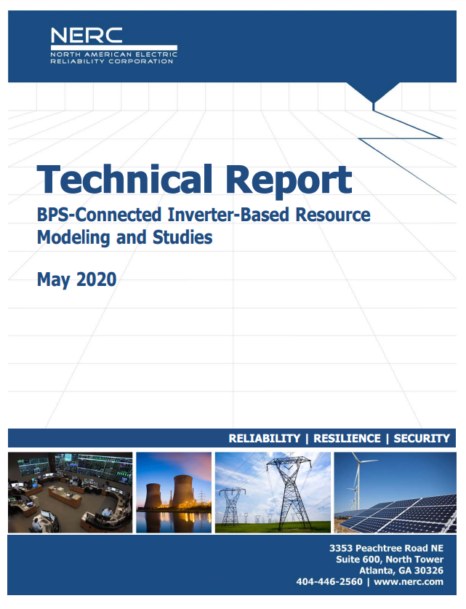
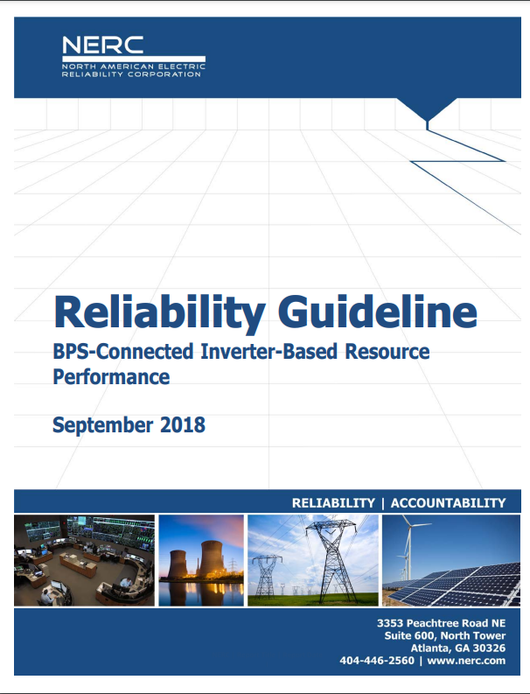
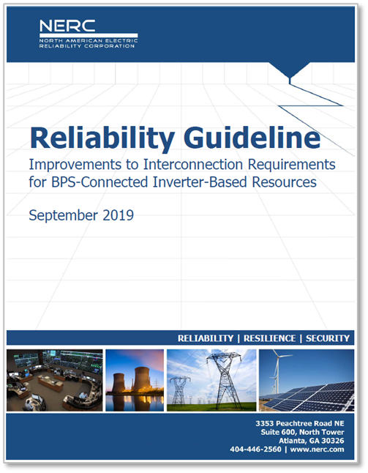
IRPTF, IRPWG Select Prior Work

Slide 4
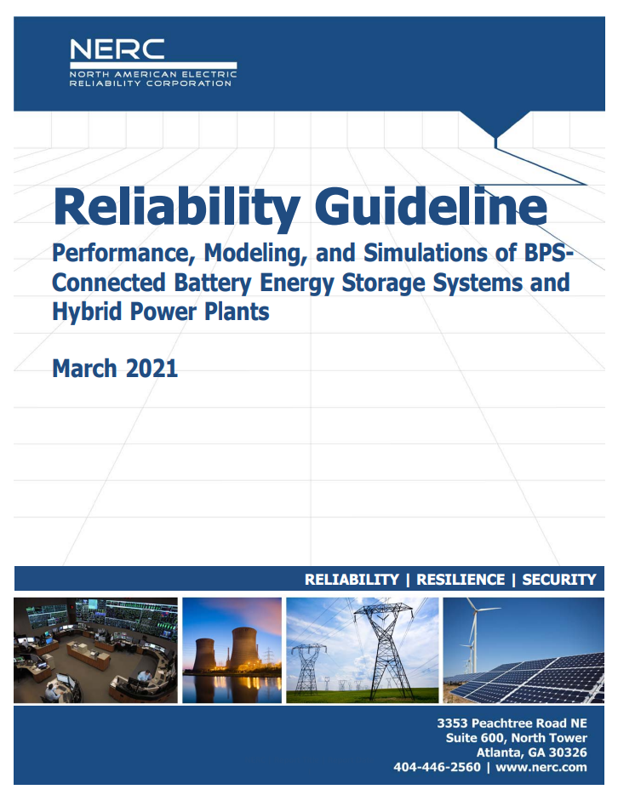
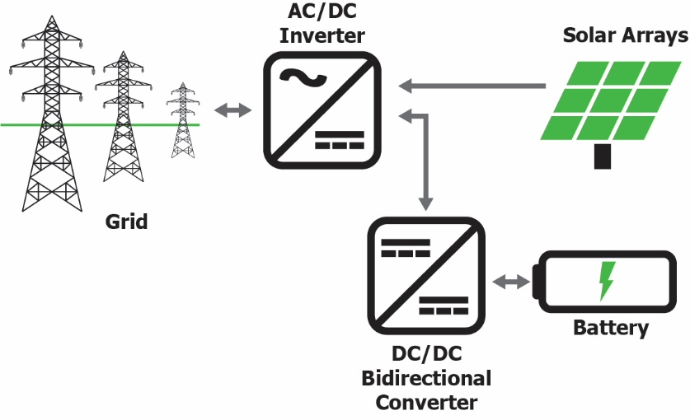
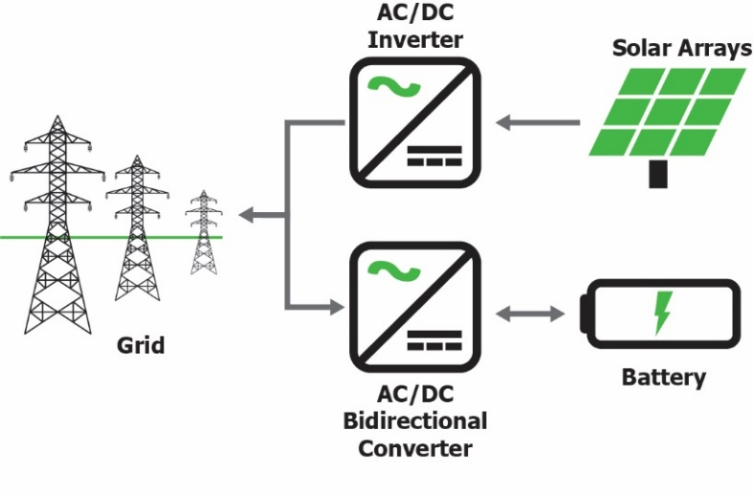
Guidelines and Reports on Inverter-Based Resource Performance
Interconnection queues are seeing a rapid influx of requests for BESSs and hybrid power plants.
IRPTF previously published a Reliability Guideline on recommended performance for BPS-connected inverter-based resources.
Certain nuances to the operation of BESS warrant additional guidance.
Different types of hybrid configurations (ac-coupled versus dc-coupled) and unique complexities of hybrid plants that need additional guidance as well.
The guideline also provides recommendations for interconnection requirements and study processes for BESSs and hybrid power plants.

Slide 5
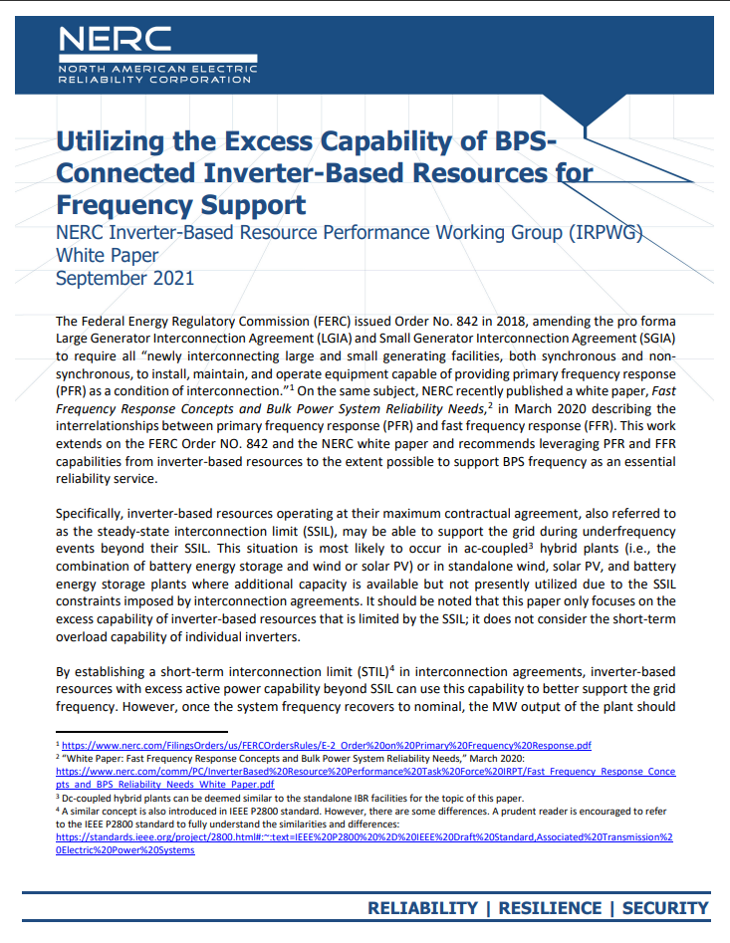
Utilizing the Excess Capability of IBRs for Frequency Support
The paper covers:
IBRs, especially hybrid resources, are often overbuilt with more MW capacity behind POI than in their signed IA
This extra capacity, if permitted, can be used for frequency support
The paper proposes:
Establishing short-term interconnection limit in interconnection agreements of IBRs > continuous interconnection limit
Establishing time to go back to continuous limit after a frequency event.
This will afford additional PFR and FFR during underfrequency events and thus enhance system reliability.
Industry webinar will be held on April 19th 12-2pm CT

Slide 6
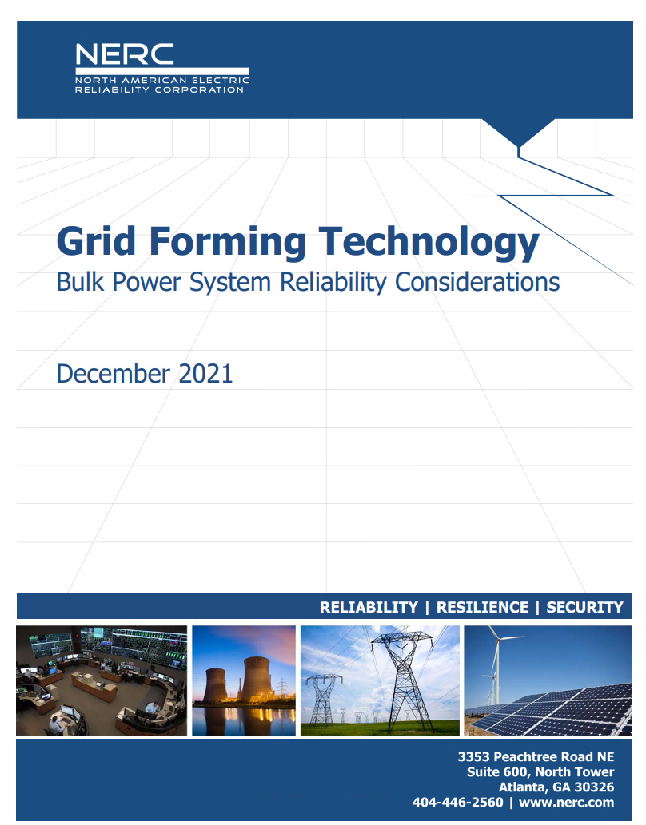
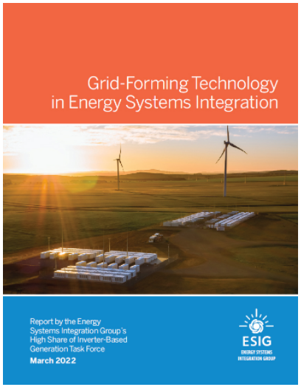
Grid Forming Technology
The white paper outlines
Background and the need for grid forming (GFM) technology
Definition of grid-forming inverter
Types of GFM control
Pilots around the world
Capability, performance and limitations
Considerations for interconnection requirements
Considerations for modeling and studies
On 4/16/2022 ESIG released a report and fact sheet on GFM technology in Energy Systems Integration. The reports provides deeper dive into technology, capability and progress to date

Slide 7
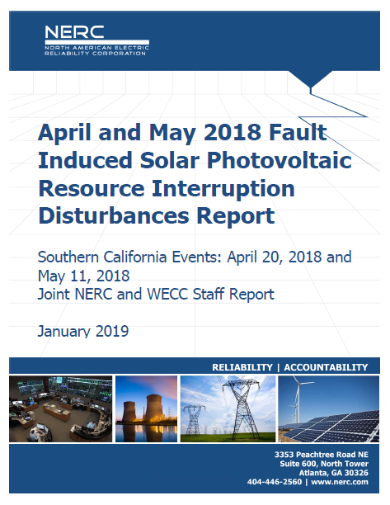
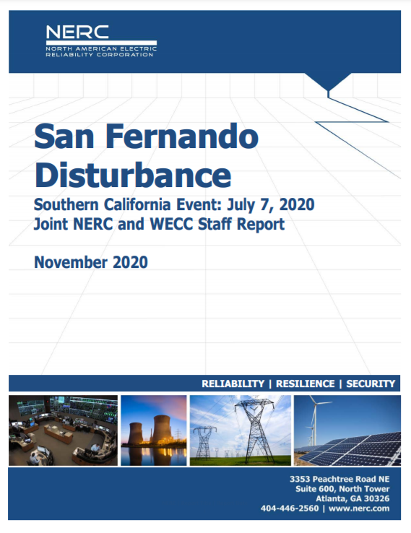
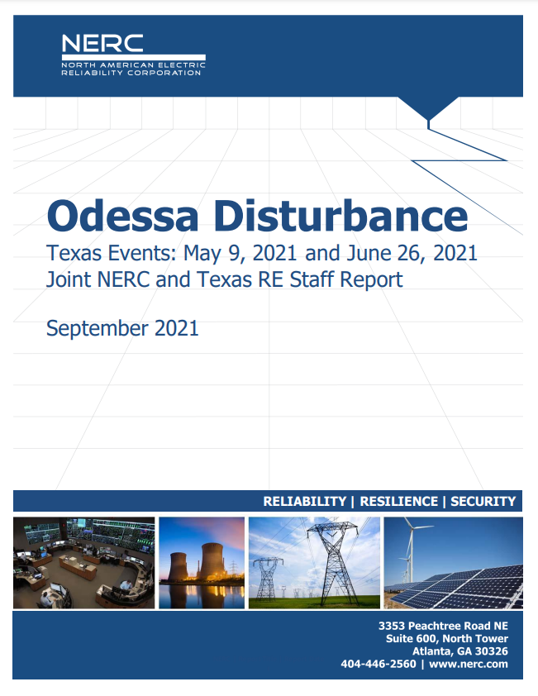
NERC Disturbance Reports and Alerts
Notes:
Ryan

Slide 8
Ongoing Activities
Reliability Guideline: Recommended Approach to Interconnection Studies for BPS-Connected Inverter-Based Resources
Reliability Guideline: Electromagnetic Transient Modelling and Simulations
Follow-up from Odessa Disturbance Report (and San Fernando Report):
Gap Analysis of any IBR-Related Issues Not Addressed by NERC Standards
SAR: EOP-004-4 Gen Loss Criteria for IBRs
SAR: Inclusion of EMT Models into MOD, TPL, and FAC Standards
SAR: Revisions to PRC-004
SAR: Revisions to PRC-024
SAR: Model Quality Checks in FAC-002 and MOD-032 Standards

Slide 9
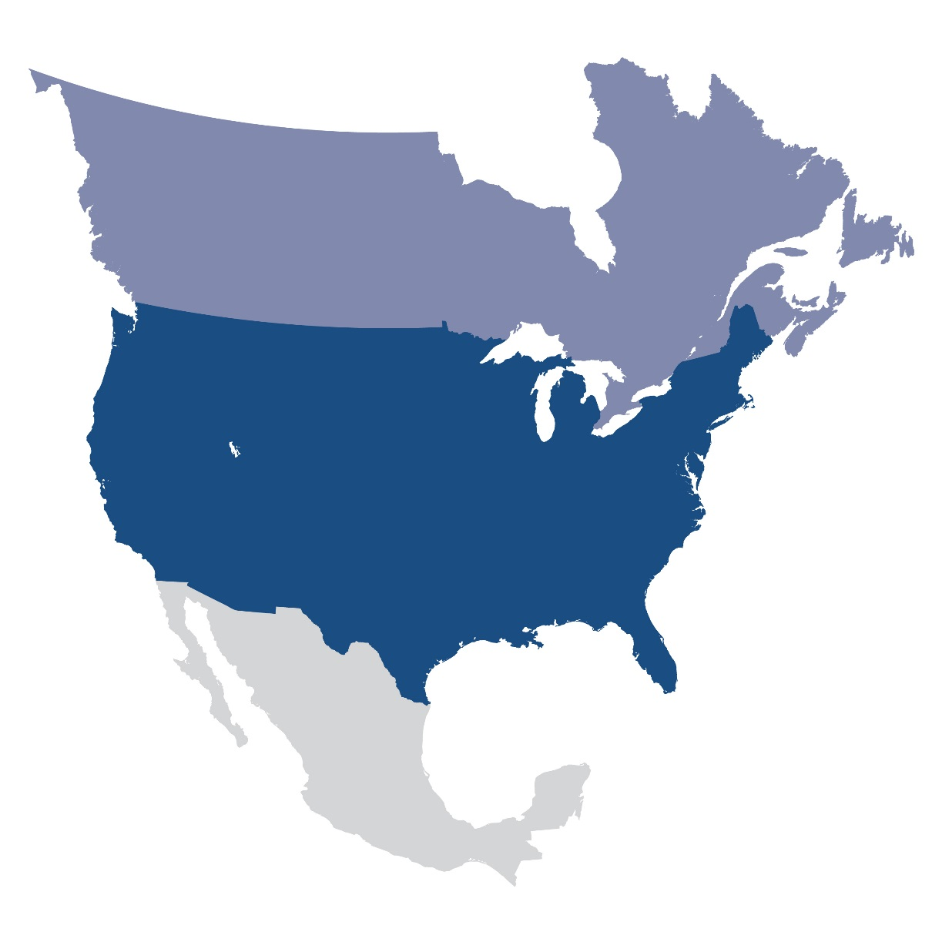
Questions and Answers
Julia Matevosyan
Chief Engineer
ESIG
julia@esig.energy

