Slide 1
ERCOT Interconnection Inertia Analysis
ERCOT Staff

Slide 2
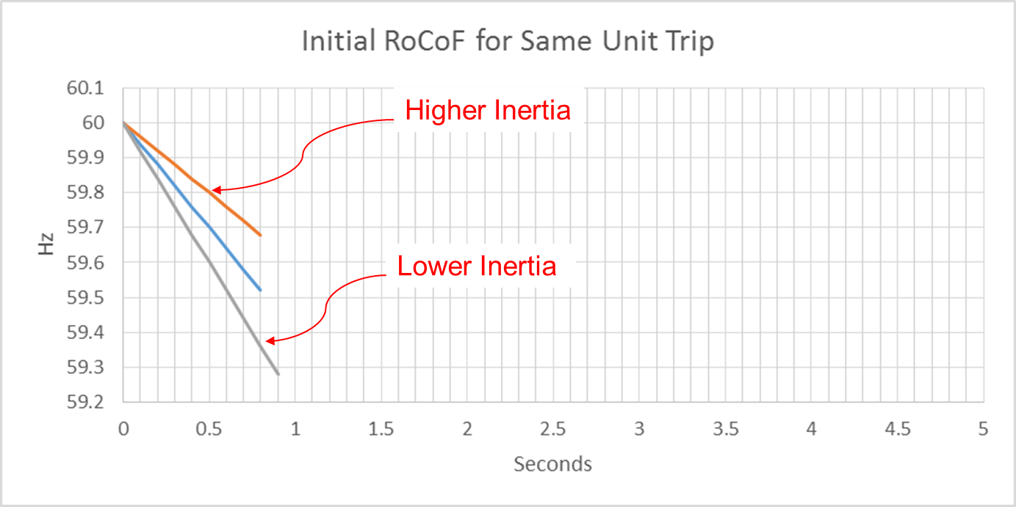
Effect of Synchronous Inertia on System Frequency
With increasing integration of inverter-based generation, there could be periods when total inertia of the system could be low since less synchronous machines will be online.
UFLS trigger
Notes:
UFLS trigger indicates the frequency (59.3 Hz) at which the first stage of involuntary underfrequency load shedding will happen. ERCOT plans and operates the system such that for the simultaneous trip of two largest generating units (2750 MW), UFLS should not be triggered, though it still can happen in some extreme unexpected situations.

Slide 3
Inertia Calculation
In 2013, as instantaneous wind power penetration reached 30%, ERCOT started analyzing impacts of inverter-based generation on system inertia.
In 2015, ERCOT implemented a real-time inertia calculation using inertia parameters of each individual synchronous generator and its status (on/off) telemetry.
$$M_{sys}=\sum_{i∈I}{H_{i}∙{MVA}_{i}}$$
where I is the set of online synchronous generators or condensers,
MVA_{i} is MVA base of on-line synchronous generator or synchronous condenser i, and
H_{i} is inertia constant for on-line generator or synchronous condenser i in a system (in seconds on machine MVA_{i})

Slide 4
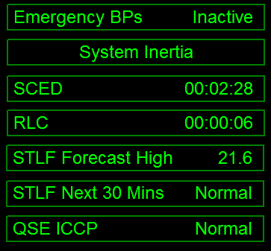
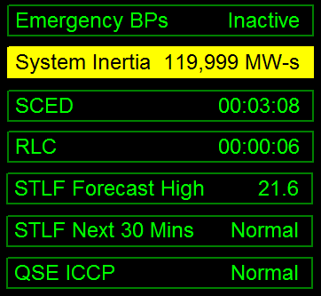
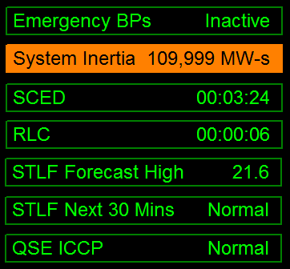
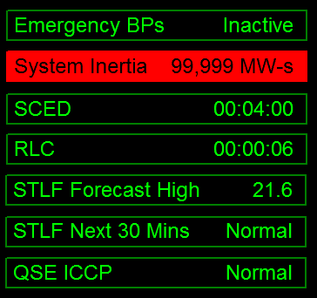
Inertia Monitoring in Real-Time
In 2016, inertia monitoring was implemented in the control room. Visual alarms are raised alarms when inertia gets close to critical levels.
As inertia approaches critical levels, ERCOT System Operators may take actions to bring additional synchronous generation resources with sufficient inertia online.
Current system inertia posted on ERCOT.com https://www.ercot.com/content/cdr/html/real_time_system_conditions.html

Slide 5
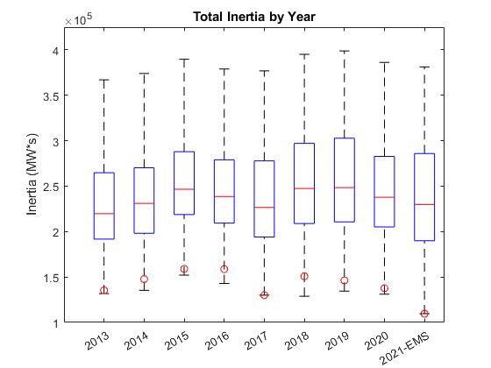
ERCOT Inertia 2013-2021
Date and Time | 2013 3/10 3:00 AM | 2014 3/30 3:00 AM | 2015 11/25 2:00 AM | 2016 4/10 2:00 AM | 2017 10/27 4:00 AM | 2018 11/03 3:30 AM | 2019 3/27 1:00 AM | 2020 05/01 2:00 AM | 2021-EMS 03/22 1:00 AM
Min synch. Inertia (GW*s) | 132 | 135 | 152 | 143 | 130 | 128.8 | 134.5 | 131.1 | 109.6*
System load at minimum synch. Inertia (MW) | 24,726 | 24,540 | 27,190 | 27,831 | 28,425 | 28,397 | 29,883 | 30,679 | 31,767
Non-synch. Gen. in % of System Load | 31 | 34 | 42 | 47 | 54 | 53 | 50 | 57 | 66
* Using updated inertia constants, re-calculated 2021 min = 116.6 GW*s
Notes:
For each box, the central mark (red line) is the median, the edges of the box (in blue) are the 25th and 75th percentiles, the whiskers correspond to +/- 2.7 sigma (i.e., represent 99.3% coverage, assuming the data are normally distributed. The corresponding lowest inertia in each year is given in the table.
The circle on each boxplot is showing inertia during time when highest portion of load was served by wind generation in that year. In 2019 it was on November 26 3:52 am, 57.87%.
ERCOT tripled installed wind capacity between 2013 and 2020, adding nearly 20 GW of wind generation (including all synchronized projects)
An equal amount of coal capacity has about 55 GW*s of inertia contribution.
Counterintuitively, the inertia trend is not declining as installed IBR capacity increases, as was anticipated, due to other factors, such as load growth, gas prices, wind curtailments etc.

Slide 6
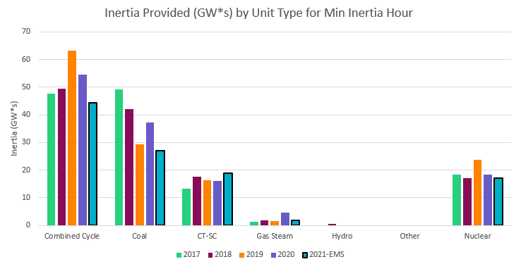
Inertia by Unit Type during Minimum Inertia Hour
Date and Time | 2013 3/10 3:00 AM | 2014 3/30 3:00 AM | 2015 11/25 2:00 AM | 2016 4/10 2:00 AM | 2017 10/27 4:00 AM | 2018 11/03 3:30 AM | 2019 3/27 1:00 AM | 2020 05/01 2:00 AM | 2021-EMS 03/22 1:00 AM
Min synch. Inertia (GW*s) | 132 | 135 | 152 | 143 | 130 | 128.8 | 134.5 | 131.1 | 109.6*
* Using updated inertia constants, re-calculated 2021 min = 116.6 GW*s

Slide 7
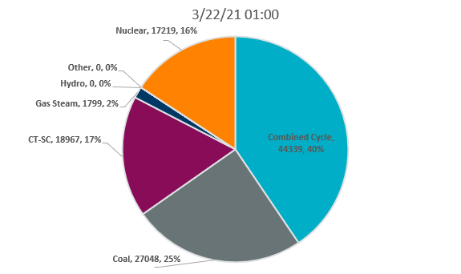
Inertia by Unit Type during Minimum Inertia Hour 2021

Slide 8
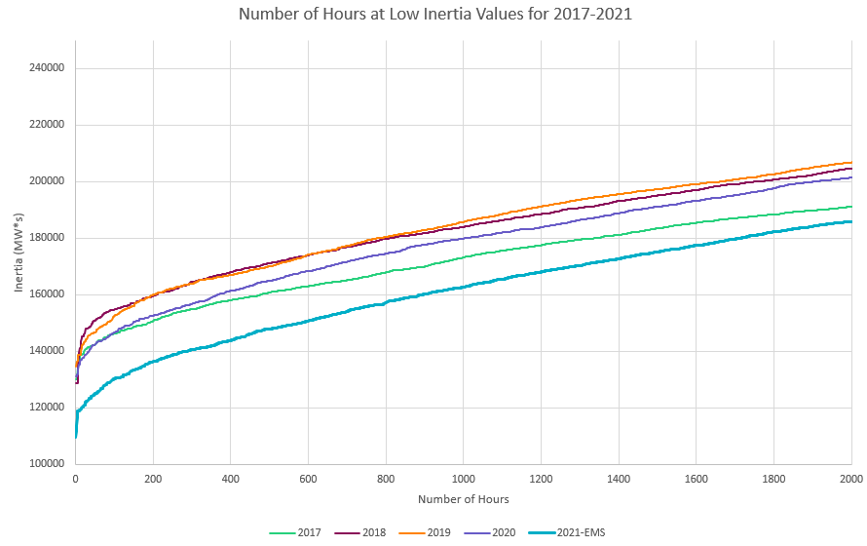
Low Inertia Hours 2017-2021

Slide 9
Wind Generation Capacity
+3,296 MW
+1,261 MW
+2,083 MW
+1,079 MW
+3,035
+1,805 MW
+3,129 MW
+1,629 MW

Slide 10
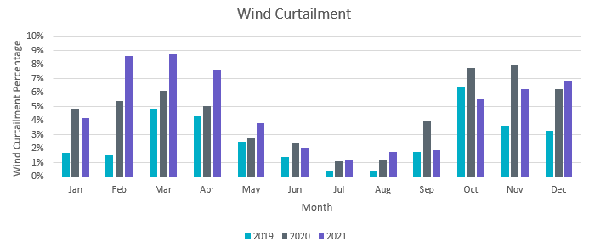
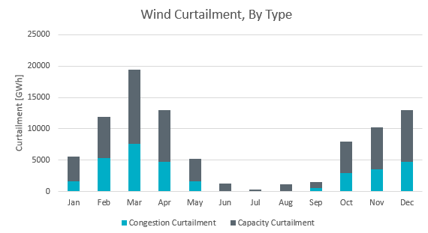
Wind Curtailments
Curtailment % is calculated based on potential uncurtailed annual energy yield

Slide 11
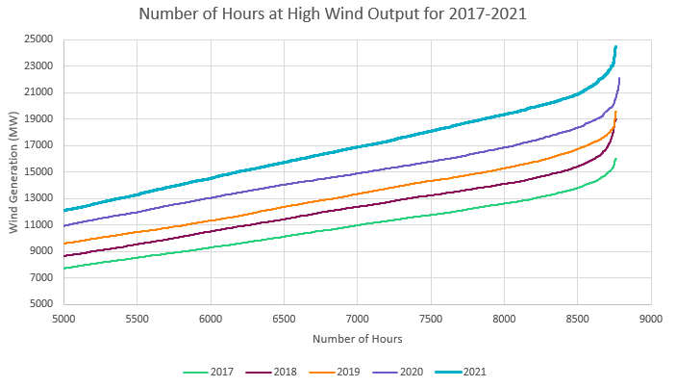
High Wind Generation Hours 2017-2021

Slide 12
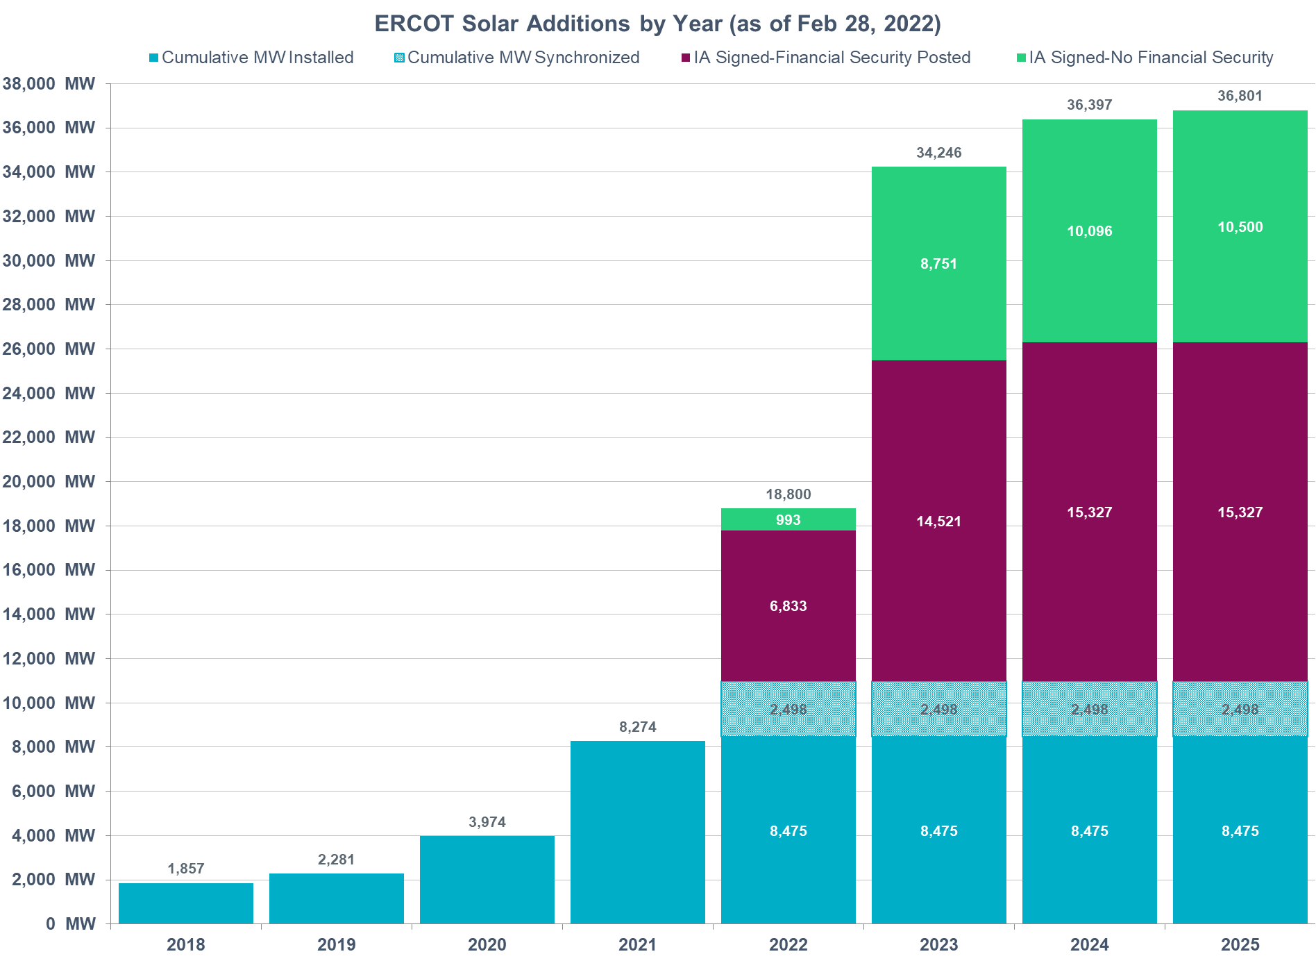
Solar Generation Capacity
+4,300 MW
+1,692 MW
+425 MW

Slide 13
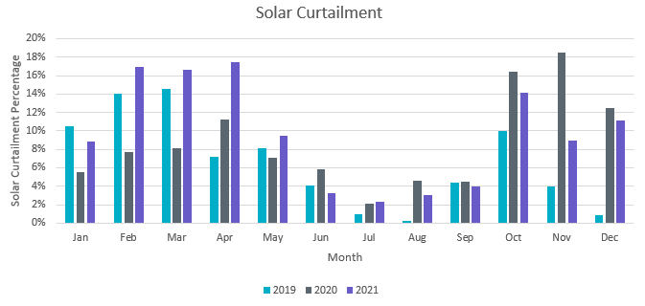
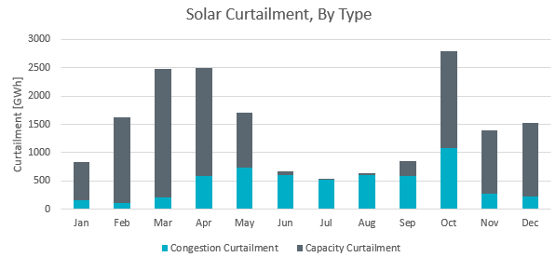
Solar Curtailments

Slide 14
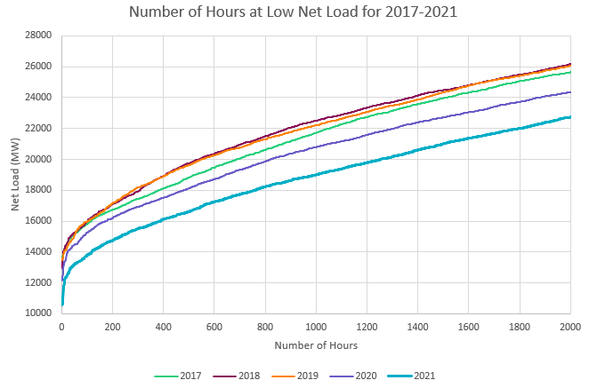
Low Net Load Hours 2017-2021

Slide 15
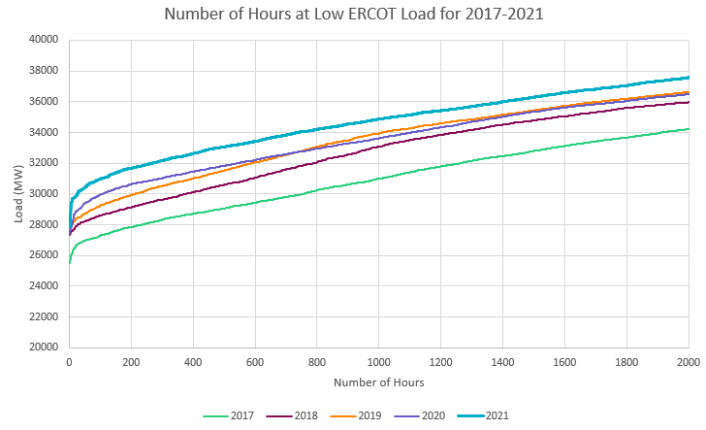
Low Load Hours 2017-2021

Slide 16
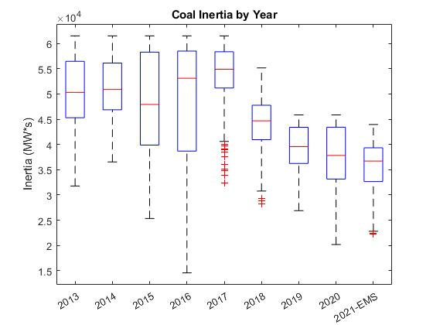
Coal vs Combined Cycle Interplay
Combined Cycle Plant has about 1.5x higher inertia than a Coal Plant with the same MVA rating

Slide 17
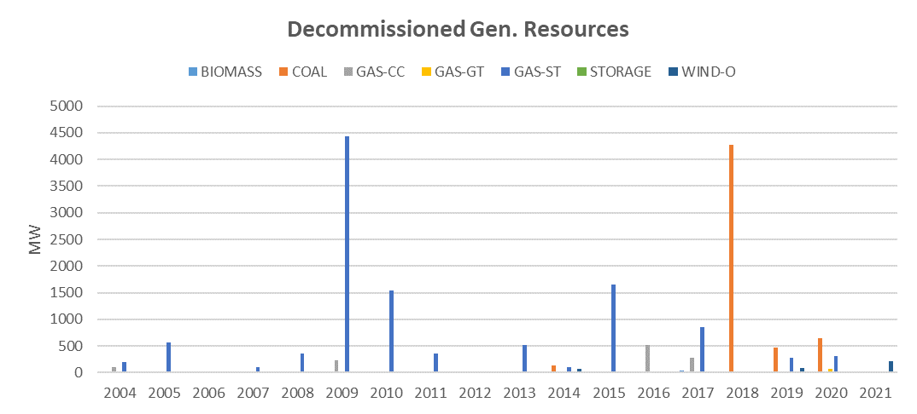
Generation Retirement
22 MW of GAS capacity and 213 MW of Wind capacity retired in 2021.

Slide 18
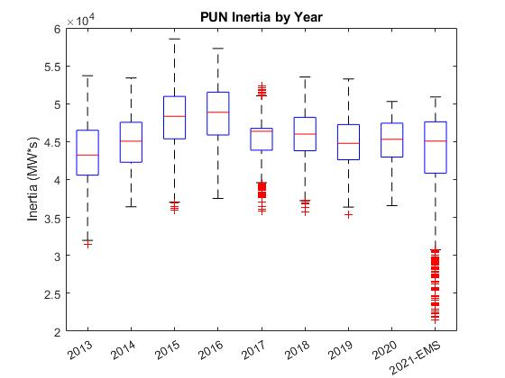
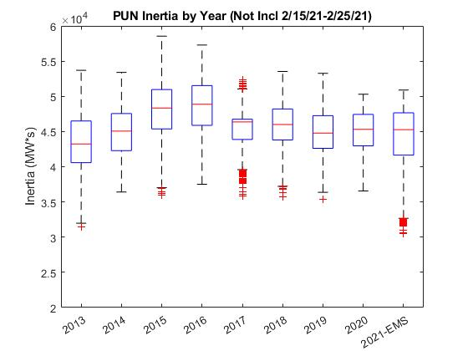
PUN Inertia
Notes:
Just EMS graphs here
PUN generators may be online at all times regardless of electricity market conditions.
Even when PUNs are not exporting power, they are contributing to system inertia, because they are synchronized to the ERCOT grid.
Inertia of PUN generation is at least 35 GW*s from 2014-2020, i.e. >30% of critical inertia.

Slide 19
Summary
All other factors being constant, inertia would decline in proportion to installed capacity of inverter-based generation;
Inertia is dependent on the resources that are online at any given time. Resource commitment is a function of load, inverter-based generation and available thermal resources.
ERCOT load is growing, which affects unit commitment and inertia trend;
Increases commitment of Combined Cycle (CC) generation result in higher overall inertia. If retired Coal generation is replaced by CCs in unit commitment, then inertia increases as well.
Levels of wind output during low load periods affects inertia
Private Use Network generation provides a significant portion of system inertia and currently does not respond to energy price variations like other Resources
In 2021, a variety of factors may have affected thermal unit availability; there was an overall decline in inertia from CCs and relatively lower inertia compared to past years

Slide 20
Thank you! Questions?
jackson.dubro@ercot.com
pengwei.du@ercot.com

Slide 21
Appendix

Slide 22
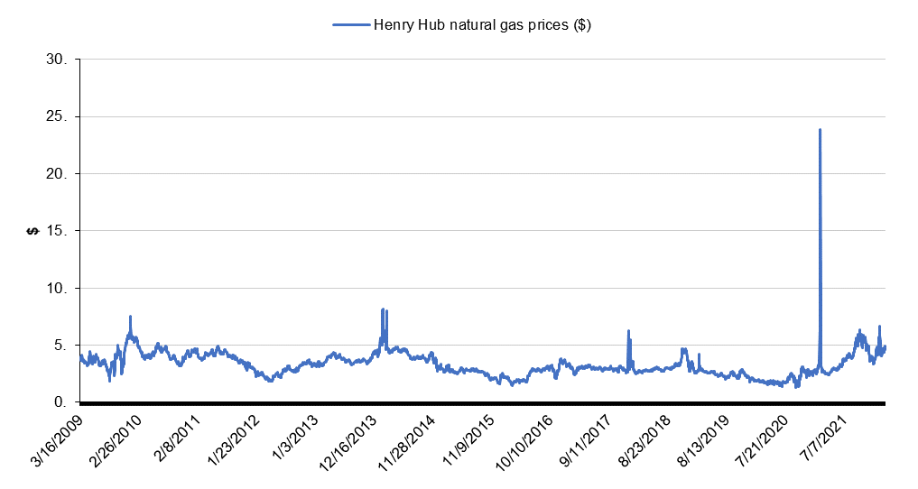
Natural Gas Prices
https://www.macrotrends.net/2478/natural-gas-prices-historical-chart
Notes:
About 50% of ERCOT’s generation fleet is natural gas based
Fluctuations in natural gas prices affect generating unit commitment patterns and, thus, system inertia
More combined cycle units are committed during periods with low gas prices (higher inertia than coal)
More Coal units are committed in periods with high gas prices (lower inertia than combined cycle)

Slide 23
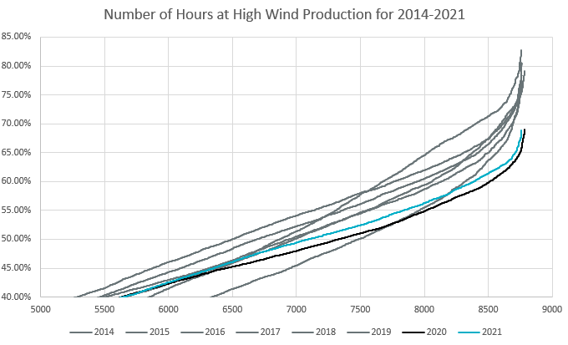
Relative Wind Production 2013-2021
Actual hourly wind power production is normalized by installed capacity at the time and ordered from lowest to highest level for each year to compare how “productive” each year was.

Slide 24
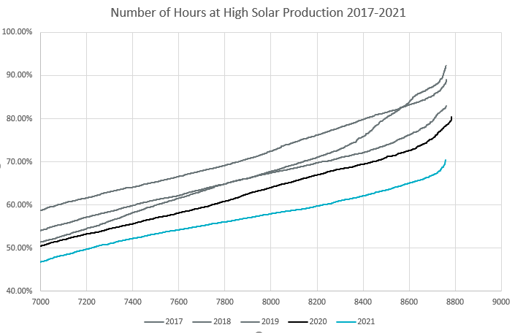
Relative Solar Production 2013-2021
Actual hourly solar power production is normalized by installed capacity at the time and ordered from lowest to highest level for each year to compare how “productive” each year was.

Slide 25
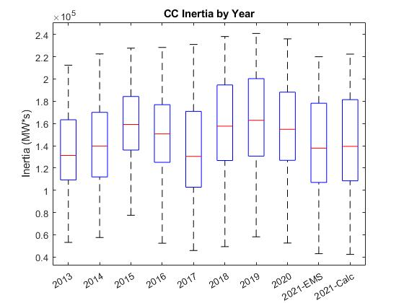
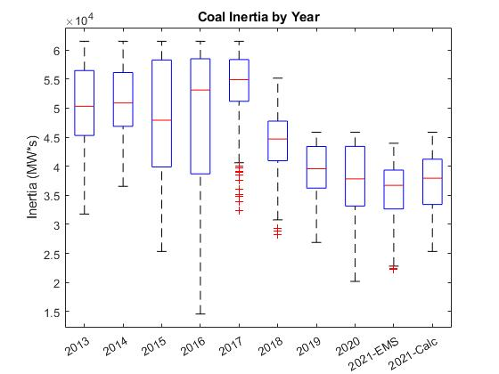
Coal vs Combined Cycle Interplay
Combined Cycle Plant has about 1.5 time higher inertia than a Coal Plant with the same MVA rating

Slide 26
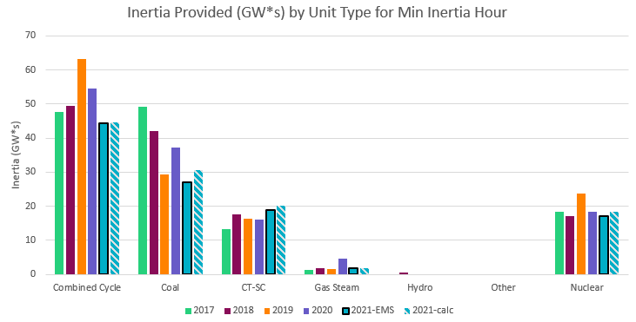
Inertia by Unit Type during Minimum Inertia Hour

