Slide 1
ERCOT Frequency Control Report
February 2022
ERCOT
Operations Planning
PDCWG | March 16th, 2022

Slide 2
Summary of February 2022
CPS1: 175.90%
Current CPS1 12-Month Rolling Average: 171.30%
0 BAAL Exceedance(s)
0 hourly CPS1 score below 100%
BAAL-003 Events have updated through 2020
2020 BAAL-003 FRM Performance: -789.34
2022 RMS1 Statistics
  Mean: 14.68 mHz
  Min: 12.43 mHz
  Max: 18.6 mHz
Energy Statistics
  Total Energy: 31,284,898 MWh
  Wind Energy: 8,261,666 MWh
  Percent Energy from Wind: 26.41 %
  Solar Energy: 1,423,230 MWh
  Percent Energy from Solar: 4.55%
Minimum System Inertia
  Mean: 209,265 MW*s
  Max: 347,921 MW*s on Feb 4th
  Min: 135,117 MW*s on Feb 21st

Slide 3
Frequency Control
CPS1, BAAL, & RMS1

Slide 4
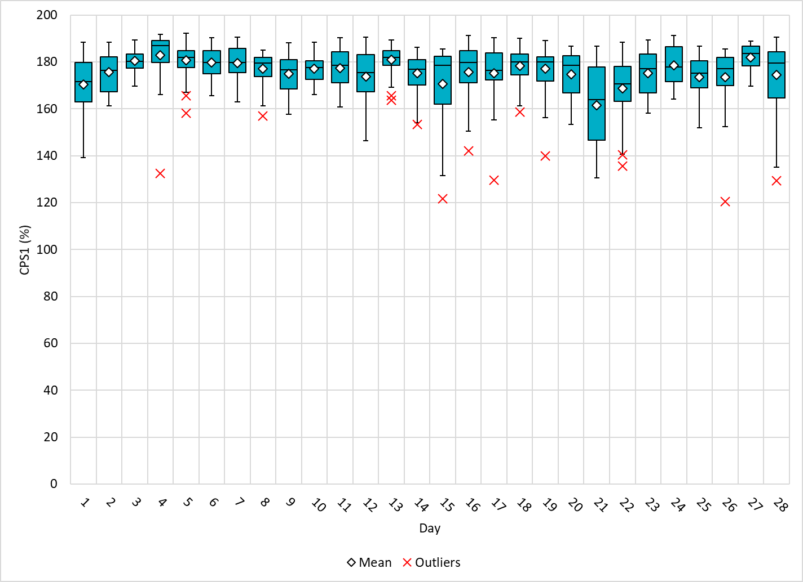
Hourly CPS1 by Day
Feb-22 CPS1 (%): 175.90

Slide 5
BAAL Exceedances & Violations
There are 0 BAAL exceedance(s) in February

Slide 6
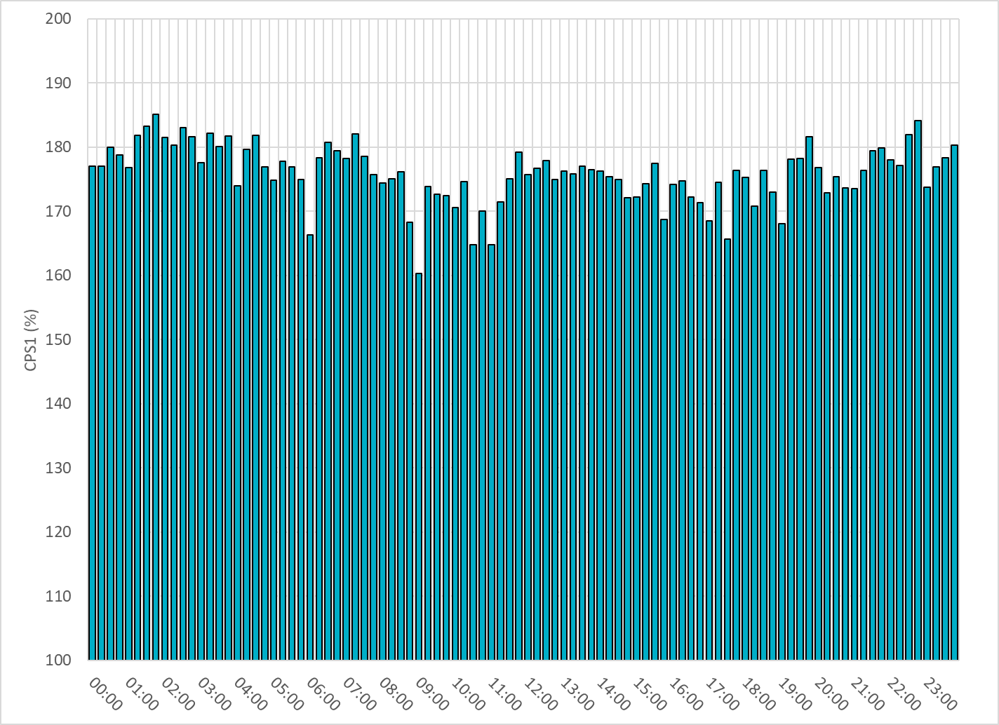
15-Minute Average CPS1%
Feb-22 CPS1 (%): 175.90

Slide 7
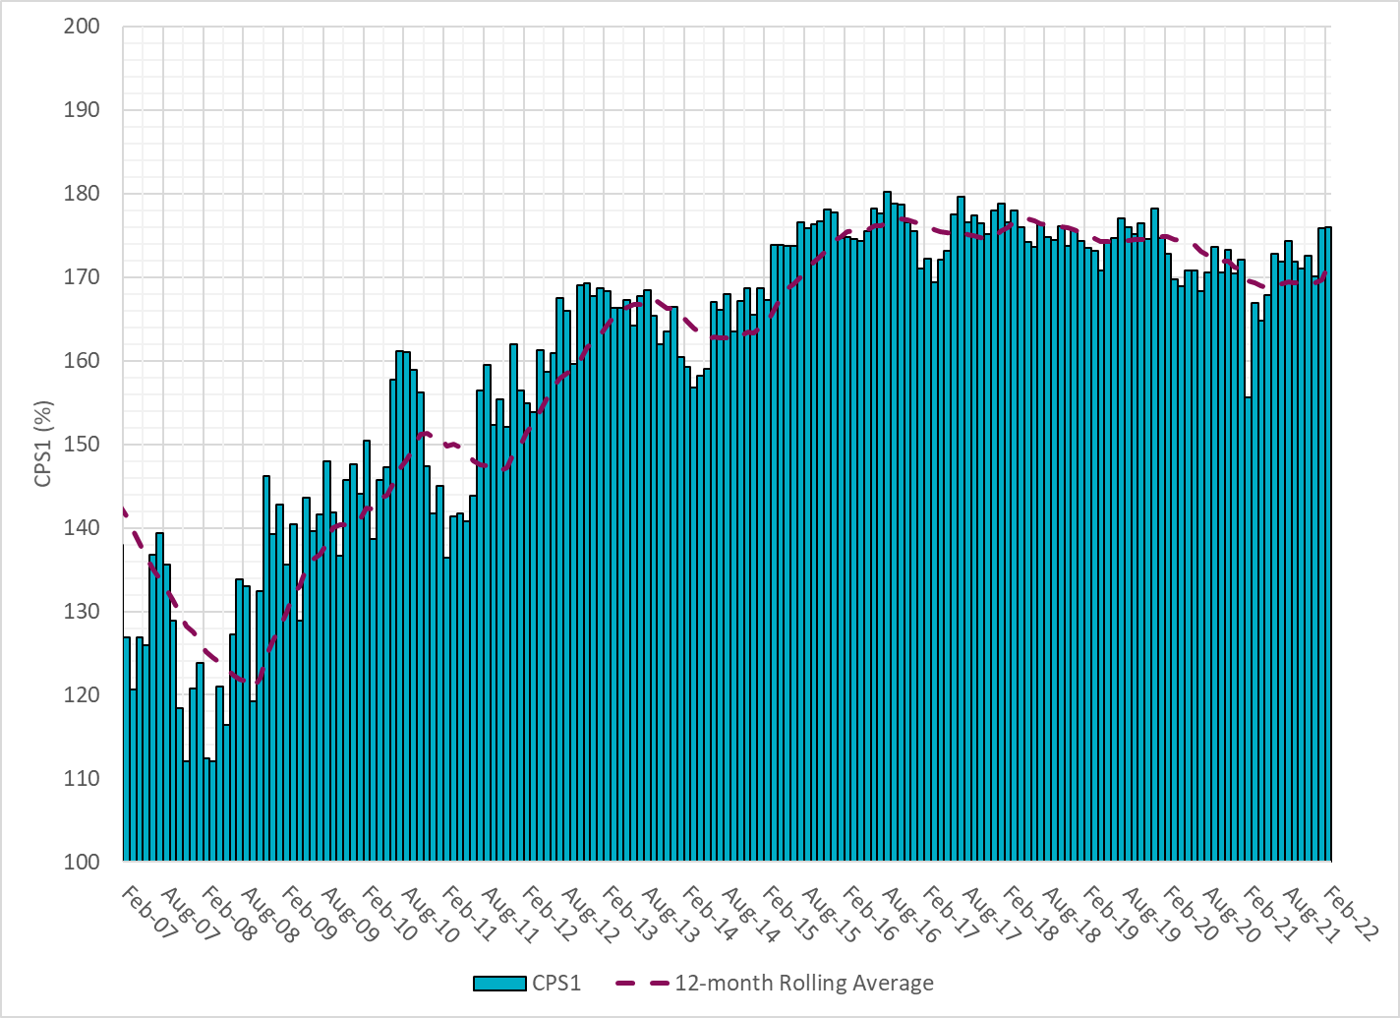
12-Month Rolling Average CPS1
Current 12-Month Rolling Average: 171.30%

Slide 8
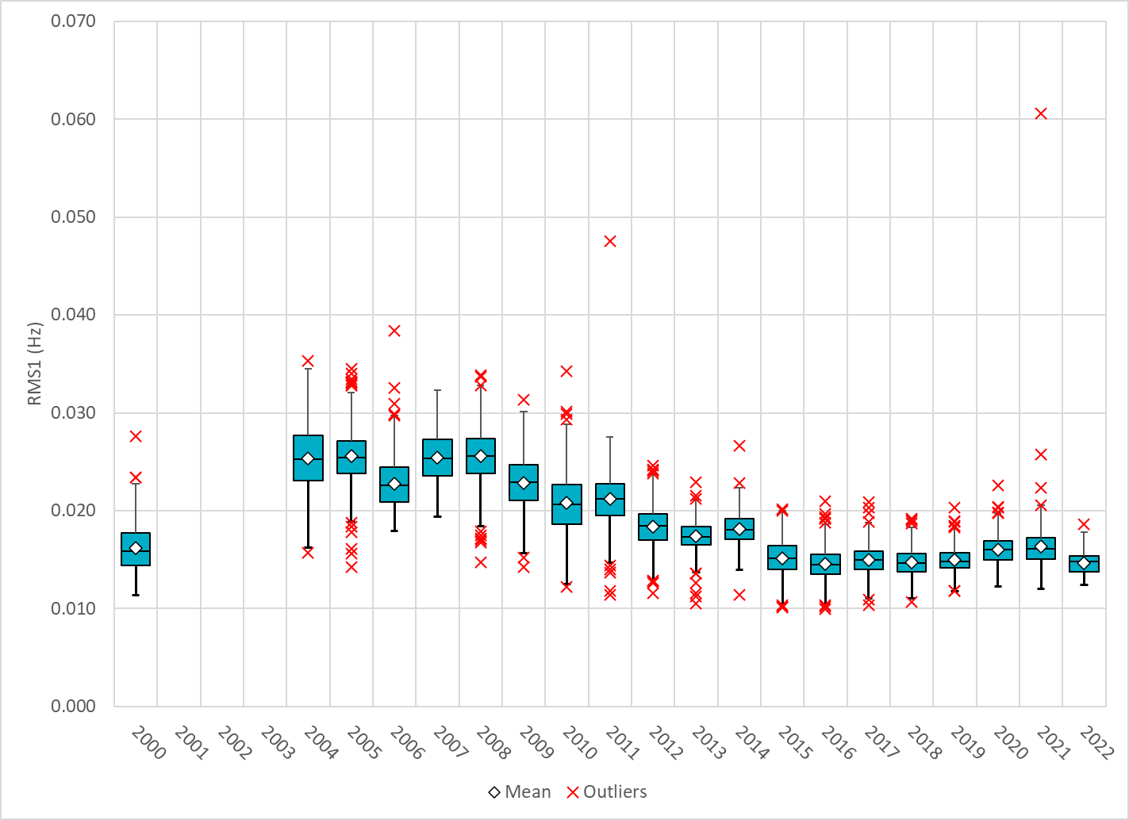
Daily RMS1 of ERCOT Frequency by Year
Notes:
Mean: 14.68 mHz
Min: 12.43 mHz
Max: 18.6 mHz

Slide 9
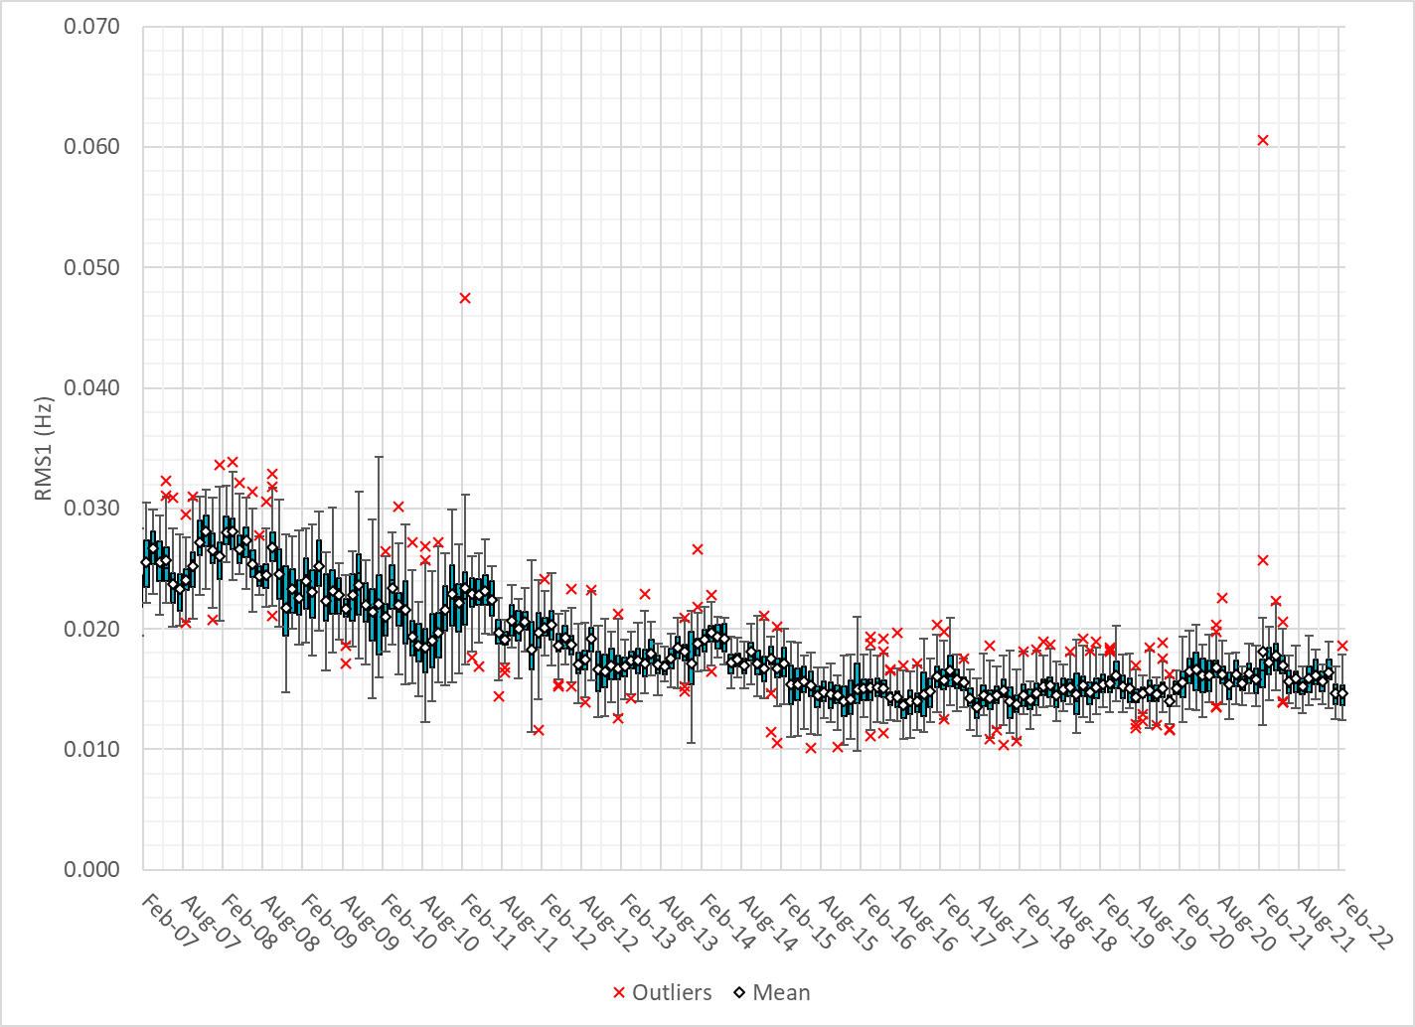
Daily RMS1 of ERCOT Frequency by Month

Slide 10
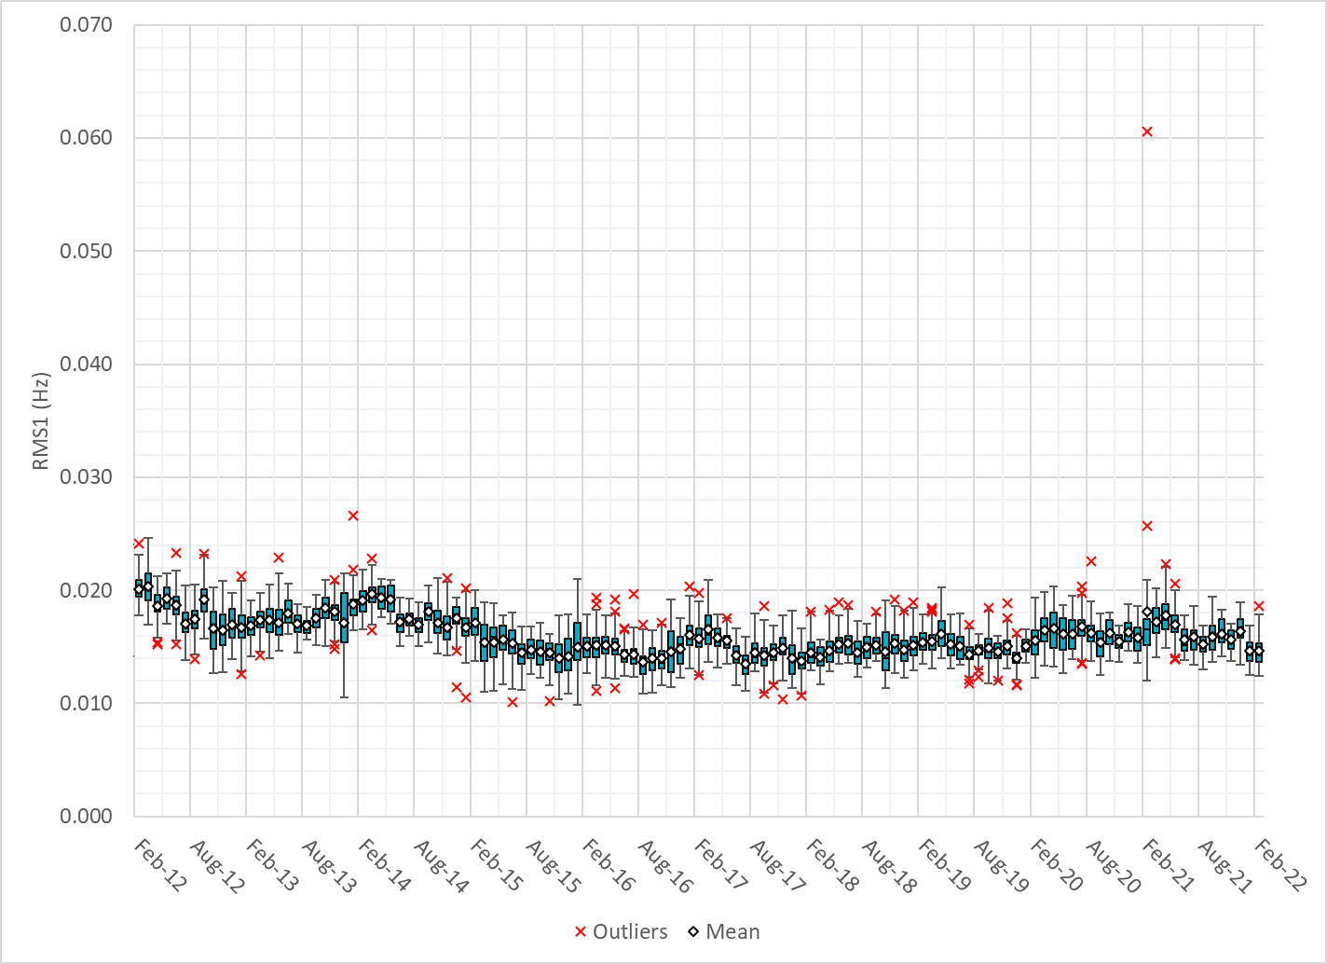
Daily RMS1 of ERCOT Frequency by Month
Notes:
16Mhz on avg

Slide 11
Frequency Profile Comparison

Slide 12
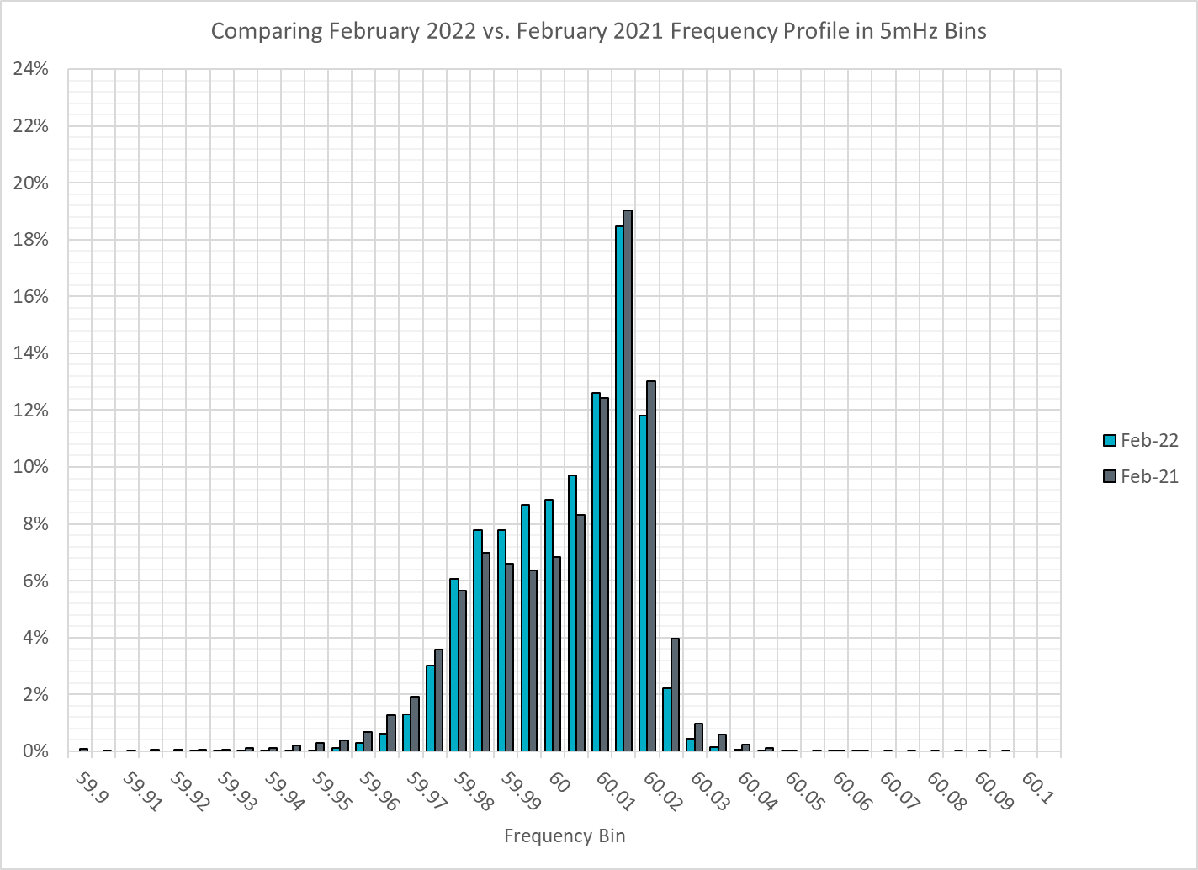
Frequency Profile Comparison

Slide 13
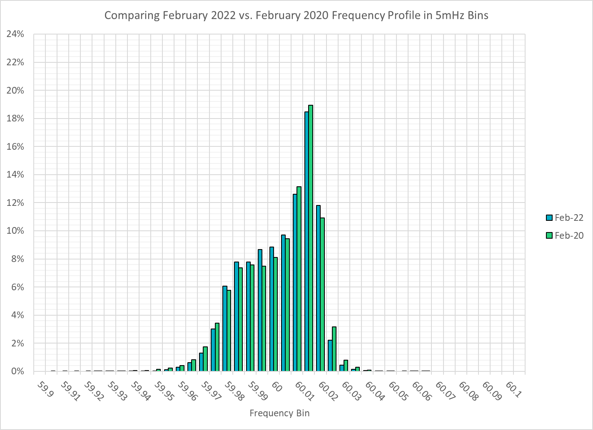
Frequency Profile Comparison

Slide 14
Time Error Correction

Slide 15
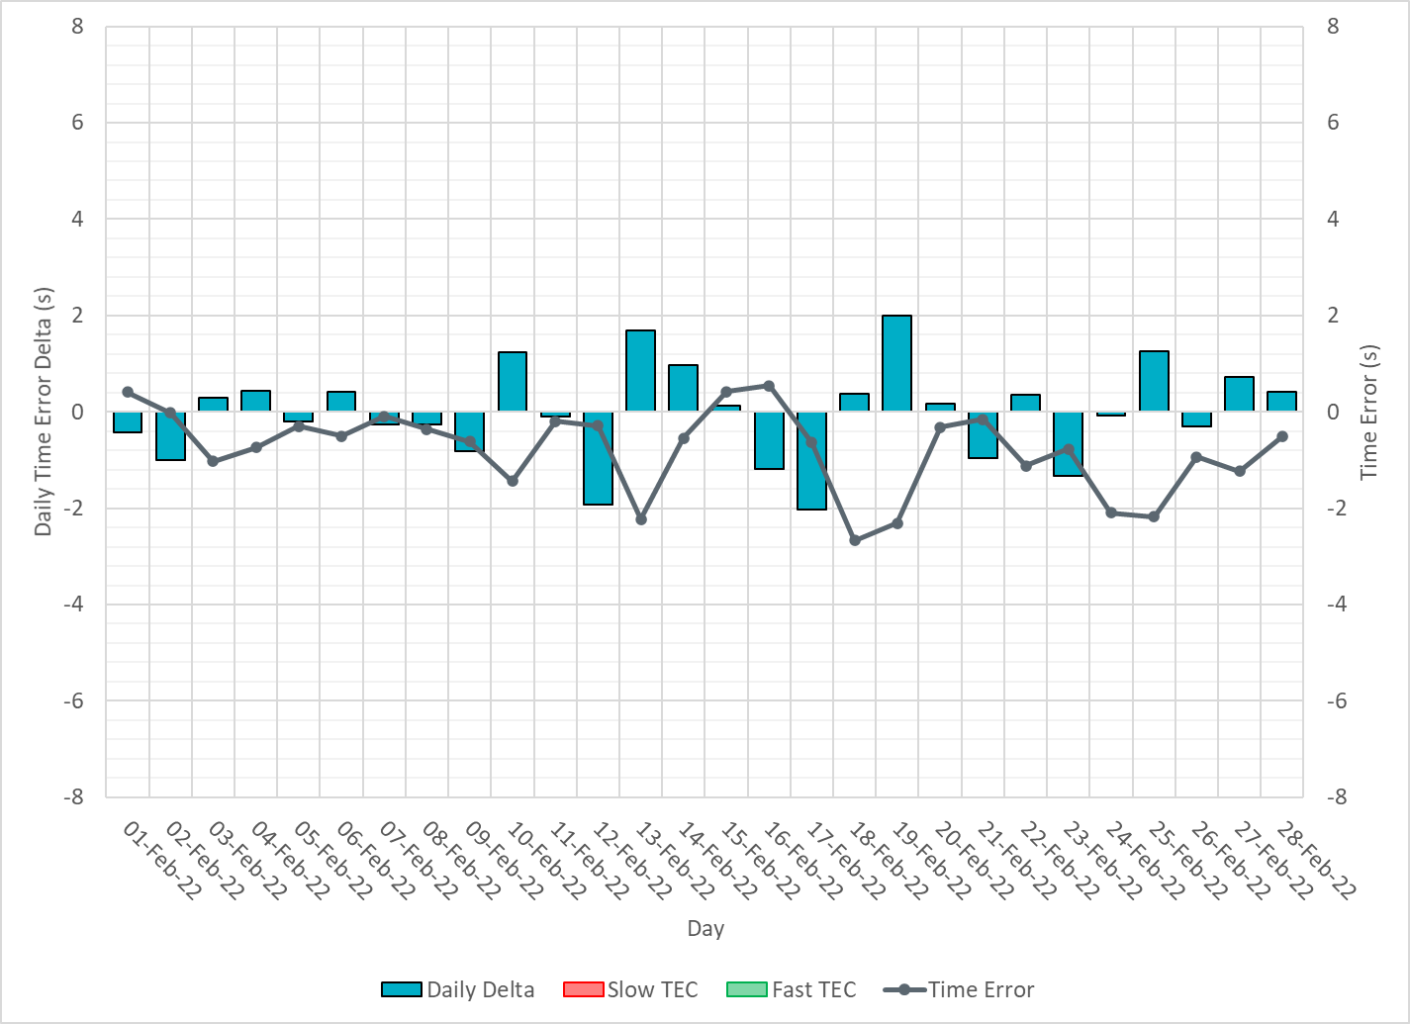
ERCOT Daily Time Error

Slide 16
Time Error Corrections Log Summary
There have been no time error corrections since December 2016

Slide 17
BAL-003 Performance

Slide 18
Op. Year 2020 BAL-003 Selected Events – Update
Notes:
BAL-003

Slide 19
Op. Year 2020 BAL-003 FRM Performance - Update
Notes:
OP2018: FRO = -381.0, FRM_median = -843.17, FRM_average = -959.7
OP2019: FRO = -381.0, FRM_median = -811.14, FRM_average = -892.5
OP2020: FRO = -425.0, FRM median = -789.34, FRM average = -879.0
OP2021: FRO =

Slide 20
ERCOT Energy Statistics

Slide 21
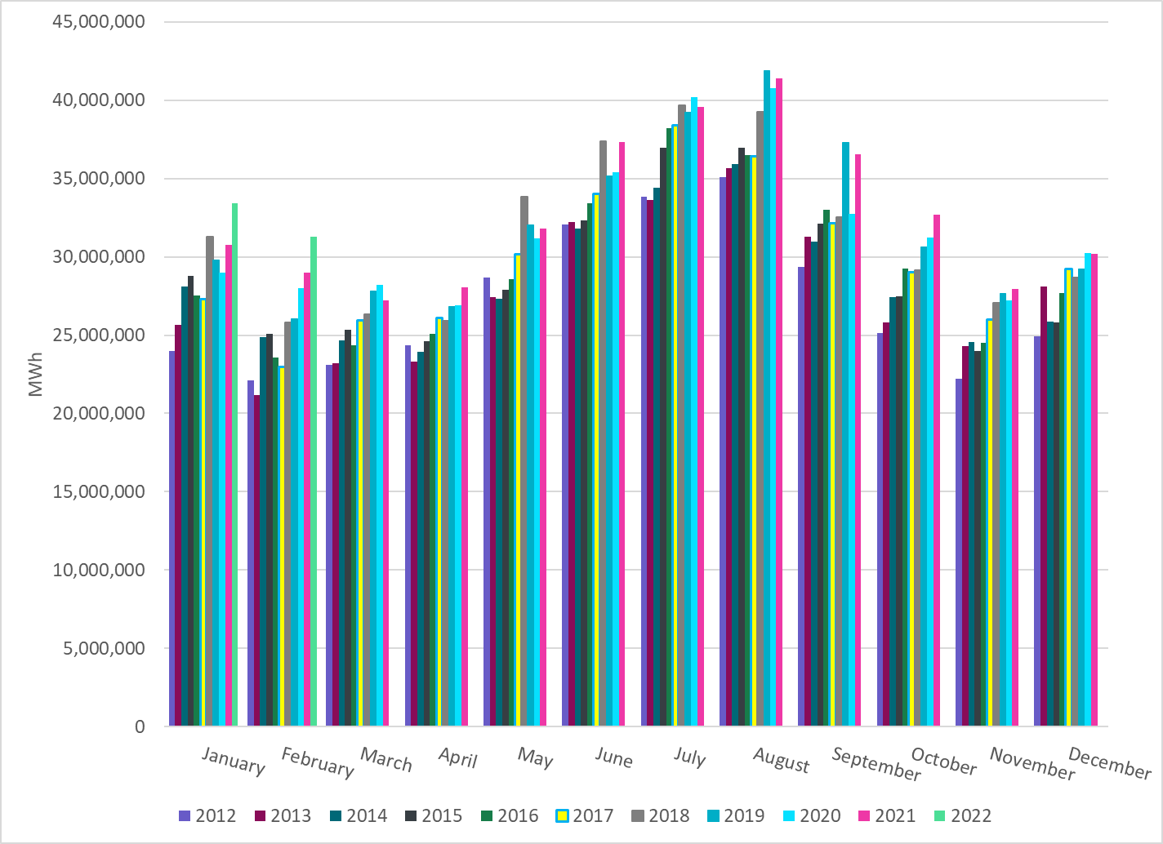
Total Energy
Notes:
31,284,898 MWh

Slide 22
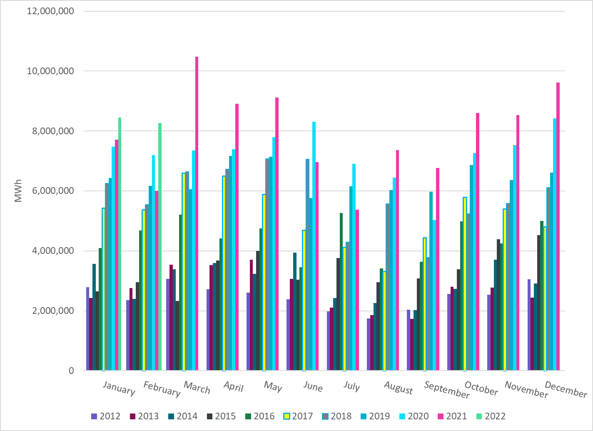
Total Energy from Wind Generation
Notes:
8,261,666 MWh

Slide 23
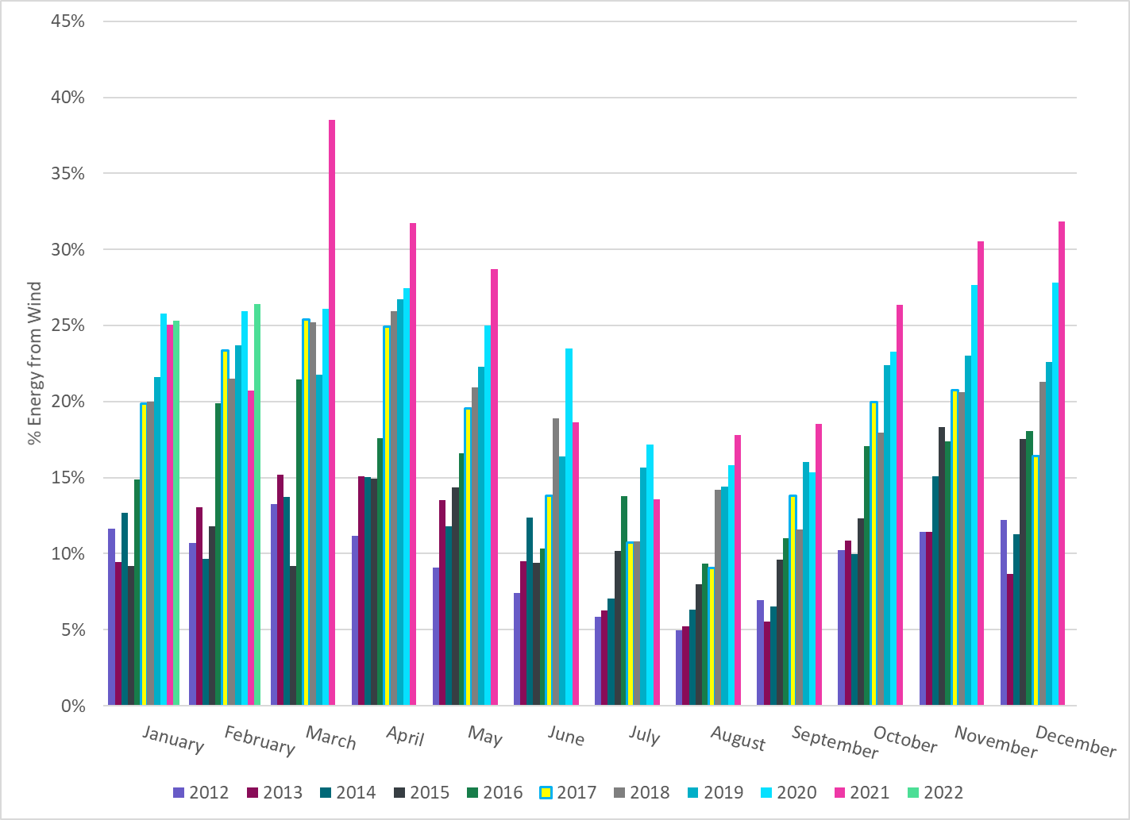
% Energy from Wind Generation
Notes:
26.41 %

Slide 24
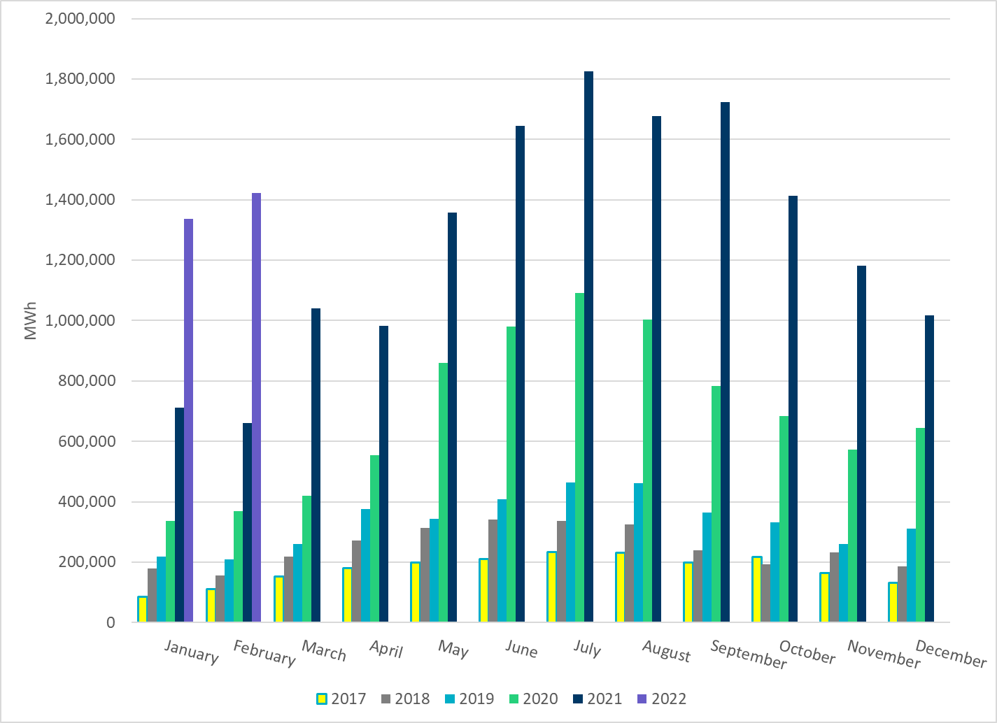
Total Energy From Solar Generation
Notes:
1,423,230 MWh

Slide 25
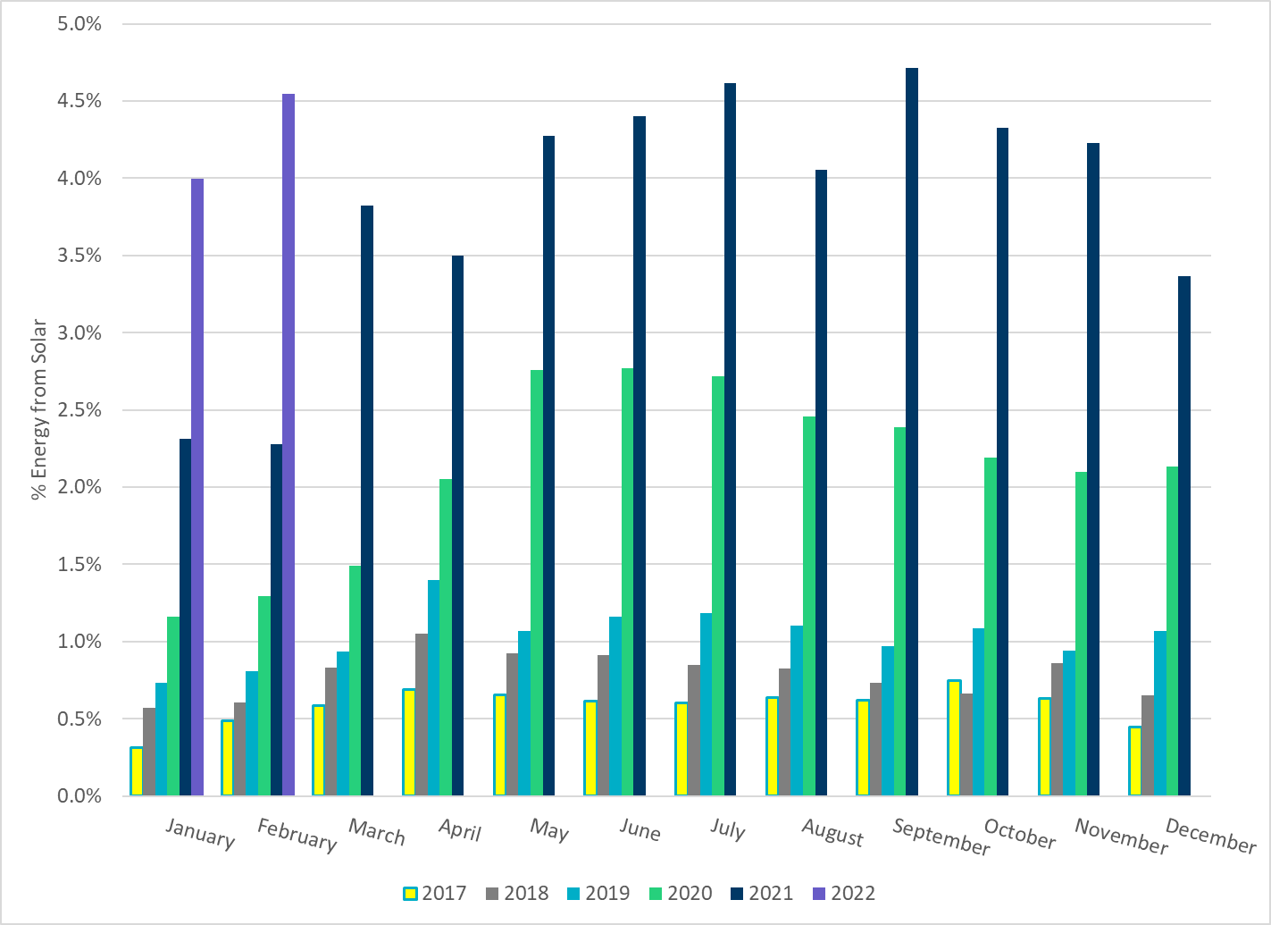
% Energy from Solar Generation
Notes:
4.55 %

Slide 26
ERCOT System Inertia

Slide 27
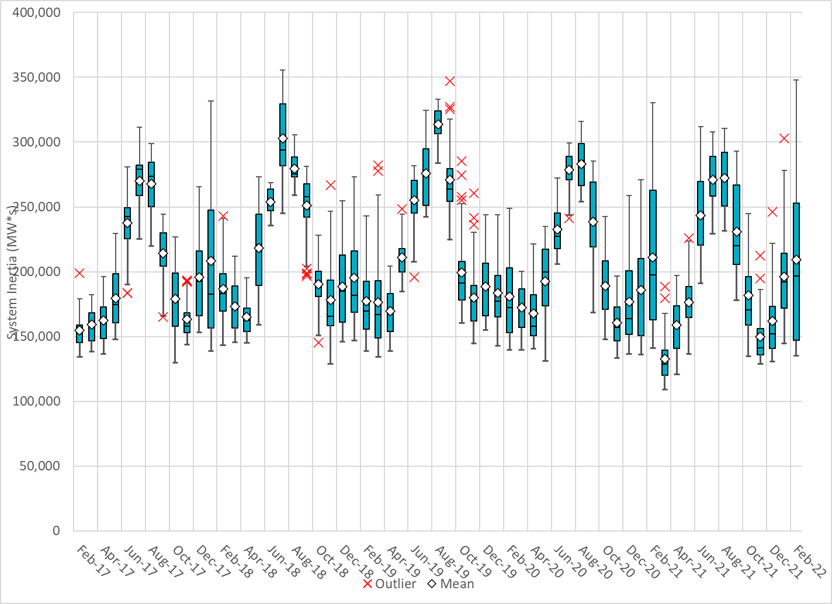
Daily Minimum System Inertia
Notes:
Minimum Inertia =135,117 MW*s on 2/21/2022
Previous Minimum was 109,029 MW*s on 3/22/2021
Data:
Mean: 209,265 MW*s
Max: 347,921 MW*s on Feb 4th
Min: 135,117 MW*s on Feb 21st

Slide 28
Questions?
Thank you!

