Slide 1
ERCOT Frequency Events
February 2022
ERCOT
Operations Planning
PDCWG | March 16th, 2022

Slide 2
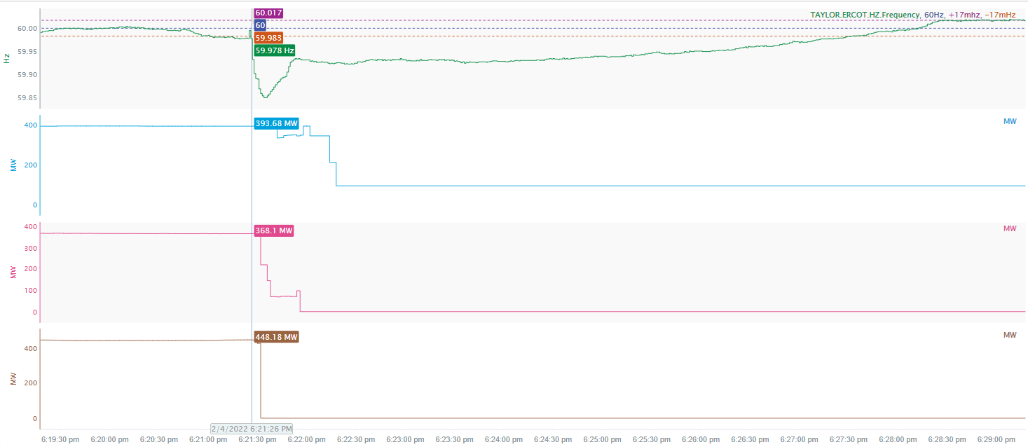
2/4/2022 18:21:26 (NON FME)
Notes:
Several thermal units tripped offline while carrying a total of approximately 1210 MW.
Starting Frequency: 59.978 Hz
Minimum Frequency: 59.851 Hz
A-C Time: 9 seconds
Recovery Time (back to deadband): 6 minutes 5 seconds
RRS Deployed: 822 MW
Trip Reason: Loss of transmission line
Contextual Information: A total of 466 MW of regulation up was deployed and 300 MW of manual offset was applied during the event.
No Selection Reason: Starting frequency is outside the deadband and A-C time is 9 seconds (more than what we typically look for). The event resulted in loss of approximately 320 MW of load, which impacted the frequency recovery.

Slide 3
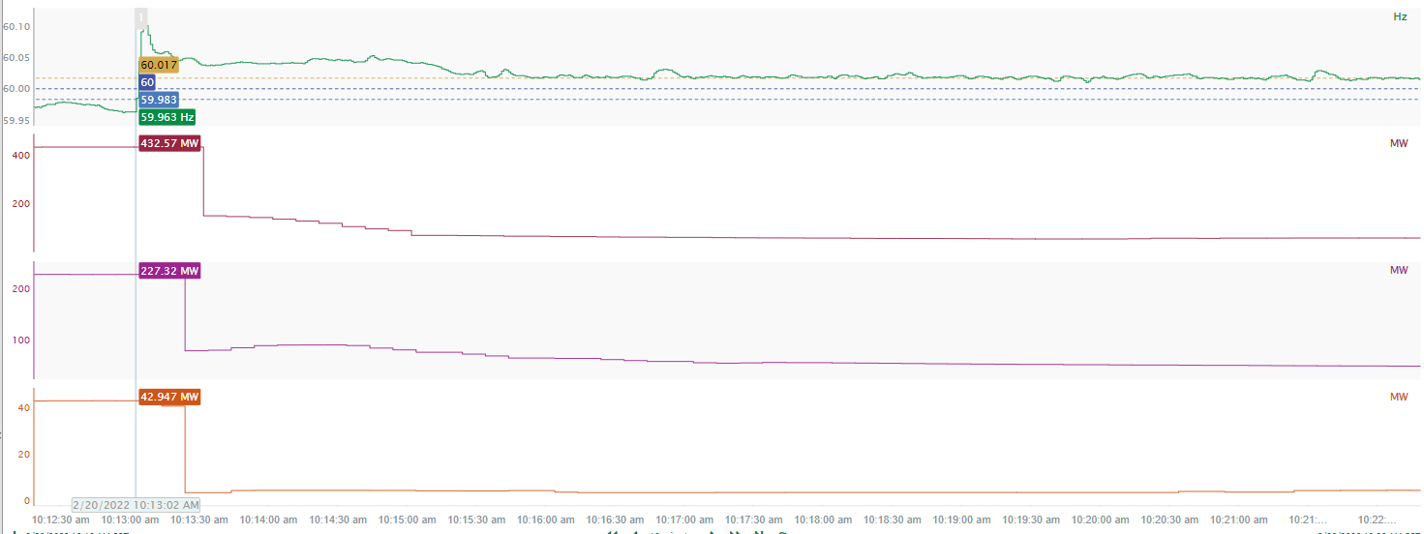
2/20/2022 10:13:02(NON FME)
Notes:
Loss of 467 MW of load
Starting Frequency: 59.963 Hz
Maximum Frequency: 60.109 Hz
A-C Time : 4 seconds
Recovery Time(back to deadband): 2 minutes and 53 seconds
RRS Deployed: 0 MW
Trip Reason: Loss of transmission line
Contextual Information: A total of 469 MW of regulation up was deployed during the event.
No Selection Reason: Starting frequency is outside the deadband

Slide 4
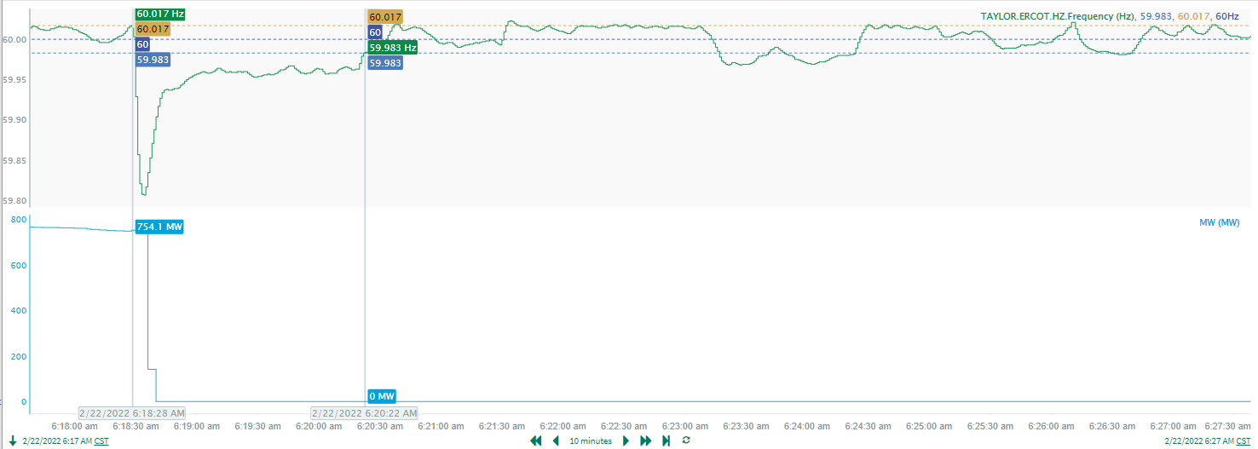
2/22/2022 6:18:28(FME)
Notes:
Unit tripped offline while carrying 754 MW
Starting Frequency: 60.017Hz
Minimum Frequency: 59.807 Hz
A-C Time : 6 seconds
Recovery Time(back to deadband): 1 minute and 54 seconds
RRS Deployed: 786 MW
Trip Reason: Unknown
Contextual Information: A total of 406 MW of regulation up was deployed and a 300 MW SCED Manual offset was applied during the event.

Slide 5
Questions?
Thank you!

