Slide 1
NPRR1111 & SCR819 Implementation
CMWG
3/21/2022

Slide 2
NPRR1111 & SCR819 Review
General description
  IRR units behind a binding GTC with a shift factor impact greater than X% on the GTC flow should NOT exceed their SCED BP when NTE is triggered.
NTE Method parameters:
  Triggering condition: To be determined. Trigger conditions being considered are:
    When GTC loading is above 85% of calculated limit
    When GTC constraint is activated/ binding in SCED
  Discount factor: Reliability limit will be discounted in a less-conservative manner, closer to 1.0.
  IRR shift factor threshold: IRR units with shift factor greater than X% on a GTC cannot exceed their SCED BP.

Slide 3
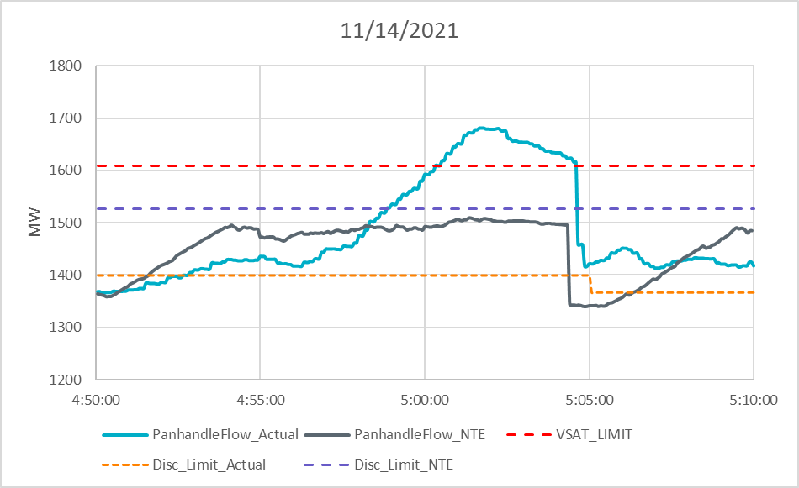
NTE Improvement Example
Notes:
Maximum actual GTC loading: 1680.5 MW (104.5% of limit)
NTE_DF = 95%
Real-Time DF = 87% and changed to 85% around 5:05.
Instantaneous MW drop at 5:04:20 was due to operators instructing a ramping unit to open their breakers. (Loss of about 197 MW)

Slide 4
Following BP once NTE is Implemented
Current SBBH is issued to Resources in cases where the Nodal LMP is aligned with the BP MW on the Resource EOC, and that the expansion of SBBH to the NTE approach will also include issuing an SBBH to Resources in cases where the Nodal LMP is not aligned with the BP MW on the Resource EOC
According to Protocol 6.5.7.4 and 6.6.5.4, ERCOT expects IRR Generation Resource to follow Base Point once NTE is implemented.
  The benefits of NTE can be maximized only when each individual IRR resource behind the GTC follows its BP.
  Operators may have to reduce the discount factor to accomodate the expected over-generation above BP.
  A large over-generation above the BP for an IRR behind the GTC when SBBH flag is set may threaten the grid reliability, and could run into a risk of being instructed to be disconnected from the grid.

Slide 5
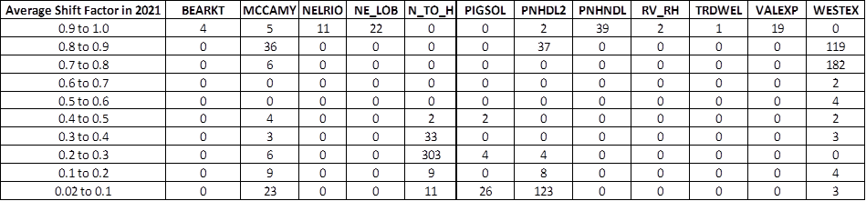
Resource Shift Factor Distribution per GTC
Number of IRRs, per GTC, per shift factor bin
Percentage of IRR MW*SF, per GTC, per shift factor threshold
Notes:
For this analysis, I used data from 01/01/2021 to 01/01/2022

Slide 6
Implementation Plan
Board Approved March 7, 2022
Implementation for Fall 2022
Start initially with Panhandle and possibly North Edinburg to Lobo GTCs
  Issue Market Notice prior to implementation
  Monitor Performance
  Report Back to CMWG
Enable other Closed Loop GTCs once comfortable
  Give prior notice via CMWG and Market Notice
  Enable NTE for one or two more GTCs
Enable Open Loop GTCs
  Give prior notice via CMWG and Market Notice
  Enable NTE for GTCs with sufficient shift factors

Slide 7
Performance Review
Report on NTE performance to CMWG on Periodic basis
  Focus on GTCs with NTE enabled
  Determine how well IRRs are performing or controlling Base Points
  How many additional MW’s are able to be exported

