Slide 1
ERCOT Post-Uri
The world has changed. ISO actions intended to ensure excess reserves, not avoidance of grid emergencies. Plan for the worst when operating the grid.
Conservative operations.
Increased operating reserves through ancillary service procurement.
Range of 2022 AS procurement: 5,500MW – 8,750MW.
Procure 1,000MW additional AS for high-risk periods.
RUC used to commit operating reserves in addition to AS procurements to provide excess margin above load forecast. Partially replaces normal market commitment.
RUC of long lead-time gas units front-runs market response (supply and demand).
“Worst case scenario” load and wind forecasts.
Prior assumptions used to establish offer floors and price adders are no longer valid.
$1,500 RUC floor adopted in 2014 as part of NPRR626, 2 months after ORDCv1.0 go-live.
Pricing outcomes still need to make sense despite the actions by ERCOT. How best to reflect the new world? What is a reasonable proxy for the market “but for” these actions?

Slide 2
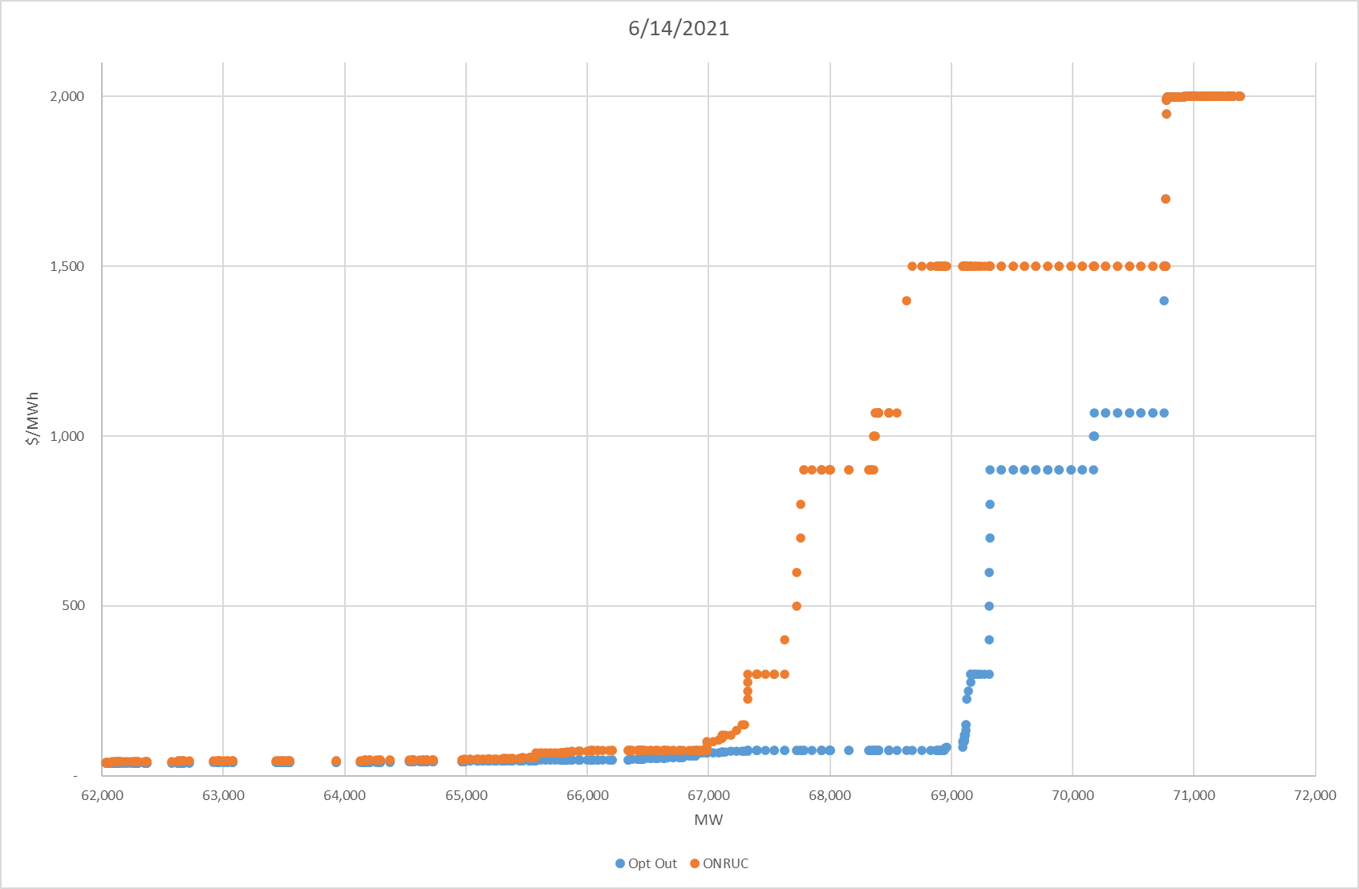
Aggregated Supply Curve
The $1,500 floor with the new use of RUC significantly alters the supply curve.
6 Generation Resources received RUC deployments during peak load hours.
1,400MW HSL – LSL Capacity
The market must price in the potential of both outcomes.
What is the value of the action?

Slide 3
RUC MWs vs. Reserves
33 Generation Resources received RUC deployments during this period
Some Generation Resources would have started on their own and/or other supply response would’ve happened
Market based offers (not $1500)
Not removed from ORDC or in RDPA
Some Generation Resources would not have started on their own
2/24/22 North Hub On Peak Average = $722
$1,500
$1,500
$1,500

Slide 4
RT Prices & Adders vs. Reserves
RUC MWs removed from ORDC
RUC LSL MWs in RDPA
EEA1

Slide 5
RT Prices & Adders vs. Reserves
RUC MWs removed from ORDC
RUC LSL MWs in RDPA
4 Generation Resources committed through RUC during this period
RUC LSL = 930MW
RUC HSL = 1,700MW
EEA1

Slide 6
Discussion
Net Result
More capacity online than would have occurred absent ERCOT’s actions.
Through AS (compensated) and RUC (“make-whole”, but not all costs recovered).
But in many instances, some portion of capacity would’ve self-committed and been reflected in SCED at much lower prices (no $1500 floor, not removed from ORDC, not in RDPA).
$1,500 RUC offer floor alters the supply stack beyond what is reasonable and no longer accurately reflects a proxy for the value of the action taken by ERCOT.
NPRR1092
ORDC will ensure prices reflect grid conditions. RDPA can overshoot with this amount of RUC.
In an efficient and competitive market, scarcity prices should only occur during scarcity. Modified ORDC will now ensure scarcity prices occur before scarcity. High offer floors not needed to contribute to scarcity pricing anymore.
RUC Resources will be dispatched near the end of the supply stack at $75.
Quick Start Generation Resource costs are not an appropriate proxy for RUC Resources used for excess reserves.
Need a RUC offer floor that is reflective of the actions being taken by ERCOT and puts units near the end of the stack. An offer floor much lower than $1,500 accomplishes these objectives.
How to appropriately price this new world?

