Slide 1
PDCWG Report to ROS
Chair: Jimmy Jackson, CPS Energy
Vice Chair: Vacant
ROS
March 03, 2022

Slide 2
Report Overview & Notes
Report Overview
Meeting Minutes
BAL-001-TRE-2 FMEs and IMFR
1 FME in the month of January
Frequency Control Report

Slide 3
Meeting Minutes
PDCWG Meeting 2/16/2022
Open Meeting
Update on RRS PFR Limit Study (GE)
High level review of 2 Non-FMEs in January
High level review of one FME in January
Reviewed ERCOT Reports
Frequency Control Metrics
Regulation Reports
Closed Meeting
Detailed review of FME on 1/26/2022 2:27:47

Slide 4
Frequency Measurable Events Performance

Slide 5
Frequency Measurable Events
There was 1 FME in January
1/26/2022 2:27:47
Loss of 814 MW generation
Interconnection Frequency Response: 1,131 MW/0.1 Hz
39 Resources were evaluated. These includes,
37 Generation Resources
2 Controllable Load Resources
0 Energy Storage Resources
0 of 37 Evaluated Generation Resources had less than 75% of their expected Initial Primary Frequency Response.
1 of 37 Evaluated Generation Resources had less than 75% of their expected Sustained Primary Frequency Response.

Slide 6
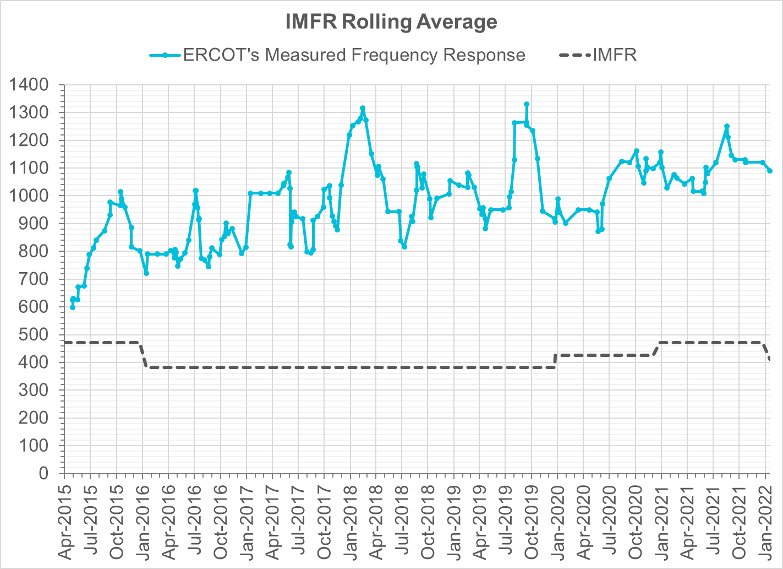
Interconnection Minimum Frequency Response (IMFR) Performance
IMFR Performance currently
1090.33 MW/0.1HZ
Frequency Response Obligation (FRO): 412 MW/0.1 Hz

Slide 7
Questions?

Slide 8
Frequency Control Report
January 2022

Slide 9
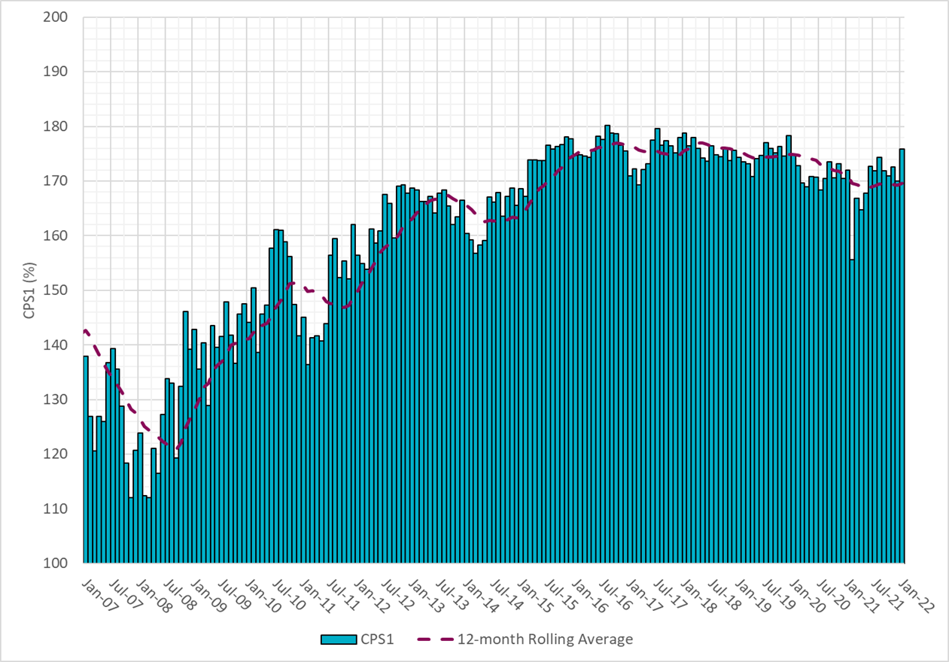
CPS1 Performance

Slide 10
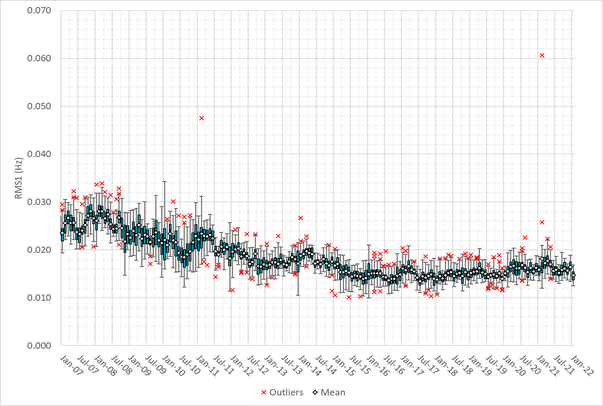
RMS1 Performance of ERCOT Frequency

Slide 11
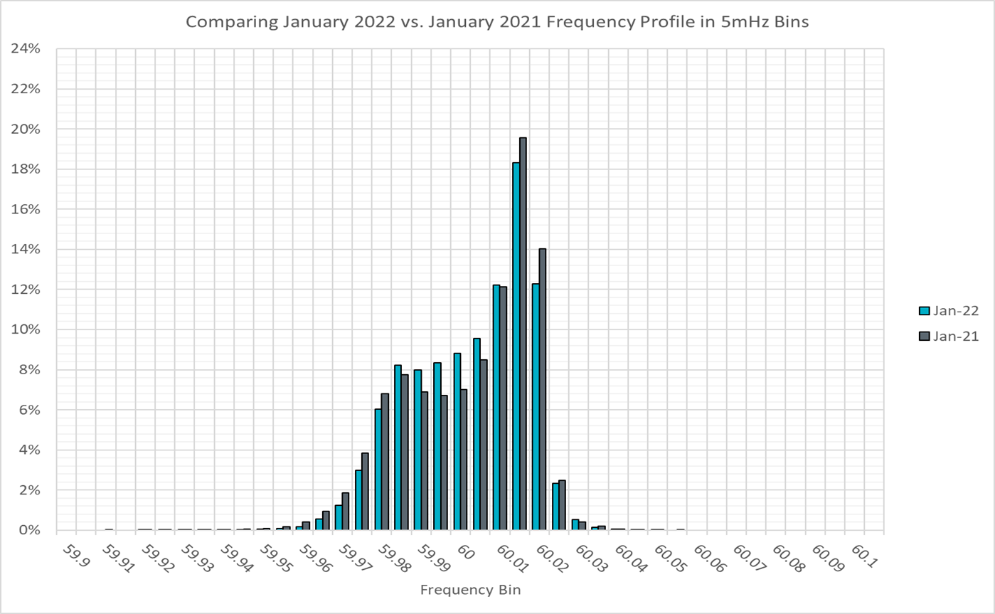
Frequency Profile Analysis

Slide 12
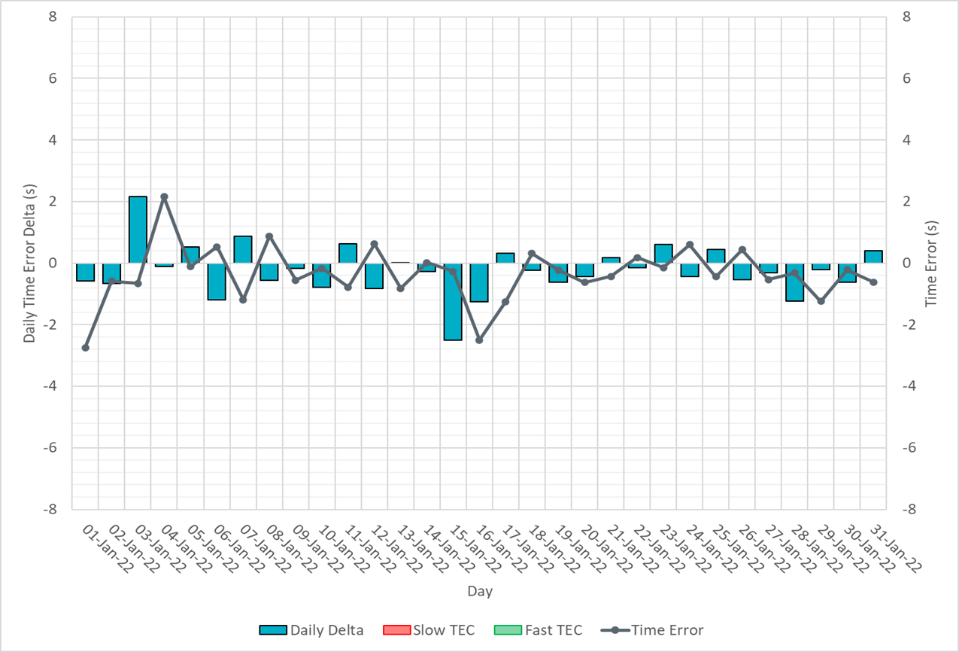
Time Error Corrections

Slide 13
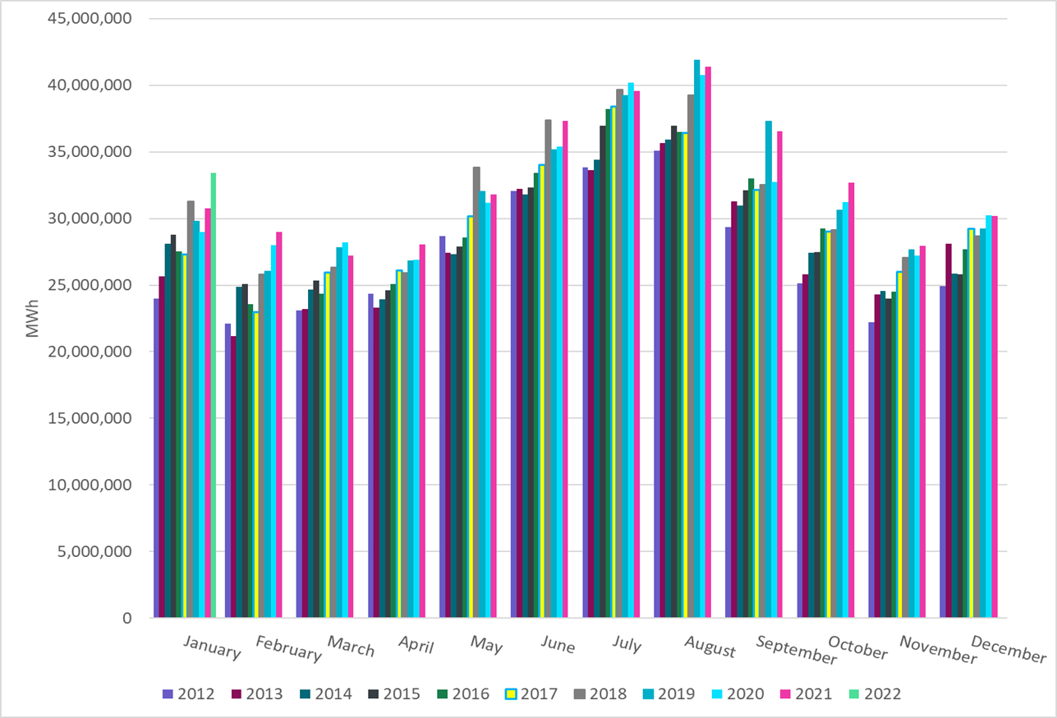
ERCOT Total Energy
Notes:
33,399,938 MWh

Slide 14
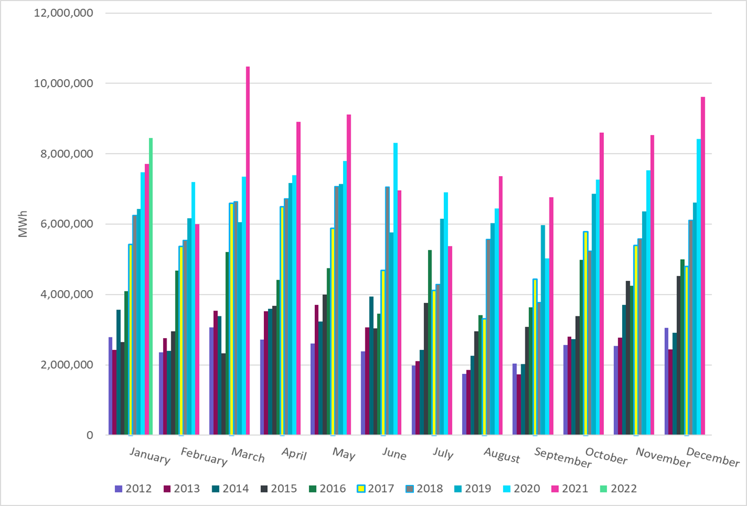
ERCOT Total Energy from Wind Generation
Notes:
8,448,159 MWh

Slide 15
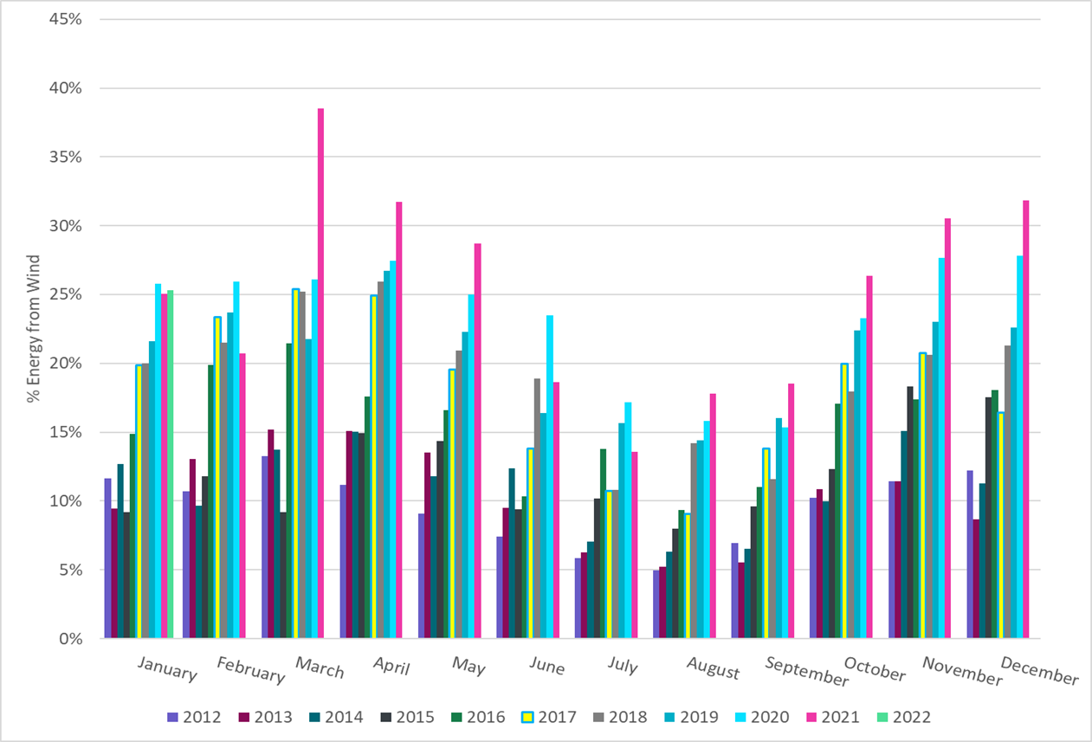
ERCOT % Energy from Wind Generation
Notes:
25.29 %

Slide 16
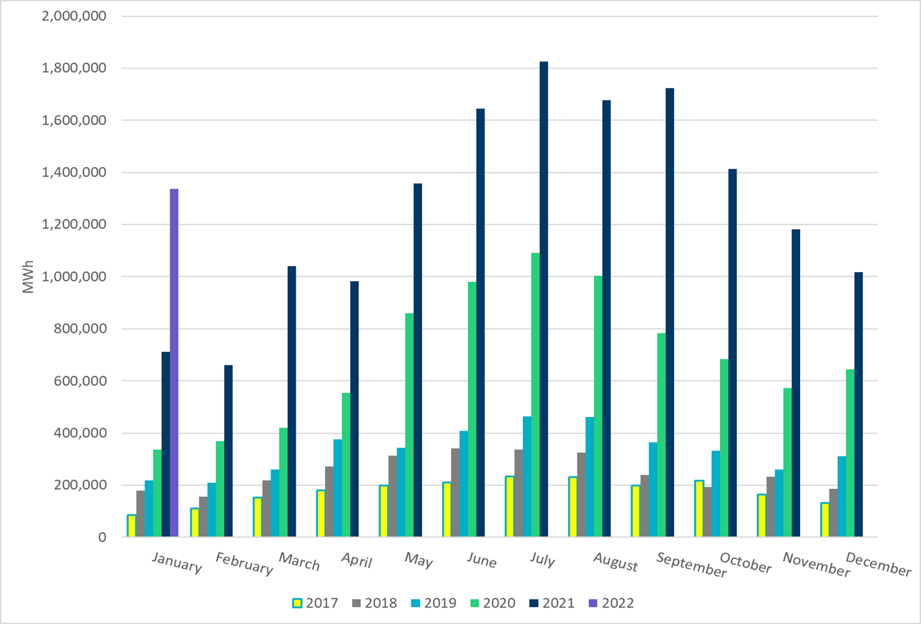
ERCOT Total Energy from Solar Generation
Notes:
1,335,908 MWh

Slide 17
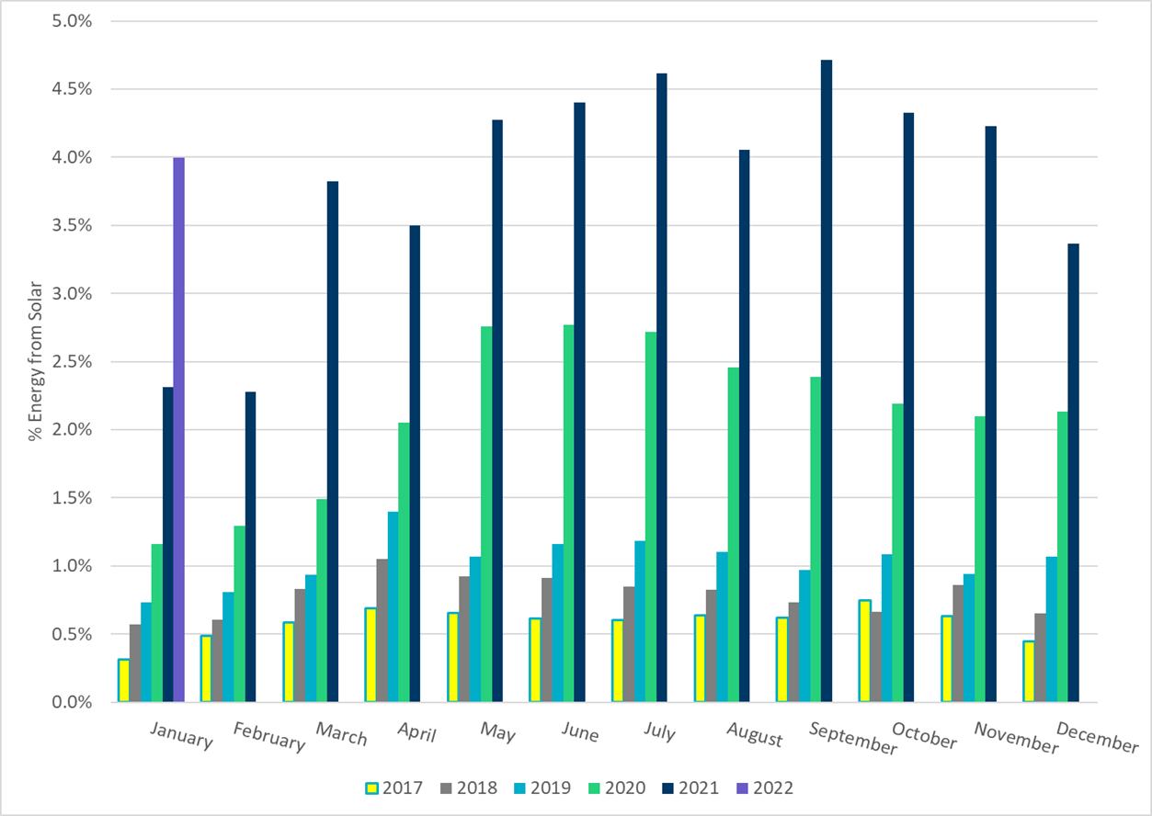
ERCOT % Energy from Solar Generation
Notes:
4.00 %

