Slide 1
Highlights: 2021 Analysis of REP and NOIE Demand Response
Carl L Raish
Principal Load Profiling and Modeling
Wholesale Market Subcommittee – March 2, 2022

Slide 2
Load Reductions by Category/System Level
HE 17:00 MW Reductions
Table Limited to days for which Total System DR > 1,500 MW
Total System DR: Amount of reduction with no double counting:
1. For an ESIID participating in more than one category
2. For a NOIE classified as responding to both price and 4CP

Slide 3
Load Reductions by Category/System Level
HE 17:00 MW Reductions
Table Limited to days for which Total System DR > 1,500 MW
Total System DR: Amount of reduction with no double counting:
1. For an ESIID participating in more than one category
2. For a NOIE classified as responding to both price and 4CP

Slide 4
ESIIDs/NOIEs by Category/System Level
HE 17:00 ESIIDs/NOIEs with Reductions
Table Limited to days for which Total System DR > 1,500 MW
Total System DR: Amount of ESIIDs/NOIEs with no double counting:
1. For an ESIID participating in more than one category
2. For a NOIE classified as responding to both price and 4CP

Slide 5
Responding ESIIDs and Reductions

Slide 6
Responding NOIEs and Reductions

Slide 7
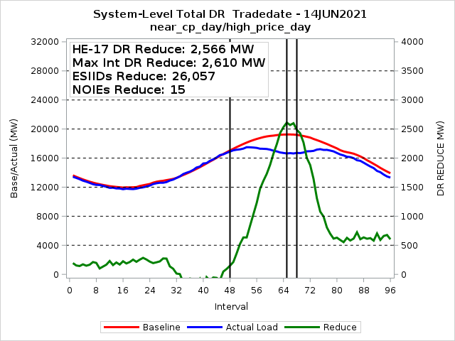
Total Competitive and NOIE Demand Response

Slide 8
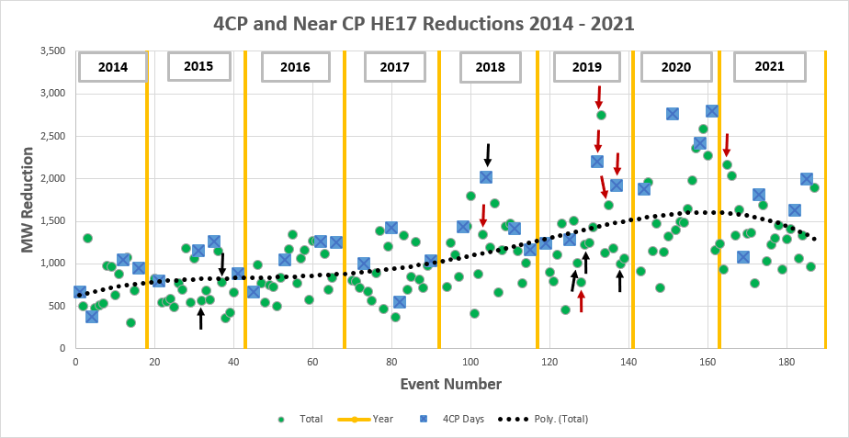
4CP Response Trend
Red Arrows: HE17 Price > $1,000 Black Arrows: HE17 Price > $500

Slide 9
4CP Response Trend

Slide 10
Residential PV – Competitive ERCOT
76 Reps with 1 or more PV ESIIDs
Reps have 73%
10 Reps have 90%
46 Reps have less than 100 PV ESIIDs
82 PV ESIIDs currently de-energized
13 ESIIDs with NIDR meter (active)

Slide 11
Residential PV – High 2021 PV Output Day
5.5 KW of PV output per ESIID

Slide 12
Questions?
ON
OFF
craish@ercot.com 512/248-3876

