Slide 1
2021 Analysis of REP and NOIE Demand Response
Carl L Raish
Principal Load Profiling and Modeling
Demand Side Working Group – February 28, 2021

Slide 2
Overview
  Summer 2021 Analysis Update
  Total System-level Demand Response
    Total ERCOT Demand Response
    Responding NOIE and ESIID counts
  Price Response and Retail DR Participation Trends
  DR/PR Category details
    4CP Response
    Real Time Pricing (IRT)
    Day-Ahead Pricing (IDA)
    NOIE Price Response
    Peak Rebate (PR)
    Other Direct Load Control (OLC)
    Time of Use (TOU)
    Free Days/Hours (FDH)
  Competitive Residential PV Analysis

Slide 3
Summer 2021 Analysis Update
  Eliminated days from baseline estimation
  Covid impacts - excluded February 1 – May 31, 2020 for all ESIIDs.
  Winter storm Uri – excluded February 1 -28, 2021 for all ESIIDs.
  Hurricane Hannah and Nicholas
    Identified specific ESIIDs in Coast and South Weather Zones with likely load impacts.
    Hannah – Jul 23 – Aug 29, 2020
    Nicholas – Sep 14 – 28, 2021

Slide 4
Total System-Level Demand Response

Slide 5
Load Reductions by Category/System Level
HE 17:00 MW Reductions
Table Limited to days for which Total System DR > 1,500 MW
Total System DR: Amount of reduction with no double counting:
1. For an ESIID participating in more than one category
2. For a NOIE classified as responding to both price and 4CP

Slide 6
ESIIDs/NOIEs by Category/System Level
HE 17:00 ESIIDs/NOIEs with Reductions
Table Limited to days for which Total System DR > 1,500 MW
Total System DR: Amount of ESIIDs/NOIEs with no double counting:
1. For an ESIID participating in more than one category
2. For a NOIE classified as responding to both price and 4CP

Slide 7
Responding ESIIDs and Reductions

Slide 8
Responding NOIEs and Reductions

Slide 9
Actual ERCOT Total Load
+
Total System DR
Summer 2021

Slide 10
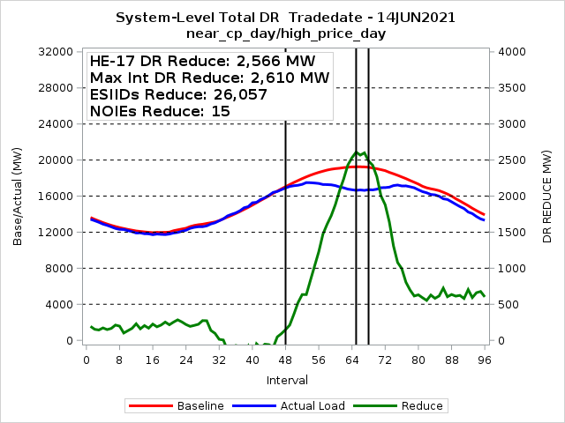
Total Competitive and NOIE Demand Response

Slide 11
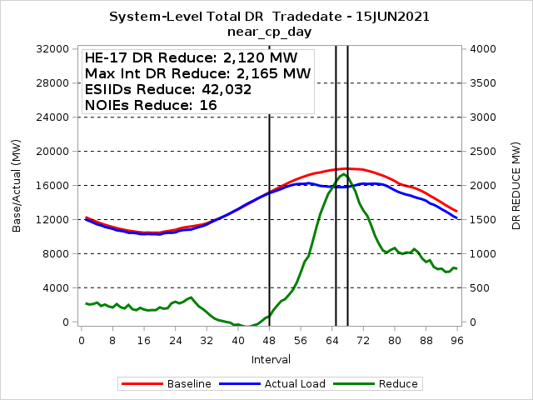
Total Competitive and NOIE Demand Response

Slide 12
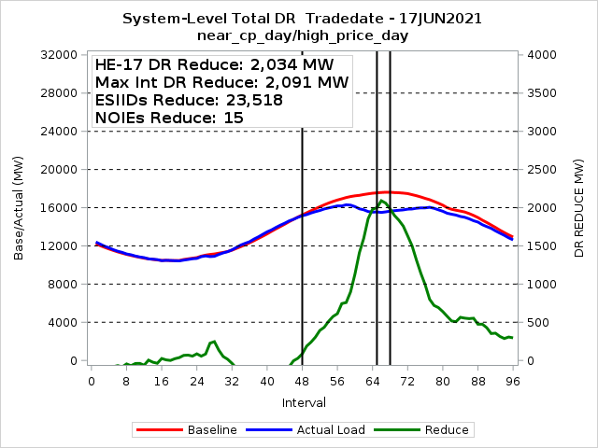
Total Competitive and NOIE Demand Response

Slide 13
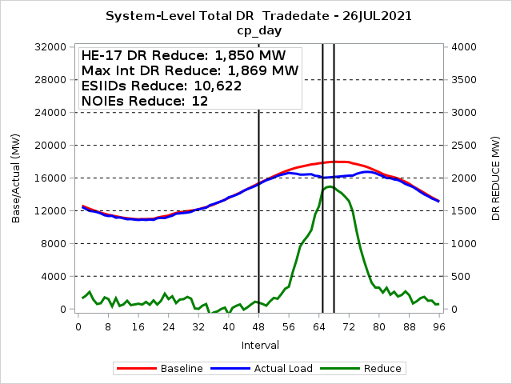
Total Competitive and NOIE Demand Response

Slide 14
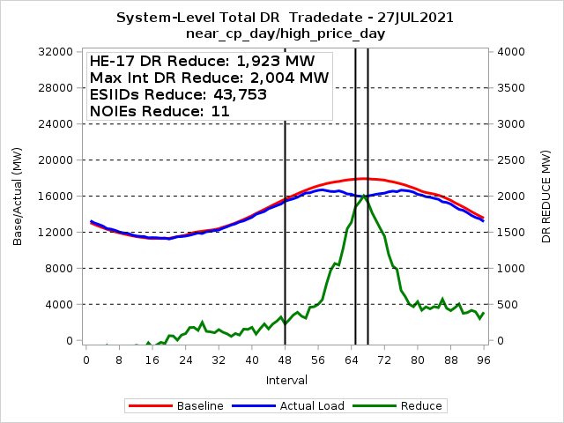
Total Competitive and NOIE Demand Response

Slide 15
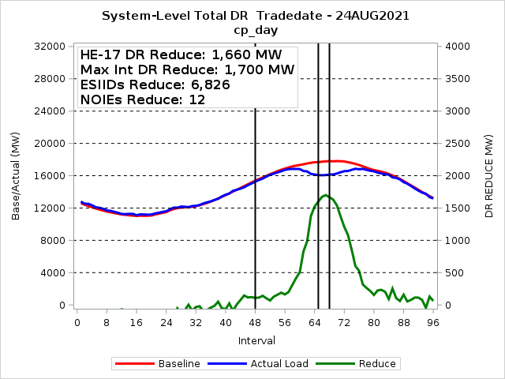
Total Competitive and NOIE Demand Response

Slide 16
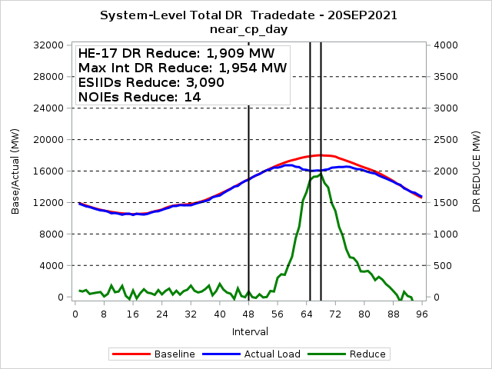
Total Competitive and NOIE Demand Response

Slide 17
Price Response and Retail DR Participation Trends

Slide 18
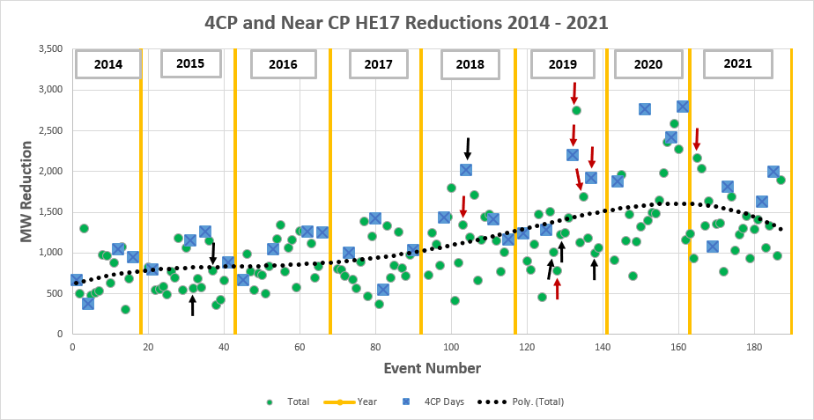
4CP Response Trend
Red Arrows: HE17 Price > $1,000 Black Arrows: HE17 Price > $500

Slide 19
4CP Response Trend

Slide 20
REP Demand Response Participation Trends

Slide 21
NOIE Demand Response Participation Trends

Slide 22
DR/PR Category Details

Slide 23
4CP Events 2021
4CP Days
NOIE 4CP Participation
Date | ESIIDs | NOIEs | HE 17 Reduce MW
23-Jun | 2,330 | 9 | 1,085
26-Jul | 3,361 | 12 | 1,833
24-Aug | 2,867 | 12 | 1,652
1-Sep | 3,924 | 14 | 2,018
 | Residential | Non-Residential
4CP Incentive | 0 | 217
4CP Advise/ Control | 71,120 | 1,329

Slide 24
4CP/NearCP Events 2021
NearCP Days
Date | ESIIDs | NOIEs | HE 17 Reduce MW
9-Jun | 3,207 | 10 | 1,183
10-Jun | 3,286 | 6 | 1,261
11-Jun | 3,303 | 6 | 946
14-Jun | 3,906 | 15 | 2,183
15-Jun | 3,396 | 16 | 2,052
16-Jun | 2,819 | 14 | 1,353
17-Jun | 3,255 | 15 | 1,658
24-Jun | 3,414 | 12 | 1,369
25-Jun | 4,184 | 14 | 1,391
23-Jul | 3,150 | 9 | 797
27-Jul | 3,302 | 11 | 1,711
Date | ESIIDs | NOIEs | HE 17 Reduce MW
29-Jul | 3,136 | 12 | 1,050
30-Jul | 3,899 | 9 | 1,252
9-Aug | 3,146 | 12 | 1,317
10-Aug | 3,153 | 13 | 1,473
11-Aug | 3,746 | 10 | 953
12-Aug | 3,071 | 13 | 1,305
23-Aug | 3,188 | 11 | 1,424
25-Aug | 2,949 | 7 | 1,085
31-Aug | 3,250 | 10 | 1,362
2-Sep | 4,221 | 7 | 985
20-Sep | 3,086 | 14 | 1,909

Slide 25
Indexed Real-Time High Price Events 2021
Date | ESIIDs | Max Reduce MW | Avg Reduce MW | Avg Price $/MWh
4-May | 33,966 | 452 | 418 | $533
14-Jun | 33,570 | 817 | 575 | $1,040
15-Jun | 6,580 | 18 | 6 | $314
17-Jun | 33,473 | 375 | 330 | $270
27-Jul | 30,916 | 525 | 445 | $389
29-Jul | 36,561 | 333 | 157 | $373
3-Aug | 34,187 | 62 | 47 | $281
19-Aug | 34,179 | 550 | 398 | $487
7-Sep | 6,263 | 21 | 17 | $328
20-Sep | 11,573 | 66 | 0 | $245

Slide 26
Indexed Day-Ahead High Price Events 2021
Date | ESIIDs | Max Reduce MW | Avg Reduce MW | Avg Price $/MWh
High DA Only
31-Aug | 41 | 2 | 0 | $263
High DA and RT
27-Jul | 46 | 6 | 2 | $394
High RT Only
3-Aug | 54 | 1 | 1 | $281

Slide 27
NOIE Price Response
Category | Residential | Non-Residential
Conservation Voltage Reduction | 639,805 | 53,676
Indexed Real-Time | 0 | 5
Other Direct Load Control | 191,286 | 3,528
Other | 344,787 | 1
Peak Rebate | 1,213 | 1,283
Time-of-Use | 1,872 | 1,223
Total (unique) | 864,843 | 49,391
NOIEs did report participation in IRT and also used other categories to respond to price.

Slide 28
NOIE High Price Events
Date | NOIEs | Max Reduce MW | Avg Reduce MW | Avg Price $/MWh
14-Jun | 12 | 684 | 417 | 1072
17-Jun | 13 | 781 | 761 | 268
7-Jul | 5 | 122 | 109 | 367
27-Jul | 9 | 587 | 374 | 350
29-Jul | 13 | 396 | 346 | 366
3-Aug | 5 | 32 | 17 | 281
19-Aug | 5 | 98 | 61 | 438

Slide 29
Direct Load Control Events
Date | ESIIDs | Max Reduce MW | Avg Reduce MW | Avg Price $/MWh
14-Jun | 10,355 | 15 | 11 | $1,028
17-Jun | 9,522 | 12 | 9 | $269
Many other summer events … most had relatively small aggregate reductions

Slide 30
Peak Rebate Events - 2021
Date | ESIIDs | Max Reduce MW | Avg Reduce MW | Avg Price $/MWh
15-Jun | 42,002 | 32 | 27 | -
16-Jun | 40,157 | 15 | 13 | -

Slide 31
Residential PV
In Competitive Area of ERCOT

Slide 32
Residential PV – Competitive ERCOT
76 Reps with 1 or more PV ESIIDs
Reps have 73%
10 Reps have 90%
46 Reps have less than 100 PV ESIIDs
82 PV ESIIDs currently de-energized
1 ESIID with NIDR meter (active)

Slide 33
Residential PV – Analysis Methodology
Find matching non-pv ESIIDs
  Same Weather Zone, Profile Type
  Stationcode, Zip Code
  Similar usage prior to PV installation
  Closest 5 with greater use and closest 5 with lower use
  Baseline load for non-match Esiids profiled based on ESIIDs in same Weather Zone
Baseline load for PV ESIIDs is average of the load for the matching ESIIDs
PV output = Export + Load Offset (Baseline – Actual Load)
  Export and Actual metered interval data
  Baseline from matching ESIIDs
Excluded ESIIDs (~3,200) with obvious non-pv export
  Further analysis being considered
  Possible recommendation to PWG for Profile Validation

Slide 34
Residential PV – High 2021 PV Output Day
5.5 KW of PV output per ESIID

Slide 35
Residential PV – Month High PV Output

Slide 36
Residential PV – ERCOT Monthly Peak

Slide 37
Residential PV Analysis – Next Steps
Investigate ESIIDs with Non-PV Export.
  Possible recommendation to PWG on profile type validation based on export pattern.
Run analysis for prior years to quantify growth in PV output.
Look at PV output by vintage … output of newer vs older installs.
Investigate whether there is an increase in PV native load consumption based on low/zero cost of energy.
Add a solar buy-back category to annual DR Survey … does buy-back affect load/export patterns? … RMS feedback requested.

Slide 38
Questions?
ON
OFF
craish@ercot.com 512/248-3876

