Slide 1
2021 Analysis of REP and NOIE Demand Response
Carl L Raish
Principal Load Profiling and Modeling
Wholesale Market Subcommittee – March 2, 2022

Slide 2
Overview
  Summer 2021 Analysis Update
  Total System-level Demand Response
    Total ERCOT Demand Response
    Responding NOIE and ESIID counts
  4CP Participation Trends
  DR/PR Events
  Competitive Residential PV Analysis

Slide 3
Total System-Level Demand Response

Slide 4
Load Reductions by Category/System Level
HE 17:00 MW Reductions
Table Limited to days for which Total System DR > 1,500 MW
Total System DR: Amount of reduction with no double counting:
1. For an ESIID participating in more than one category
2. For a NOIE classified as responding to both price and 4CP

Slide 5
ESIIDs/NOIEs by Category/System Level
HE 17:00 ESIIDs/NOIEs with Reductions
Table Limited to days for which Total System DR > 1,500 MW
Total System DR: Amount of ESIIDs/NOIEs with no double counting:
1. For an ESIID participating in more than one category
2. For a NOIE classified as responding to both price and 4CP

Slide 6
Responding ESIIDs and Reductions

Slide 7
Responding NOIEs and Reductions

Slide 8
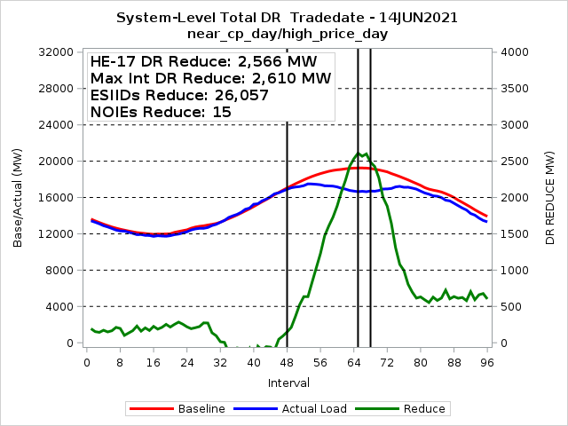
Total Competitive and NOIE Demand Response

Slide 9
Price Response and Retail DR Participation Trends

Slide 10
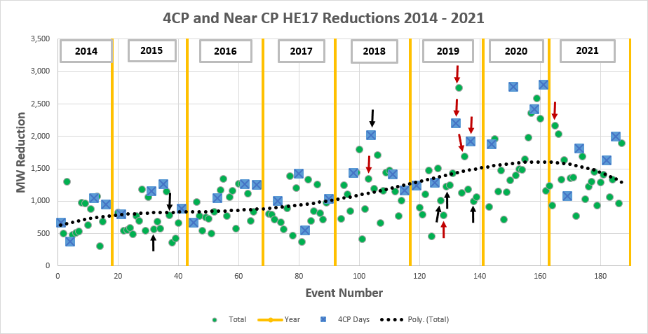
4CP Response Trend
Red Arrows: HE17 Price > $1,000 Black Arrows: HE17 Price > $500

Slide 11
4CP Response Trend

Slide 12
DR/PR Events

Slide 13
4CP Events 2021
4CP Days
NOIE 4CP Participation
Date | ESIIDs | NOIEs | HE 17 Reduce MW
23-Jun | 3,150 | 6 | 1,085
26-Jul | 3,361 | 12 | 1,833
24-Aug | 2,867 | 12 | 1,652
1-Sep | 3,924 | 14 | 2,018
 | Residential | Non-Residential
4CP Incentive | 0 | 217
4CP Advise/ Control | 71,120 | 1,329

Slide 14
4CP/NearCP Events 2021
NearCP Days
Date | ESIIDs | NOIEs | HE 17 Reduce MW
9-Jun | 3,207 | 10 | 1,183
10-Jun | 3,286 | 6 | 1,261
11-Jun | 3,303 | 6 | 946
14-Jun | 3,906 | 15 | 2,183
15-Jun | 3,396 | 16 | 2,052
16-Jun | 2,819 | 14 | 1,353
17-Jun | 3,255 | 15 | 1,658
24-Jun | 3,414 | 12 | 1,369
25-Jun | 4,184 | 14 | 1,391
23-Jul | 3,150 | 9 | 797
27-Jul | 3,302 | 11 | 1,711
Date | ESIIDs | NOIEs | HE 17 Reduce MW
29-Jul | 3,136 | 12 | 1,050
30-Jul | 3,899 | 9 | 1,252
9-Aug | 3,146 | 12 | 1,317
10-Aug | 3,153 | 13 | 1,473
11-Aug | 3,746 | 10 | 953
12-Aug | 3,071 | 13 | 1,305
23-Aug | 3,188 | 11 | 1,424
25-Aug | 2,949 | 7 | 1,085
31-Aug | 3,250 | 10 | 1,362
2-Sep | 4,221 | 7 | 985
20-Sep | 3,086 | 14 | 1,909

Slide 15
Indexed Real-Time High Price Events 2021
Date | ESIIDs | Max Reduce MW | Avg Reduce MW | Avg Price $/MWh
4-May | 33,966 | 452 | 418 | $533
14-Jun | 33,570 | 817 | 575 | $1,040
15-Jun | 6,580 | 18 | 6 | $314
17-Jun | 33,473 | 375 | 330 | $270
27-Jul | 30,916 | 525 | 445 | $389
29-Jul | 36,561 | 333 | 157 | $373
3-Aug | 34,187 | 62 | 47 | $281
19-Aug | 34,179 | 550 | 398 | $487
7-Sep | 6,263 | 21 | 17 | $328
20-Sep | 11,573 | 66 | 0 | $245

Slide 16
Indexed Day-Ahead High Price Events 2021
Date | ESIIDs | Max Reduce MW | Avg Reduce MW | Avg Price $/MWh
High DA Only
31-Aug | 41 | 2 | 0 | $263
High DA and RT
27-Jul | 46 | 6 | 2 | $394
High RT Only
3-Aug | 54 | 1 | 1 | $281

Slide 17
NOIE Price Response
Category | Residential | Non-Residential
Conservation Voltage Reduction | 639,805 | 53,676
Indexed Real-Time | 0 | 5
Other Direct Load Control | 191,286 | 3,528
Other | 344,787 | 1
Peak Rebate | 1,213 | 1,283
Time-of-Use | 1,872 | 1,223
Total (unique) | 864,843 | 49,391
NOIEs did report participation in IRT and also used other categories to respond to price.

Slide 18
NOIE High Price Events
Date | NOIEs | Max Reduce MW | Avg Reduce MW | Avg Price $/MWh
14-Jun | 12 | 684 | 417 | 1072
17-Jun | 13 | 781 | 761 | 268
7-Jul | 5 | 122 | 109 | 367
27-Jul | 9 | 587 | 374 | 350
29-Jul | 13 | 396 | 346 | 366
3-Aug | 5 | 32 | 17 | 281
19-Aug | 5 | 98 | 61 | 438

Slide 19
Direct Load Control Events
Date | ESIIDs | Max Reduce MW | Avg Reduce MW | Avg Price $/MWh
14-Jun | 10,355 | 15 | 11 | $1,028
17-Jun | 9,522 | 12 | 9 | $269
Many other summer events … most had relatively small aggregate reductions

Slide 20
Peak Rebate Events - 2021
Date | ESIIDs | Max Reduce MW | Avg Reduce MW | Avg Price $/MWh
15-Jun | 42,002 | 32 | 27 | -
16-Jun | 40,157 | 15 | 13 | -

Slide 21
Residential PV
In Competitive Area of ERCOT

Slide 22
Residential PV – Competitive ERCOT
76 Reps with 1 or more PV ESIIDs
Reps have 73%
10 Reps have 90%
46 Reps have less than 100 PV ESIIDs
82 PV ESIIDs currently de-energized
13 ESIIDs with NIDR meter (active)

Slide 23
Residential PV – Analysis Methodology
Find matching non-pv ESIIDs
  Same Weather Zone, Profile Type
  Stationcode, Zip Code
  Similar usage prior to PV installation
  Closest 5 with greater use and closest 5 with lower use
  Baseline load for non-match Esiids profiled based on ESIIDs in same Weather Zone
Baseline load for PV ESIIDs is average of the load for the matching ESIIDs
PV output = Export + Load Offset (Baseline – Actual Load)
  Export and Actual metered interval data
  Baseline from matching ESIIDs
Excluded ESIIDs (~3,200) with obvious non-pv export
  Further analysis being considered
  Possible recommendation to PWG for Profile Validation

Slide 24
Residential PV – High 2021 PV Output Day
5.5 KW of PV output per ESIID

Slide 25
Residential PV – Month High PV Output

Slide 26
Residential PV – ERCOT Monthly Peak

Slide 27
Residential PV Analysis – Next Steps
Investigate ESIIDs with Non-PV Export.
  Possible recommendation to PWG on profile type validation based on export pattern.
Run analysis for prior years to quantify growth in PV output.
Look at PV output by vintage … output of newer vs older installs.
Investigate whether there is an increase in PV native load consumption based on low/zero cost of energy.
Add a solar buy-back category to annual DR Survey … does buy-back affect load/export patterns? … RMS feedback requested.

Slide 28
Questions?
ON
OFF
craish@ercot.com 512/248-3876

