Slide 1
ERCOT Retail Market Training Task Force
UPDATE TO RMS
Tuesday, March 1st, 2022

Slide 2
RMTTF ACTIVITIES
ERCOT Retail 101 Training, January 27 Session:
45 attendees, 20 provided feedback (very positive)
TX SET WBT Module Development:
progressing
goal is a Q2 launch
RETAIL 2022 TENTATIVE TRAINING PLAN
Retail 101 – April/May timeframe – WebEx
MarkeTrak & IAG – late June, again in Oct/Nov – WebEx
TXSET – in person ILT – Q3??
MarkeTrak Upgrade/Tech Refresh – mid to late May – WebEx only

Slide 3
Upcoming Retail Training
Marketrak, Inadvertent Gain Training
2 Half day training sessions WebEx only
Date: Class: Start Time:
Wednesday, March 2, 2022 MT – Part 1 8:30 AM
Thursday, March 3, 2022 MT&IAG – Part 2 8:30 AM

Slide 4
On-line ERCOT Retail Training Modules Available
MarkeTrak Series
Marketrak Overview
Switch Hold Removal
Cancel With/Without Approvals
Inadvertent Gains/Losses & Rescissions
Usage and Billing
Other D2D Subtypes
Bulk Insert
MarkeTrak Admin Functionality
Data Extract Variances (DEV) LSE Subtypes
Data Extract Variances (DEV) Non-LSE Subtypes
Emails and Notifications
Reporting – Background & GUI
Retail 101
Mass Transition
MarkeTrak modules to be updated reflecting tech refresh changes (new screenshots) by June 2022 prior to GO LIVE

Slide 5
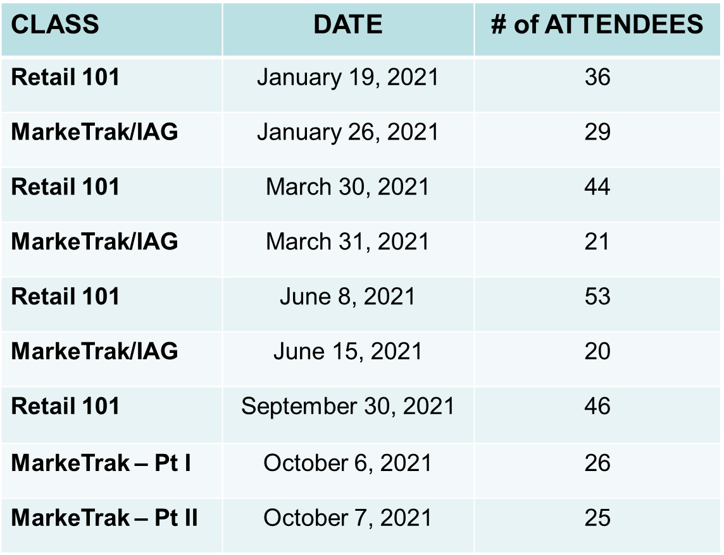
Accomplishments for 2021
 | 2021 Accomplishments
1. | Facilitated the following Instructor-led Courses educating a total of 300 market participants:
2. | MarkeTrak on-line modules – 174 Total Participants in 2021 ( 1360 all time) Retail 101 on-line module – 398 Total Participants in 2021 ( 1522 all time) Mass Transition on-line module - 67 Total Participants in 2021 ( 74 all time )

Slide 6
Accomplishments for 2021 – cont.
 | 2021 Accomplishments - cont.
3. | Continued developing TXSET 101 training materials for WebEx training only
4. | Support ERCOT market notifications and communications for training efforts
5. | Verified content and modified Additional Day to Day Subtypes (Siebel Change, Projects, Other) MarkeTrak on-line training modules to align with market revisions as needed
6. | Modified ILT training materials based on feedback as warranted – MarkeTrak & IGL/SH classes
7. | Modified training materials to maintain consistency with Retail market changes (i.e. Emergency Conditions list directing Mass Transition training clarity)
8. | Collaborated with RMS working groups by providing input when updating market documentation (i.e. user guides, process flows), particularly TDTMS

Slide 7
Goals for 2022
 | 2022 Goals
1. | Facilitate Retail 101 training classes by providing SME support for ERCOT led instruction. Classes to be offered at least three times a year and aligned with TXSET Flight schedule.
2. | Conduct MarkeTrak and IGL/Switch Hold instructor led training. Classes to be offered as needed.
3. | Remain flexible and continue to monitor ERCOT and market participant COVID guidelines to determine when in person classes may resume. May pivot Retail 101, MarkeTrak/IGL/SH, and TXSET 101 offerings mid 2022.
4. | Finalize TXSET 101 on-line module for 24x7 Web-based training by mid 2022
5. | Support ERCOT market notifications and communications for training efforts
6. | Support ERCOT training for MarkeTrak technical refresh scheduled to GO LIVE early June 2022. Conduct training workshops on relevant changes.

Slide 8
Goals for 2022 – cont.
 | 2022 Goals – cont.
7. | Support ERCOT training for SCR 815 MarkeTrak Enhancements scheduled for a December 2022 release. Conduct training workshops on relevant changes.
8. | Modify training materials to maintain consistency with Retail market changes: MarkeTrak on-line training modules to align with the technical refresh and SCR 815 MarkeTrak Enhancements utilizing the revised MarkeTrak User’s Guide as a reference.
9. | Review feedback (survey results) from all training sessions and modify training materials as warranted.
10. | Collaborate with RMS working groups in providing input when updating market documentation (i.e. user guides, process flows)
11. | Support enhancements for ERCOT’s Learning Management System if applicable

Slide 9
Retail Market Training - Registration
Registration is required for ERCOT Instructor Led and ERCOT Web Based Training (WBT) sessions.
To complete registration, please follow the process below.
Access the ERCOT Training Website through the following link http://www.ercot.com/services/training/
Click ‘Course Catalog’
Click your selected course
Click ‘Schedule/Registration’
Click ‘Sign Up’
Log in (or create a log in) to register for the course.
Look for an email from ERCOT confirming registration for the course.
Note! Online modules are able to be completed in approximately 30 minutes or less.

Slide 10
Upcoming RMTTF Meeting
Thursday, April 7th, 2022
9:30 AM
Primary Topics:
TX SET Training Module – Review
Retail Training Plan 2022

