Slide 1
TDTMS Update
RMS
March 1st, 2022

Slide 2
TDTMS
Update
RMGRR166 – Revised Timing for Switch Hold Extract Availability – Approved by TAC & PUCT – effective 3/1/22 NOTE: Oncor’s SH files have been available by 5 AM in late January
SCR 817 – MarkeTrak Validation Revisions aligning with TXSET 5.0 – Approved by TAC, onto Board and PUCT for approval
ERCOT System Instances & MarkeTrak Monthly Performance Review – no major instances and performance remains good
Review of monthly ERCOT IAG Report (October 2021):
Overall % of IAGs to transaction volumes has increased for 2021
Fewer REPs with repeated “#12s” on overall IAG percentages indicating some REPs are improving performance
Increasing # of overall IALs – shift has been made IALs>IAGs
Seeing improvement in repeat offender Rescission %

Slide 3
TDTMS
MarkeTrak Upgrade
Application is currently undergoing testing
Side by side comparisons available early March and will be reviewed at next TDTMS meeting 3/24
TDTMS will be promoting tech refresh at upcoming MarkeTrak training on 3/2 & 3/3 encouraging utilization of RMTE to become familiar with the new look and feel
MT refresh will be available around mid-May
Training sessions conducted near end of May for market participants
GO LIVE June 4th 2022

Slide 4
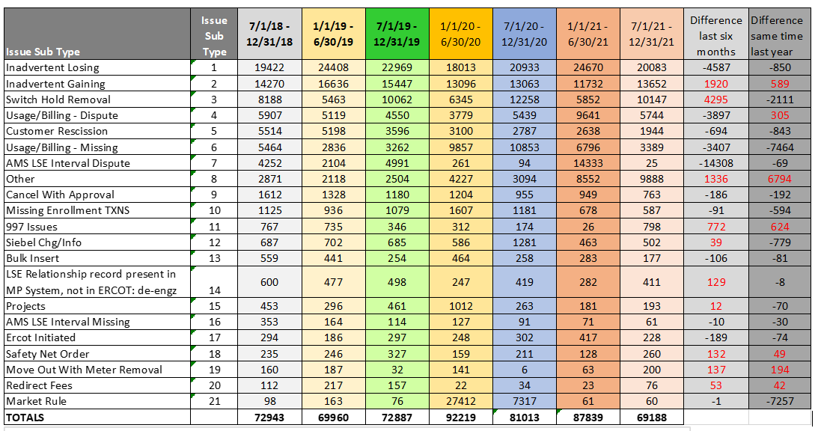
TDTMS
Biannual MarkeTrak Subtype Analysis

Slide 5
TDTMS
Biannual MarkeTrak Subtype Analysis - continued
IALs have dropped in the last six months and are lower than same time last year
IAGs have increased, yet not as much as IALs have decreased
Switch Hold Removals up significantly ~2x likely due to hold over of DPPs due to Covid/Winter Storm Uri
Other bucket much higher in all of 2021 likely due to Oncor’s transition of IDR to AMS profile efforts (~5500-6000 ESIs)
997s ~1.5x higher in 2021 – further analysis revealed activity of one TDSP and associated with REP changes and receipt of 810s
ERCOT Initiated primarily related to special character issues – good to see trending downward
Safety Nets have more than doubled – evaluated ~260 MTs –only two TDSPs utilize notification and ~40% went to one REP – reminder of PUCT Sub Rule 25.287 requires transaction to be sent on or before the 5th business day following the submittal of the safety net
MVOs w/ Meter Removal also more than doubled – evaluated ~200 MTs – only one TDSP utilizing notification – potentially associated with ‘clean up’ effort from Hurricane Nicholas with a spike in MTs late Aug-Sept timeframe.

Slide 6
TDTMS
 | 2021 Accomplishments
1. | Supported Texas data transport improvement initiatives and continuous joint efforts with other retail market working groups TXSET Supported development of an IAG solution for consideration of TXSET v5.0 enhancements, SCR817 MarkeTrak Validation Revisions Supported inclusion of ERCOT MIS API functionality in NPRR1095 TXSET v5.0 Changes and RMGRR169, TXSET v5.0 Changes RECTF Assisted in establishing SLAs and guidance for “breakglass” procedures for ERCOT Listserv communication platform RMTTF Provided continued support of market education opportunities as discovered in the MarkeTrak subtype analyses
2. | Reviewed biannual overall MarkeTrak subtype volumes, discussed trends, and applied results to support MarkeTrak enhancements SCRs 815 & 817

Slide 7
TDTMS
 | 2021 Accomplishments - continued
3. | Submitted two SCRs for proposed Marketrak enhancements Sorted the list of enhancements by administrative vs validation revisions SCR815, administrative suggestions to be managed via MarkeTrak technical refresh Expanded common Unexecutable reasons for various subtypes SCR817, validation suggestions requiring more coding/logic and aligned with TXSET 5.0 NPRR1095 and RMGRR169
4. | Unexecutable IAG/IAL Subtype Deep Dive Analysis – utilized the IAG MarkeTrak Performance Metrics framework evaluating 1553 Unexecuted IAG and IAL MarkeTraks to identify timelines for the first four steps in the IAG/IAL Marketrak process.
5. | Support of ERCOT’s extended release window in May – preparation, establish workarounds to ensure market operations during cutover, communication, post implementation discussion

Slide 8
TDTMS
 | 2021 Accomplishments - continued
6. | Reviewed current switch hold notification market process (by TDU) and pivoted from a suggestion for new secure repository in ERCOT MIS to an RMGRR modifying the timelines for Switch Hold extract information to made available to market participants – RMGRR166, Revised Timing for Switch Hold Extract Availability
7. | Improved the Switch Hold Removal process in creating RMGRR167 to ensure language in the RMG provides additional clarity in documents required for the removal of a switch hold
8. | “Cleaned up” the Market Metric page and PUCT links on ercot.com as instructed by RMS
9. | Reviewed and monitored monthly IT retail incident and service availability
10. | Approved the Retail Market Services Service Level Agreements for 2022 for endorsement to RMS including new Listserv SLAs

Slide 9
TDTMS
 | 2022 Goals
1. | Support Texas data transport improvement initiatives and continue joint efforts with other retail market working groups Collaborative with the Retail Market Training Task Force on operational issues in educating the market and support for the scheduled MarkeTrak Upgrade Continued support of TXSET 5.0 IAG solution for any development requirements Quarterly review of monthly ERCOT IAG report
2. | Support/monitor/promote ERCOT’s efforts in the MarkeTrak Technical Refresh and SCR815 MarkeTrak Enhancements, i.e. encouraging RMTE participation
3. | Perform biannual review of overall MarkeTrak subtype volumes for trends and the need for further analysis of various subtypes based on data points established
4. | Perform IAG data analysis using framework established in 2020 to identify metrics/trends for market participants performance using ERCOT provided data

Slide 10
TDTMS
 | 2022 Goals - continued
5. | Use MT data analysis results to review expected Service Level Agreements to improve performance and streamline processes
6. | Perform monthly review of the Retail Market Services and Market Data Transparency Service Level Agreements (SLAs), and work with ERCOT to evaluate and implement any potential changes, as needed
7. | Review the quarterly ERCOT Retail Market Performance Measures if needed
8. | Support ERCOT resolution efforts in addressing each outage and/or degradation of service

Slide 11
TDTMS
Next Meeting – March 24th , Thursday @ 9:30 AM WebEx
On the Agenda:
MarkeTrak Upgrade status
Review of Side-by-Side comparisons of MarkeTrak Tech Refresh
System instances and MarkeTrak Monthly Performance Review

