Slide 1
Monthly Review of Reliability Unit Commitment Market Impacts
January 1 to February 15, 2022
Zhengguo Chu
Supervisor, Market Analysis
WMWG
February 24, 2022
ERCOT Public

Slide 2
RUC Resource-Hours
 | January 2022 |  |  | February 1-15, 2022
 | Total | Opt-Out | Non-Opt-Out | Total | Opt-Out | Non-Opt-Out
Instructed Resource-hours | 114.0 | 26.0 | 88.0 | 380.0 | 4.0 | 376.0
Effective Resource-hours* | 105.8 | 26.0 | 79.8 | 377.5 | 4.0 | 373.5
Average LSL | 128.0 | 208.8 | 102.5 | 122.2 | 289.3 | 120.4
Average LDL | 132.0 | 220.0 | 104.1 | 124.4 | 563.5 | 119.8
Average BP | 137.8 | 241.2 | 105.1 | 124.9 | 598.6 | 119.8
Average HSL | 386.9 | 353.9 | 397.3 | 313.4 | 611.6 | 310.2
* The difference between “Instructed” and “Effective” values is a result of Resources starting up, shutting down, receiving partial hour instructions, or otherwise not being dispatchable by SCED.

Slide 3
RUC Instruction Reasons
January 2022
105.8 effective RUC Resource-hours, 100% for capacity concerns.
  26.0 effective Resource-hours (24.6%) were successfully bought back.
February 1-15, 2022
377.5 effective RUC Resource-hours, 100% for capacity concerns.
  4.0 effective Resource-hours (1.1%) were successfully bought back.

Slide 4
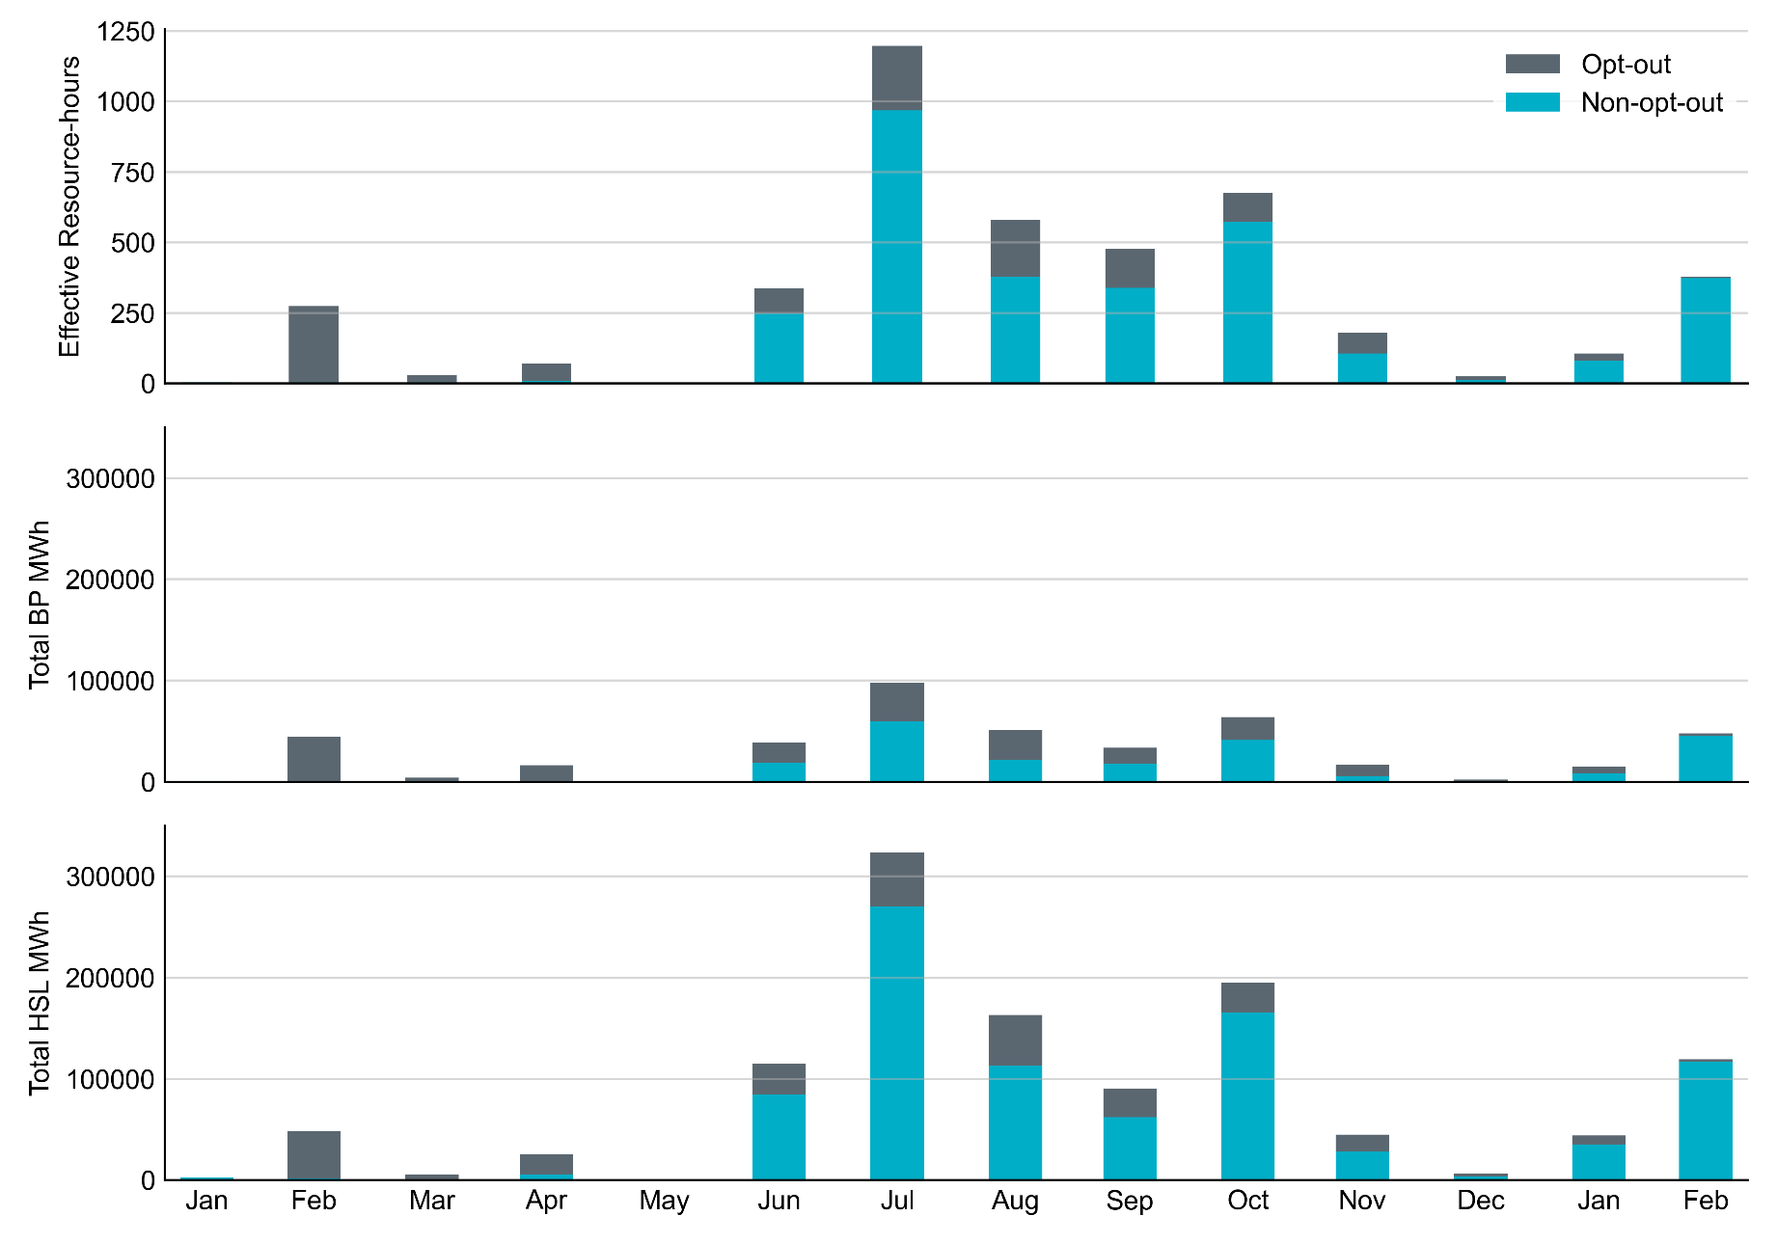
Non-opt-out and Opt-out Totals: Last 13 Months
February data includes February 1-15 only.

Slide 5
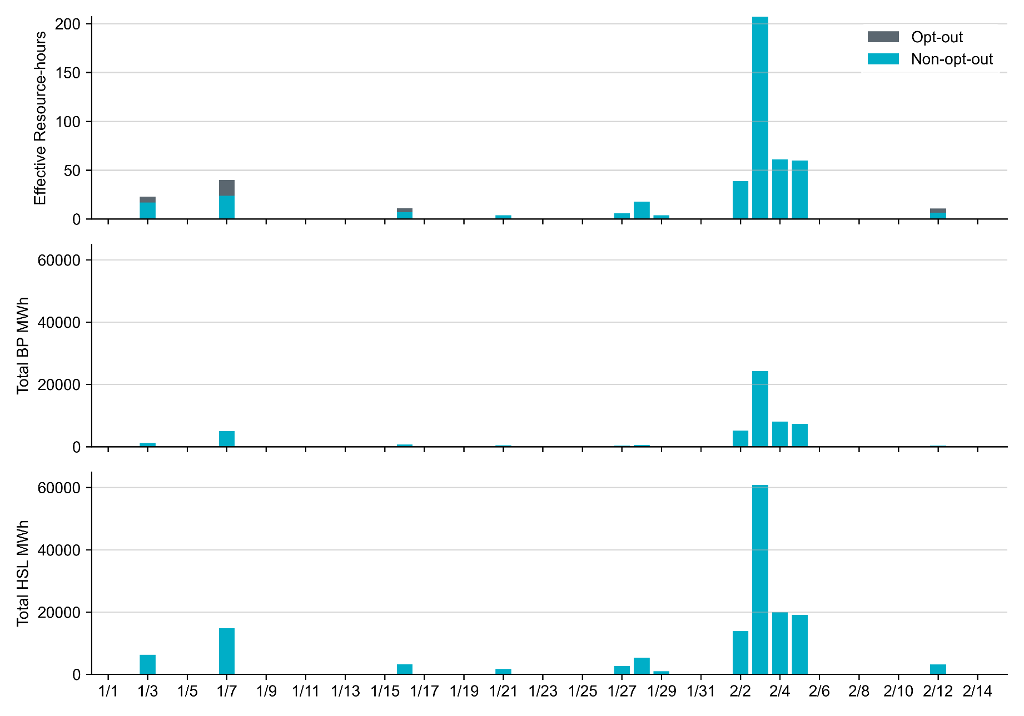
Non-opt-out and Opt-out Totals: January 1 – February 15

Slide 6
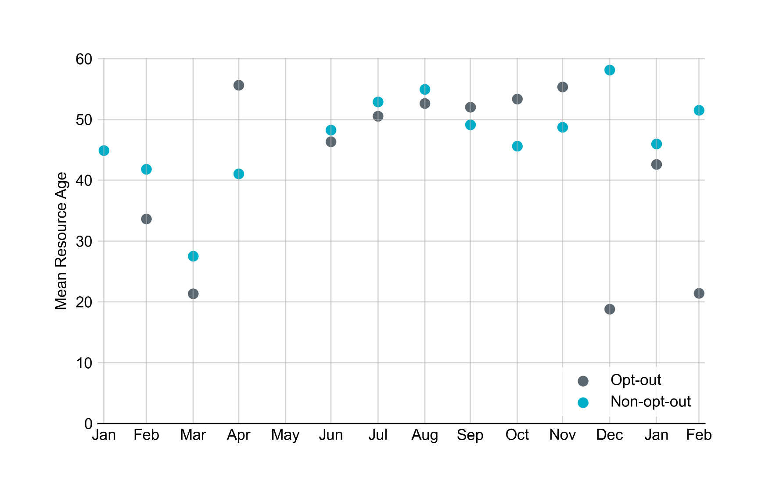
Average Resource Age
Note: For Resource configurations with multiple physical generators, the age of the oldest generator is used.
February data includes February 1-15 only.

Slide 7
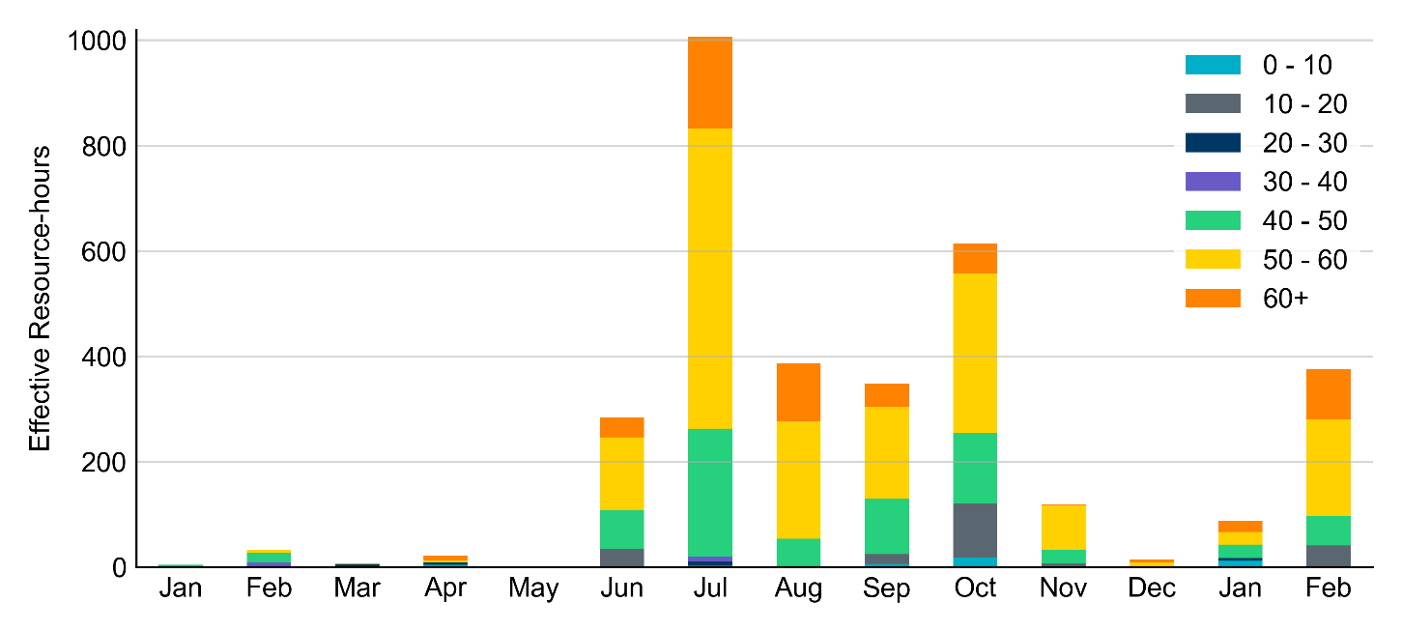
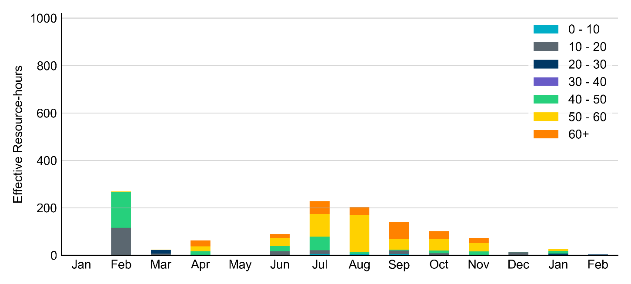
Age Category
Non-opt-out
Opt-out
February data includes February 1-15 only.

Slide 8
RUC-Instructed Resource Dispatch above LDL
January 2022
When Resources did not successfully opt out, there were 1.8 effective Resource-hours for which the Resource was dispatched above its LDL.
  For all these Resource-hours, the RUC-instructed Resource was mitigated.
February 2022
When Resources did not successfully opt out, there were 0.3 effective Resource-hours for which the Resource was dispatched above its LDL.
  For all these Resource-hours, the RUC-instructed Resource was mitigated.

Slide 9
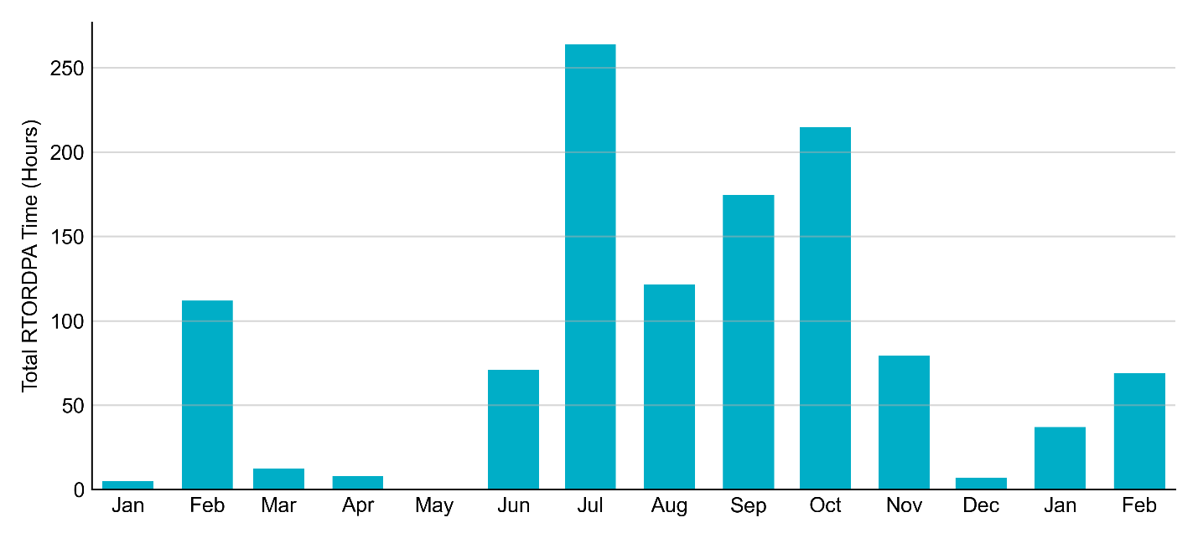
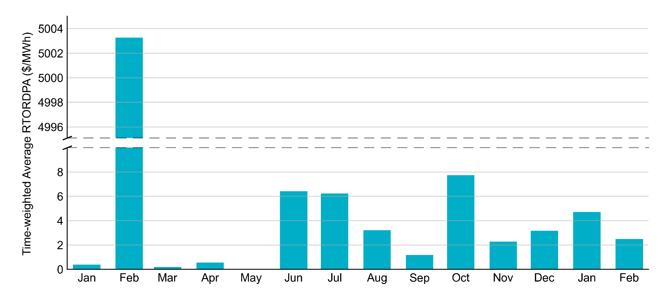
Reliability Deployment Price Adder: Last 13 Months
February data includes February 1-15 only.

Slide 10
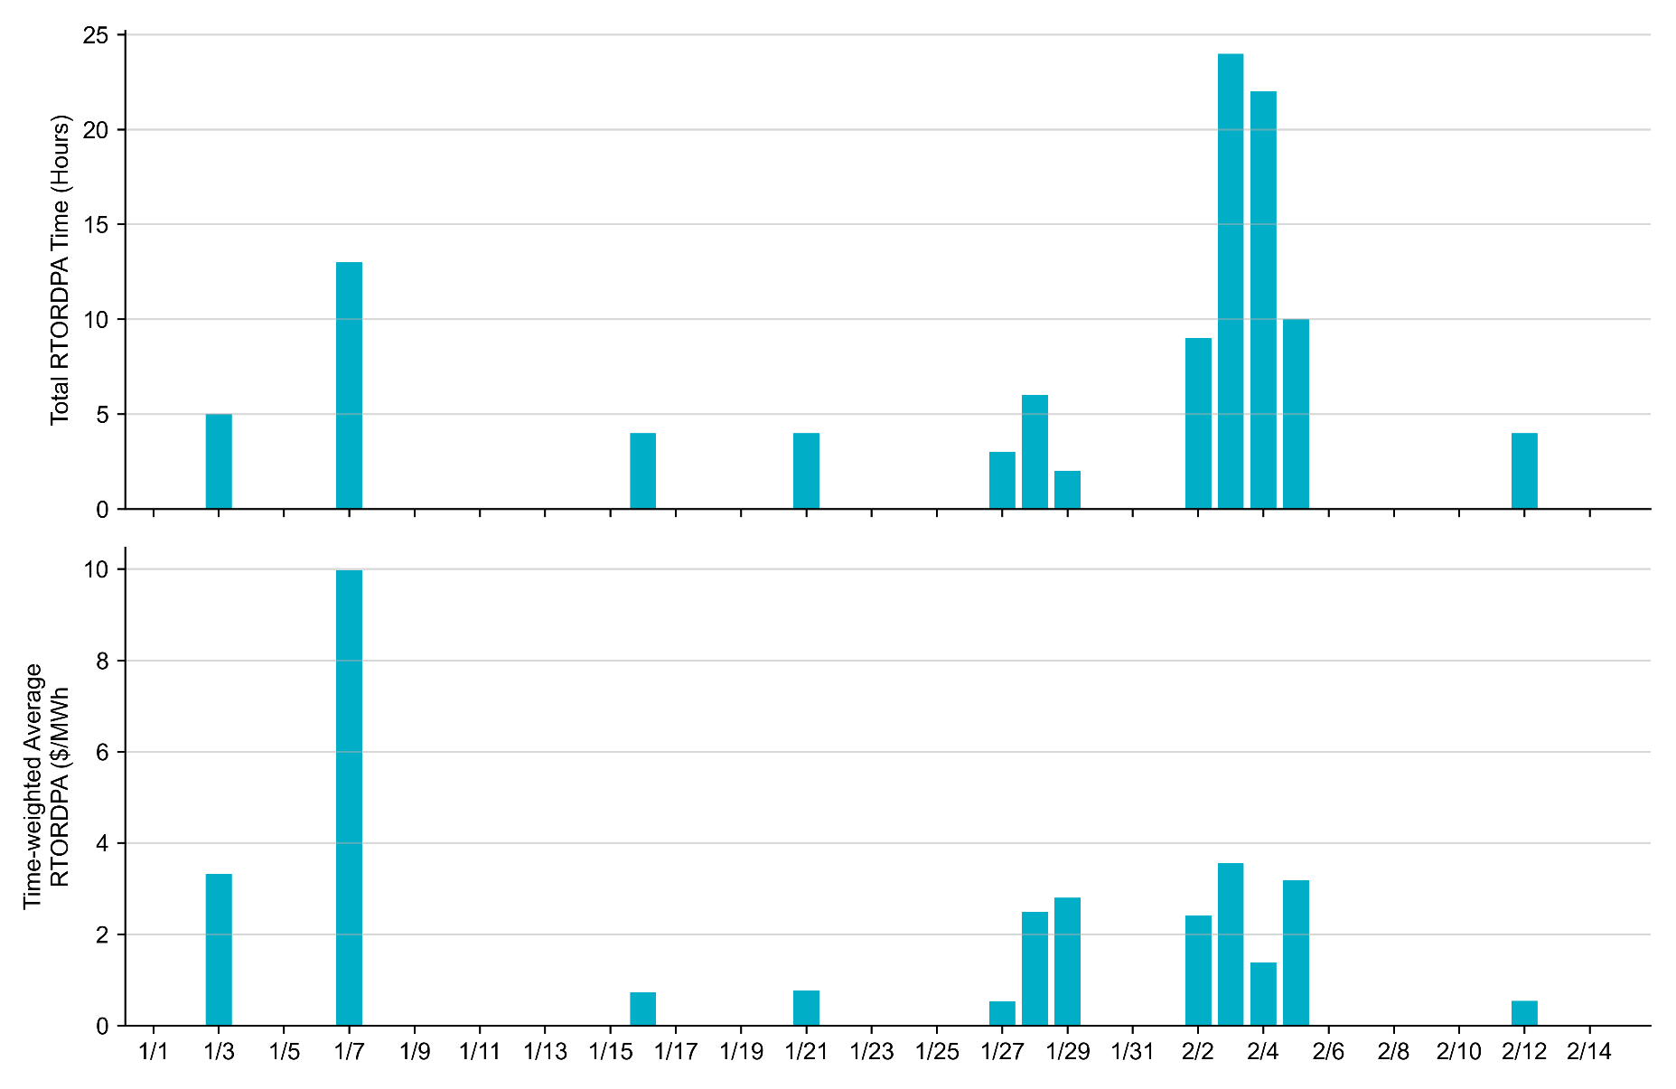
Reliability Deployment Price Adder: Jan 1 – Feb 15

Slide 11
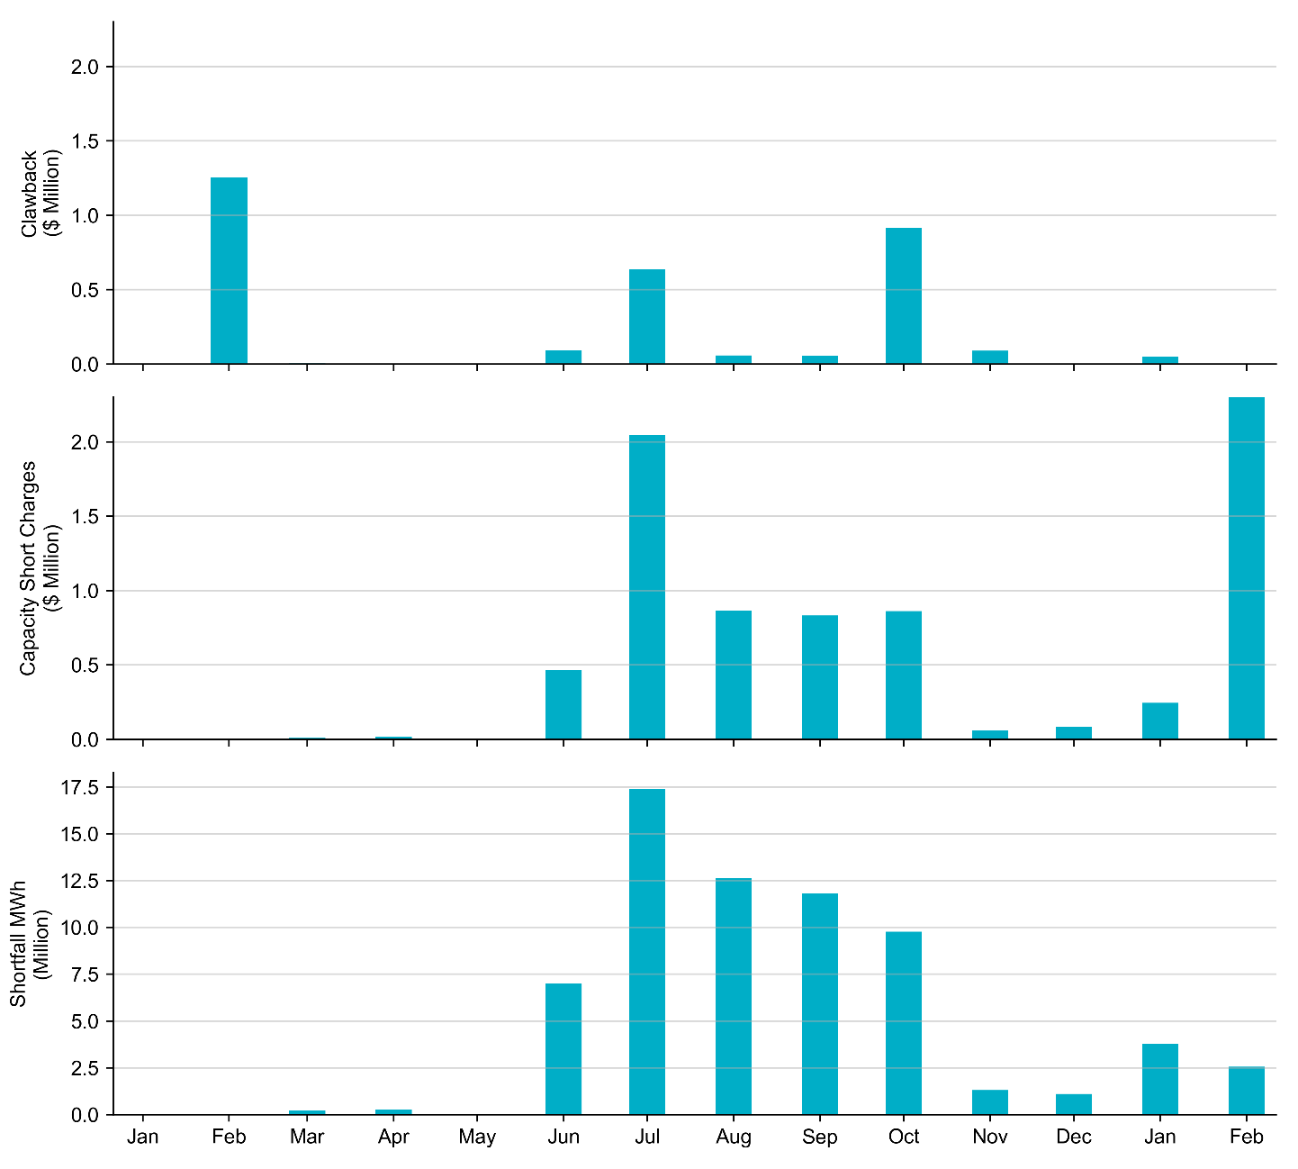
RUC Clawback, Capacity Short Charges, and Shortfall
 | January 2022 | February 1-15, 2022
Make-whole ($ Million) | 0.245 | 2.610
Uplift to Load ($) | 0.31 | 0.85
February data includes February 1-15 only.

