Slide 1
Market Credit Working Group update to the Wholesale Market Subcommittee
Brenden Sager, Austin Energy, Chair
Seth Cochran, DC Energy, Vice Chair
2 March 2022

Slide 2
MCWG update to WMS
General Update
16 Feb 2022 Joint MCWG/CWG WEBEX Meeting

Slide 3
MCWG update to WMS
1096NPRR Require Sustained Two-Hour Capability for ECRS and Four-Hour Capability for Non-Spin. This Nodal Protocol Revision Request (NPRR) requires Resources that provide ERCOT Contingency Reserve Service (ECRS) to limit their responsibility to a quantity of capacity that is capable of being sustained for two consecutive hours and/or Non-Spinning Reserve (Non-Spin) to limit their responsibility to a quantity of capacity that is capable of being sustained for four consecutive hours. Additionally, this NPRR also requires ERCOT to conduct unannounced tests on Energy Storage Resources (ESRs) that are providing ECRS and/or Non-Spin in Real-Time.
1116NPRR Remove Obsolete Reference to Market Information System (MIS). This Nodal Protocol Revision Request (NPRR) removes obsolete paragraph (h) of Section 12.3, which references Other Binding Documents on the Market Information System (MIS). With the implementation of NPRR1039, Replace the Term MIS Public Area with ERCOT Website, the reference to public Other Binding Document postings in paragraph (5) of Section 12.2, ERCOT Responsibilities, was updated to reflect that public Other Binding Documents are posted to the ERCOT website.
1117NPRR Related to SMOGRR025, Modifications to Line Loss Compensation Requirement for EPS Metering. This Nodal Protocol Revision Request (NPRR) aligns the Protocols with Settlement Meter Operating Guide (SMOG) revisions allowing for losses in short runs of connecting lines to be disregarded in instances where the ERCOT-Polled Settlement (EPS) Meter is not physically placed at the Point of Interconnection (POI).

Slide 4
MCWG update to WMS
DC Tie Load, even though allocated costs like other Load, is still a trading activity – i.e., there is no mass transition required for DC Tie Load
Currently, QSE engaging in trading activity only having no Load or generation but exporting over DC Ties (DC Tie Load) is not considered a Trading Activity Only (TAO) QSE
Change: Export (DC Tie Load) should be treated as trading activity in designation of TAO QSE.

Slide 5
MCWG update to WMS
NPRR 1112 – Elimination of Unsecured Credit Limits
ERCOT staff submitted urgent status NPRR to eliminate unsecured credit limits in the market
Credit group unanimously approved lowering unsecured limits from $50 million to $30 million
Group will review further mitigants such as cutting off unsecured credit to entities for late or non-payment

Slide 6
MCWG update to WMS
Default uplift methodology
Purpose to mitigate over allocation to CRR market
Discussed possibility of implementing a credit calculation similar to PJM’s
Would be a substantial change to ERCOT, time consuming and expensive
Considering a simpler approach using a formulaic change to the existing ERCOT methodology
ERCOT staff is reviewing

Slide 7
Default Uplift
Counter-Party Levl*
Segment | January MMA Total (MWh) | January MMA (MWh) | January MMARS %
Gen | 218,577,111.29 | 5,111,155.62 | 2.34%
Load |  | 11,775,576.00 | 5.39%
Load and Gen |  | 94,398,323.87 | 43.19%
Trader |  | 99,998,094.20 | 45.75%
CRRAH Only |  | 7,293,961.60 | 3.34%
Total |  | 218,577,111.29 | 100.00%
QSE/CRRAH Level
Segment | January MMA Total (MWh) | January MMA (MWh) | January MMARS %
Gen | 218,577,111.29 | 4,998,318.29 | 2.29%
Load |  | 28,785,812.00 | 13.17%
Load and Gen |  | 19,844,419.05 | 9.08%
Trader |  | 54,240,444.34 | 24.82%
CRRAH Only |  | 110,708,117.60 | 50.65%
Total |  | 218,577,111.29 | 100.00%
Counter-Party Level
Segment | Total Charges and Credits ($) | Abs of Charges and Credits ($) | Ratio Share
Gen | 1,496,363,922.22 | 53,471,250.62 | 3.57%
Load |  | 87,143,599.79 | 5.82%
Load and Gen |  | 1,120,881,237.36 | 74.91%
Trader |  | 221,417,553.05 | 14.80%
CRRAH Only |  | 13,450,281.40 | 0.90%
Total |  | 1,496,363,922.22 | 100.00%
QSE/CRRAH Level
Segment | Total Charges and Credits ($) | Abs of Charges and Credits ($) | Ratio Share
Gen | 1,496,363,922.22 | 187,529,320.43 | 12.53%
Load |  | 189,353,817.96 | 12.65%
Load and Gen |  | 717,775,179.92 | 47.97%
Trader |  | 242,624,783.77 | 16.21%
CRRAH Only |  | 159,080,820.14 | 10.63%
Total |  | 1,496,363,922.22 | 100.00%

Slide 8
MCWG update to WMS
Draft NPRRs – Clarifications to PURA Subchapter M Securitization Default Charges and Clarifications to PURA Subchapter N Uplift Charges
This has been a big problem that people are sending money to the wrong account.
It can lead to a payment default

Slide 9
MCWG update to WMS
Market-wide average TPE increased from $ 782.5 million in December to $ 848.8 million in January
TPE increased mainly due to higher Real-Time and Day-Ahead Forward Adjustment Factors and Settlement Point prices in January than in December
Discretionary Collateral is defined as Secured Collateral in excess of TPE,CRR Locked ACL and DAM Exposure
Average Discretionary Collateral increased from $1,787.4 million to $1,906.1 million
The increase in Discretionary Collateral is largely due to increase in Secured Collateral, and decrease in CRR Locked ACL
No unusual collateral call activity

Slide 10
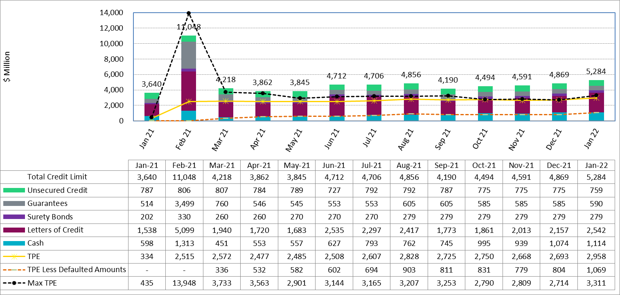
MCWG update to WMS

Slide 11
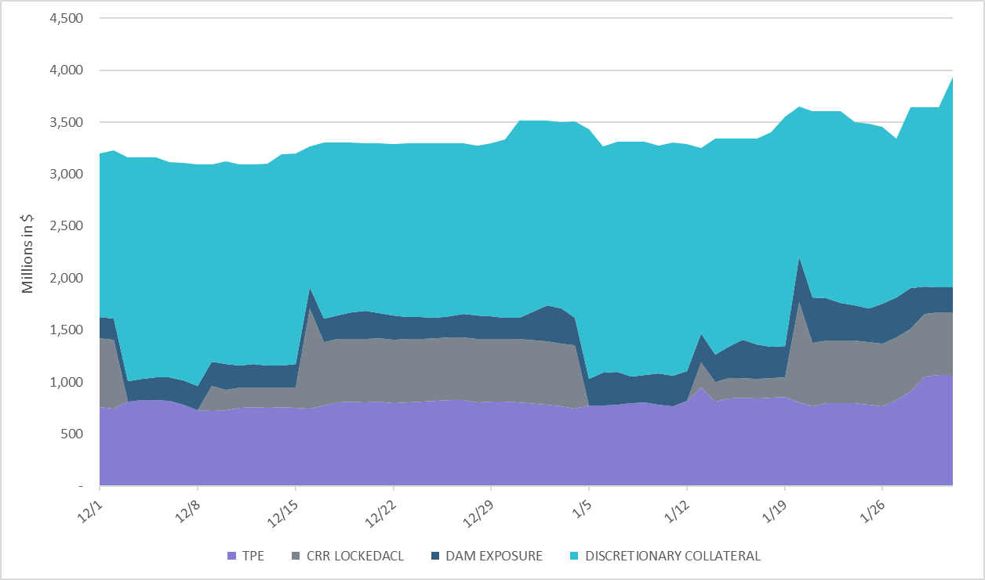
MCWG update to WMS

