Slide 1
Resource Integration – Small Generation Topics Process, Modeling, RARF, Reactive and AVR Testing Scenarios for DGRs / DESRs
Zach Reich, P.E.
ERCOT
Resource Integration Working Group
February 22, 2022

Slide 2
Topics: Small Generation
DGR / DESR Timelines
DGR / DESR Process and Flows
DGR / DESR Simplified Modeling
DGR / DESR Information in the RARF
DGR / DESR Reactive Testing
DGR / DESR AVR Testing

Slide 3
DGR / DESR Timelines and Process Flows:

Slide 6
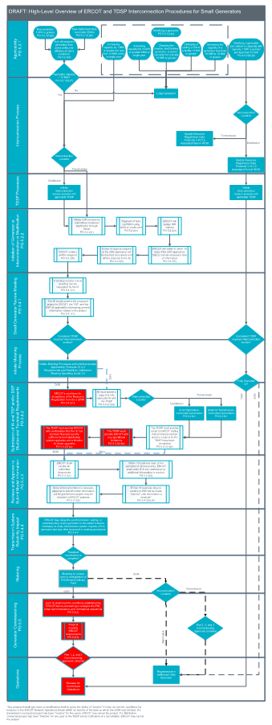
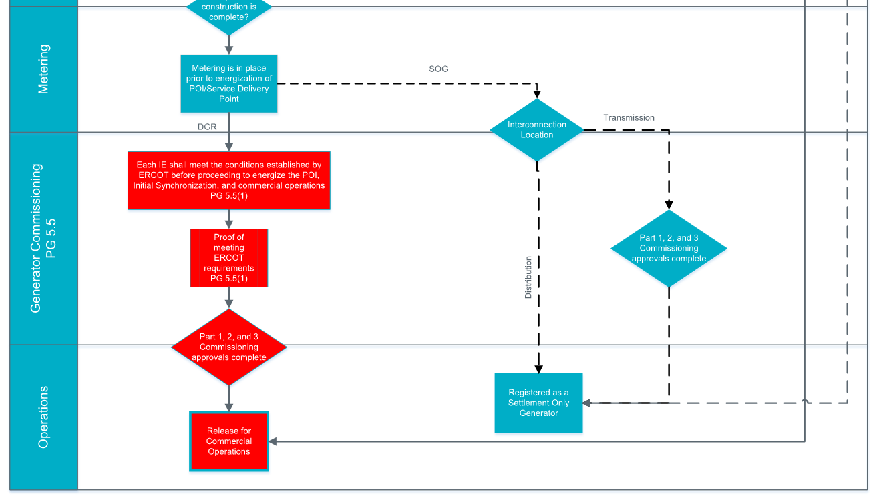
DGR and SOG Process Combined
Note: This Small Gen process also includes Settlement Only Generators (SOG)s.
The distinction between the DGRs and the SOGs is denoted by the dotted lines and red boxes with white text (See below):
(Magnified representation)
P.G. 5.1.1 - Applicability

Slide 7
Examples for Applicability (Initial Interconnection)

Slide 8
Examples for Applicability (Modification Interconnection)

Slide 9
Examples for Applicability (Modification Interconnection)

Slide 10
NPRR1026 and PGRR081 Self Limiting Facility (Not Implemented Yet)
Self-Limiting Facility’s established limit on the total MW Injection

Slide 11
NPRR1026 and PGRR081 Self Limiting Facility (Not Implemented Yet)
Self-Limiting Facility’s established limit on the total MW Injection

Slide 12
DGR / DESR Modeling Guidelines:

Slide 13
Old DGR Modeling Topology (Example)
TDSP Station
DGR / DESR Station
Transmission Network
Generating Unit
TDSP Modeling Responsibility
RE Data responsibility (RARF)
DGR
Line

Slide 14
Current DGR Modeling Topology
Transmission Network
Unit EPS Meter
RE Data responsibility (RARF)
Generating Unit
DGR
ERCOT’s SE will zero-out these flows.

Slide 15
Current Multiple DGR Modeling Topology
Transmission Network
DGR #1 EPS Meter
DGR #2 EPS Meter
DGR #3
EPS Meter
DGR #1
DGR #2
DGR #3
RE Data responsibility (RARF)
Generating Unit(s)

Slide 16
End State
DGR Status:
  All DGRs modeled/reflected on the transmission side of the CIM load.
RE Role:
  Submit Service Requests to register new transmission connected DGRs.
  Submit Service Requests or RIOO-RS RSCRs to make updates to existing DGRs.
TDSP Role:
  Provide EPS meter information.
ERCOT Role:
  Model DGRs.

Slide 17
DGR / DESR RARF Guidelines:

Slide 18
RARF Data Requirements
Transmission Form:
  Only fill out “Station” tab information
  USE TDSP STATION CODE as no new Site is created
  Still include one-lines and transformer test reports
  Get Lat/Long information from TDSP
  Put 0.1 ohms as grounding resistance (placeholder value)
  All other tabs are to be LEFT BLANK!

Slide 19
RARF Data Requirements
Gen Form:
  Impedance needs to reflect equivalent impedance of entire generating unit
  Does not have pad-mount step up transformer data and Gen Unit-Battery-inverter-transformer configuration
    Transformer impedance derived from test report or word document which is not part of RARF data. Estimated based on one-line
POI Information is based on the TDSP Station Code. Voltage level is transmission level voltages
Impedance base will be based off the MVA Nameplate values and the MV voltage levels.
  For the RARF, the Unit Generating Voltage can be at the MV level at Nameplate MVA
  For the Model, impedances will first be calculated using MV level and a Nameplate MVA base, then it will be converted to transmission voltage levels (On a 100MVA base) and be entered into the Model by ERCOT

Slide 20
RARF Data Requirements
Load Resource Form:
  Dispatch asset code is the next asset code in the model (LD1, LD2, ETC). Get this from the TDSP.
  Voltages will all be transmission level voltages
  Station POD is TDSP Station Code
  Assign a descript description for the Load name

Slide 21
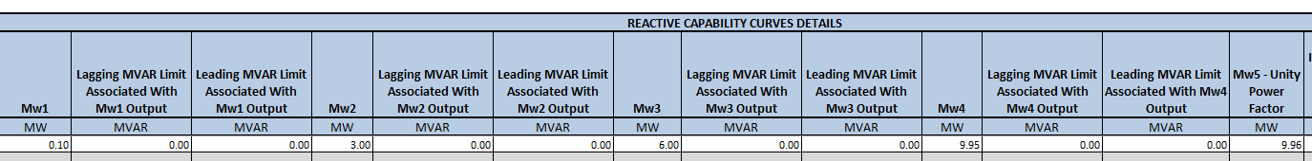
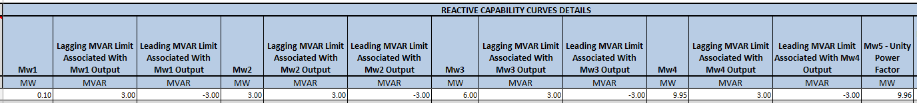
RARF Data Requirements Example – Control Modes
Reactive Capability – Unity PF Control Mode:
Reactive Capability – Voltage Control Mode:

Slide 22
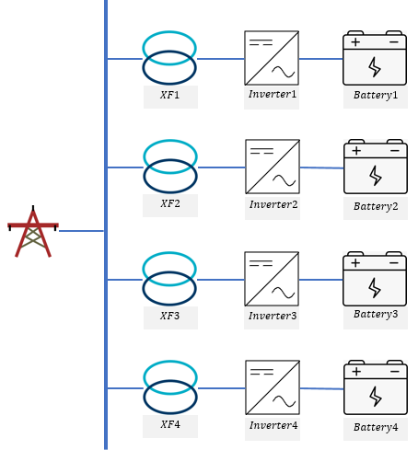






Equivalent impedance example
$$Z at 2.75 MVA$$
$$Z at 11 MVA$$
Module1
R=0.02 p.u.
X=1.02 p.u.
R=0.08 p.u.
X=4.08 p.u.
$$Z_{Module1}=Z_{Inverter1}$$
Module2
$$Z_{Module2}=Z_{Inverter2}$$
R=0.02 p.u.
X=1.02 p.u.
R=0.08 p.u.
X=4.08 p.u.
Module3
R=0.02 p.u.
X=1.02 p.u.
R=0.08 p.u.
X=4.08 p.u.
$$Z_{Module3}=Z_{Inverter3}$$
Module4
R=0.02 p.u.
X=1.02 p.u.
R=0.08 p.u.
X=4.08 p.u.
$$Z_{Module4}=Z_{Inverter4}$$

Slide 23

Equivalent impedance example cont’d
Test Step-up Transformer Specifications
  Voltage
    Low Side: 0.5 kV
    High (MV) Side: 12.5 kV
  MVA ratings: 2.75 MVA
  Positive sequence impedances: 6%
  Zero sequence impedance: 5%
  X/R: 10
  Available Taps: 5 (±2 x 3%)
$$Z_{XF}=6\%$$
$$X_{XF}=Z_{XF}×\sin\left(\tan^{−1}\left(X/R\right)\right)×\frac{11}{2.75}$$
= $6\%×\sin\left(\tan^{−1}{10}\right)×4$
$=0.23881 p.u.$
$$R_{XF}=Z_{XF}×\cos\left(\tan^{−1}\left(X/R\right)\right)×\frac{11}{2.75}$$
= $6\%×\cos\left(\tan^{−1}{10}\right)×4$
$=0.023881 p.u$.

Slide 24






Equivalent impedance example cont’d
$$Z_{T1}=Z_{XF1}+Z_{Module1}$$
$$R_{T1}=0.08+0.023881=0.103881 p.u.$$
$$X_{T1}=4.08+0.23881=4.31881 p.u.$$
$$Z_{T2}=Z_{XF2}+Z_{Module2}$$
$$R_{T1}=0.08+0.023881=0.103881 p.u.$$
$$X_{T1}=4.08+0.23881=4.31881 p.u.$$
$$Z_{T3}=Z_{XF3}+Z_{Module3}$$
$$R_{T1}=0.08+0.023881=0.103881 p.u.$$
$$X_{T1}=4.08+0.23881=4.31881 p.u.$$
$$Z_{T4}=Z_{XF4}+Z_{Module4}$$
$$R_{T1}=0.08+0.023881=0.103881 p.u.$$
$$X_{T1}=4.08+0.23881=4.31881 p.u.$$

Slide 25
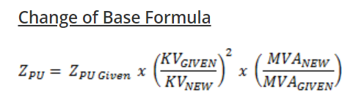
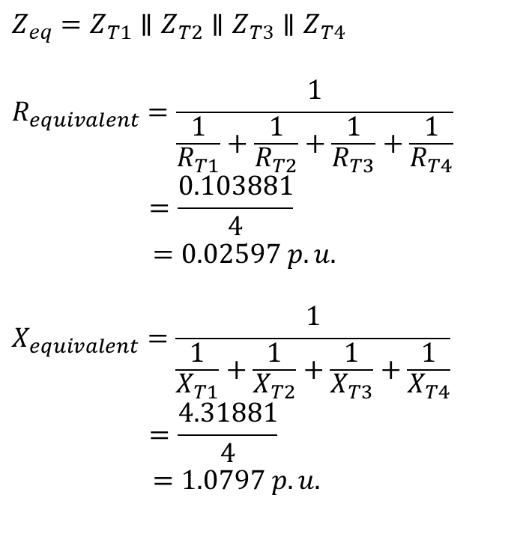
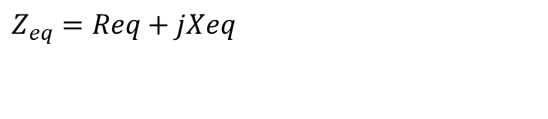
Equivalent impedance example cont’d
$$Z_{eq}=Z_{T1}∥Z_{T2}∥Z_{T3}∥Z_{T4}$$
$$R_{equivalent}=\frac{1}{\frac{1}{R_{T1}}+\frac{1}{R_{T2}}+\frac{1}{R_{T3}}+\frac{1}{R_{T4}}}$$
$$=\frac{0.103881}{4}$$
$=0.02597 p.u.$
$$X_{equivalent}=\frac{1}{\frac{1}{X_{T1}}+\frac{1}{X_{T2}}+\frac{1}{X_{T3}}+\frac{1}{X_{T4}}}$$
$$=\frac{4.31881}{4}$$
$=1.0797 p.u.$
$$Z_{eq}=Req+jXeq$$
Assumptions:
The impedances of all transformer-inverter-battery modules have the same MVA base.
The equivalent impedances of all transformer-inverter-battery modules have the same R/X ratios.
Note: Final Z (R and X components) calculations vary depending on MVA base and kV bases.

Slide 26

Equivalent impedance example cont’d
End Result:
DGR
For example, here’s an 11 MVA project Nameplate with a MV rating of 12.5 kV, and a transmission voltage level of 138 kV)
  For the RARF, the Unit Generating Voltage can be at 12.5 kV at 11 MVA
  For the Model, impedances will first be calculated using 12.5 kV and an 11 MVA base, then it will be converted to 138 kV 100MVA base and be entered into the Model by ERCOT staff

Slide 27
DGR / DESR Reactive Testing Guidelines:

Slide 28
Reactive Testing Update for DGRs that are <20 MVA
If TDSP specifies to maintain unity power factor
  Fill out reactive form in NDCRC (Put 0 or .1 MVAr for all CURL values)
  Attach TDSP Document requiring unity power factor to NDCRC
  RARF CURL and NDCRC CURL and other parameters all zero’s
  This allows ERCOT to document that no test was done and why for the 5-year requirement to retest
Otherwise, RARF and NDCRC CURL values to show reactive power output
  Fill out reactive form in NDCRC (Put actual MVAr values for CURL)
  Reactive test will validate CURL
  Reactive test can either follow current procedure or the “grey box” language if RE prefers that

Slide 29
DGR / DESR AVR Test Guidelines:

Slide 30
ESR/BESS DGR - AVR Testing Objectives
The purpose of the AVR test is to test the BESS’s ability to go from full charge to full discharge while the AVR keeps the reactive power to as close as possible to 0 MVAr for a Unity power factor controlled AVR test at the Point of Interconnection (POI) or within the voltage specifications of the TDSP for a Voltage controlled AVR test.
Keep voltage flicker at the POI to less than 1%, 2% or 3% depending on the frequency of voltage dips
Minimize MVAR transients to the POI
AVR test data will be entered on an Excel worksheet in 4 second time intervals. Column A is for the time-stamp (CST). Column B is for POI kV, Column C is for MW flow at the POI (+ for flow from the BESS to the POI). Column D is for MVAr flow at the POI (+ for flow from the BESS to the POI).

Slide 31
Voltage Setpoint for AVR test For Unity Power Factor
Control DGR / DESR
During the AVR test, measurements must be taken and recorded at each the following MW levels:
100% charging
75% charging
50% charging
25% charging
0% charging/discharging
25% discharging
50% discharging
75% discharging
100% discharging
Allow MW output to settle for each scenario
25% Discharging
50% Discharging
75% Discharging
100% Discharging
MW
0
25% Charging
50% Charging
75% Charging
100% Charging
Coordinate test with ERCOT and DSP and/or TSP
Report data in 4 second intervals
t

Slide 32
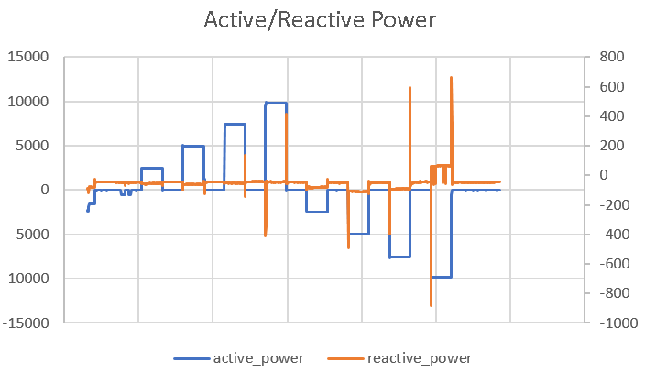
Example of MVAr Transients:
These occur mostly during changes from 0 to charging/discharging and need to be kept to a minimum
Switching Transients

Slide 33
PASS/FAIL Criteria (Without Taking
Transients Into Consideration):
Each test point is evaluated using three test criteria:
For when abs(BESS MW POI flow) is >= 30% of maximum MW BESS capability
  A test measurement will “pass” if the abs(BESS MVAr POI flow) is <= 3.5% of abs(BESS MW POI flow)
For when abs(BESS MW POI flow) is < 30% of maximum MW BESS capability
  A test measurement will “pass” if the abs(BESS MVAr POI flow) is <= 1.3% of the BESS MW capability or 130KVAr (which ever is higher, see below)
A test measurement will “pass” if the MVAr flow at the POI is less than X as follows
  12.47 kV, X = 0.130 MVAr
  24.9 kV, X = 0.170 MVAr
  34.5 kV, X = 0.200 MVAr

Slide 34
Overall AVR Test Evaluation:
Overall to “pass” the ERCOT AVR test, the test points must “pass” one of the above three criteria, OR
For the test points that “fail” the above 3 criteria, the voltage dips must be less than the following. (to minimize MVAR transients to the POI)
  Voltage dips resulting in a <= 3% change in POI voltage will “pass” if the frequency of voltage dips is <= 10 voltage dips per hour (for typical operations)
  Voltage dips resulting in a <= 2% change in POI voltage will “pass” if the frequency of voltage dips is <= 1 voltage dip per minute (for typical operations)
  Voltage dips resulting in a <= 1% change in POI voltage will “pass” if the frequency of voltage dips is <= 15 voltage dips per minute (for typical operations)
ERCOT will consult DSP/TSP if there is a question of the AVR Test passing

Slide 35
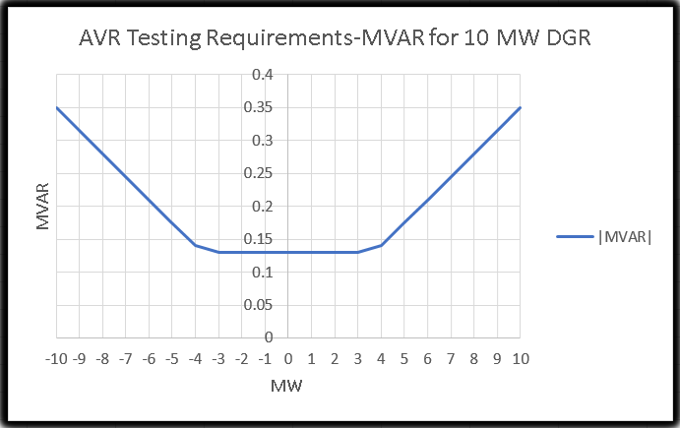
PASS/FAIL Criteria:
This is a visualization for a 10 MW DGR/ESR as an example:
A test measurement will “pass” if the MVAr flow at the POI is less than X as follows:
  12.47 kV, X = 0.130 MVAr
  24.9 kV, X = 0.170 MVAr
  34.5 kV, X = 0.200 MVAr
NOTE: This curve is duplicated for (–) MVAR as well

Slide 36
Voltage Setpoint for AVR Voltage Control test For DGR ESR/BESS
Coordinate test with ERCOT and TDSP
Report data in 4 second intervals or smaller
Exceptions to 3% step requirement:
  If a 3% step will cause the voltage to exceed 1.05 p.u. or drop below 0.95 p.u.
  The TDSP has placed additional restrictions on the voltage setpoint
  Don’t violate any DSP or TSP restrictions
  Acceptance Criteria is on a case by bases based on agreements between the RE and TDSP
Allow voltage to settle
3% step up
Return to original setpoint
kV
3% step down
Return to original setpoint
Allow voltage to settle
t

Slide 37
AVR Voltage Control Example:
There is no KVT or KVM mapping currently, so the voltage instructions are given manually and verbally.
While in AVR control mode, sites will automatically adjust reactive power, up to their maximum leading/lagging reactive capabilities, to maintain voltage at the Point of Common Coupling (PCC) to the target setpoint.
The acceptance criteria is specified by each TDSP and validated by ERCOT
If the target voltage needs to be temporarily adjusted, the following process should be followed.
Entity requesting change must contact other entity via phone call to operations control room and communicate the new desired voltage setpoint. If requesting entity is,
  TDSP:
    RE will confirm feasibility of requested voltage setpoint based on unit availability/capability.
    RE remote operator will then manually adjust voltage target within the respective site controller.
    Voltage target will remain in place until manually readjusted. Steps 1 and 2 must be repeated to revert to initial target.
  RE:
    TDSP will confirm feasibility of requested voltage setpoint based on system conditions.
    RE remote operator will then manually adjust voltage target within the respective site controller.
    Voltage target will remain in place until manually readjusted. Steps 1 and 2 must be repeated to revert to initial target.

Slide 38
Other contact information
ResourceIntegrationDepartment@ercot.com is distribution list for Resource Integration department
Mailing List
  RESOURCE_INTEGRATION@LISTS.ERCOT.COM

Slide 39

Questions?
Thank you!

