Slide 1
Follow Up RFIs for Odessa Disturbance
IBRTF Meeting
February 18, 2022

Slide 2
Agenda
Summary of plants requiring follow up action from NERC’s Odessa Disturbance Report
RFIs sent / received
Review of responses
Next Steps
Discuss RFI Procedure

Slide 3
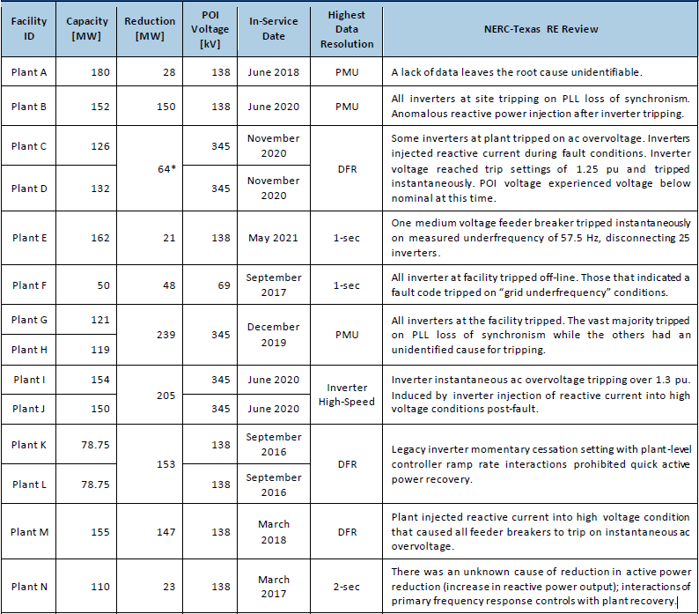
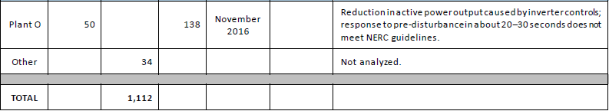
Plants Identified in NERC Odessa Disturbance Report
*
*
*
*
*
Table B.1 from NERC’s Odessa Disturbance Report

Slide 4
Follow Up RFIs Sent
5 Follow Up RFIs sent on 12/1/2021 representing 894 MW of the 1,112 MW lost from solar farms during event:
Unit(s) | MW Lost | Inverter OEM/Model | Reason
Plant G/H | 239 | OEM 1, Model 1 | PLL Loss of Synchronism
Plant B | 150 | OEM 1, Model 1 | PLL Loss of Synchronism
Plant K/L | 153 | OEM 2, Model 1 | Momentary Cessation
Plant M | 147 | OEM 2, Model 2 | Feeder AC Overvoltage
Plant I/J | 205 | OEM 1, Model 2 | Inverter AC Overvoltage

Slide 5
Plants that Tripped from Loss of Synchronism
Total MW loss from 2 plants that tripped for loss of synchronism was 389 MW
Plant G/H lost combined 239 MW - reported that loss of synchronism function had been disabled
  OEM verified there are other adequate protections to allow Loss of Synchronism to be disabled
  Restart delay reduced from 5 minutes to 10 seconds
  Parameter update made on 12/6/2021 to mitigate active power oscillation
  Models being reviewed to determine impact of inverter changes and will submit accordingly

Slide 6
Plants that Tripped from Loss of Synchronism
Plant B lost 150 MW - reported loss of synchronism function was removed from all inverters effective 2/1/2022
  Original RFI response stated they were still working with OEM to determine if LOS could be disabled
  No other protection settings determined to trip for similar event
  Reactive oscillations during event have not been addressed
  Need to follow up about possible model update/submittal

Slide 7
Plant Reduction from Momentary Cessation
Plant K/L lost combined 153 MW - OEM stated Loss of Synchronism and/or Momentary Cessation could not be disabled from inverter protection settings without causing potential harm to equipment.
  Legacy inverters lost synchronization causing phase angle jump >20° which invokes momentary cessation
  Did not respond appropriately about possibly relaxing momentary cessation settings if they cannot be disabled
  Unit #1 took 5 minutes to return to full power while Unit #2 took 2 minutes
  Need to investigate plant level controller ramp rates preventing inverter level recovery for future events
  No future action or model changes expected from plant and will trip again for similar event

Slide 8
Plant that Tripped from Feeder Overvoltage
Plant M lost 147 MW – Disabled all overvoltage and undervoltage protection scheme for feeder breakers
  Reviewed inverter voltage and frequency settings against ERCOT and PRC-024 requirements and stated they are outside of “No Trip Zone” with adequate margin.
  However, very fast overvoltage protection still set at point which inverters may trip for similar event
  Seeing considerable difference between voltage at inverter terminals and POI
  No changes to be made to reactive injection for LVRT conditions
  Plant will review MOD-026 and MOD-027 model validation by end of Q1 2022 and adjust/resubmit model if necessary

Slide 9
Plant that Tripped from Inverter Overvoltage
Plant I/J lost combined 205 MW – Stated inverter overvoltage protection setpoints are the current design limitations of the equipment from the inverter OEM and can not be relaxed
  No plant modifications made at this time and inverters will trip again for similar event
  PMU data provided by plant shows highest voltage of 1.08 pu on high side of GSU, well within PRC-024 “No Trip Zone”
  Inverter terminal voltage reached above 1.25 pu
  Model performance not matching actual performance
  Not meeting VRT requirements in NOG
  No plans for model updates currently

Slide 10
Next Steps
Meet with OEM to discuss options for plants who have not or cannot modify inverter protection settings
Follow up on potential model updates (both incorrect models and models to reflect system changes)
Work with plants that will trip again to establish best possible solutions (returning to pre-disturbance output quickly)
Contact remaining plants that tripped or lost output (5 plants total)
Unit(s) | MW Lost | Inverter OEM/Model | Reason
Plant C/D | 64 | OEM 1, Model 2* | Inverter AC Overvoltage
Plant F | 48 | OEM 3, Model 1 | Inverter Underfrequency
Plant E | 21 | OEM 1, Model 2 | Feeder Underfrequency
Plant A | 28 | OEM 3, Model 2 | Unknown
Plant N | 23 | OEM 3, Model 3 | Unknown

Slide 11
RFI Procedure
Currently ERCOT’s best tool for collecting information for event analysis
Time consuming for both ERCOT and MPs
Clarity of questions and responses often leads to follow up communications
Conference calls with SMEs more effective for technical matters
ERCOT will need to work more closely with MPs to get these matters resolved

Slide 12
Questions?

