Slide 1
ERCOT Frequency Control Report
January 2022
ERCOT
Operations Planning
PDCWG | February 16th, 2022

Slide 2
Summary of January 2022
CPS1: 175.89%
Current CPS1 12-Month Rolling Average: 169.60%
0 BAAL Exceedance(s)
1 hourly CPS1 score below 100%
BAAL-003 Events have updated through 2020
2020 BAAL-003 FRM Performance: -789.34
2022 RMS1 Statistics
  Mean: 16.37 mHz
  Min: 12.01 mHz
  Max: 60.6 mHz
Energy Statistics
  Total Energy: 33,399,938 MWh
  Wind Energy: 8,448,159 MWh
  Percent Energy from Wind: 25.29 %
  Solar Energy: 1,335,908 MWh
  Percent Energy from Solar: 4.00%
Minimum System Inertia
  Mean: 196,374 MW*s
  Max: 303,097 MW*s on Jan 21st
  Min: 144,524 MW*s on Jan 16th
Notes:
Mean: 162,176 MW*s
Max: 246,027 MW*s on Dec 20th
Min: 130,757 MW*s on Dec 24th

Slide 3
Frequency Control
CPS1, BAAL, & RMS1

Slide 4
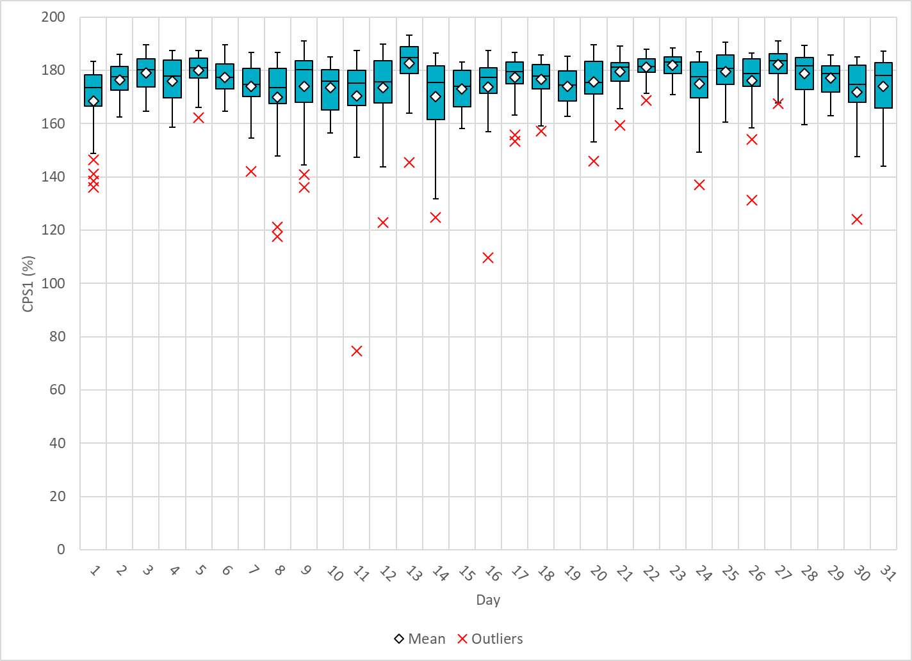
Hourly CPS1 by Day
Jan-22 CPS1 (%): 175.89
Notes:
1. 75% @ 1/11/2022 HE 10:00
Expected Generation Deviation
Expected gen dev remained negative for the first half hour. The largest expected gen dev was -2553 MW @ 9:14 with signification contribution from thermal resources and wind generation.
IRR Ramps
Between 9:00 to 9:30 wind ramped down by ~900 MW.
Regulation: Regulation up was exhausted during the ramp intervals. A 550 MW SCED manual offset was applied and 635 MW of RRS was deployed.

Slide 5
BAAL Exceedances & Violations
There are 0 BAAL exceedance(s) in January
Notes:
Both occurred on 12/23/2021 due to significant wind down ramps

Slide 6
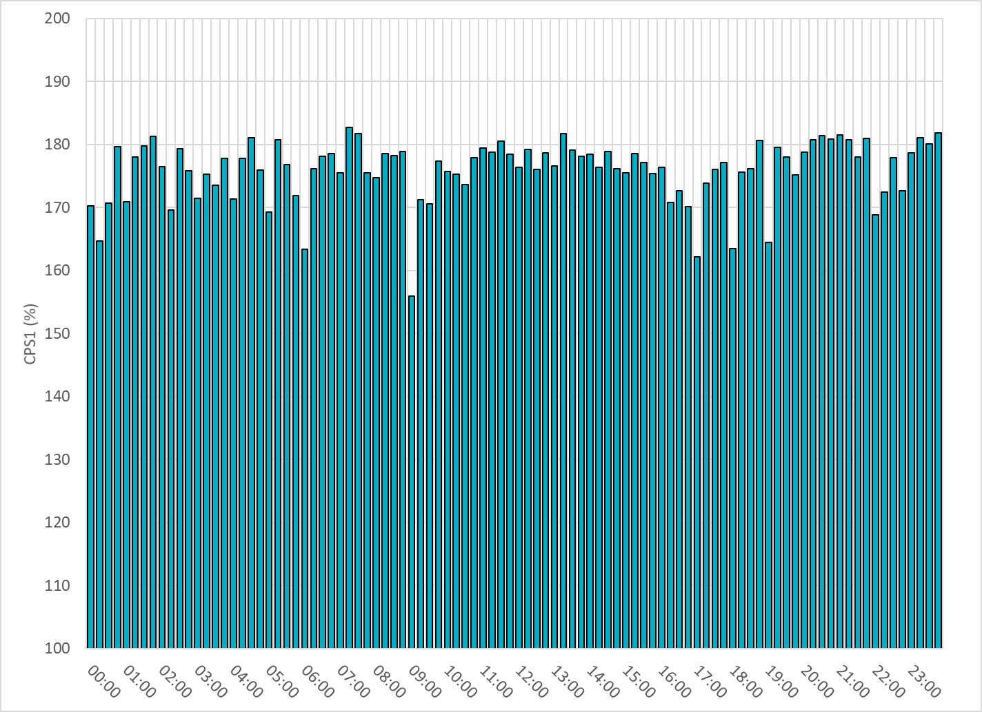
15-Minute Average CPS1%
Jan-22 CPS1 (%): 175.89

Slide 7
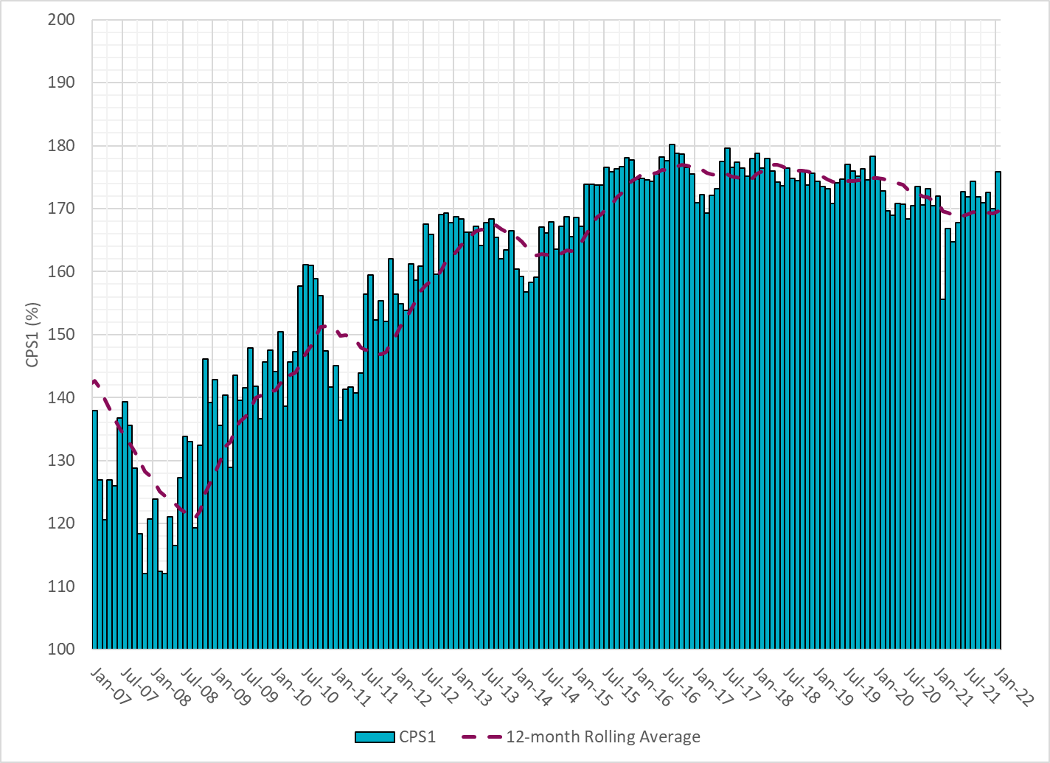
12-Month Rolling Average CPS1
Current 12-Month Rolling Average: 169.60%

Slide 8
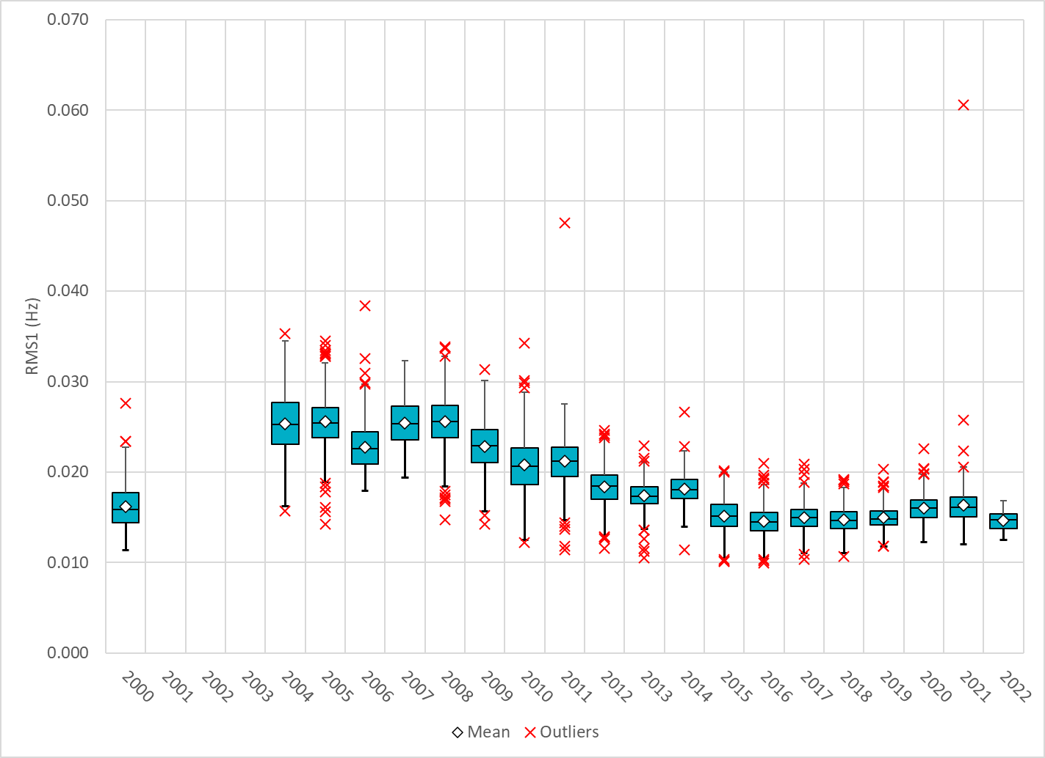
Daily RMS1 of ERCOT Frequency by Year
Notes:
Mean: 14.68 mHz
Min: 12.51 mHz
Max: 16.9 mHz

Slide 9
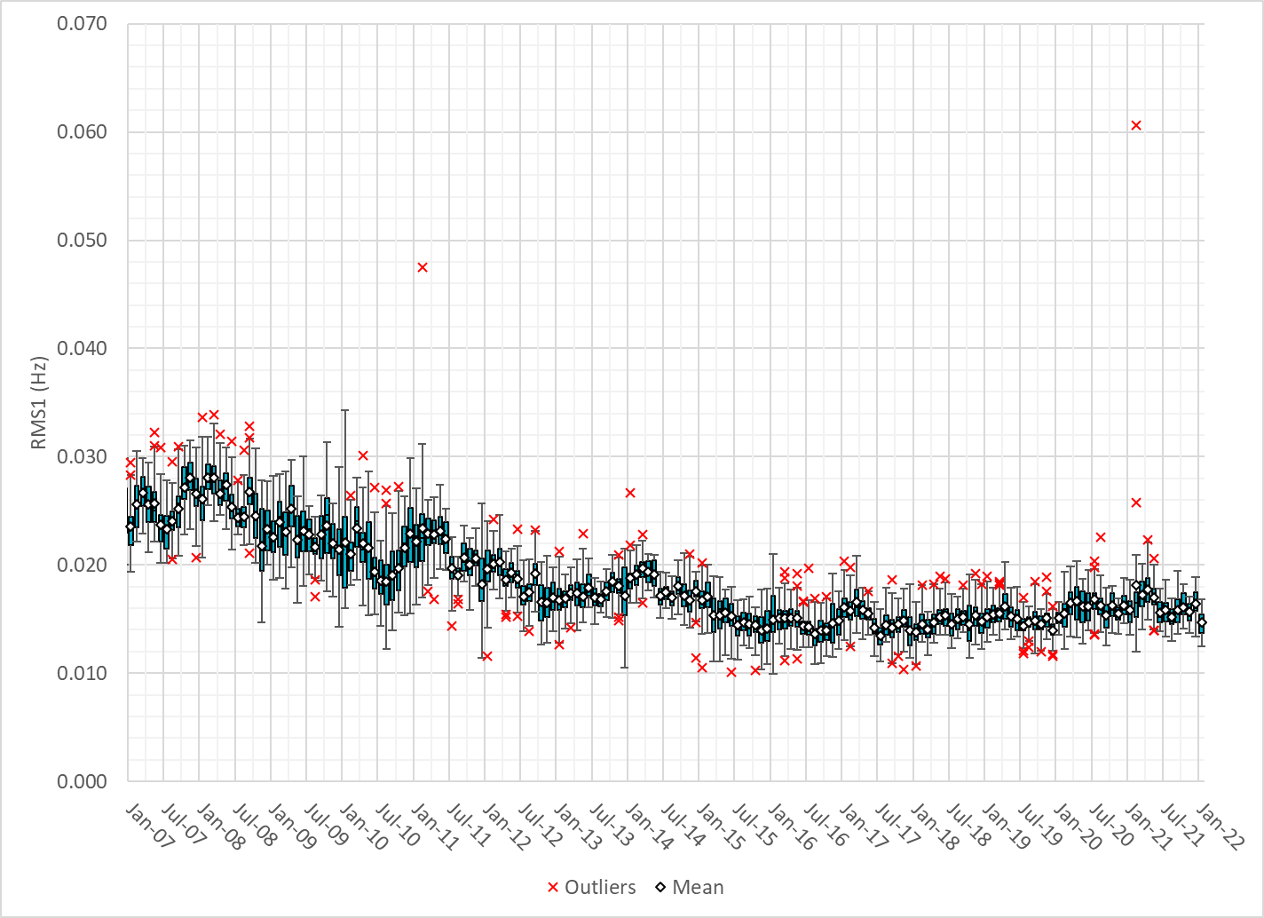
Daily RMS1 of ERCOT Frequency by Month

Slide 10
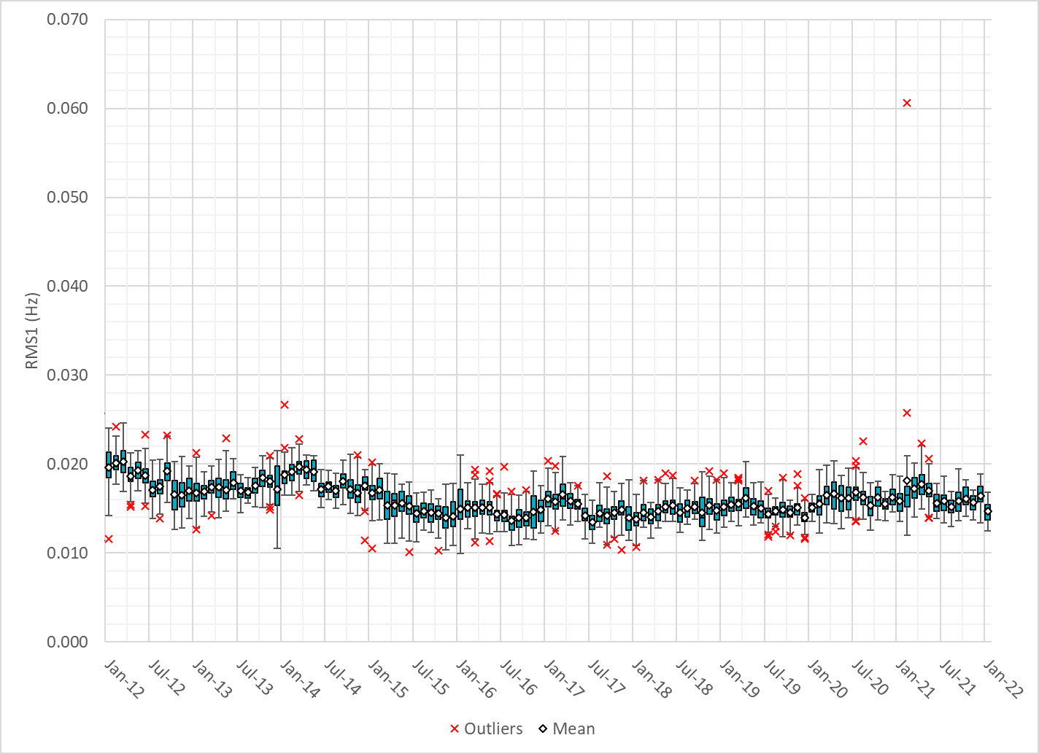
Daily RMS1 of ERCOT Frequency by Month
Notes:
16Mhz on avg

Slide 11
Frequency Profile Comparison

Slide 12
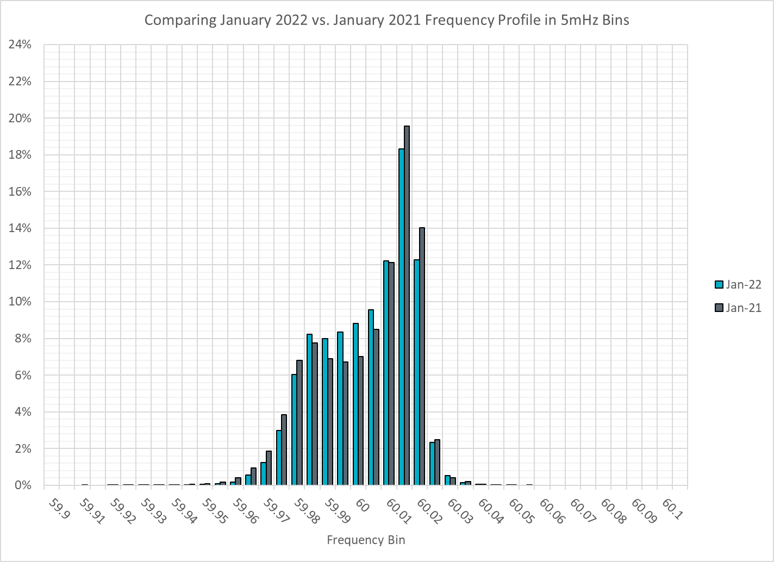
Frequency Profile Comparison

Slide 13
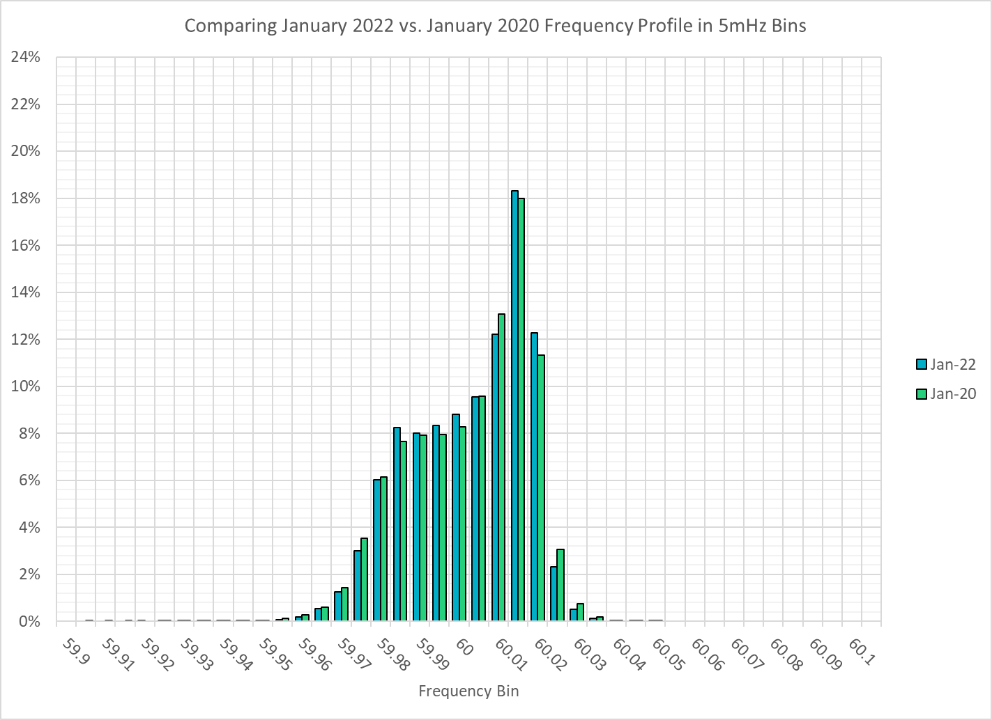
Frequency Profile Comparison

Slide 14
Time Error Correction

Slide 15
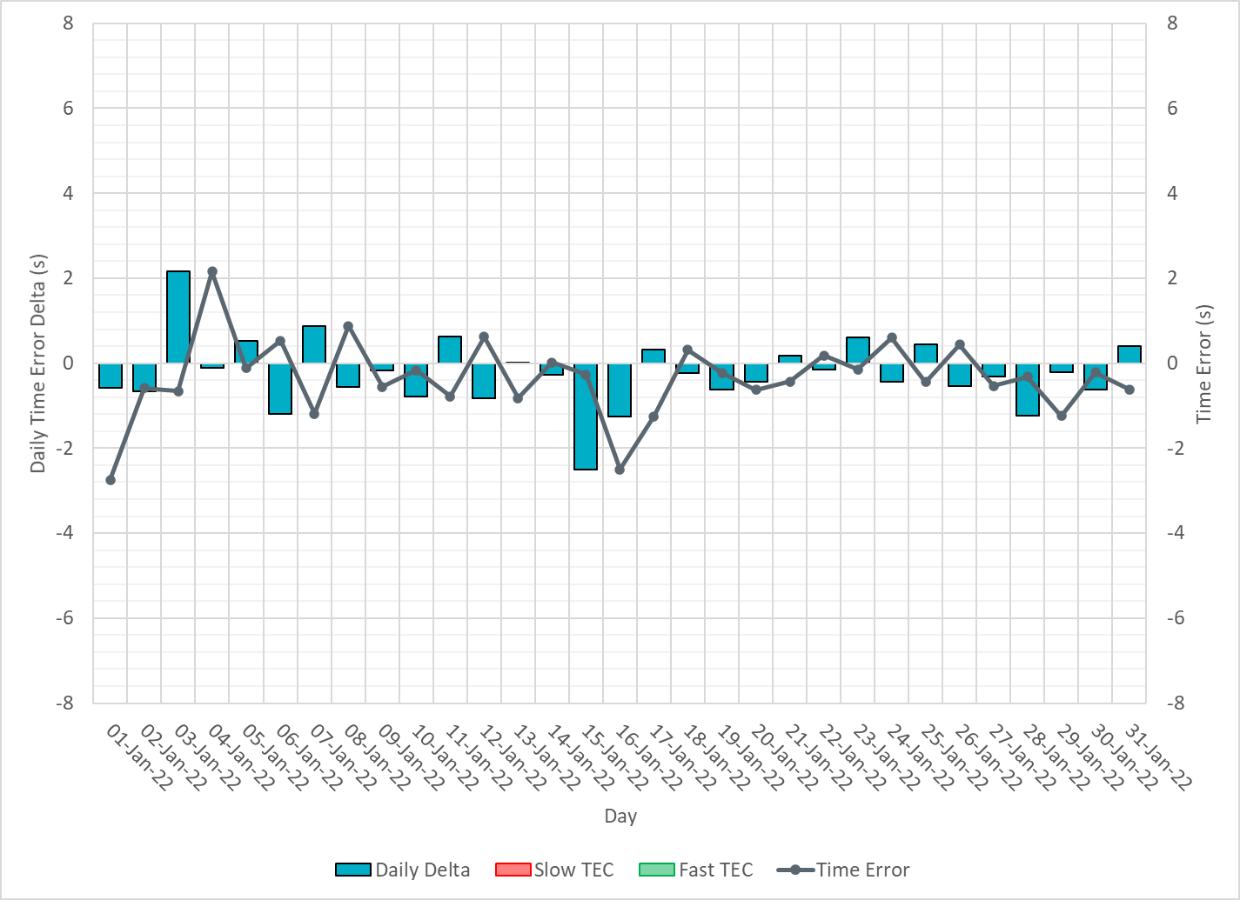
ERCOT Daily Time Error

Slide 16
Time Error Corrections Log Summary
There have been no time error corrections since December 2016

Slide 17
BAL-003 Performance

Slide 18
Op. Year 2020 BAL-003 Selected Events – Update
Notes:
BAL-003

Slide 19
Op. Year 2020 BAL-003 FRM Performance - Update
Notes:
OP2018: FRO = -381.0, FRM_median = -843.17, FRM_average = -959.7
OP2019: FRO = -381.0, FRM_median = -811.14, FRM_average = -892.5
OP2020: FRO = -425.0, FRM median = -789.34, FRM average = -879.0
OP2021: FRO =

Slide 20
ERCOT Energy Statistics

Slide 21
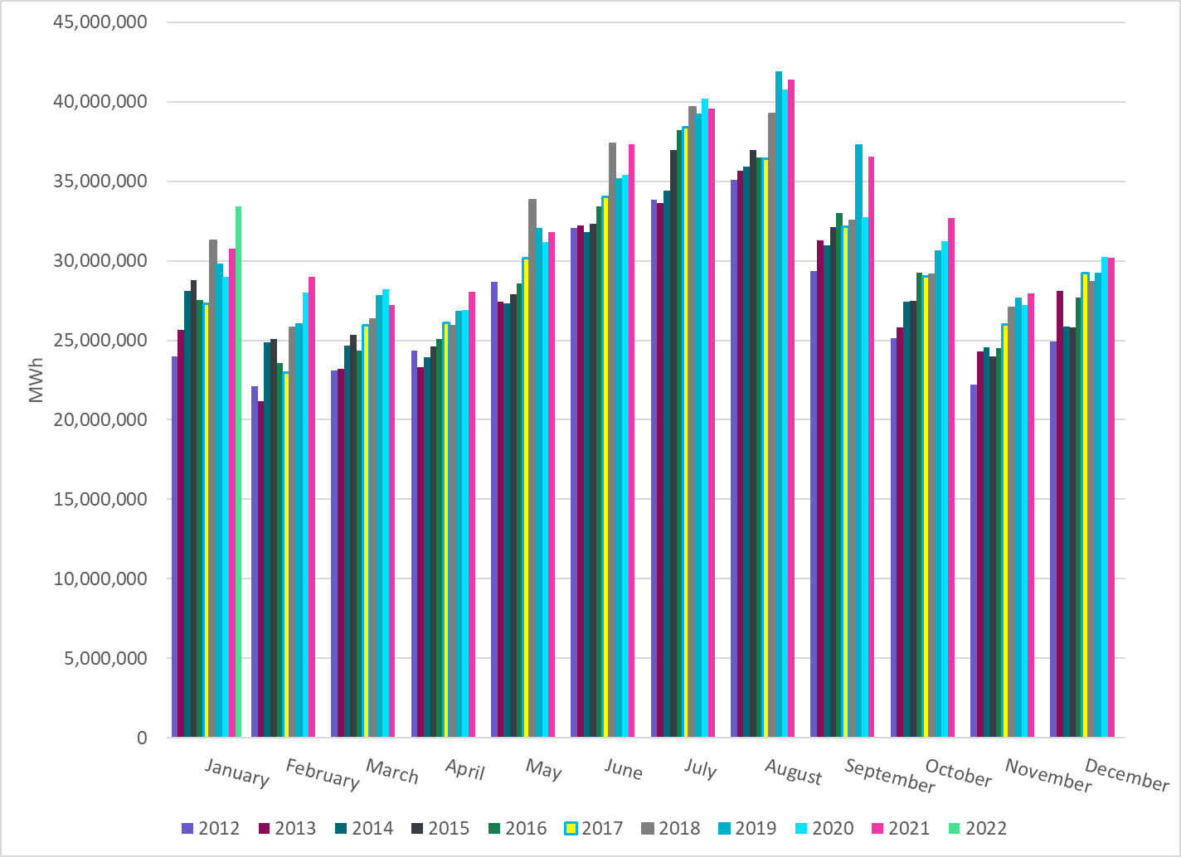
Total Energy
Notes:
33,399,938 MWh

Slide 22
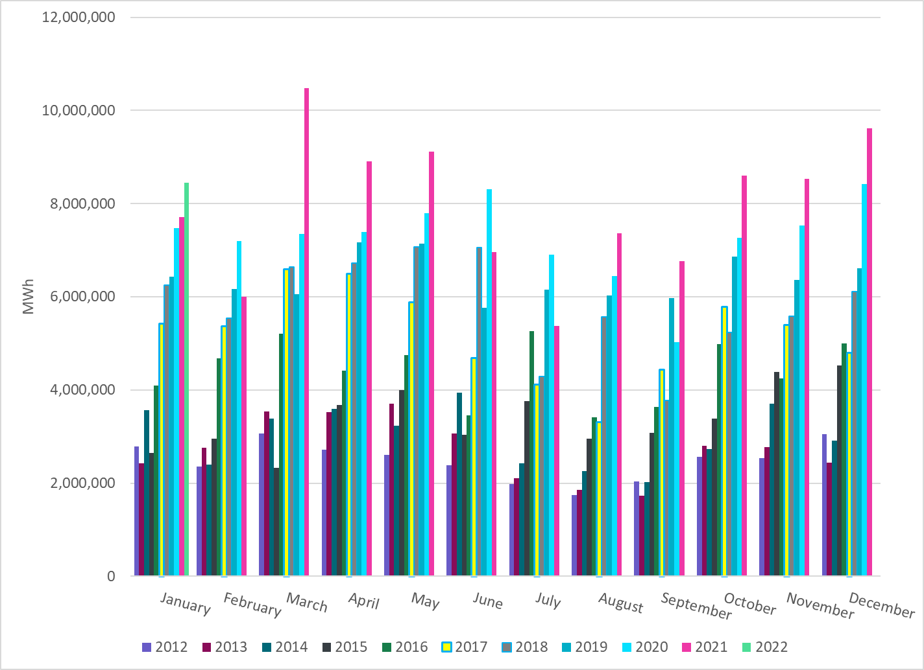
Total Energy from Wind Generation
Notes:
8,448,159 MWh

Slide 23
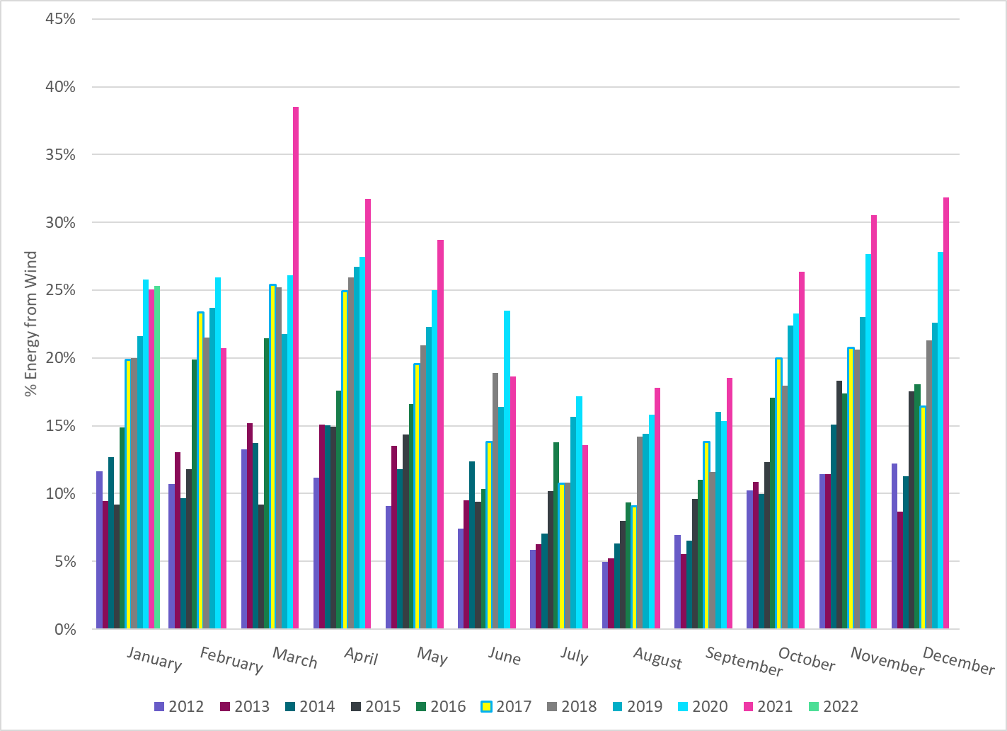
% Energy from Wind Generation
Notes:
25.29 %

Slide 24
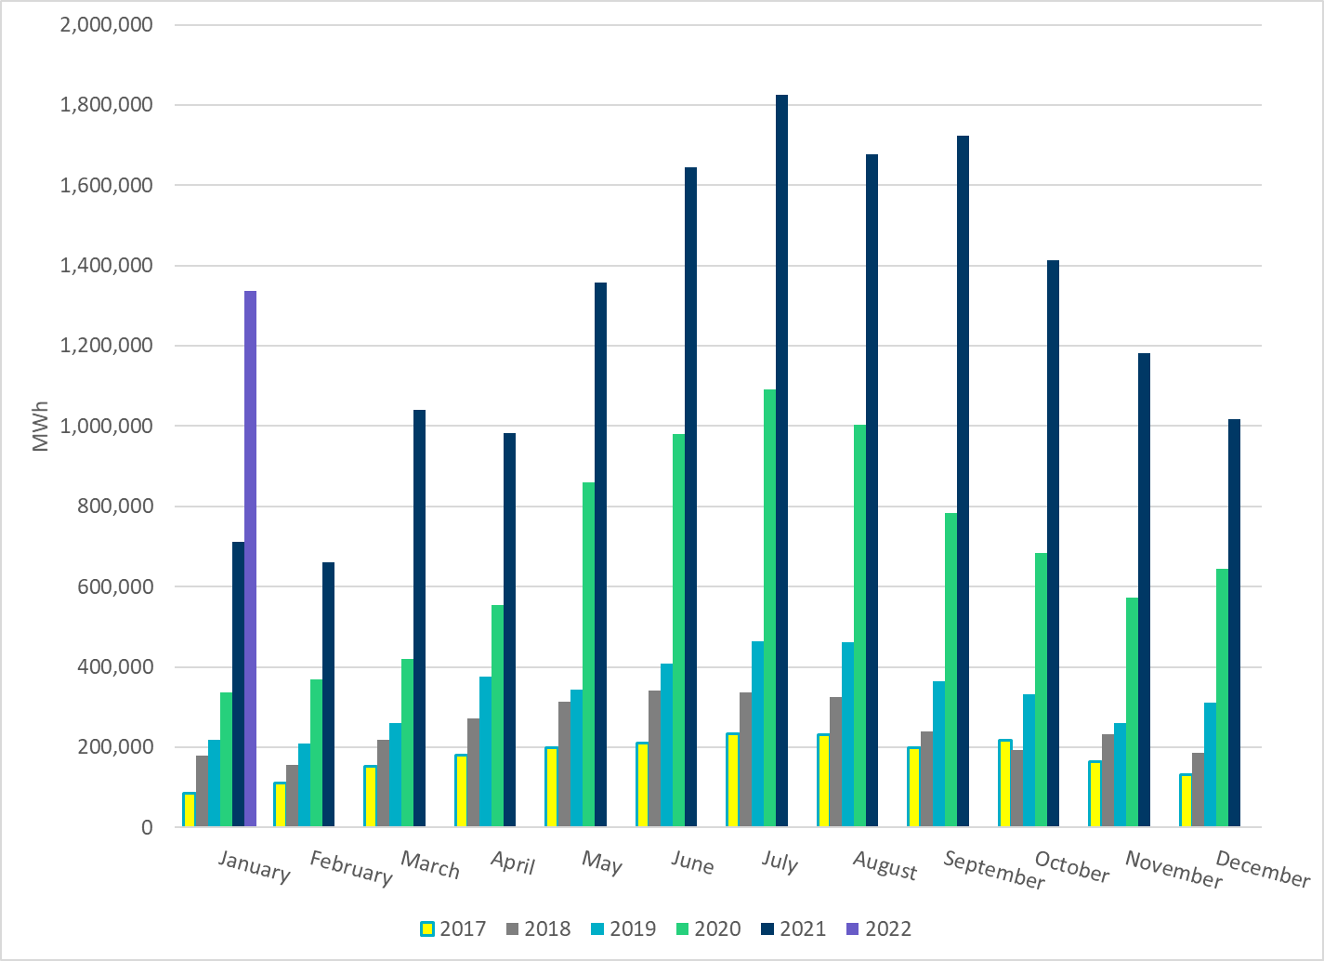
Total Energy From Solar Generation
Notes:
1,335,908 MWh

Slide 25
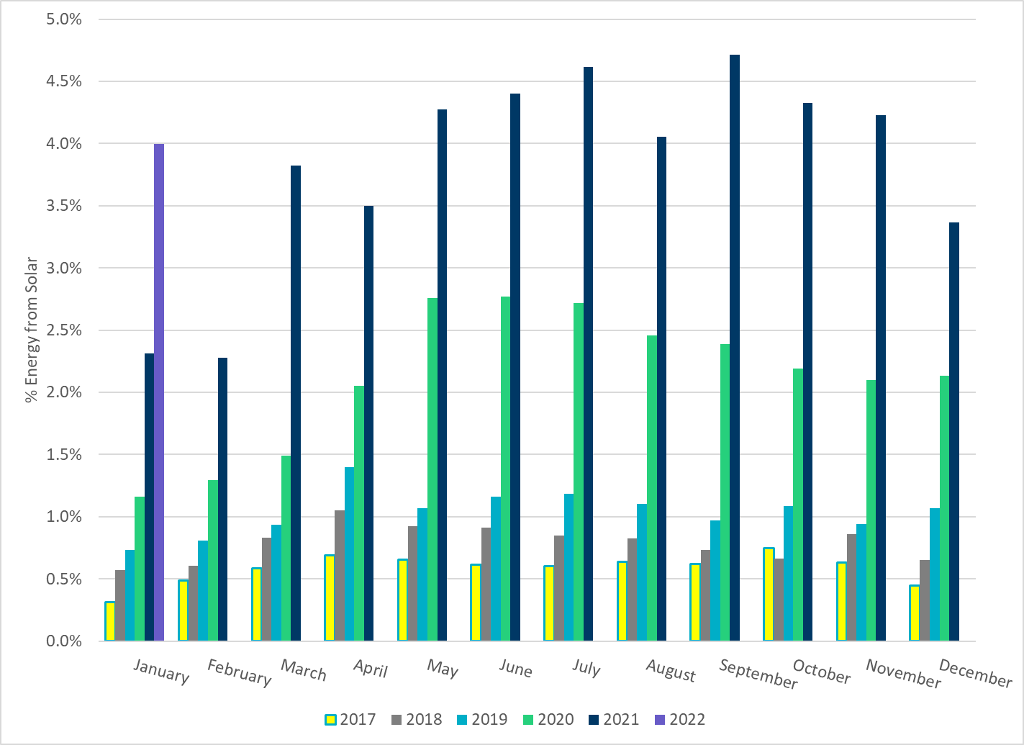
% Energy from Solar Generation
Notes:
4.00 %

Slide 26
ERCOT System Inertia

Slide 27
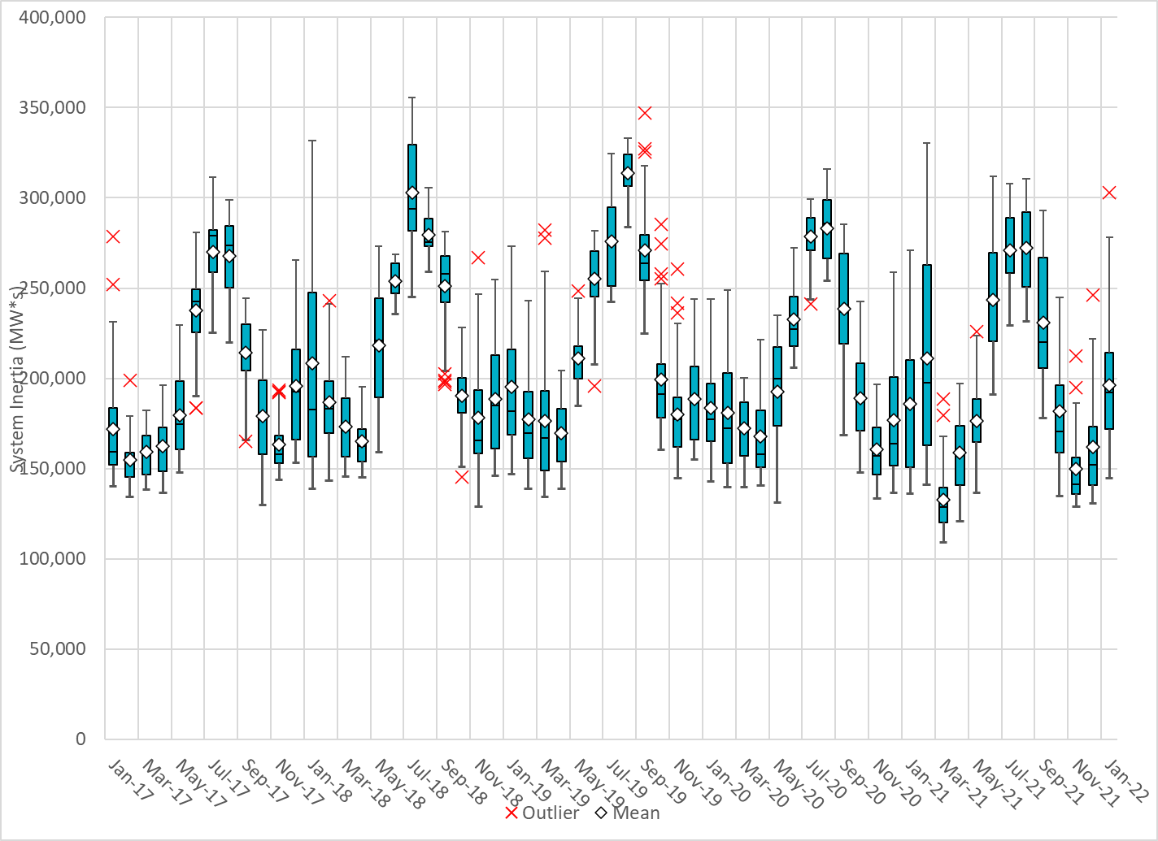
Daily Minimum System Inertia
Notes:
Minimum Inertia = 144,524 MW*s on 1/16/2022
Previous Minimum was 109,029 MW*s on 3/22/2021
Data:
Mean: 196,374 MW*s
Max: 303,097 MW*s on Jan 21st
Min: 144,524 MW*s on Jan 16th

Slide 28
Questions?
Thank you!

