Slide 1
ERCOT Frequency Events
January 2022
ERCOT
Operations Planning
PDCWG | February 16th, 2022

Slide 2
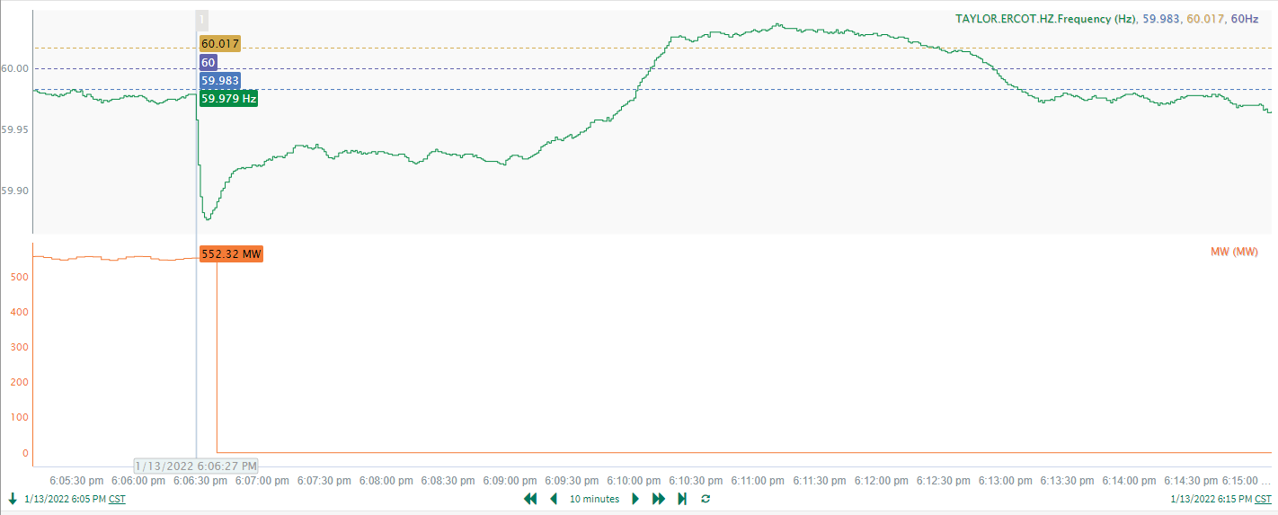
1/13/2022 18:06:27 (NON FME)
Notes:
Unit tripped offline while carrying 552 MW
Starting Frequency: 59.979 Hz
Minimum Frequency: 59.876 Hz
A-C Time: 6 seconds
Recovery Time (back to deadband): 3 minutes 35 seconds
RRS Deployed: 742.38 MW
Trip Reason: High hood temperature
Contextual Information: A total of 310MW of regulation up was deployed during the event.
No Selection Reason: The starting frequency is too low.

Slide 3
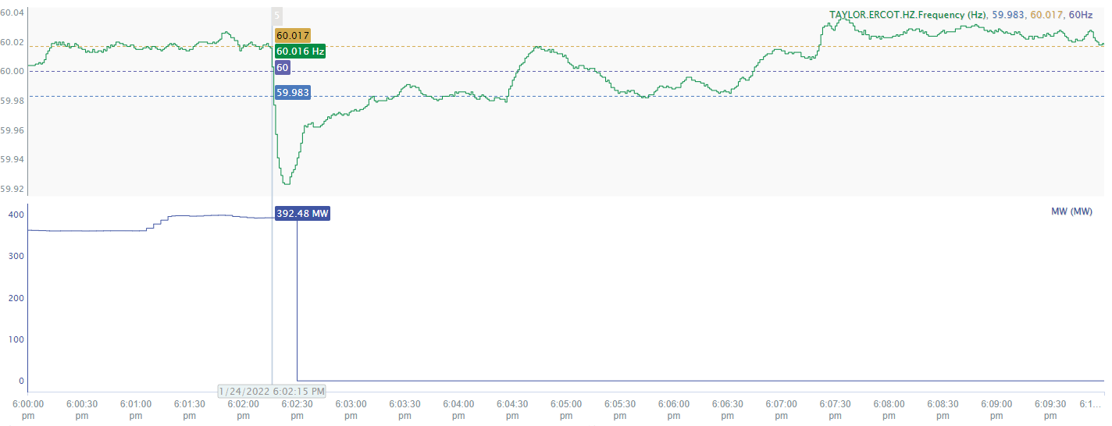
1/24/2022 18:02:15 (NON FME)
Notes:
Unit experienced runback and tripped offline while carrying 393 MW
Starting Frequency: 60.016 Hz
Minimum Frequency: 59.923 Hz
A-C Time : 10 seconds
Recovery Time(back to deadband): 1 minutes and 10 seconds
RRS Deployed: 0 MW
Trip Reason: Unknown
Contextual Information: A total of 175 MW of regulation up was deployed during the event.
No Selection Reason: Small size event and high starting frequency

Slide 4
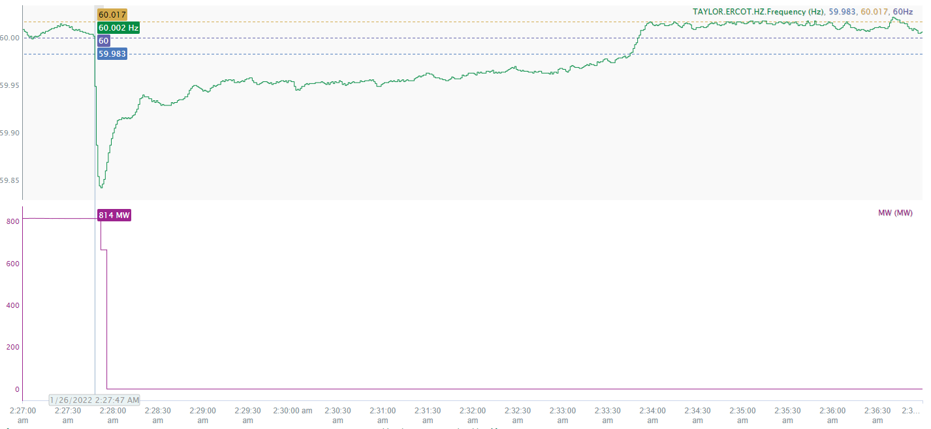
1/26/2022 2:27:47 (FME)
Notes:
Unit experienced runback and tripped offline while carrying 814 MW
Starting Frequency: 60.002Hz
Minimum Frequency: 59.842 Hz
A-C Time : 5 seconds
Recovery Time(back to deadband): 5 minutes and 58 seconds
RRS Deployed: 1053.4 MW
Trip Reason: Unknown
Contextual Information: A total of 157MW of regulation up was deployed and a 200 MW SCED Manual offset was applied during the event.

Slide 5
Questions?
Thank you!

