Slide 1
Projects with Interface Change Requirements
NPRR1093, FFRA, ECRS
ERCOT Staff Presenting
Matt Mereness
Susan Jinright
Nathan Smith
2/10/2022

Slide 2
Outline
Purpose
Protocol Projects with Upcoming Market Facing Changes
NPRR1093 Loads in Non-Spin
NPRR863/FFRA delivery
NPRR863/ECRS delivery
Feedback for next TWG Meeting

Slide 3
Purpose
ERCOT plans to leverage the TWG as a forum to communicate future Protocol project changes where MPs will be required to change their ERCOT interfaces.
Target audience includes Market Participant staff and/or vendors responsible for developing and deploying systems to adapt to market interface changes with ERCOT.
ERCOT plans to publish interface changes earlier in project process and use this forum to share technical details, listen to feedback, and provide estimated project dates including MOTE availability and Go-Live dates.
Note that this will not be the forum for project business details (will be in project readiness workshops).
3

Slide 4
NPRR1093 Load Resource Participation in Non-Spinning Reserve
High-priority PUCT project
Expands procurement of Non-Spin to include Load Resources
“Allow Load Resources that are not Controllable Load Resources to participate in Non-Spinning Reserve so that additional capacity is available to ERCOT Operators for the upcoming winter and summer 2022.” excerpt from NPRR
ERCOT just completed Business Requirements and planning for production 2022 Release 3 (late May 2022)
ERCOT worked to minimize interface changes
Relatively minor changes to Market MMS XML submission
Changes limited to new values with AS Self-Arrangement and AS Trades for Non-Spin from Load
Backward compatible (traditional Non-Spin AS type remains the same)
No changes to Telemetry/ICCP
Changes to Reports still TBD (later phase of project)

Slide 5
Library of NPRR1093 Requirement Changes
Technical Specifications modified:
External_Web_Services_XSD_V1.22_NPRR1093
EIP_External_Interfaces_Specification_v1_22
Note the word doc leverages “gray boxed” language to capture multiple protocol changes.
MarketSubmissionValidationRules_NP4-450-NPRR1093
Transaction Changes:
AS Trades (new type of Non-Spin, NSPNM)
AS Self-Arrangement (new type of Non-Spin, NSPNM)

Slide 6
NPRR 1093 XSD changes
External Web Services XSD V1.22_NPRR1093
ERCOTCommonTypes

Slide 7
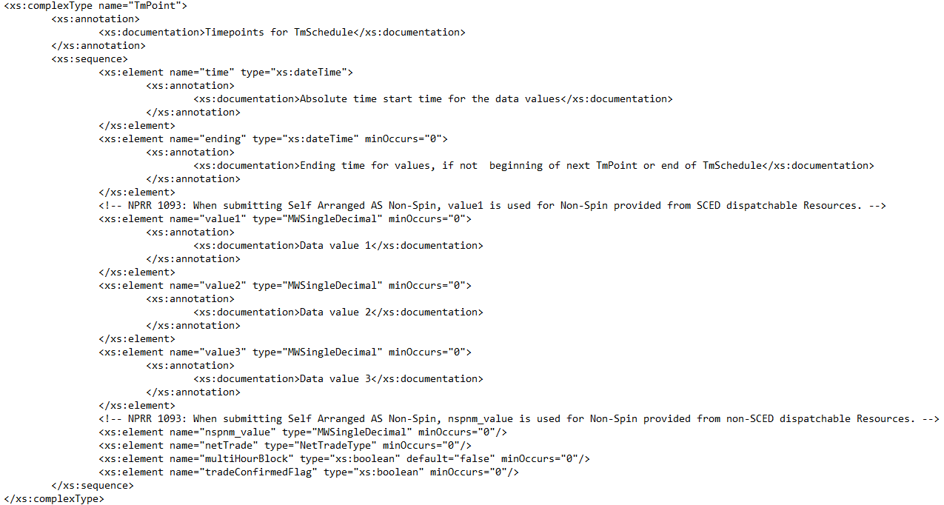
NPRR 1093 XSD changes
ERCOTCommonTypes

Slide 8
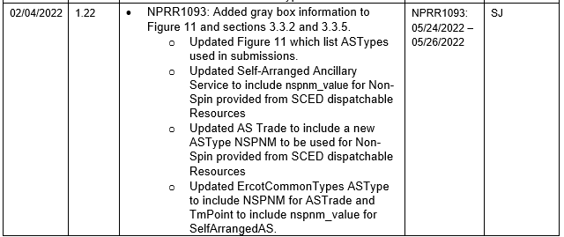
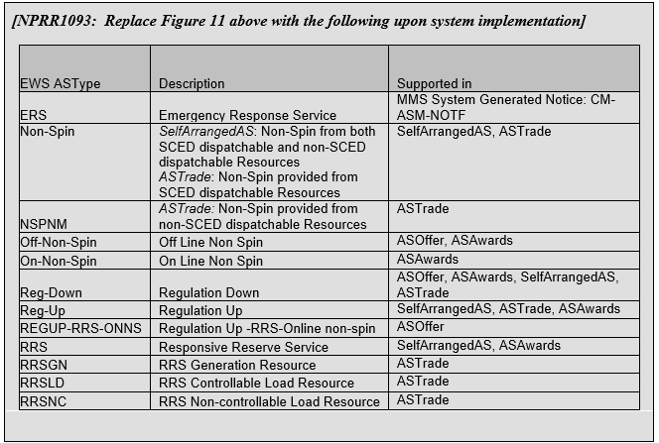
NPRR 1093 Interface changes
EIP_External_Interface_Specifications_v1_22

Slide 9
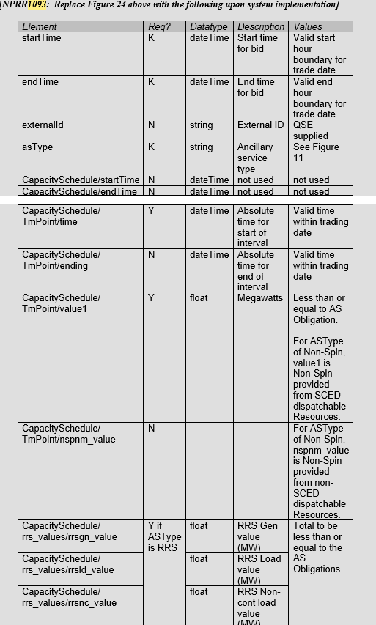
NPRR 1093 Interface changes
EIP_External_Interface_Specifications_v1_22

Slide 10
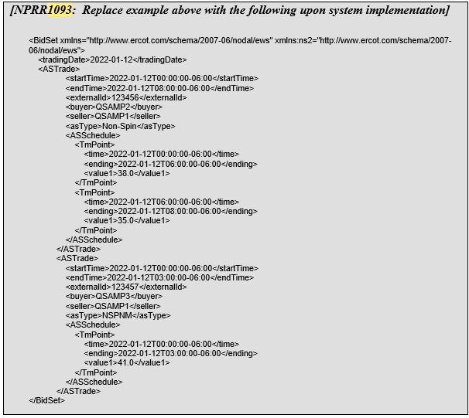
NPRR 1093 Interface changes
EIP_External_Interface_Specifications_v1_22

Slide 11
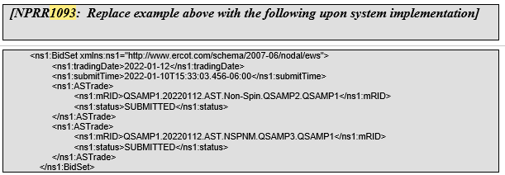
NPRR 1093 Interface changes
EIP_External_Interface_Specifications_v1_22

Slide 12
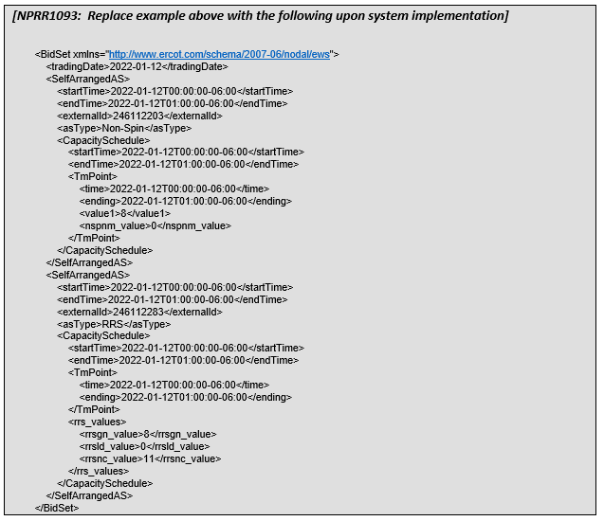
NPRR 1093 Interface changes
EIP_External_Interface_Specifications_v1_22

Slide 13
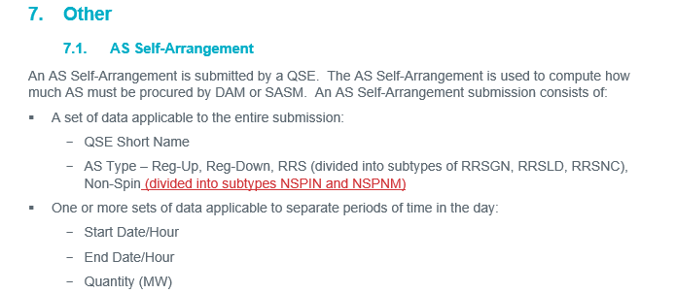
NPRR 1093 Market Validation Changes
MarketSubmissionValidationRules_NP4-450-NPRR1093

Slide 14
NPRR863/FFRA Fast-Frequency Response Advancement Project
High-priority PUCT project
Incorporates Fast-Frequency Response into Response Reserves
Project scheduled for October 2022 Go-Live in R5
Originally was planned for go-live Dec 2021
Project in re-planning stages
Interface specifications previously published are still valid for FFRA changes
See detailed content from 12/7/2021 workshop
Creates 3 sub-types of RRS products
Structural changes to XML and telemetry additions
Changes affect all QSEs that schedule/sell/buy AS (not backward compatible)
Planning for extending time in MOTE (time for QSE break/fix)
ERCOT exploring technical market readiness options (measure MOTE success)
Potentially discuss more at next TWG

Slide 15
Library of NPRR863/FFRA Requirement Changes
Reminder of specs posted in library zip file at 12/7/2021 workshop
MarketSubmissionValidationRules_NP4-450
External Web Services XSD V1.21
EIP External Interfaces Specification v1.21 (FFR & DGR)
ERCOT_Nodal_ICCP_Communications_Handbook_v3_11_Change_Upd
Current Day Reports XSD v6.xx –Excerpt for workshop
Disclosure Reports Column Definitions Guide

Slide 16
NPRR863/ECRS ERCOT Contingency Reserve Service
High-priority PUCT project
Incorporates new 10-minute Ancillary Service (ERCOT Contingency Reserve Service).
Project recently initiated and targeting 2023 Go-Live in first half of year.
Project Impacts
Similar to FFRA in terms of level of changes as this new Ancillary Service will impact all AS-related submissions and not be backward compatible.
ERCOT sharing high-level schedule and impacts so MPs can plan for development resources and budget as needed.

Slide 17
Feedback for next TWG Meeting
Current plan for next TWG meeting:
Discuss changes or additional details for:
NPRR1093 (R3-May 2022 release)
NPRR863/FFRA (R5-Oct 2022 release)
NPRR863/ECRS (first half 2023 release)
Any new projects on horizon
High-level discussion of potential Market Readiness assessment for FFRA & ECRS
ERCOT open to feedback/questions for next TWG meeting
Feedback in meeting, or can be directed to Matt.Mereness@ercot.com

