Slide 1

2022 NERC EMSWG Work Plan
Wei Qiu, Lead Engineer, NERC
ERCOT TWG Conference Call
February 10, 2022

Slide 2
2022 Work Plan
2022 Monitoring and Situational Awareness Conference
  2022 Q3, Virtual
  Renewable resources
  Lessons Learned
  EMS best practice
Risk and Mitigations for Losing EMS Functions Reference Document (biennial)
  2022 Q3/Q4
Definition of “monitoring and control”

Slide 3
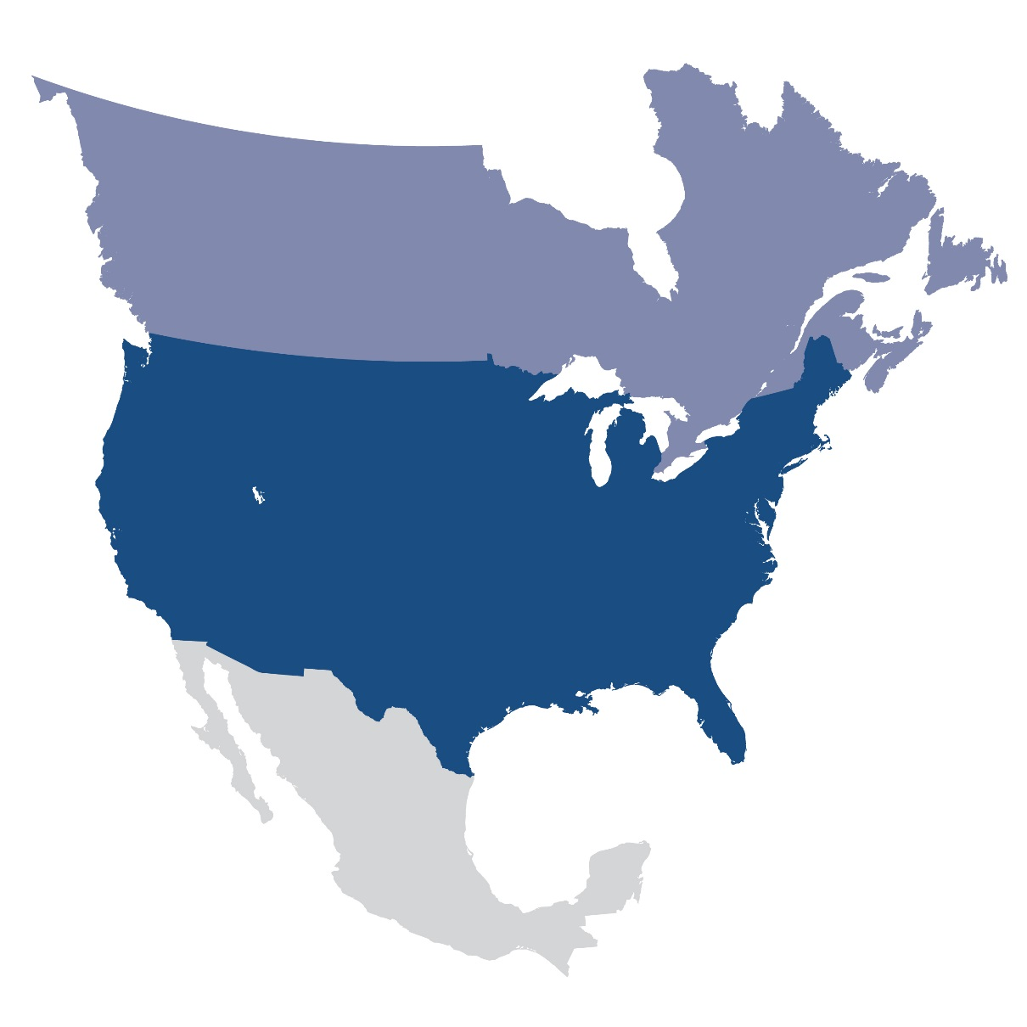
Questions and Answers
Contact Information:
wei.qiu@nerc.net

