Slide 1
ERCOT Technology Working Group (TWG)
February 10, 2022

Slide 2
ERCOT TWG – Venkat Tirupati
WELCOME

Slide 3
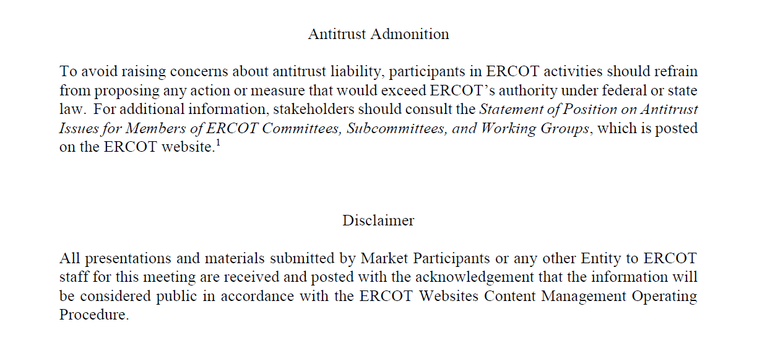
ERCOT TWG

Slide 4
ERCOT TWG Agenda
Item # | Item Description | Presenter
1 | Antitrust admonition | Venkat Tirupati
2 | Review of Charter | Venkat Tirupati
3 | Vice-Chair nomination/selection | Venkat Tirupati
4 | Project Update | Troy Anderson
5 | Discussion of Projects with Interface Change Requirements NPRR1093 – May 2022 New review of XSD changes FFRA/NPRR863 – Oct 2022 Materials previously posted 12/7/21 ECRS/NPRR863 – mid-2023 TBD | Matt Mereness & ERCOT Staff
6 | WAN refresh and encryption project update | Todd Jaksch
7 | NERC EMSWG update | Wei Qiu - NERC
8 | Information Only Topics MMS/OS UI web browser support MOTE enhancements Operator Real-Time Messaging SCR820 | Venkat Tirupati & ERCOT Staff
9 | Future topics of interest Lessons from other ISO TWGs | Open Forum
10 | Adjourn | Venkat Tirupati

Slide 5
ERCOT TWG – Review of Charter
Purpose
Leadership
Membership
Meetings
Charter Review
Scope

Slide 6
ERCOT TWG : Vice-Chair
Nomination/Selection

Slide 7
ERCOT TWG – Troy Anderson
Project Update

Slide 8
ERCOT TWG – Matt Mereness & ERCOT Team
Projects with Interface Change Requirements
NPRR1093 – May 2022
New review of XSD changes
FFRA/NPRR863 – Oct 2022
Materials previously posted 12/7/21
ECRS/NPRR863 – mid-2023
TBD

Slide 9
ERCOT TWG – WAN Refresh Project
Project:
ERCOT is replacing Legacy AT&T TDM network with a dual
T-Mobile MPLS and VoIP alternative. This will upgrade network to a more relevant technology and communication platform.
Goals:
IP based network
Improved engineering and diversity
Allows for voice communications after retirement of legacy AT&T TDM
Status: Project is approximately 90% complete as of end of January.

Slide 10
ERCOT TWG – WAN Encryption Project
Project:
To comply with NERC CIP-012, ERCOT is implementing an encrypted VPN tunnel overlay to all WAN Market Participant sites.
Requirements:
NERC CIP-012 compliance
ERCOT Data Center to WAN Market Participant Encryption
Status: Project is under way, and we estimate completion by end of April 2022.

Slide 11
ERCOT TWG – Wei Qiu
NERC Update

Slide 12
ERCOT TWG – Information Only Topics
MMS/OS UI web browser support
MOTE enhancements
Operator Real-Time Messaging SCR820

Slide 13
ERCOT TWG – Open Forum
What would like to discuss here @TWG in future?

Slide 14
ERCOT TWG
Thank You
Contact me
Venkat.Tirupati@ercot.com

