Slide 1
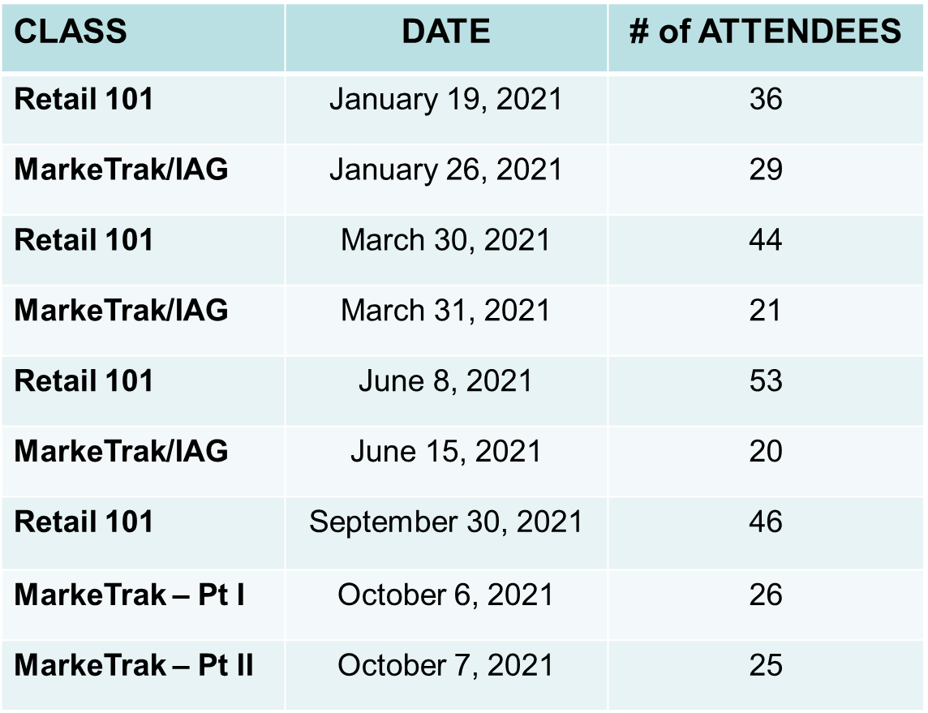
Accomplishments for 2021
 | 2021 Accomplishments
1. | Facilitated the following Instructor-led Courses educating a total of 300 market participants:
2. | MarkeTrak on-line modules – ---Total Participants in 2021 ( --- all time) Retail 101 on-line module – --- Total Participants in 2021 ( --- all time) Mass Transition on-line module - --- Total Participants in 2021

Slide 2
Accomplishments for 2021 – cont.
 | 2021 Accomplishments - cont.
3. | Continued developing TXSET 101 training materials for WebEx training only
4. | Support ERCOT market notifications and communications for training efforts
5. | Verified content and modified Additional Day to Day Subtypes (Siebel Change, Projects, Other) MarkeTrak on-line training modules to align with market revisions as needed
6. | Modified ILT training materials based on feedback as warranted – MarkeTrak & IGL/SH classes
7. | Modified training materials to maintain consistency with Retail market changes (i.e. Emergency Conditions list directing Mass Transition training clarity)
8. | Collaborated with RMS working groups by providing input when updating market documentation (i.e. user guides, process flows), particularly TDTMS

Slide 3
Goals for 2022
 | 2022 Goals
1. | Facilitate Retail 101 training classes by providing SME support for ERCOT led instruction. Classes to be offered at least three times a year and aligned with TXSET Flight schedule.
2. | Conduct MarkeTrak and IGL/Switch Hold instructor led training. Classes to be offered as needed.
3. | Remain flexible and continue to monitor ERCOT and market participant COVID guidelines to determine when in person classes may resume. May pivot Retail 101, MarkeTrak/IGL/SH, and TXSET 101 offerings mid 2022.
4. | Finalize TXSET 101 on-line module for 24x7 Web-based training by mid 2022
5. | Support ERCOT market notifications and communications for training efforts
6. | Support ERCOT training for MarkeTrak technical refresh scheduled to GO LIVE early June 2022. Conduct training workshops on relevant changes.

Slide 4
Accomplishments 2020 – cont.
 | 2020 Accomplishments
7. | Support ERCOT training for SCR 815 MarkeTrak Enhancements scheduled for a December 2022 release. Conduct training workshops on relevant changes.
8. | Modify training materials to maintain consistency with Retail market changes: MarkeTrak on-line training modules to align with the technical refresh and SCR 815 MarkeTrak Enhancements utilizing the revised MarkeTrak User’s Guide as a reference.
9. | Review feedback (survey results) from all training sessions and modify training materials as warranted.
10. | Collaborate with RMS working groups in providing input when updating market documentation (i.e. user guides, process flows)
11. | Support enhancements for ERCOT’s Learning Management System if applicable

