Slide 1
PDCWG Report to ROS
Chair: Jimmy Jackson, CPS Energy
Vice Chair: Vacant
ROS
February 07, 2022

Slide 2
Report Overview & Notes
Report Overview
Meeting Minutes
BAL-001-TRE-2 FMEs and IMFR
0 FME in the month of December
Frequency Control Report

Slide 3
Meeting Minutes
PDCWG Meeting 1/19/2022 (Open Meeting Only)
ERCOT provided an update on RRS PFR Limit Study
Summary of January 2022 PRS Update on FFR and ECRS
SCR809 Resource Limit Calculator during Start up/Shut Down
ERCOT Reports
TEXAS RE : 2021 Year End Analysis

Slide 4
Frequency Measurable Events Performance

Slide 5
Frequency Measurable Events
There was 0 FME in December

Slide 6
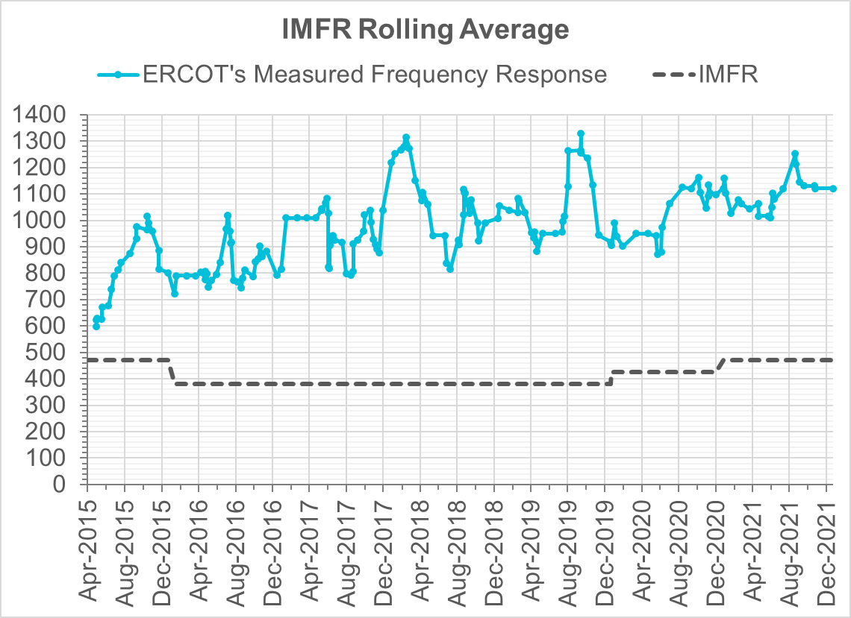
Interconnection Minimum Frequency Response (IMFR) Performance
IMFR Performance currently
1120.7 MW/0.1HZ
Frequency Response Obligation (FRO): 412 MW/0.1 Hz

Slide 7
Questions?

Slide 8
Frequency Control Report
December 2021

Slide 9
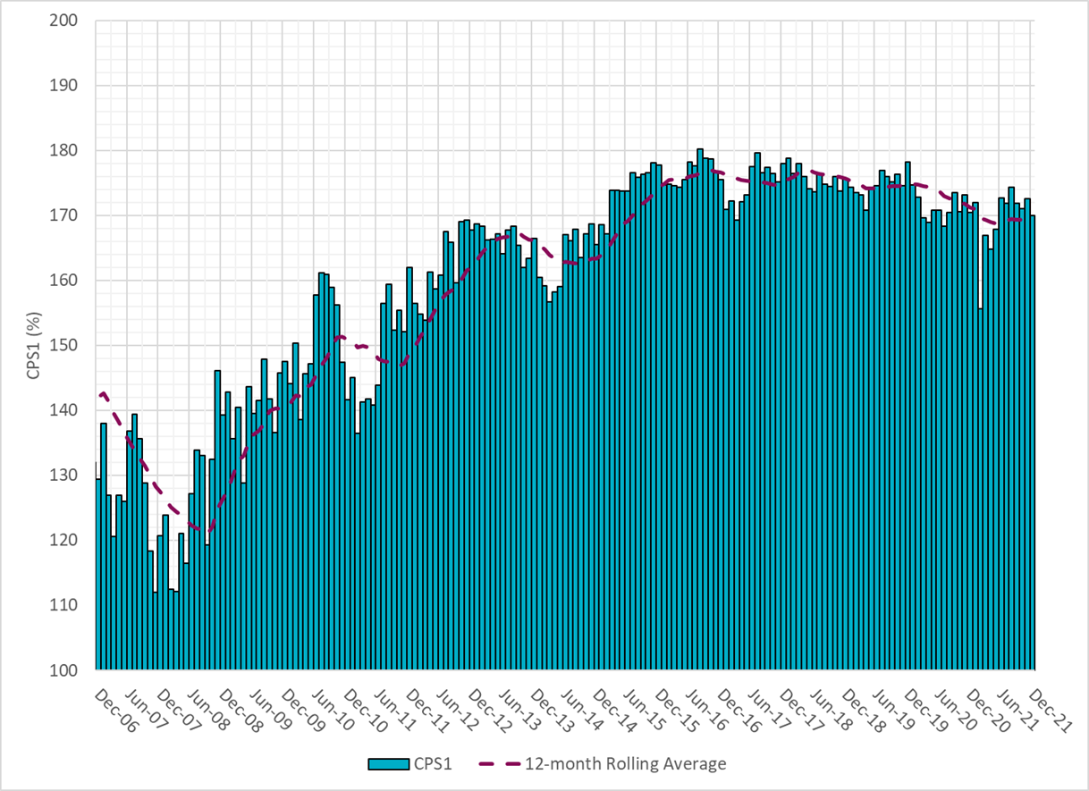
CPS1 Performance

Slide 10
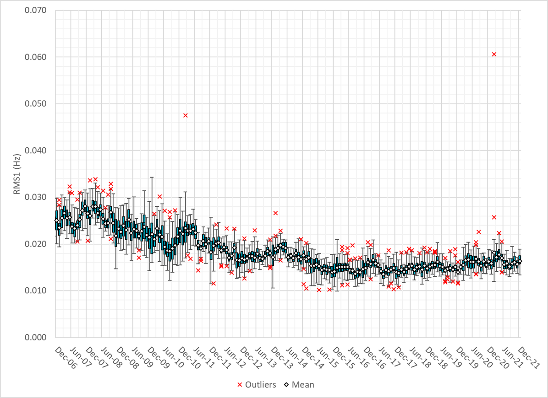
RMS1 Performance of ERCOT Frequency

Slide 11
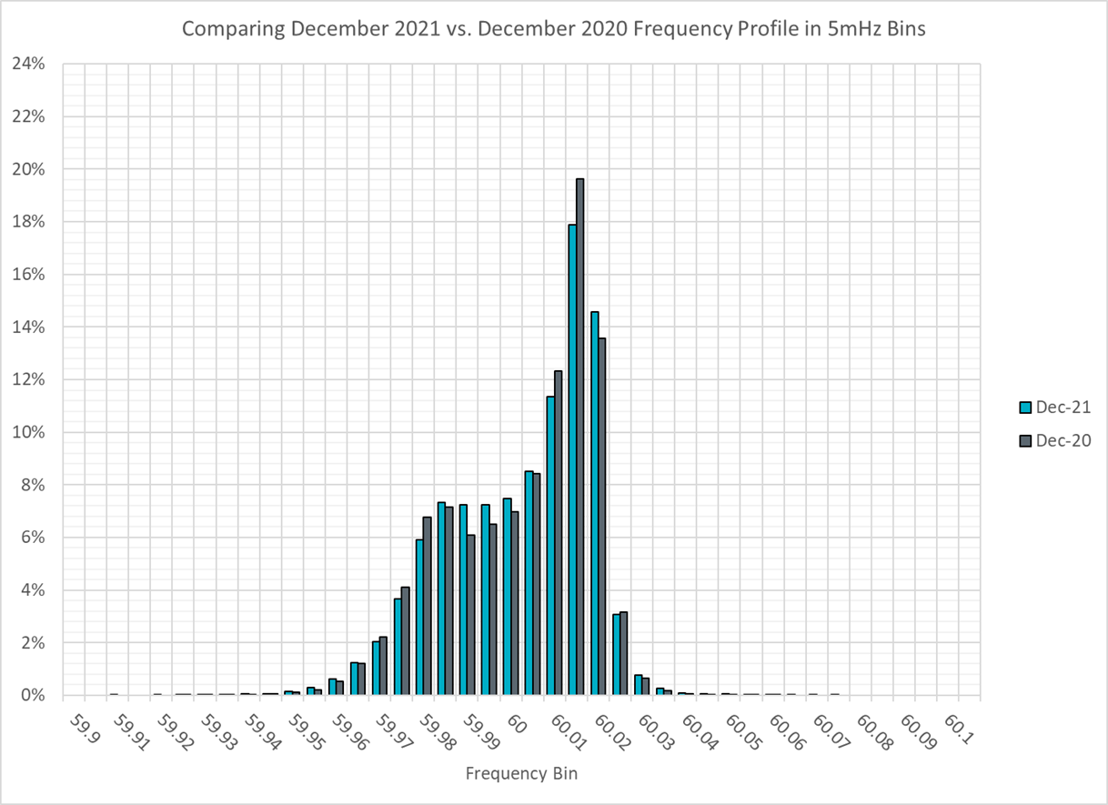
Frequency Profile Analysis

Slide 12
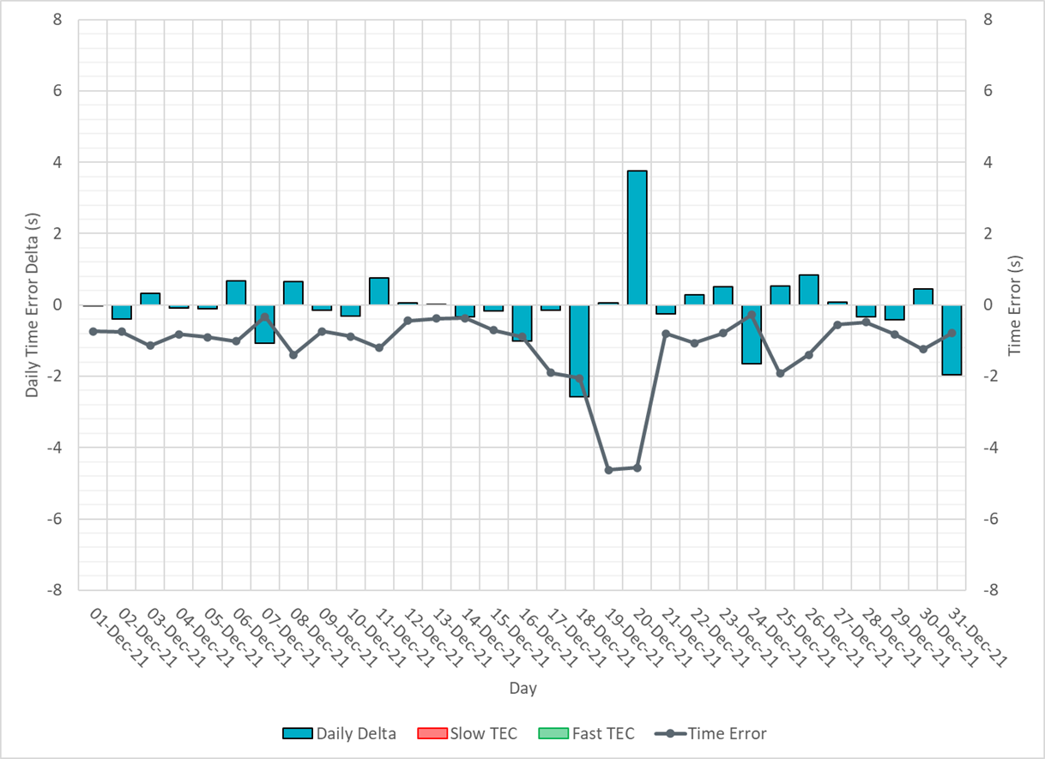
Time Error Corrections

Slide 13
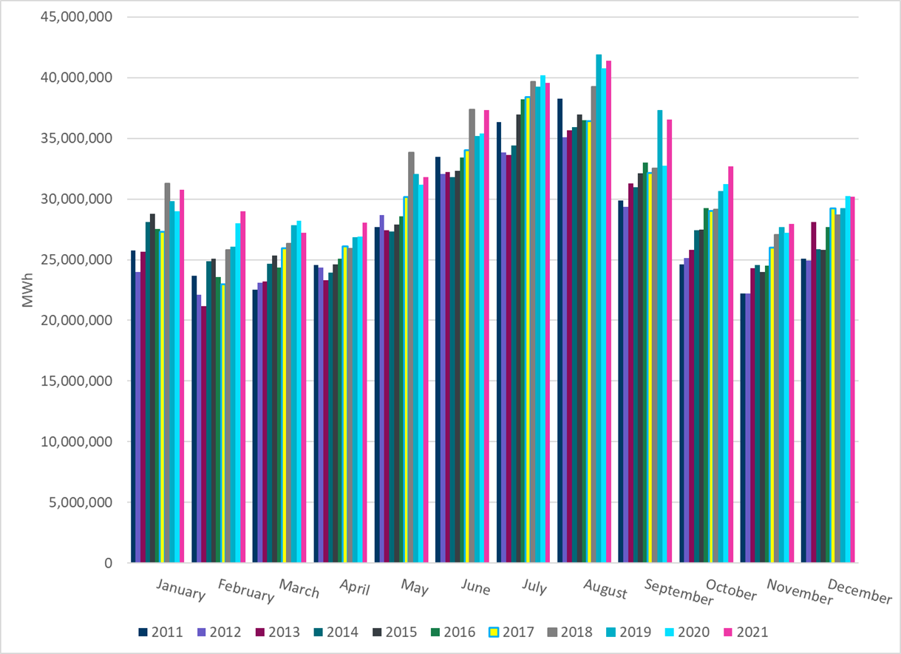
ERCOT Total Energy
Notes:
30,205,131 MWh

Slide 14
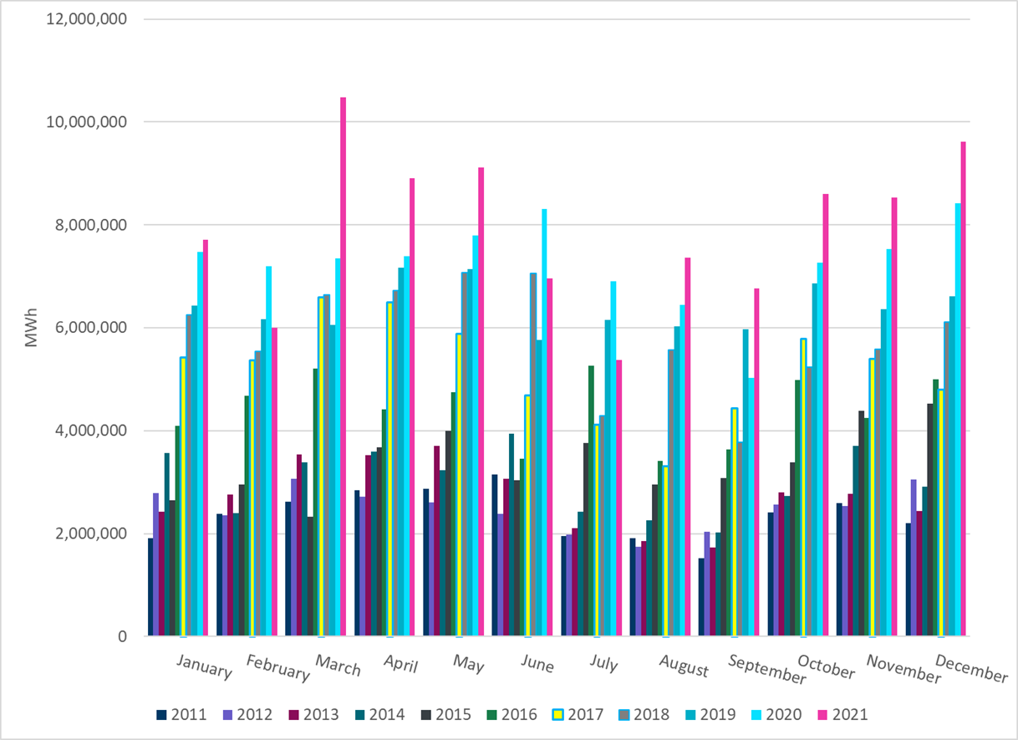
ERCOT Total Energy from Wind Generation
Notes:
9,617,446 MWh

Slide 15
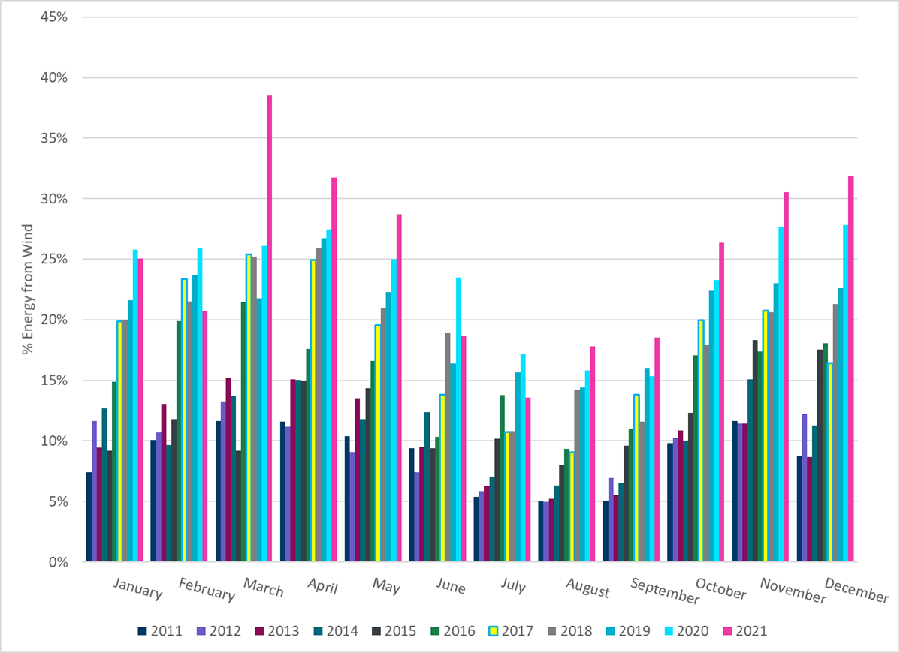
ERCOT % Energy from Wind Generation
Notes:
31.84%

Slide 16
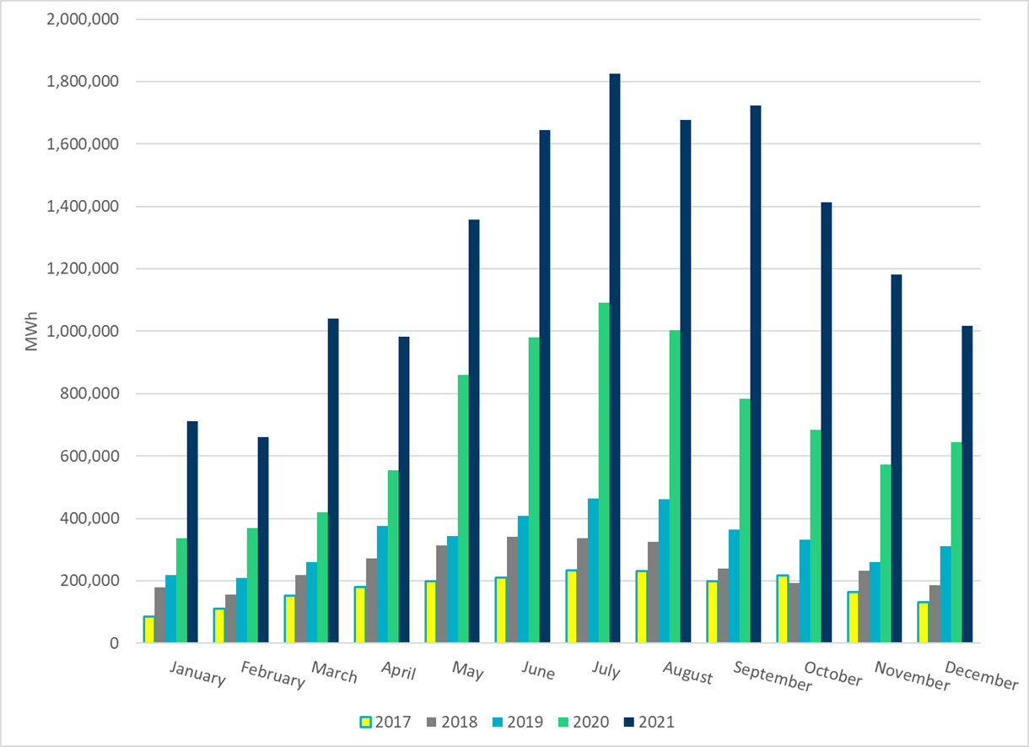
ERCOT Total Energy from Solar Generation
Notes:
1,016,276 MWh

Slide 17
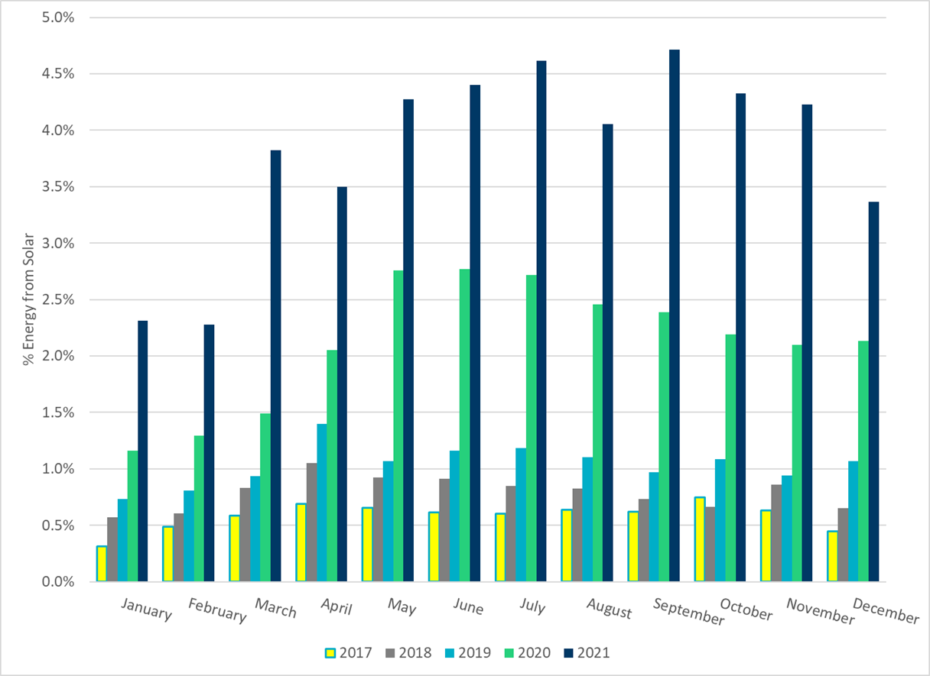
ERCOT % Energy from Solar Generation
Notes:
3.36%

