Slide 1
Meter Working Group Update to WMS
February 2, 2022
Doug Breshears

Slide 2
Update on NPRR1117 and SMOGRR025
MWG reviewed the language for NPRR1117 and SMOGRR025 and support the changes
Design proposal Version 3.1, which support the changes for the line loss compensation requirements, was reviewed and agreed to by the MWG. Document will be posted upon approval of NPRR1117 and SMOGRR025

Slide 3
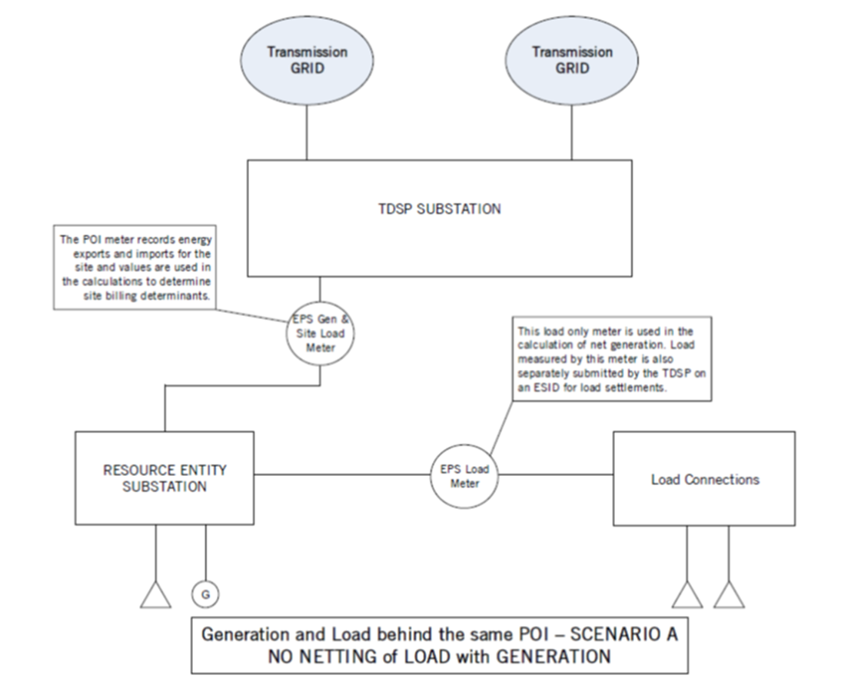
Meter Netting Schemes
Scenario A
Generation and load are both behind the POI
- EPS metering point for the load behind the POI
will be used to calculate net generation flows
Discussion requirements and Protocol questions
-Responsibilities for EPS Load metering?
- Loss compensation requirements for Load Meter
- Separate settlement of generation and Load
- Modeling or operations impacts?

Slide 4
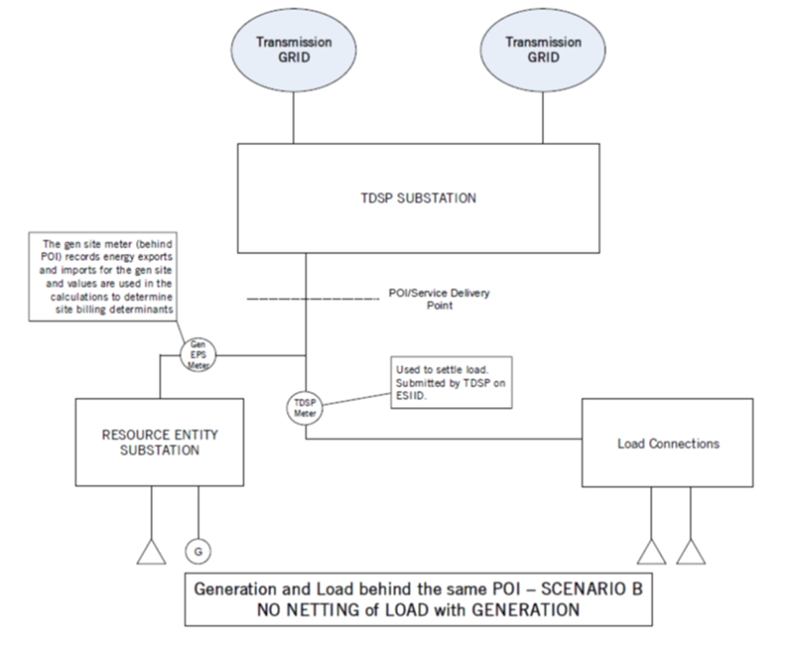
Meter Netting Schemes Continued
Scenario B
EPS metering for the generation site and TDSP metering for
the load point. The load behind the POI is NOT being netted
with generation.
ERCOT has received a Design Proposal for this configuration.
Considerations
- Loss compensation requirements (fixed percentage?).
- Responsibilities for EPS generation and Load metering.
- UFLS and ERCOT Firm Load Shed practices.

Slide 5
Scenario B Continued
Does WMS have any policy concerns on implementing a TDSP EPS Metering Design Proposal that has a separate metering and settlement of Load and generation behind a single POI?
Do other groups need to review this scenario?
Protocols or Guides that may need additional market discussions prior to implementation?

