Slide 1
Market Credit Working Group update to the Wholesale Market Subcommittee
Brenden Sager, Austin Energy, Chair
Seth Cochran, DC Energy, Vice Chair
2 Feb 2022

Slide 2
MCWG update to WMS
General Update
19 Jan 2022 Joint MCWG/CWG WEBEX Meeting
Annual Elections
Brenden Sager, MCWG Chair/Seth Cochran, Vice
Loretto Martin, CWG Chair/no vice
Adopted 2021 goals for 2022 pending possible updates from ERCOT and PUC
Adopted 2021 charter for 2022

Slide 3
MCWG update to WMS
NPRR’s considered for vote
NPRR 1112 – Elimination of Unsecured Credit Limits
ERCOT staff submitted NPRR in late December with Urgent status
Presented first at PRS and referred to MCWG January meeting (not at MCWG)
Attempts to mitigate financial risks from Uri
Group discussing alternatives and plans vote at February meeting to expedite
NPRR 1114 – Securitization Subchapter N Uplift Charges
Assess and collect Uplift Charges to QSEs representing LSEs pursuant to the DOO issued in PUCT Docket No. 52322.
Group approved unanimously because it has positive credit implications and supports PUC and DOO related to Uri

Slide 4
MCWG update to WMS
Following NPRR’s reviewed by the group and considered as NOT having credit impacts
1099NPRR Managing Network Operations Model Resource Nodes. This Nodal Protocol Revision Request (NPRR) grants ERCOT greater authority to move a Resource Node in the Network Operations Model when deemed necessary to properly reflect Point of Interconnection (POI) changes or Resource retirements.
1102NPRR ERCOT Discretion for Adjusting Non-Interval Data Recorder (NIDR) Backcasted Load Profiles. This Nodal Protocol Revision Request (NPRR) grants ERCOT the authority to make adjustments to backcasted Non-Interval Data Recorder (NIDR) Load Profiles.
1113NPRR Clarification of Regulation-Up Schedule for Controllable Load Resources in Ancillary Service Imbalance. ERCOT has discovered that the ERCOT Protocols allow for double counting of the Regulation-Up (Reg-Up) Ancillary Service Schedule when calculating capacity in the Ancillary Service Imbalance Settlement for Controllable Load Resources available to Security-Constrained Economic Dispatch (SCED). This NPRR adjusts the definitions in Section 6.7.5 to prohibit this double counting.

Slide 5
MCWG update to WMS
Ongoing discussions for NPRR’s under consideration
NPRR 1067 – Market Entry Qualifications, Continued Participation Requirements, and Credit Risk Assessment
NPRR 1088 – Applying Forward Adjustment Factors to Forward Market Positions and Un-applying Forward Adjustment Factors to Prior Market Positions
NPRR 1067, NPRR 1088 and the NPRR on Default uplift will be discussed next meeting.

Slide 6
MCWG update to WMS
Default uplift methodology
ERCOT Method
Based on MWh activity ratio share.
Based on month activity before the default occurred.
Allocated to participants under a Counter-Party that contributed the maximum MWh of activity.
PJM Method
Based on an absolute dollar ratio share from monthly bills.
Based on three months activity; month of default and previous two months.
Allocated to all participants, even participants that did not have a monthly bill.

Slide 7
Default Uplift
Fundamentally changing calculation methodology involves substantial resource commitment for ERCOT
Criticism that ERCOT method overallocates financial risk to CRR market and reduces risk to purchase CRR’s
Changing ERCOT’s existing allocations among MP types may be easier to implement and less costly

Slide 8
Default Uplift
Counter-Party Levl*
Segment | January MMA Total (MWh) | January MMA (MWh) | January MMARS %
Gen | 218,577,111.29 | 5,111,155.62 | 2.34%
Load |  | 11,775,576.00 | 5.39%
Load and Gen |  | 94,398,323.87 | 43.19%
Trader |  | 99,998,094.20 | 45.75%
CRRAH Only |  | 7,293,961.60 | 3.34%
Total |  | 218,577,111.29 | 100.00%
QSE/CRRAH Level
Segment | January MMA Total (MWh) | January MMA (MWh) | January MMARS %
Gen | 218,577,111.29 | 4,998,318.29 | 2.29%
Load |  | 28,785,812.00 | 13.17%
Load and Gen |  | 19,844,419.05 | 9.08%
Trader |  | 54,240,444.34 | 24.82%
CRRAH Only |  | 110,708,117.60 | 50.65%
Total |  | 218,577,111.29 | 100.00%
Counter-Party Level
Segment | Total Charges and Credits ($) | Abs of Charges and Credits ($) | Ratio Share
Gen | 1,496,363,922.22 | 53,471,250.62 | 3.57%
Load |  | 87,143,599.79 | 5.82%
Load and Gen |  | 1,120,881,237.36 | 74.91%
Trader |  | 221,417,553.05 | 14.80%
CRRAH Only |  | 13,450,281.40 | 0.90%
Total |  | 1,496,363,922.22 | 100.00%
QSE/CRRAH Level
Segment | Total Charges and Credits ($) | Abs of Charges and Credits ($) | Ratio Share
Gen | 1,496,363,922.22 | 187,529,320.43 | 12.53%
Load |  | 189,353,817.96 | 12.65%
Load and Gen |  | 717,775,179.92 | 47.97%
Trader |  | 242,624,783.77 | 16.21%
CRRAH Only |  | 159,080,820.14 | 10.63%
Total |  | 1,496,363,922.22 | 100.00%

Slide 9
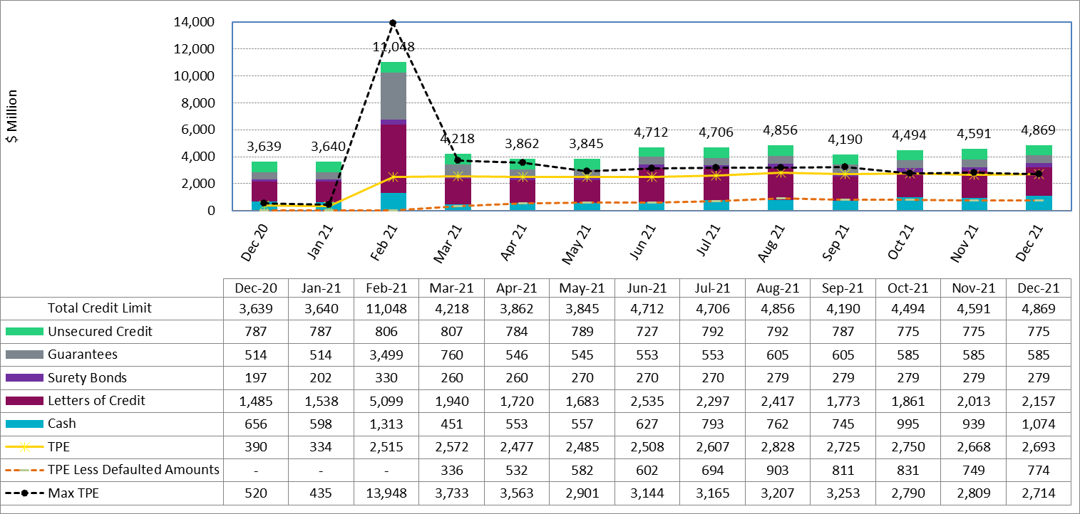
Collateral by Type vs TPE

Slide 10
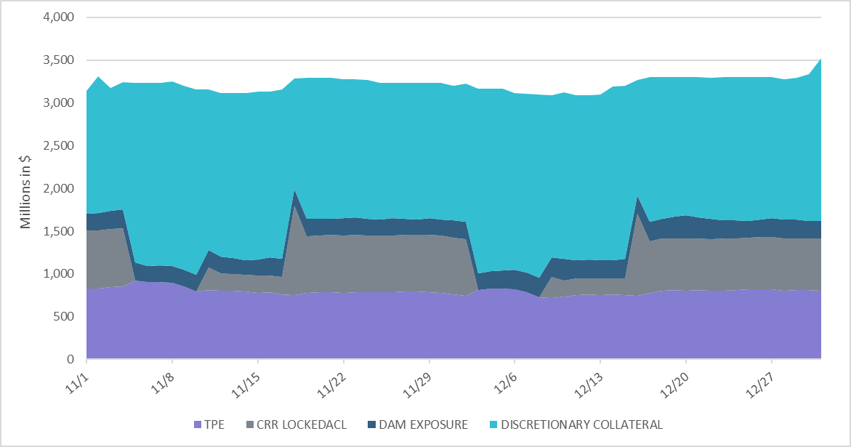
Discretionary Collateral

