Slide 1
Exceptional Fuel Cost Overview
ERCOT
Fred Adadjo | Joshua McGuire
WMWG
January 28, 2022

Slide 2
Exceptional Fuel Costs OVERVIEW
Definition
Submission Process
Used in Mitigated Offer Cap
Submissions: 2021 and 2022
Validation Process

Slide 3
Definition of Exceptional Fuel Costs
Approved with NPRR 847 in August 2018
Exceptional Fuel Cost (EFC): The hourly volume-weighted price of natural gas, purchased during an Operating Day or after the Day-Ahead nomination deadline of 1300 Central Prevailing Time (CPT) on the prior Operating Day, submitted in accordance with paragraph (1)(f) of Section 4.4.9.4.1, Mitigated Offer Cap.
The purpose of EFCs is to provide a fuel cost recovery mechanism for QSEs when their Resources are mitigated in Real-Time.

Slide 4
Submission Process
ERCOT Protocol 4.4.9.4.1(1)(h) Mitigated Offer Cap, allows QSEs to submit EFCs based on the weighted average fuel price (WAFP).
Submission is required by the end of the Adjustment Period for each Operating Hour.
EFCs are submitted into the Market Management System (MMS) via the User Interface (UI).
No later than 5 Business Days after an Operating Day for which an EFC is submitted, ERCOT is required to issue a Market Notice indicating the affected Operating Hours and the number of Resources.

Slide 5
Real-Time Mitigation Offer Cap
General Form of the Mitigated Offer Cap (MOC)
The greater of:
[Generic Heat Rate * Max(FIP, WAFP), {IHR * Max[(FIP + FA),WAFP] + O&M} * Multiplier]
Generic Term Verifiable Term¹
Where,
FIP = Index Price for Natural Gas
IHR = Incremental Heat Rate
FA = Fuel Adder ($0.50 or actual Resource-specific approved rate)
O&M = Approved variable O&M
Multiplier = Based on Capacity Factor
WAFP = Fuel cost based on the actual exceptional fuel prices, weighted by applicable volumes
¹ For Resources with approved Verifiable Costs

Slide 6
Real-Time Mitigation Offer Cap Example
Sample calculation
Assumptions:
Index fuel price (FIP) = $3.00/MMBtu
Fuel Adder (FA) = $0.50/MMBtu. Generic value used for Resources with approved Variable Costs.
Weighted Average Fuel Price for the period (WAFP) = $15.00/MMBtu
Generic Heat Rate = 14.50 MMBtu/MWh
Incremental Heat Rate (IHR) = 13.00 MMBtu/MWh
O&M = $4.00/MWh
Capacity Factor Multiplier = 1.20¹
MOC = Max [Generic Heat Rate * Max(FIP, WAFP), {IHR * Max [(FIP + FA), WAFP] + O&M} * Multiplier]
MOC = Max [14.5 * MAX(3, 15), {13 * Max [(3 + 0.5), 15] + 4} * 1.2]
MOC = Max [217.5, 238.8] = $238.8/MWh
¹Based on capacity factor per Protocol section 4.4.9.4.1 (e) Mitigated Offer Cap

Slide 7
EFC Submissions
As of 1/26/2022, ERCOT has received EFC submissions on 52 Operating Days since 12/1/2021.
The only other EFC submissions since implementation occurred over 10 days in February 2021 during Winter Storm Uri.

Slide 8
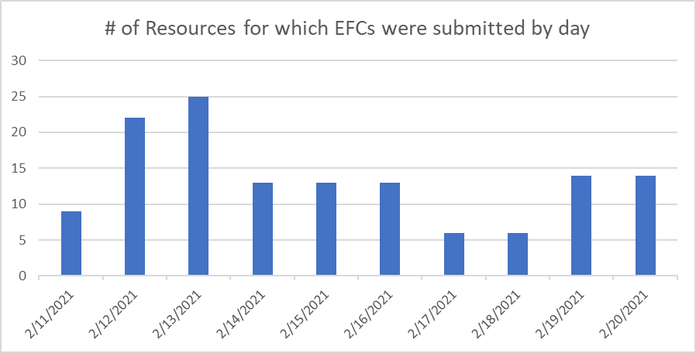
EFC Submissions February 2021

Slide 9
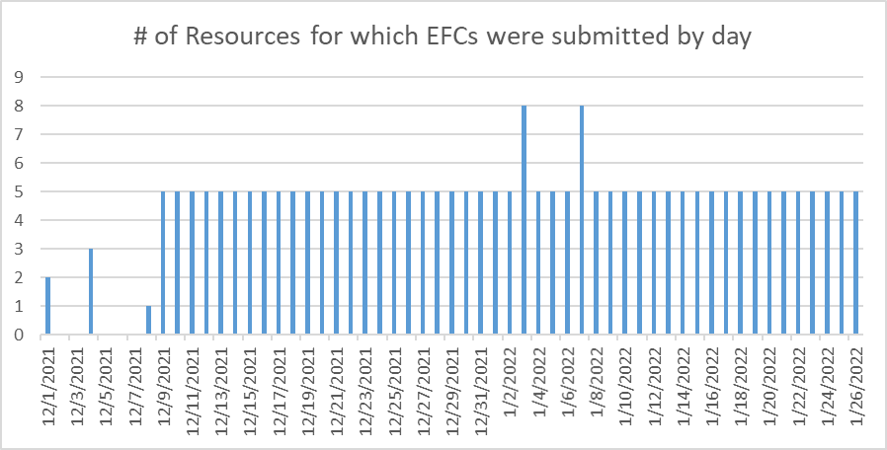
EFC Submissions Since December 1, 2021

Slide 10
Validation Process
QSE Deadlines
15th day following EFC submission
  Attestation
  WAFP calculation
  Fuel purchases
  Any other available documentation
60th day following EFC submission
  Any other supporting documentation not previously provided
  Any information or documentation requested by ERCOT

Slide 11
Validation Process – cont.
ERCOT Validation
WAFP calculation (WAFP > FIP + Fuel Adder + $1.00)
Documentation (e.g., Fuel invoices, contracts, etc.)
Fuel purchases at least 10% of fuel consumed by Resource(s)
No Fixed Costs included

