Slide 1
Overview of
NPRR 1100 Discussion Topics
ERCOT
WMWG
January 28, 2022

Slide 2
Overview of Discussion Topics (slide 1 of 3)
What are the possible site configurations?: (Transmission Connected Only… both Load and Resources)
  Scenario A - Generation Resource serving Load behind the EPS POI meter when both are disconnected from the ERCOT System during an ERCOT Transmission System Outage
  Scenario B - ESR receiving WSL and serving Load behind the EPS POI meter when both are disconnected from the ERCOT System during an ERCOT Transmission System Outage
  Scenario C - Generation Resource located with an ESR (WSL or no WSL) and serving Load behind the EPS POI meter when both are disconnected from the ERCOT System during an ERCOT Transmission System Outage
  Scenario D - ESR not receiving WSL and serving Load behind the EPS POI meter when both are disconnected from the ERCOT System during an ERCOT Transmission System Outage

Slide 3
Scenario B – Energy Storage Resource (“strategically located”)
345 kV line
345 kV line
M1
EPS POI Meter
M3
M4
M2
L1
L2
ESR
Only used when there are Transmission Facility Outages that prevent L1, L2 and the ESR (all three) from being connected to the ERCOT Transmission Grid.

Slide 4
Overview of Discussion Topics (slide 2 of 3)
Definition for “Microgrid Island Mode” (MIM):
  When is it allowed for a Resource and Load to be in MIM?
    As proposed in the Nov 3, 2021, Tesla comments, “the Resource is permitted to switch its energy delivery capabilities to serve a co-located Load only when it cannot participate in ERCOT due to a loss of the transmission system”.
    ERCOT believes this should only be permissible under narrow conditions.
    TDSPs should not be able to intentionally disconnect GRs/ESRs except during Planned Transmission Outages or whenever a GR/ESR is causing an operational issue.
  How is the Resource and Load represented when in MIM?
    Telemetry (see next slides) [Telemetry needed by Operations needs to be usable for Settlements]
    COPs (see next slides) [Operations/Settlements]
    Don’t include Load as part of ERCOT Load
  Should ERCOT perform settlement of energy for the Load and the Resource for the 15-minute intervals when in MIM?

Slide 5
Overview of Discussion Topics (slide 3 of 3)
  How do we ensure that energy discharged during MIM is reconciled for receiving WSL treatment?
    Should NOT let a portion of the ESR consumption from the ERCOT grid get WSL treatment. The portion that is not eligible for WSL treatment should be the quantity that is consumed from the grid but not subsequently provided back to the ERCOT grid ---- due to output from the ESR during MIM intervals.
    What intervals (with consumption by the ESR) should be the intervals ….where there are no WSL benefits?
    How can this be accomplished without a “full-blown” “Generation Accumulator” implementation. [Note that currently there is no protocol language for the Generation Accumulator concept for transmission connected ESRs.]
    Determination of QTY not eligible for WSL treatment
      Option A: Measure with meters.
      Option B: Assume State of Charge (SoC) is “full” at the start of the MIM period and “empty” at the end of the MIM … and take the difference. [Potentially overstates the QTY.]
      Option C: Use SoC telemetry at the start of the MIM period and at the end of the MIM period … and take the difference.
    What intervals should WSL treatment not be provided?
      Option 1: Once the quantity is determined above, find the15-minute intervals preceding the start of the MIM and reduce the previously allowed WSL energy by the same quantity.
    ERCOT to examine options and perform “Value Engineering”. Is there a “less than 100% automated approach” that is reasonable?
  What metering or other calculation of energy flows is required (and used) during MIM? [Depends on outcome of “c” and “d” above.]

Slide 6
Discussion of Operations Requirements for Transmission Connected Resources [Covered at 1-20-22 OWG]
Limited GR/ESR may serve the load BTM ONLY when transmission system is out. (Not directly related to an ERCOT emergency.) [Need to adjust NPRR language and remove reference to emergency.]
Pre-approval of procedures, settings and expected behavior by TDSP/ERCOT/QSE/RE:
  Existing procedures only apply to generation, not picking up energized loads
    Relay settings including synchronization
    Switching procedures and timing
    Consider limiting to open transition switching instead. (Refer to Tesla's proposed sequencing presented at their workshop.)
  Modeling simulations validating that GR/ESR will not trip during transition to and from Microgrid Island mode

Slide 7
Discussion of Operations Requirements for Transmission Connected Resources (cont.) [Covered at 1-20-22 OWG]
Awareness of the island during an event [Needed for Closed Transition]
  Telemetry status of “Out” is not adequate – need an entirely new COPS status with a new Telemetry point to identify “Microgrid” operation for Loads and Generators for Operators.
  Operators will need visual changes to Ops model to highlight islands (new symbol or color).
  Limit GR/ESR Island support to single transmission POI, otherwise too many combinations.
Reconnecting with the transmission system after an event
  Restoration after outage proposes closed transition switching with duration less than 2 seconds.
    Full synchronization capability for Load must be demonstrated and approved in advance.
Reporting after the event
  TDSP and ERCOT required to provide full report on island > 100 MW within 24 hours of event.
    NERC EOP-004
    DOE OE-417

Slide 8
Background-- Timeline
1-27-22: Metering Working Group
1-20-22: OWG stepped through Operation Issues (ERCOT PPT)
12-17-21: WMWG stepped through “Issues to Discuss” slide from Tesla
12-1-21: WMS assigns NPRR to Metering Working Group (MWG) and Wholesale Markets Working Group (WMWG)
12-2-21: ROS assigns NPRR to Operations Working Group (OWG)
10-26-21: NPRR 1100 Workshop
  Not just for Energy Storage Resources. To be made available to any Resource type.
  NPRR is for Resources connected to Transmission System. (Expanding to include Resources connected to the Distribution System is a possible separate NPRR.)
  Solution proposed would apply specifically when the ERCOT transmission system has experienced an Outage that affects both the Resource and the co-located Load (as opposed to during an Energy Emergency Alert (EEA) Load Shed event directed by ERCOT)
  For “Normal Operation” the Resource output and Customer Load is not netted.
  Wholesale Storage Load considerations need to be addressed.
10-6-21: NPRR 1100 Emergency Switching Solutions for Energy Storage Resources is posted

Slide 9
25.501 (m) paragraph 2
  Wholesale storage occurs when electricity is used to charge a storage facility; the storage facility is separately metered from all other facilities including auxiliary facilities; and energy from the electricity is stored in the storage facility and subsequently re-generated and sold at wholesale as energy or ancillary services. Wholesale storage is wholesale load and ERCOT shall settle it accordingly, except that ERCOT shall settle wholesale storage using the nodal energy price at the electrical bus that connects the storage facility to the transmission system, or if the storage facility is connected at distribution voltage, the nodal price of the nearest electrical bus that connects to the transmission system. Wholesale storage is not subject to retail tariffs, rates, and charges or fees assessed in conjunction with the retail purchase of electricity. Wholesale storage shall not be subject to ERCOT charges and credits associated with ancillary service obligations, or other load ratio share or per megawatt-hour based charges and allocations. The owner or operator of electric storage equipment or facilities shall not make purchases of electricity for storage during a system emergency declared by ERCOT unless ERCOT directs that such purchases occur.

Slide 10
Appendix
Links
  ERCOT Presentation at 1-20-22 OWG Webex Meeting: https://www.ercot.com/files/docs/2022/01/21/OWG%20NPRR1100_discussion_updated_mp01202022_pdf.pdf
  Tesla Presentation at the 10-26-21 Workshop: https://www.ercot.com/files/docs/2021/11/10/Tesla_Presentation_to_NPRR_Workshop_10.20.2021_CORRECTED.pptx

Slide 11
Tesla Presentation from 10-26-21 Workshop (next 8 slides)
NPRR1100 ERCOT Workshop – Oct 26, 2021 Speaker: Amir Berahmand, Tesla Electrical Infrastructure Lead Eric Goff, Tesla Consultant
https://www.ercot.com/files/docs/2021/11/10/Tesla_Presentation_to_NPRR_Workshop_10.20.2021_CORRECTED.pptx
11

Slide 12
Overview
Tesla is looking for a solution to use a utility-scale battery storage system, that participates in the wholesale market (under normal conditions), to provide emergency back up power to local facilities in case of grid outage causing loss of transmission service to both the local facilities and the battery storage system.
12

Slide 13
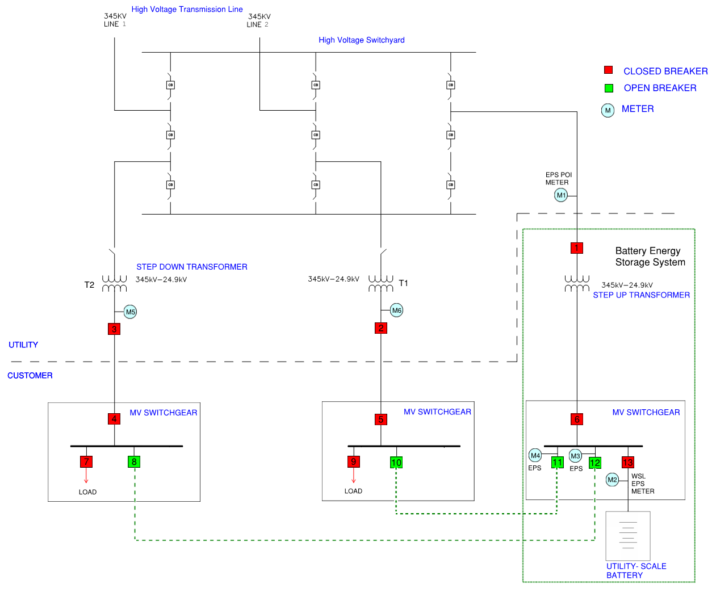
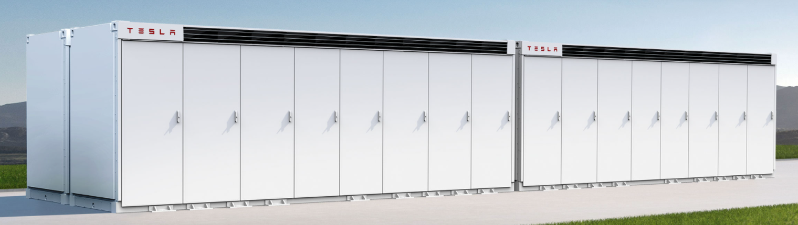
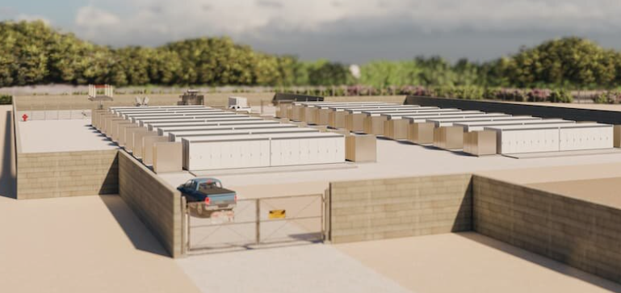
System Overview
TESLA Megapack
TESLA Gambit BESS
13

Slide 14
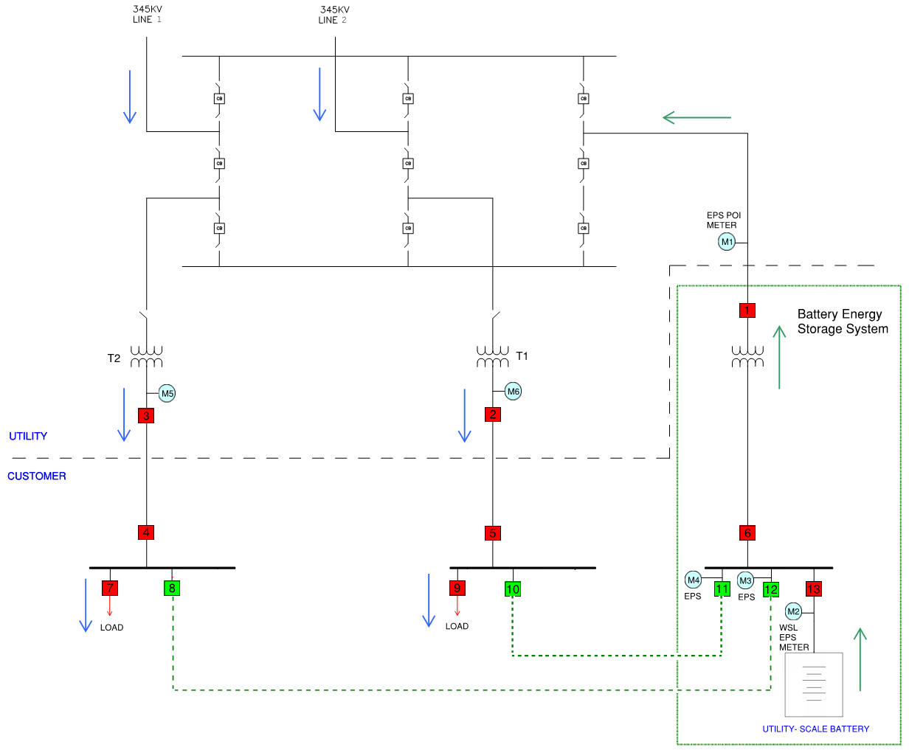
Normal Condition Scenario
Load is fed from the grid
BESS only participates in wholesale market
Load and BESS are isolated (no power flow)
14

Slide 15
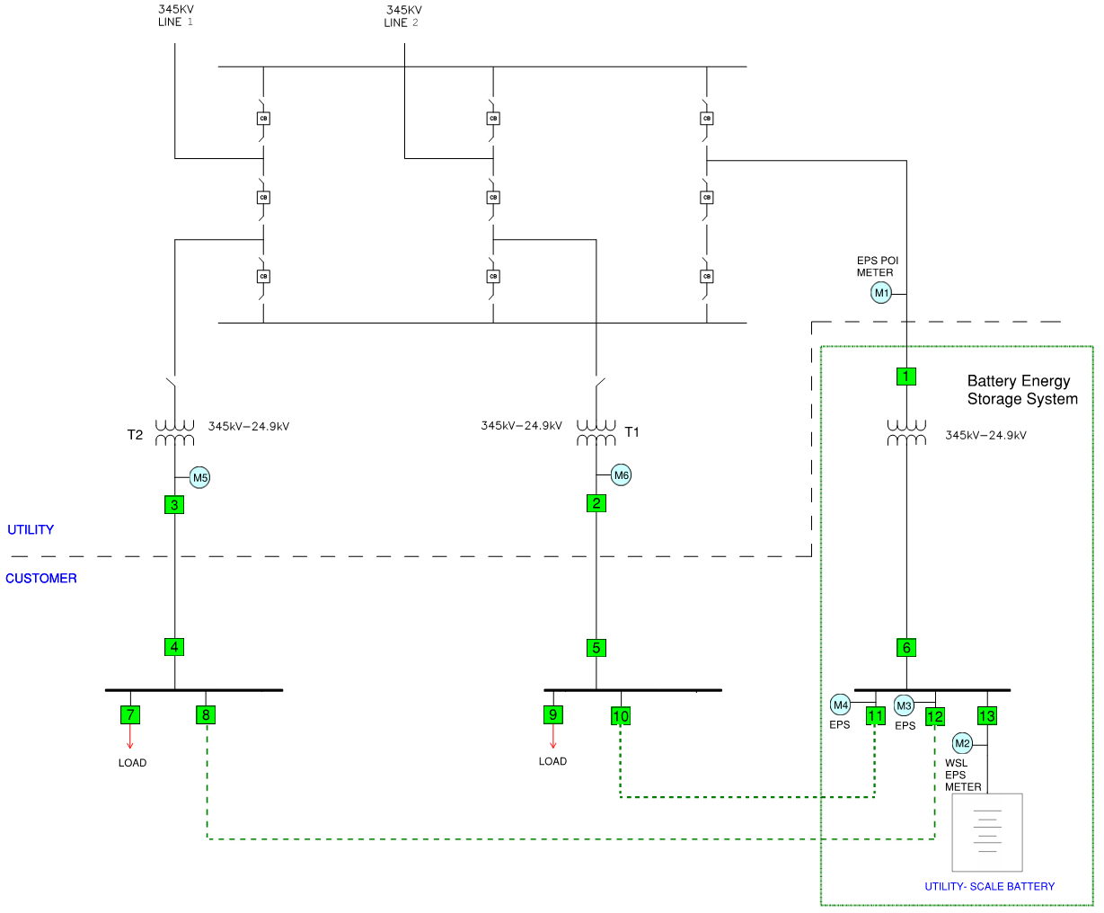
Power Outage
Grid power Outage
BESS is disconnected from the grid (Brk #1, 6)
Load is disconnected from the grid (Brk #2,3,4,5)
BESS and load remain disconnected (Brk #8, 10,11,12)
15

Slide 16
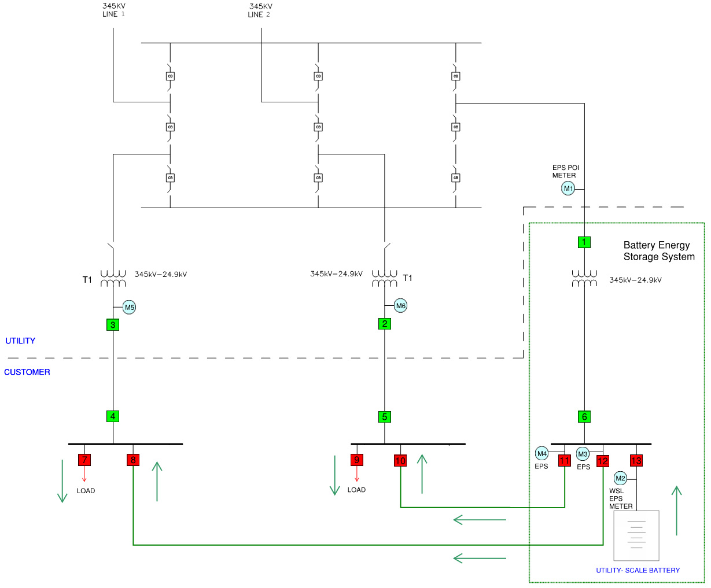
Battery Switching
Battery starts feeding the load, using remaining charge on the battery, by closing brk 8, 10, 11, 12 (Open transition)
Micro grid established
No power flow through Transmission Interconnection Facilities (TIF)
  load and BESS are isolated from the TIF
  Transmission bus is de-energized
  Dead bus pricing rules apply for EPS metering
16

Slide 17
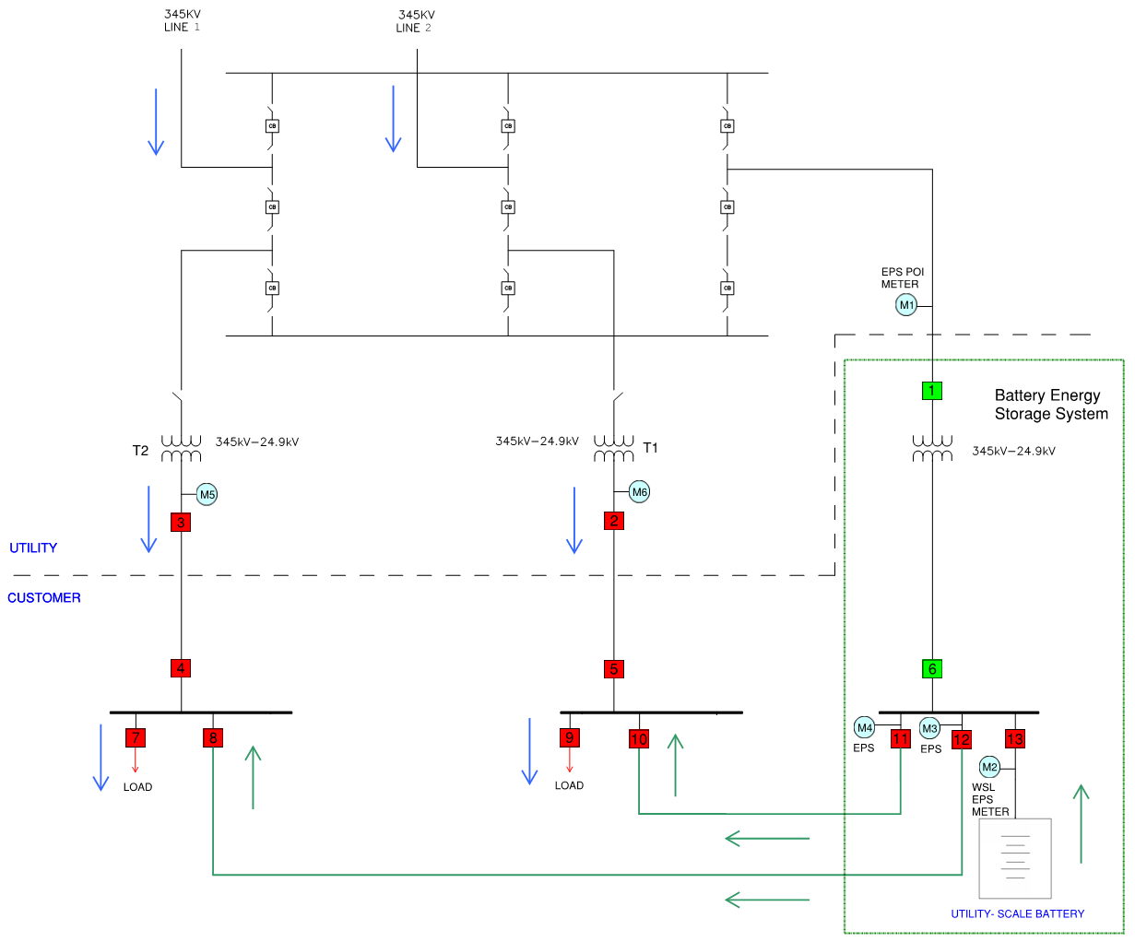
Utility Power Restoration
Transmission service restored
Load is fed from the grid (Closed transition)
BESS remains disconnected from the grid (Brk 1, 6)
17

Slide 18
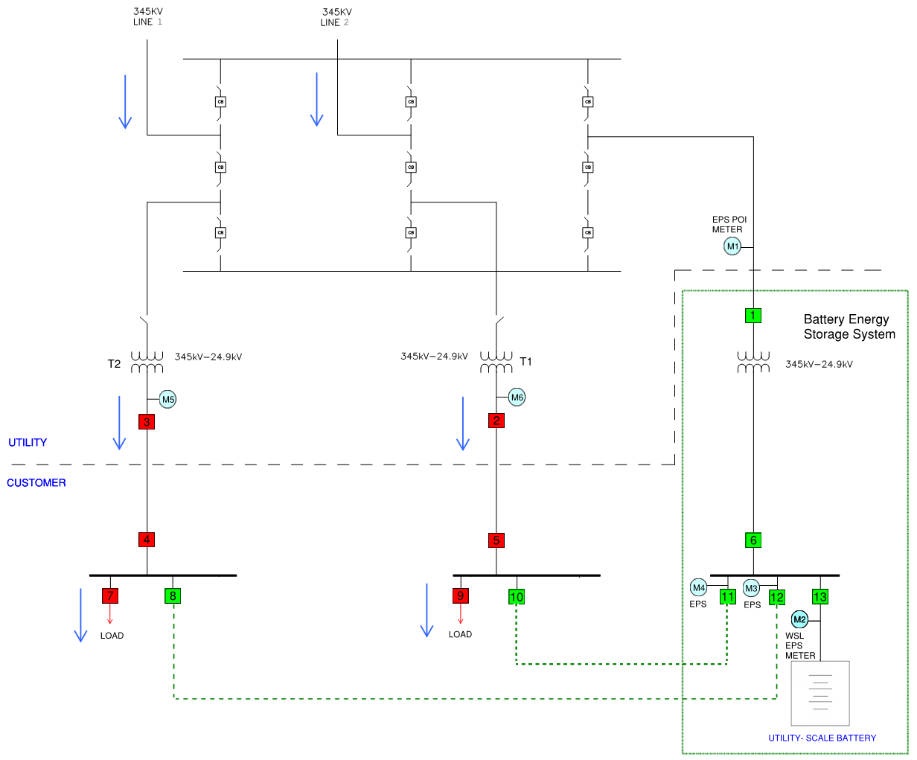
Utility Power Restoration
Battery is disconnected from load (Brk 8, 10, 11 ,12)
18

Slide 19
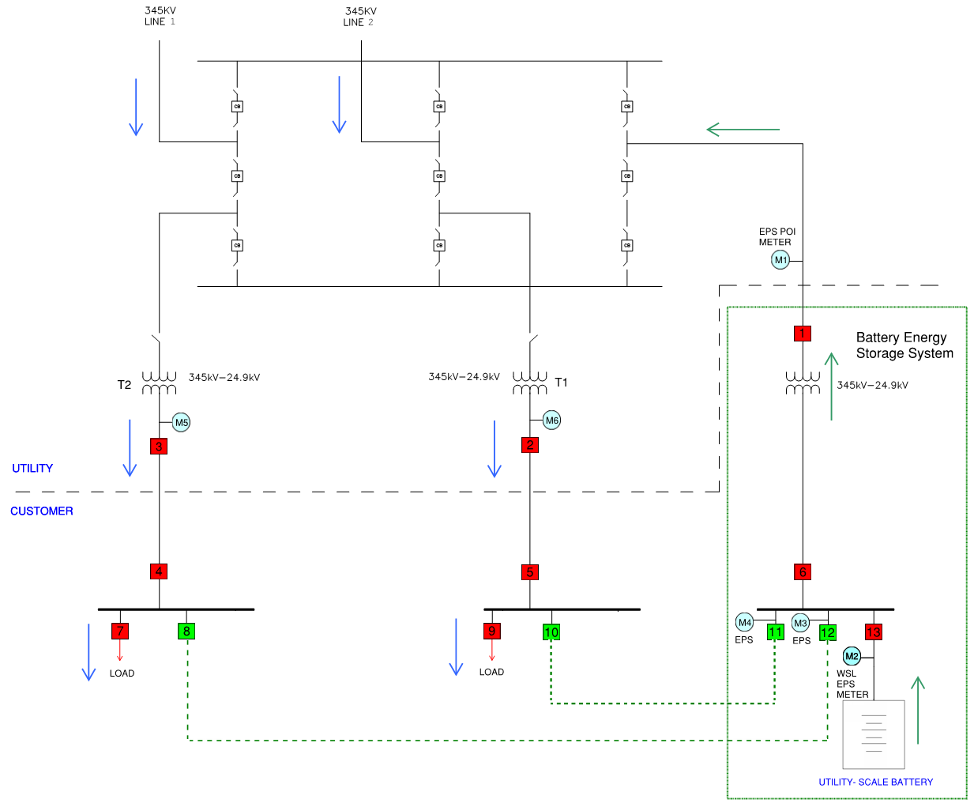
Normal condition
Battery is reconnected to the grid (Brk 1, 6) (Open transition)
19

