Slide 1
Supply Analysis Working Group Update
February 2, 2022, report to WMS
Caitlin Smith, Chair
Kim Rainwater, Vice Chair
Pete Warnken, Vice Chair

Slide 2
Long-Term Load Forecast Discussion
January SAWG presentation https://www.ercot.com/calendar/event?id=1638416970696
Load Forecast Report posted January 18
2022 Long-term Load Forecasting page www.ercot.com/gridinfo/load/forecast

Slide 3
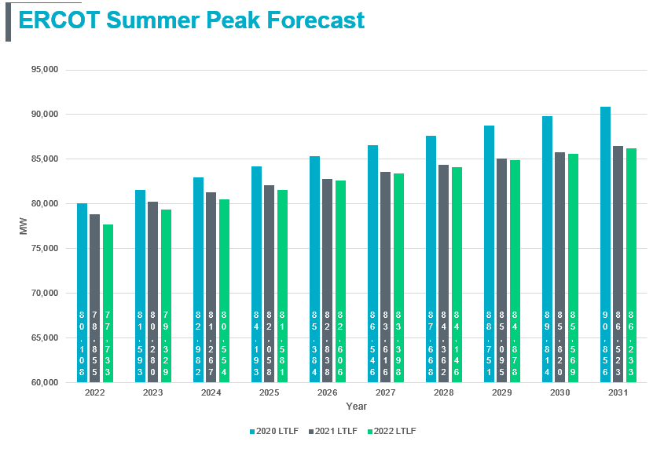
Long-Term Load Forecast Discussion
Reductions in load forecasts, year over year, attributed to COVID impacts and slower development of West Texas oil & gas load

Slide 4
Long-Term Load Forecast Discussion
Rooftop PV Approach
First year with hourly rooftop PV forecast was created
A forecast was created for residential ESIIDs using the load profile assignment for each weather zone
Total installed capacity was approximately 1,030 MW as of September 2021
Forecast is for the total installed capacity to increase to approximately 6,000 MW by August 2031
The gross forecast minus the rooftop PV forecast results in the net forecast
Residential ESIIDs with PV have greater average usage per hour than ESIIDs without PV during the early morning and evening hours
Some studies suggest that customers with PV tend to use more energy
Forecast Adjustments
Lubbock added to North Forecast from 2022 on
Rayburn added to East Forecast from 2022 on
Adjustments added for large industrial facilities (mostly crypto mining)
Current assumptions are conservative, due to uncertainty (good topic for future task force)

Slide 5
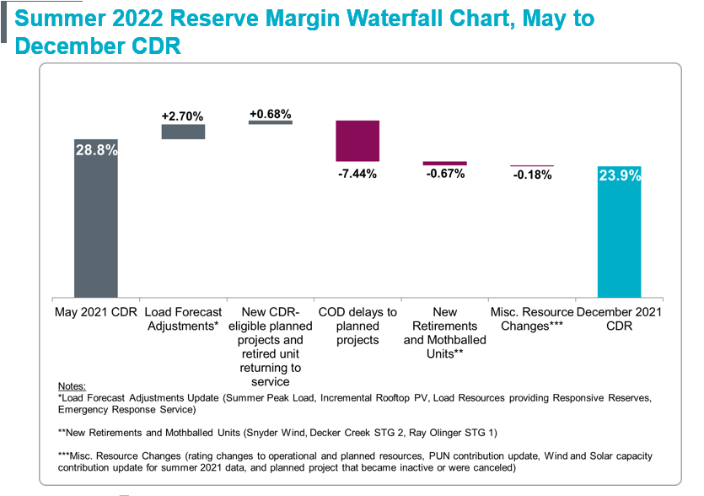
December 2021 CDR Review
Changes from May 2021 CDR: Summer 2022 reserve margin dropped from 28.8% to 23.9%, primarily due to commercial operations delays to planned projects (Supply chain and Federal renewable tax incentive issues account for some of the delays)
ERCOT plans to develop new report similar to past interconnection queue analysis that looked at synchronization success rates of planned projects in the queue
This will be an ongoing discussion at SAWG on developing the report

Slide 6
December 2021 CDR Review
Report design changes:
Consolidated all 10 years of forecast data in the Summary tabs, which was the practice prior to the December 2016 CDR
Moved the Planned-Resource Scenarios into its own tab to make them more conspicuous; the scenarios reflect resources under various planning criteria
Current criteria for inclusion in the CDR
Planning Guide Section 6.9(1) requirements
Planning Guide Section 6.9 requirements
Criteria for inclusion in the Quarterly Stability Assessment
Also compares Planning Reserve Margins across the four Planned Resource Scenarios

Slide 7
CDR Modification Roadmap
ERCOT discussed preliminary plans to be later reviewed and implemented at SAWG, following internal ERCOT and Public Utility Commissioner input
Subject to PUCT approval, CDR improvement initiatives are likely to include:
Distributed Generation reporting
Replace current Peak Average Capacity Contribution method for IRRs with Effective Load Carrying Capability (ELCC)
Including multiple solar regions for ELCC calculation
Expand CDR planned resource eligibility criteria
Net Peak Load Forecast Methodology
Incorporate Reserve Margin Risk Scenarios; possible scenarios include:
Different planned resource inclusion criteria
Alternate load forecast/demand response assumptions
Unconfirmed retirements
Capacity Contribution for batteries and thermal DG resources
Report Organization & Distribution

Slide 8
Next meeting
SAWG next meets March 11, 2022 (note that this was moved from March 9, 2022)

