Slide 1
Congestion Management Working Group
February 2, 2021
Katie Rich, Chair
Andy Nguyen, Vice Chair

Slide 2
Review of NPRR 1111 and SCR 819 Impacts to GTCs
Based on the discussion at the January WMS, CMWG reviewed the impacts to GTCs before and after implementing a Not to Exceed (NTE) limit
The goal of the revisions is to increase the discount limit closer to 100%
To accomplish this, all Intermittent Renewable Resource (IRRs) would be issued a SCED basepoint to follow
ERCOT offered three scenarios to represent how SCED would have controlled the units under the NTE method
ERCOT will be rerunning the NTE cases to adjust assumptions and modeling to better simulate actual conditions (and will be posting an updated presentation to the CMWG meeting page)
Next month: ERCOT will be providing more information on the pricing impacts of the NTE method

Slide 3
Nodal Settlement of Controllable Load Resources (CLRs)
Based on the direction from WMS, CMWG began reviewing the various issues associated with settlement using nodal pricing for CLRs
Items discussed included:
Setting a minimum MW size threshold
Impacts to the increased number of Resource Nodes
Site meter configuration
CLRs collocated with a Generation Resource/Energy Storage Resource
Outage coordination/approval
Next month ERCOT will provide more discussion on allowing collocated CLRs and GR/ESRs to provide full capacity to the market

Slide 4
CRR Activity Calendar Annual Update
ERCOT provided its annual update on the CRR Activity Calendar
Two proposed changes were addressed:
Move the “CRR Ownership Assigned” date back one day to account for the Juneteenth bank holiday.
In June 2024, there will be an extra week between the bid windows for the July 2024 Monthly Auction and the second Annual Auction in 2025 to avoid a conflict with Independence Day.

Slide 5
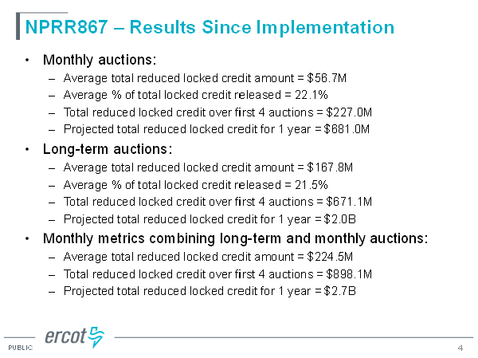
NPRR867 – Update on Reduced Locked Credit Since Implementation
Since implementation, ERCOT has seen signficantly reduced locked credit amounts:

Slide 6
Next Meeting: February 21
Review of NPRR 1111 and SCR 819 Impacts to GTCs
Nodal Settlement of Controllable Load Resources (CLRs)

Slide 7
Questions?

