Slide 1
Unregistered Distributed Generation Report:
2021 Q4 Update
Resource Adequacy
Fred Khodabakhsh
2/2/2022

Slide 2
2021 Q4 Unregistered Distributed Generation Report
Load Zone | 2021 Q4 Distributed Generation Installed Capacity in MW (AC)
 | SOLAR |  | WIND |  | OTHER RENEWABLE |  | OTHER NON-RENEWABLE |  | TOTAL
 | < 50 kW | ≥ 50 kW | < 50 kW | ≥ 50 kW | < 50 kW | ≥ 50 kW | < 50 kW | ≥ 50 kW | < 50 kW | ≥ 50 kW | Combined
LZ_AEN | 72 | 29 | - | - | - | - | - | - | 72 | 29 | 101
LZ_CPS | 197 | 41 | - | - | 3 | - | - | 20 | 200 | 60 | 260
LZ_HOUSTON | 146 | 3 | - | - | - | - | - | 5 | 147 | 8 | 155
LZ_LCRA | 75 | 22 | - | - | - | 1 | 1 | - | 76 | 23 | 99
LZ_NORTH | 375 | 31 | 2 | 1 | - | - | 4 | 5 | 381 | 37 | 418
LZ_RAYBN | 27 | 3 | - | - | - | - | - | - | 28 | 3 | 31
LZ_SOUTH | 151 | 29 | 1 | - | - | - | 1 | - | 152 | 29 | 181
LZ_WEST | 60 | 7 | 1 | - | - | - | - | 1 | 60 | 7 | 68
TOTAL | 1,103 | 163 | 4 | 2 | 3 | 1 | 7 | 30 | 1,117 | 196 | 1,313
Totals may not match the sum of their columns/rows due to rounding
Notes:
Competitive vs. NOIE breakdown:
Competitive: 695 MW
NOIE: 618 MW
NOIE data is submitted through surveys. Competitive TDSP data is submitted through load profile codes.

Slide 3
2021 Q3 → Q4 Change
Load Zone | 2021 Q3 → Q4 Change in Distributed Generation Installed Capacity in MW (AC)
 | SOLAR |  | WIND |  | OTHER RENEWABLE |  | OTHER NON-RENEWABLE |  | TOTAL
 | < 50 kW | ≥ 50 kW | < 50 kW | ≥ 50 kW | < 50 kW | ≥ 50 kW | < 50 kW | ≥ 50 kW | < 50 kW | ≥ 50 kW | Combined
LZ_AEN | +2.07 | +0.61 | - | - | - | - | - | - | +2.07 | +0.60 | +2.67
LZ_CPS | +8.20 | +0.21 | - | - | +0.53 | - | - | - | +8.74 | +0.21 | +8.95
LZ_HOUSTON | +17.16 | +0.05 | - | - | - | - | +0.04 | - | +17.21 | +0.05 | +17.26
LZ_LCRA | +5.60 | +3.56 | -0.004 | - | - | +0.30 | +0.33 | - | +5.93 | +3.86 | +9.79
LZ_NORTH | +24.54 | +0.49 | - | - | - | - | +1.06 | - | +25.61 | +0.49 | +26.09
LZ_RAYBN | +3.59 | +0.05 | - | - | - | - | - | - | +3.59 | +0.05 | +3.64
LZ_SOUTH | +5.73 | +0.43 | - | - | - | - | +0.10 | - | +5.83 | +0.43 | +6.26
LZ_WEST | +2.83 | - | - | - | - | - | +0.02 | - | +2.85 | - | +2.85
TOTAL | +69.73 | +5.39 | -0.004 | - | +0.53 | +0.30 | +1.56 | - | +71.81 | +5.69 | +77.50
Totals may not match the sum of their columns/rows due to rounding
Notes:
- Wind capacity drop for LCRA Load Zone was due to a unit retirement.

Slide 4
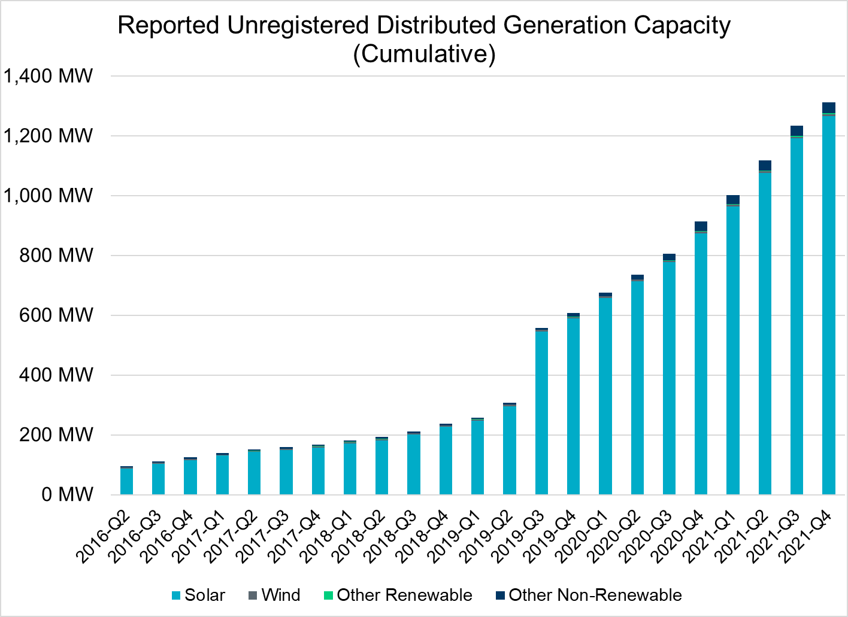
Unregistered DG Growth: 2016-Q2* to 2021-Q4
Large increase due to reporting requirement change**
* 2016-Q2 was the first report published after implementation of report changes per NPRR794/COPMGR044
** 2019-Q3 was the first report published after implementation of report changes per NPRR891

