Slide 1
2022 Long-Term West Texas Export Study – Review
Jameson Haesler
Economic Analysis & Long-Term Studies
January 25, 2022

Slide 2
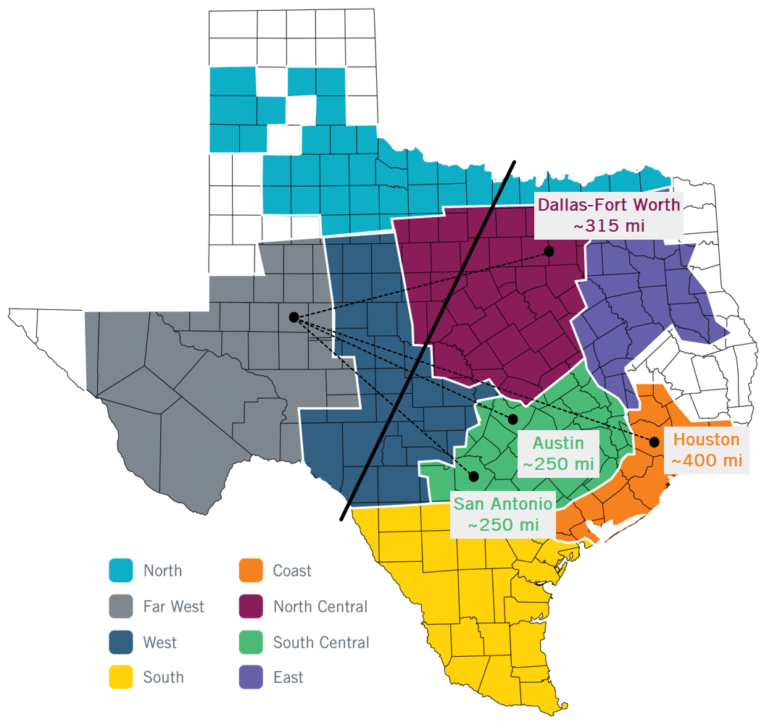
2022 Long-Term West Texas Export Study
More than 67 GW of IBRs planned to be operational by 2023.
Nearly 60%, or over 38 GW, of that IBR capacity is planned for West Texas.
Generation curtailment has been necessary to constrain flows across the interface in real-time operations and may continue to be necessary to maintain stability and a reliable transfer level on the existing system.
In October 2020, a Generic Transmission Constraint (GTC) was established in real-time operations to address wide-area instability challenges associated with large power transfers from West Texas.

Slide 3
2022 Long-Term West Texas Export Study
ERCOT initiated the Long-Term West Texas Export Study⁽¹⁾ in late 2020 with the following objectives:
identify potential cost-effective long-term transmission improvement options, tailored to future system load and generation trends, that alleviate the West Texas export constraint
maximize the realized benefits of increased transfer limits by addressing downstream constraints
improve operational flexibility and resilience
(1). https://www.ercot.com/gridinfo/planning - Long-Term West Texas Export Study Report

Slide 4
Key Findings
The West Texas export interface is expected to become one of the top system constraints by 2023 as a result of continued growth of IBRs in West Texas.
New transfer pathways are essential to effectively improve the West Texas export transfer limit. Additional reactive support alone is not sufficient.
Technologies beyond typical 345-kV circuit additions are needed to effectively improve the West Texas export limit.
Holistic solutions addressing both the West Texas export limit and constraints closer to electrical demand centers are required to accommodate large-scale generation transfers.
The identified improvement options are expected to reduce curtailment but not necessarily allow full output of all IBRs under all system conditions, including peak demand months.

Slide 5
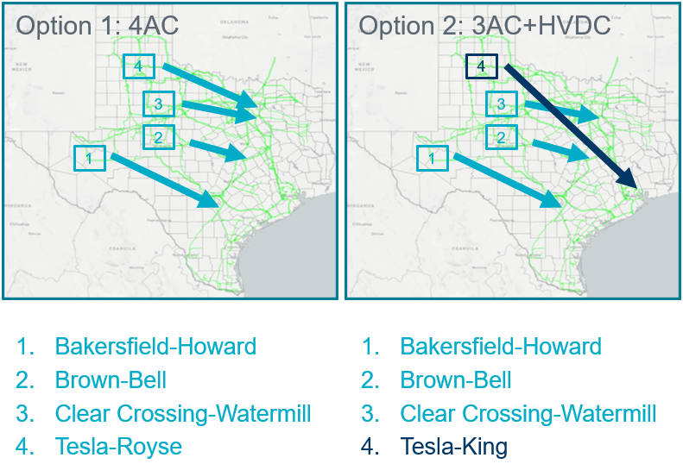
Preferred, Short-Listed Options
Two preferred, short-listed options⁽²⁾ which effectively increased the transfer across the West Texas export interface, reduced West Texas wind and solar curtailment, and delivered transferred power to electrical demand centers.
(2). Teal represents low-impedance 345-kV technology, while dark blue represents 1.5 GW HVDC technology.

Slide 6
Reliability and Economic Results Summary
Both options increased the calculated voltage stability limit by approximately 35%.
In the 2030 study case, approximately $140M of additional production-cost savings resulted from Option 2 as compared with Option 1, highlighting the benefits of a holistic approach considering downstream constraints in tandem with the West Texas export constraint.
Improvement Option | Steady-State Voltage Stability Limit (GW) |  | Estimated New Double-Circuit Miles | Production-Cost Savings ($M) |  | TSP Cost Estimate ($M)
 | 2023 | 2030 |  | 2023 | 2030
Base Case | 12.24 | 13.75 | - | - | - | -
Option 1 (4AC) | 16.46 | 18.35 | 1,009 | 135 | 642 | 2,738
Option 2 (3AC+HVDC) | 16.49 | 18.78 | 1,274 | 170 | 783 | 5,203

Slide 7
Additional 2030 Results Summary
While the two short-listed options did not fully resolve West Texas curtailment or the interface constraints, they are expected to provide consistent and notable system benefits.
Both short-listed options resulted in significant reductions in congestion on the West Texas export interface and West Texas wind and solar generation curtailment.
Option 2 also resulted in reduced congestion on the North-to-Houston interface.
Improvement Option | West Texas Wind and Solar Curtailment (%) | West Texas Interface % of Year Binding | North-to-Houston Interface % of Year Binding
Base Case | 28.4 | 52.4 | 74.5
Option 1 (4AC) | 19.3 | 43.5 | 76.8
Option 2 (3AC+HVDC) | 18.7 | 40.0 | 59.9

Slide 8
Next Steps
ERCOT will continue to evaluate system needs associated with the West Texas export constraint and coordinate with TSPs to identify transmission improvements following applicable planning criteria, including new and updated criteria resulting from ongoing discussions at the Public Utility Commission of Texas (PUCT) and ERCOT stakeholder groups.
Ongoing evaluation will include continued consideration of new transmission technologies and endpoints for potential transmission improvements to determine the most effective approach for maximizing system benefits.
Option | Estimated Power Transfer Improvement | Estimated Cost | Notes
Typical 345-kV double-circuit line | < 1 GW | $$ | Not effective for long-distance transfer Complex SSR issues need to be addressed if adding series capacitors
Low impedance 345-kV double-circuit line | ~1-1.2 GW | $$ | Suitable for long-distance power transfer Not widely implemented
Typical 500-kV double-circuit line | ~1.3-1.6 GW | $$$ | Suitable for very long-distance power transfer Additional transformers are needed to connect to the existing system (~4 transformers per circuit)
VSC-HVDC line | ~1.5-2 GW | $$$ | Suitable for very long-distance power transfer Further discussion on system and market operation required
Reactive Devices | ~2-4 MVAr/MW | $ | Additional reactive devices alone could increase the operational risk of voltage instability near nominal voltage Cost inefficient

Slide 9
Questions / Comments
Please send questions and/or comments to:
Jameson.Haesler@ercot.com
John.Bernecker@ercot.com

