Slide 1
Retroactively Applying NTE to Historic Panhandle Exceedances
ERCOT
01/24/2022

Slide 2
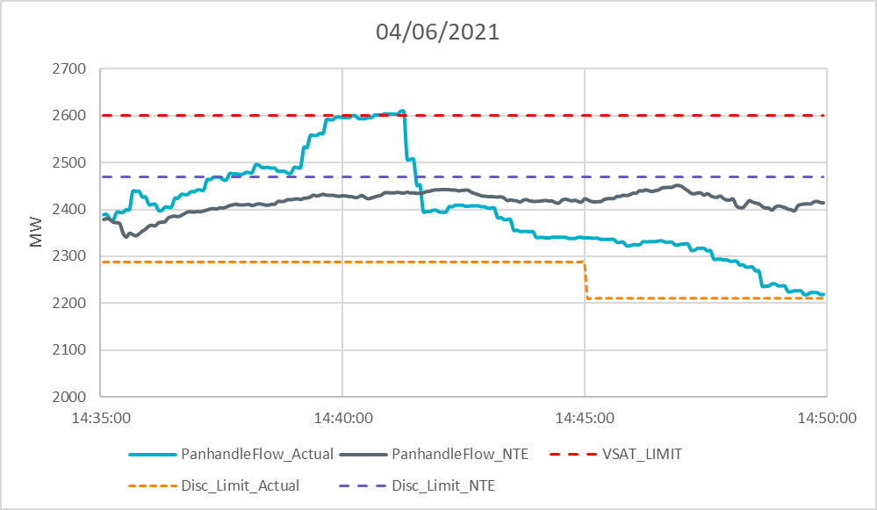
04/06/2021
Notes:
In real-time, SCED was re-run at 14:41:50 (resulting in the reissuance of BP’s and curtailments causing decrease in flow)
NTE_DF = 95%
Real-Time DF = 88%, dropped to 85% at 14:45

Slide 3
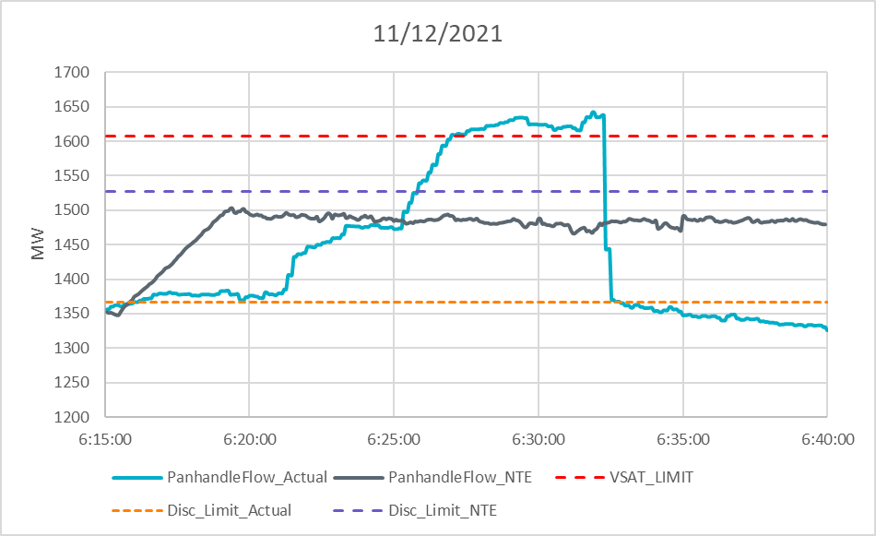
11/12/2021
Notes:
NTE_DF = 95%
Real-Time DF = 85%
Exceedance was due to two units deviating from base points by roughly 300 MW.

Slide 4
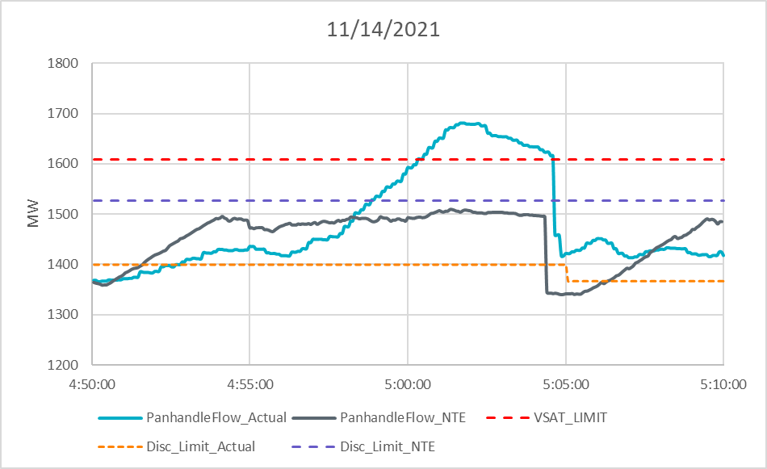
11/14/2021
Notes:
NTE_DF = 95%
Real-Time DF = 87% and changed to 85% around 5:05.
Instantaneous MW drop at 5:04:20 was due to operators instructing a ramping unit to open their breakers. (Loss of about 197 MW)

