Slide 1
Meter Working Group
January 27, 2022

Slide 2
Anti-Trust Admonition
Antitrust Admonition
To avoid raising concerns about antitrust liability, participants in ERCOT activities should refrain from proposing any action or measure that would exceed ERCOT’s authority under federal or state law. For additional information, stakeholders should consult the Statement of Position on Antitrust Issues for Members of ERCOT Committees, Subcommittees, and Working Groups, which is posted on the ERCOT website. http://www.ercot.com/about/governance/index.html
Disclaimer
All presentations and materials submitted by Market Participants or any other Entity to ERCOT staff for this meeting are received and posted with the acknowledgement that the information will
be considered public in accordance with the ERCOT Websites Content Management Operating Procedure.

Slide 3
Attendance Roll-call and Introductions
Brief review of WebEx attendees and meeting format
Selection/Confirmation of Chair/Vice Chair

Slide 4
NPRR 1100 Discussions
Discussion on impacts to metering for NPRR 1100
Telsa presentation from NPRR workshop
https://www.ercot.com/files/docs/2021/11/10/Tesla_Presentation_to_NPRR_Workshop_10.20.2021_CORRECTED.pptx

Slide 5
EPS Metering Document Exchange Options
ERCOT has established a secure share site that can be used to transfer documents instead of email
Current system is only practical on a small scale
Is there a market need to pursue a more widespread approach?
Any TDSP expecting to face restrictions on sending documents (design proposal, one- and three-line drawings, site certification, etc.) over email?

Slide 6
Line Loss Compensation Language Changes Status
Meter Working Group discussed and agreed on language for loss compensation update in Protocol and SMOG during the 11/18/20 MWG.
Had been waiting for NPRR1005 to be approved and implemented
Approved 8/19/21 and Protocol language go live 2/1/2022
https://www.ercot.com/services/comm/mkt_notices/detail?id=8325cfc8-1ac3-4456-825d-50776c231dc8
Update on NPRR and SMOGRR submittal with MWG consensus language on 11/18/20.
https://www.ercot.com/mktrules/issues/NPRR1117#keydocs
https://www.ercot.com/mktrules/issues/SMOGRR025#keydocs
If approved, Design Proposal 3.1 will be published to the ERCOT website which contains updates on how to document the scenario on the design proposal (revisions had consensus from MWG on 11/18/20).
See key document 5 – Design Proposal 3.1 Redline

Slide 7
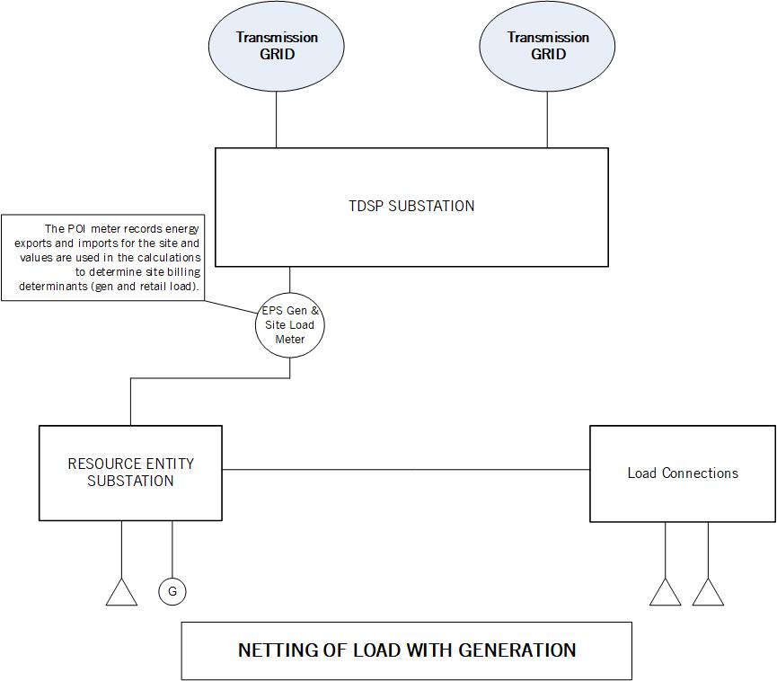
Design Proposal Requirements for Non-Aux Load Netting Configurations

Slide 8
Design Proposal Requirements for Non-Aux Load Netting Configurations
The EPS Metering Design Proposal must be updated to add the additional load to document the netting scheme.
Load value should be updated in boxes A7 for the facility
Changes to the netting arrangement should be noted in box A15 including a reference to the new load type
It is allowed for fixed percentage load split amongst more than one ESIID
Other comments should be added to box A16 to clarify the installation for the settlement purposes as it applies to the whole facility
B27 should also be updated to the new load value and to include the new load type

Slide 9
Design Proposal Requirements for Non-Aux Load Netting Configurations
The EPS Metering Design Proposal reflecting the new load must be approved before the Resource Entity can have the new load placed in the network model and energized
If only adding a new load there are no changes needed to existing site certification documentation.

Slide 10
Design Proposal Requirements for Non-Aux Load Netting Configurations
Current design proposal box A15 states that one-line drawings need to include load circuits.
One-line drawing requirement are listed under Part C instructions.
“A one line drawing should be of sufficient detail to allow verification of the accurate settlement metering of Resources and Loads at EPS Metering Facilities. The drawing should allow the design philosophy, instrument transformer locations, netting scheme, compensation scheme and any breakers isolating loads from generation to be understood.”
Is there value to TDSPs of having the circuit to the load(s) be a requirement of the one-lines?
If not, the language should be updated
Design proposal can be updated as part of the 3.1 change to modify this language (see example below)

Slide 11
Metering Configurations Being Proposed for Use of Existing Infrastructure to Connects Loads and Generation with No Netting
See key document 7. Metering Configuration Discussion – Single POI No Netting

Slide 12
Final Update on Voltage Throw-Over Schemes Related to Black Start
Discussions have been held with TDSPs identified as having potential issues as seen during the black start testing instance
Future design proposals will consider possible system configuration impacts to throw over VT configurations during ERCOT review
If metering issues from throw over VTs occur again and there is a need, this issue may be brought back to the MWG

Slide 13
Reports on EPS Activities
See key document 9. Report on EPS Activities Jan2022

Slide 14
Progress Report on NPRR949 Implementation
NPRR949 was approved 8/13/2019 and Protocol 10.12.1 will be updated effective 1/1/2023 requiring IP EPS meter communication
See key document 10. Progress Report on NPRR949 Jan2022

Slide 15
New or Other Business Items
Request for any new or other business items

Slide 16
Meeting Summary and Closing Remarks
Thank you for your attendance and participation.
Notes from this meeting will be posted on the ERCOT website under the key documents for this meeting.
https://www.ercot.com/calendar/event?id=1639180926783

