Slide 1
Metering Configuration Discussion
Single POI – no netting
January 27, 2022

Slide 2
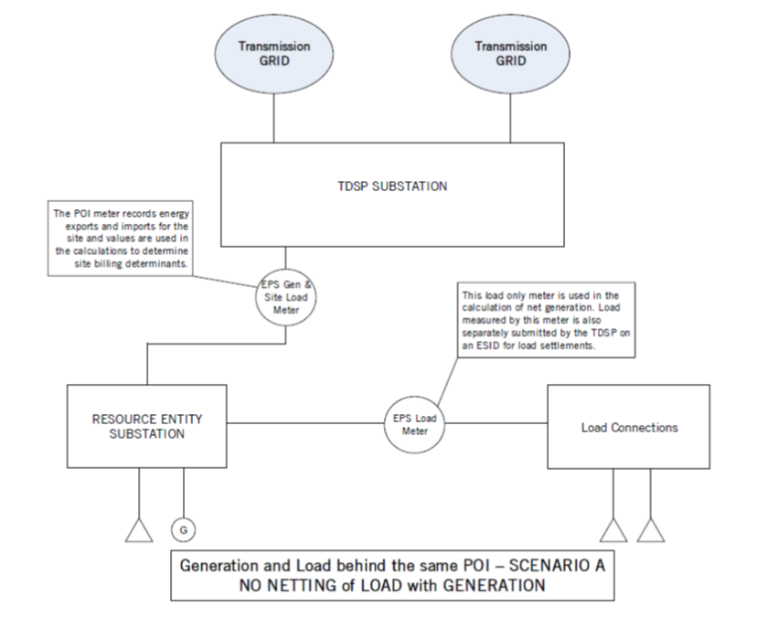
Retail Load Metering Point behind the POI

Slide 3
Retail Load Metering Point behind the POI
The Load and Generation Resource are only electrically connected to the ERCOT Transmission Grid through the EPS metering point at the POI for the Facility.
The EPS Metering Design Proposal indicates that the Load behind the POI is NOT being netted with the generation and includes the Load Metering point behind the POI.
EPS Metering point at the POI and EPS Meter point for the Load behind the POI to support ERCOT Settlements of the generation site

Slide 4
Retail Load Metering Point behind the POI
EPS Metering point for the Load behind the POI used in the calculation of net generation flows for the site, treated as generation production and
  Used to populate NOIE Load for ERCOT Load settlements or
  Meter data submitted by TDSP on an ESI ID and used for ERCOT Load settlements
Calculated site net energy is settled through generation or load settlements and the metered Load values are settled through load settlements.
  Note: As per current protocols (January 2022), load is settled at the applicable Load Zone SPP.

Slide 5
Retail Load Metering Point behind the POI
Some of the concepts requiring discussion and decisions for updating Protocol language to support implementation:
Responsibilities for EPS Load metering point behind the POI
Loss compensation requirements for the EPS Load metering point
Separate settlement of generation site and Load
Any market, modeling or operations impacts
How is the load behind EPS Load metering point considered by the TDSP for UFLS and ERCOT Firm Load Shed practices
Probably others

Slide 6
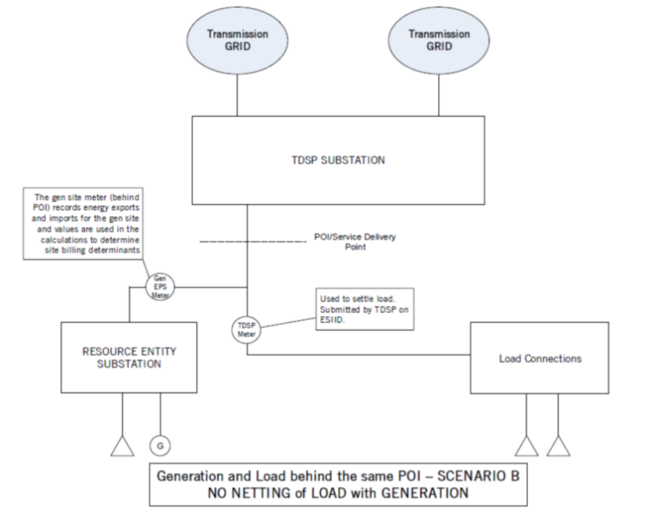
Metering of Gen Site and Retail Load Behind POI

Slide 7
Metering of Gen Site and Retail Load Behind POI
ERCOT has received an EPS Metering design proposal with this configuration, where the connectivity of the load uses existing infrastructure behind a generation site single POI.
The Generation Resource and Load are only electrically connected to the grid through the POI for the Generation Facility. The EPS Metering for the generation site and TDSP metering for the NOIE load point are behind the POI/SDP.
The EPS Metering Design Proposal indicates that the Load behind the POI/SDP is NOT being netted with the generation and includes information that the Load interconnected behind the POI is being settled separately from the generation site as either NOIE or competitive Load.

Slide 8
Metering of Gen Site and Retail Load Behind POI
EPS Metering point behind the POI for the generation facility to support ERCOT Settlements of the generation site
  The generation site metered net energy flows behind the POI are settled as either, net generation through generation settlement or net load through load settlement
TDSP metering for the Load to support ERCOT Load settlements.
  Note: As per current protocols (January 2022), load is settled at the applicable Load Zone SPP
  TDSP Load metering point will be submitted by the TDSP on an ESI ID and used for ERCOT Load settlements
    There is an option for NOIE to have EPS Metering and have ERCOT populate the associated EPS Metering point RID

Slide 9
Metering of Gen Site and Retail Load Behind POI
How would this configuration meet the defined metering requirements for the generation to be metered at/compensated to the shared POI/TDSP Transmission interconnection point?
  Is the generation site EPS meter programmed to compensate the gen site Load and generation channel energy to the shared POI/TDSP Transmission interconnection point?
    Recognize that there would be inaccuracies based on actual energy flows.
      Generation serving load does not flow from the POI, calculation of losses will not represent actual losses.
      Under a net load condition at the POI, individual meter programming will not account for the cumulative current on the line and calculated losses will not represent actual losses.

Slide 10
Metering of Gen Site and Retail Load Behind POI
How would this configuration meet the defined metering requirements for the generation to be metered at/compensated to the shared POI/TDSP Transmission interconnection point?
  Is a fixed factor used to compensate the Load and generation channel energy to the shared POI/TDSP Transmission interconnection point?
    What criteria is used to set the fix factors?
      Maximum possible generation output to POI?
      Maximum possible coincident load consumption at the POI?
      Other?

Slide 11
Metering of Gen Site and Retail Load Behind POI
How would this configuration meet the defined requirements for the NOIE metering point to be compensated to the shared POI/TDSP Transmission interconnection point?
  Is the NOIE Load metering point meter programmed to compensate the energy to the shared POI/TDSP Transmission interconnection point?
    Recognize that there would be inaccuracies based on actual energy flows.
      Generation serving load does not flow from the POI, calculation of losses will not represent actual losses.
      Under a net load condition at the POI, individual meter programming will not account for the cumulative current on the line and calculated losses will not represent actual losses.

Slide 12
Metering of Gen Site and Retail Load Behind POI
How would this configuration meet the defined requirements for the NOIE metering point to be compensated to the shared POI/TDSP Transmission interconnection point?
  Is a fixed factor used to compensate the NOIE Load metering point to the shared POI/TDSP Transmission interconnection point?
    What criteria is used to set the fix factors?
      Maximum possible generation output to POI?
      Maximum possible coincident load consumption at the POI?
      Other?

Slide 13
Metering of Gen Site and Retail Load Behind POI
Some of the concepts requiring discussion and decisions for implementation:
Responsibilities for EPS metering of generation behind the POI
Responsibilities for EPS Load metering point behind the POI
Loss compensation requirements to account for losses under net gen and net load conditions at the POI/TDSP transmission interconnection point Separate settlement of generation site and Load
  Generation site EPS Meter
  TDSP Load metering point

Slide 14
Metering of Gen Site and Retail Load Behind POI
Some of the concepts requiring discussion and decisions for implementation:
Settlement of generation site and TDSP Load metering point
Any market, modeling or operations impacts
How is the load behind EPS Load metering point considered by the TDSP for UFLS and ERCOT Firm Load Shed practices
Probably others

Slide 15
Metering of Gen Site and Retail Load Behind POI

