Slide 1
CRR Activity Calendar Update
Donald House
Supervisor, CRR
CMWG
January 24, 2022

Slide 2
CRR activity calendar – overview
Protocol 7.5.1(4)(c) requires ERCOT to post an updated calendar no later than April 1 of each calendar year
Each calendar includes auction activity dates for the remainder of the current calendar year and for the two subsequent calendar years
The calendar must be approved by WMS prior to the annual posting
Would like feedback today from CMWG on the draft calendar before seeking final approval from WMS on February 2, 2022

Slide 3
CRR activity calendar – general reminders
The model build process begins 2 weeks prior to the model posting date (get outages and Common Information Model snapshot)
We hold a monthly auction and a long-term auction every month of the year
Typical pattern is monthly auction bid window in the first half of the month followed by the long-term auction bid window the very next week (occasionally, there will be a one-week gap to avoid holidays)
Monthly auction results are posted one week after the bid window closes; long-term auction results are posted two weeks after the bid window closes
Monthly auction credit is usually released 1 day after the long-term auction credit is locked (SCR816 will remove this overlap)

Slide 4
CRR activity calendar – general reminders
There are two additional tabs on the calendar
“Calendar Protocol References” includes any specific protocol sections related to the selection of dates
“PCRRs” gives activity dates and protocol sections related to the annual PCRR allocation process

Slide 5
CRR activity calendar – description of changes
Current calendar
Current calendar goes through the 2024.MAR.Monthly.Auction
One change to the currently approved calendar dates
“CRR Ownership Assigned” date moved back one day for the 2022.JUL.Monthly.Auction to adjust the settlements invoice cycle for the new Juneteenth bank holiday (not an ERCOT holiday)
Draft dates cover CRR activities through the 2025.MAR.Monthly.Auction
Applied the same patterns to assign the dates as have been used for previous calendars to maintain Protocol requirements and consistency

Slide 6
CRR activity calendar – description of changes
One exception to the normal timelines
In June 2024, there will be an extra week between the bid windows for the 2024.JUL.Monthly.Auction and the 2025.2nd6.AnnualAuction.Seq3
Necessary to avoid a conflict with Independence Day, which would have required auction credit to be locked 5 days longer than usual
Will result in a 1-day overlap of locked credit, but this overlap will not occur if SCR816 is implemented before these auctions
SCR816 will release auction credit on the day that results are posted
Currently, credit is released when auction invoices are issued on the next business day after results are posted
SCR816 is expected to be approved and implemented sometime in 2022
PCRR-eligible NOIEs are encouraged to view the dates on the “PCRRs” tab of the calendar

Slide 7
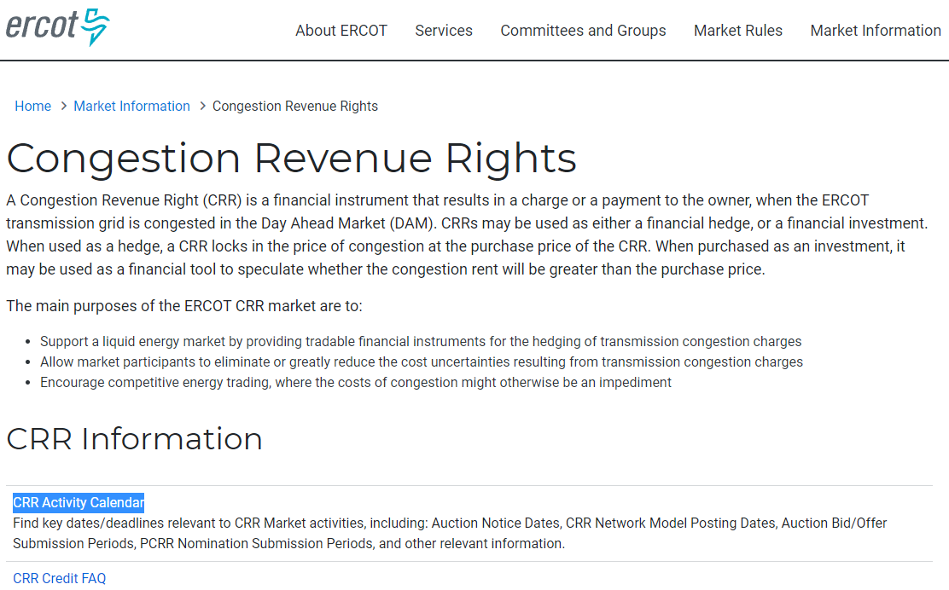
CRR activity calendar – next steps
Will take to WMS for final approval on February 2
Last chance to get WMS approval will be on March 2
Approved calendar will be posted on the CRR webpage by April 1

