Slide 1
ERCOT Frequency Control Report
December 2021
ERCOT
Operations Planning
PDCWG | January 19th, 2022

Slide 2
Summary of December 2021
CPS1: 170.03%
Current CPS1 12-Month Rolling Average: 169.28%
2 BAAL Exceedance(s)
6 hourly CPS1 score below 100%
BAAL-003 Events have updated through 2020
2020 BAAL-003 FRM Performance: -789.34
2021 RMS1 Statistics
  Mean: 16.37 mHz
  Min: 12.01 mHz
  Max: 60.6 mHz
Energy Statistics
  Total Energy: 30,205,131 MWh
  Wind Energy: 9,617,446MWh
  Percent Energy from Wind: 31.84%
  Solar Energy: 1,016,276 MWh
  Percent Energy from Solar: 3.36%
Minimum System Inertia
  Mean: 162,176 MW*s
  Max: 246,027 MW*s on Dec 20th
  Min: 130,757 MW*s on Dec 24th
Notes:
Mean: 162,176 MW*s
Max: 246,027 MW*s on Dec 20th
Min: 130,757 MW*s on Dec 24th

Slide 3
Frequency Control
CPS1, BAAL, & RMS1

Slide 4
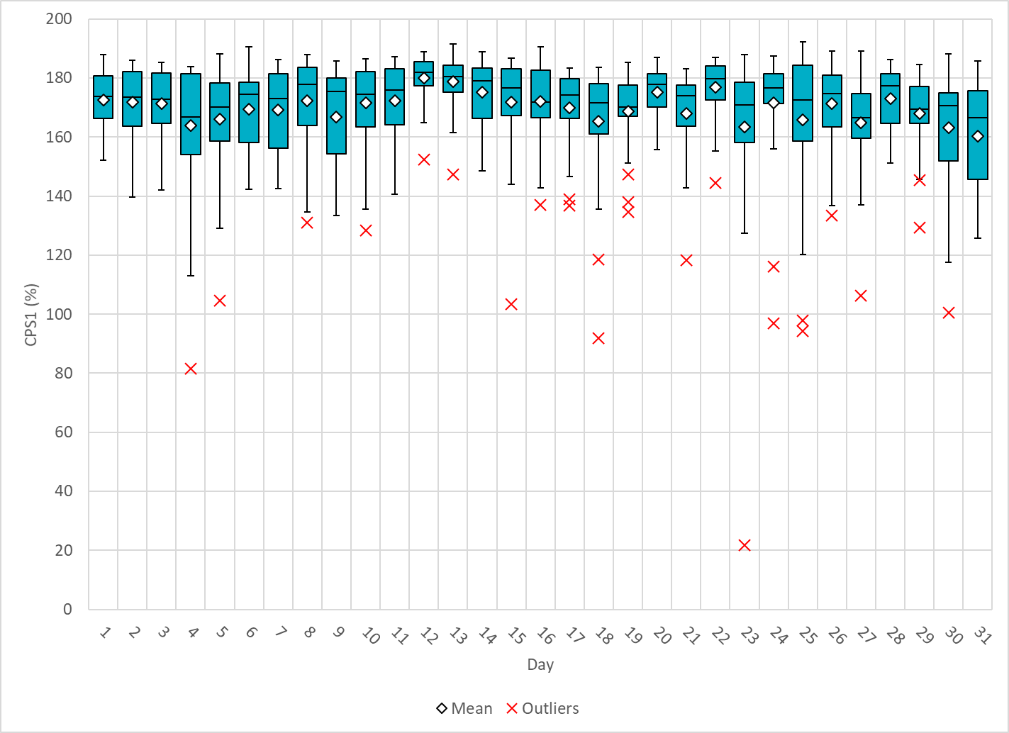
Hourly CPS1 by Day
Dec-21 CPS1 (%): 170.03
Notes:
1. 81.64% @ 12/4/2021 HE 17:00
Expected Generation Deviation
Expected gen dev remained negative for the entire hour. The largest expected gen dev was -1666 MW @ 16:54 with contribution from solar for the most part.
IRR Ramps
Between 16:00 to 17:00 solar ramped down by ~2640 MW.
DC Ties
Between 16:40 to 17:00 DC Tie ramped down by ~460 MW.
Non-conforming Load
Between 16:40 to 17:00 non-conforming load increased by ~250 MW.
Regulation: Regulation up was exhausted in the end of the hour. A 250 MW SCED manual offset was applied.
2. 91.83% @ 12/18/2021 HE 22:00
Expected Generation Deviation
Expected gen dev remained negative for half of the hour. The largest expected gen dev was -1001 MW @ 21:30 with contribution from wind for the most part.
IRR Ramps
Between 21:21 to 21:46 wind ramped down by 844 MW.
Regulation: Regulation up was exhausted during the ramp intervals.
3. 21.78% @ 12/23/2021 HE 10:00
Expected Generation Deviation
Expected gen dev remained negative for majority of the hour. The largest expected gen dev was -2792MW @ 9:37 with contribution from mostly wind.
IRR Ramps
Between 9:00 to 10:00 wind ramped down by ~4200 MW.
Regulation: Regulation up was exhausted during the IRR ramp intervals. A 300 and 600 MW SCED manual offset were applied. 813 MW of RRS was deployed.
4. 96.92% @ 12/24/2021 HE 9:00
Expected Generation Deviation
Expected gen dev remained negative for two thirds of the hour. The largest expected gen dev was -887 MW @ 8:23 with contribution from mostly wind.
IRR Ramps
Between 8:00to 9:00 wind ramped down by ~1070 MW.
Regulation: Regulation up was exhausted for the wind ramp.
5. 94.24% @ 12/25/2021 HE 10:00
Expected Generation Deviation
Expected gen dev was negative for majority of the hour. The largest expected gen dev was -753 MW @ 9:34 with contribution from mostly wind.
IRR Ramps
Between 9:00to 10:00 solar ramped down by 3100 MW and wind ramped down by 1300 MW.
DC Ties
Between 9:26 to 9:36 DC Tie ramped down by ~250 MW.
Regulation: Regulation up was exhausted for most part of the hour.
6. 97.93% @ 12/25/2021 HE 11:00
Expected Generation Deviation
Expected gen dev was negative for majority of the hour. The largest expected gen dev was -851 MW @ 10:26 with contribution from solar and wind and thermal units.
IRR Ramps
A sudden solar down ramp Between 10:17 to 10:24 by ~270MW.
DC Ties
Between 10:16 to 10:24 DC Tie ramped down by ~110 MW.
Regulation: Regulation up was exhausted for most part of the hour..

Slide 5
BAAL Exceedances & Violations
There are 2 BAAL exceedance(s) in December
Notes:
Both occurred on 12/23/2021 due to significant wind down ramps

Slide 6
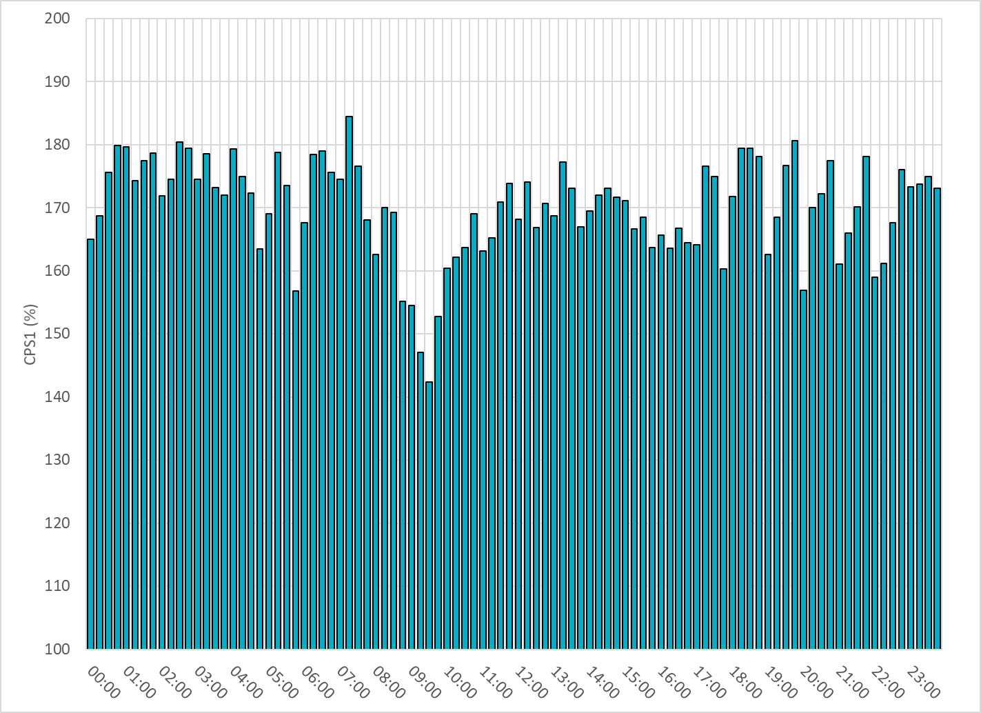
15-Minute Average CPS1%
Dec-21 CPS1 (%): 170.03

Slide 7
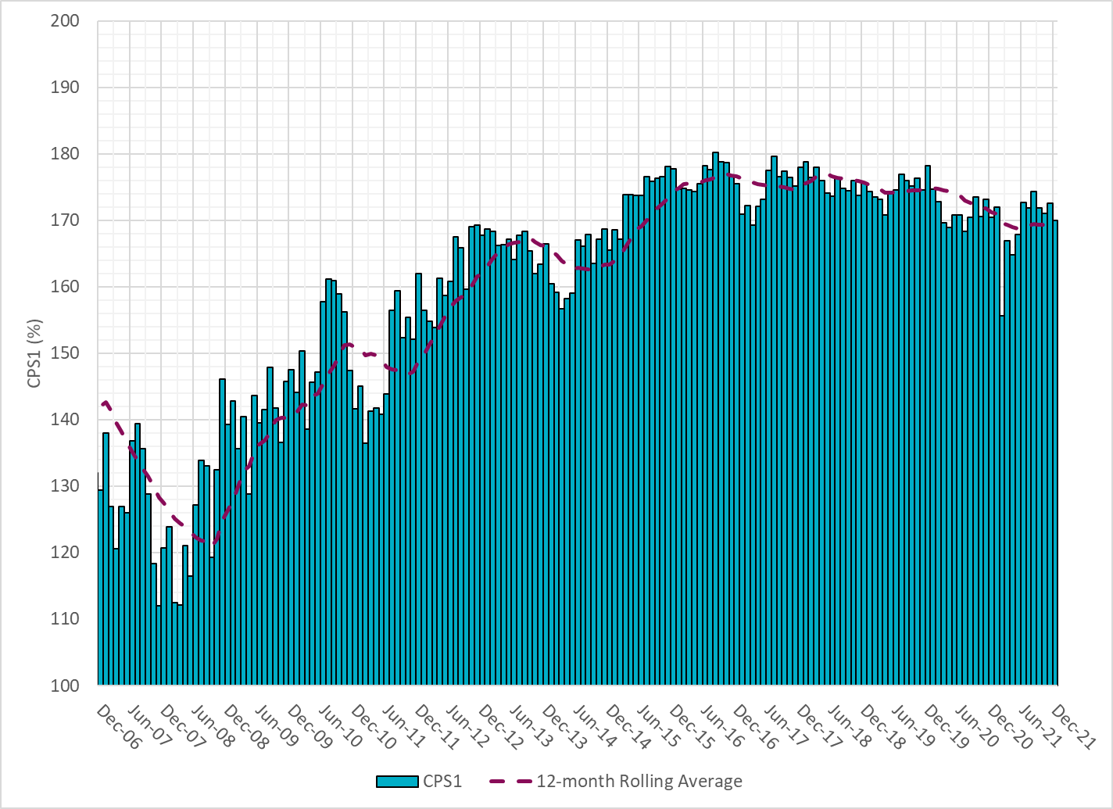
12-Month Rolling Average CPS1
Current 12-Month Rolling Average: 169.28%

Slide 8
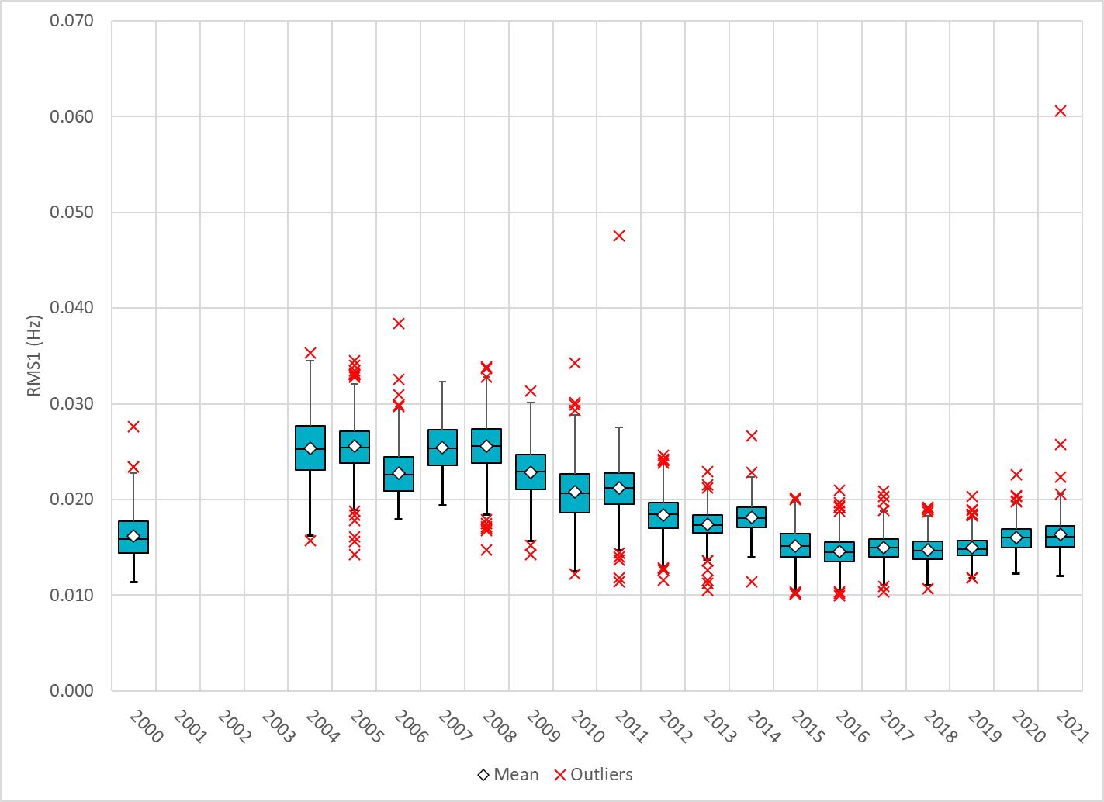
Daily RMS1 of ERCOT Frequency by Year
Notes:
Mean: 16.37 mHz
Min: 12.01 mHz
Max: 60.6 mHz

Slide 9
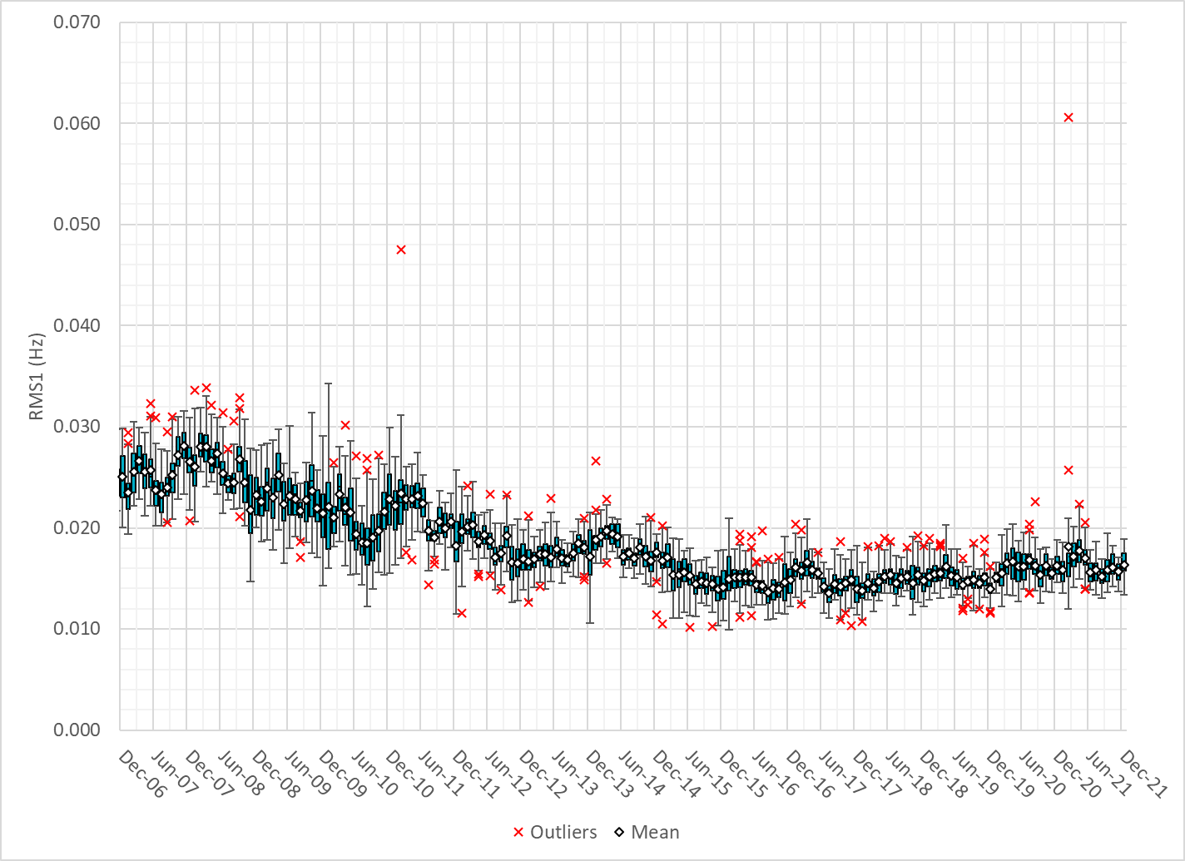
Daily RMS1 of ERCOT Frequency by Month

Slide 10
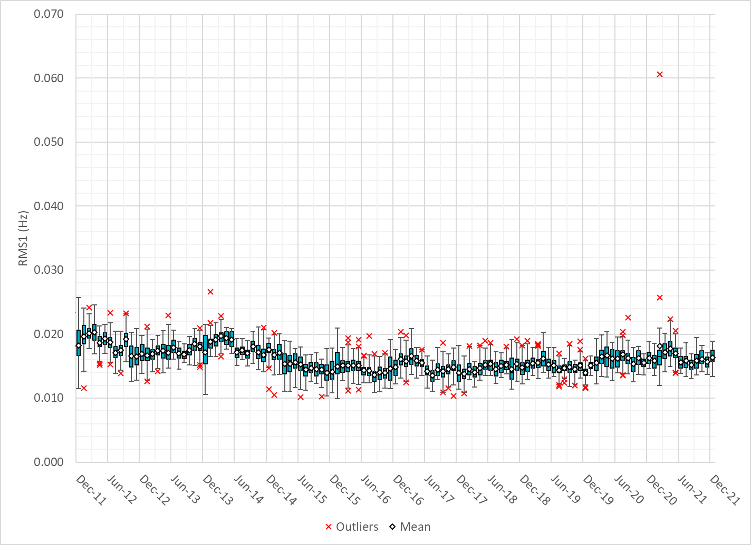
Daily RMS1 of ERCOT Frequency by Month
Notes:
16Mhz on avg

Slide 11
Frequency Profile Comparison

Slide 12
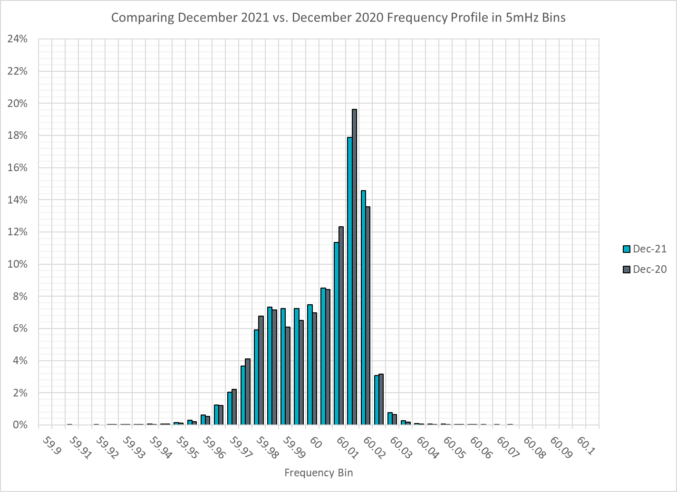
Frequency Profile Comparison

Slide 13
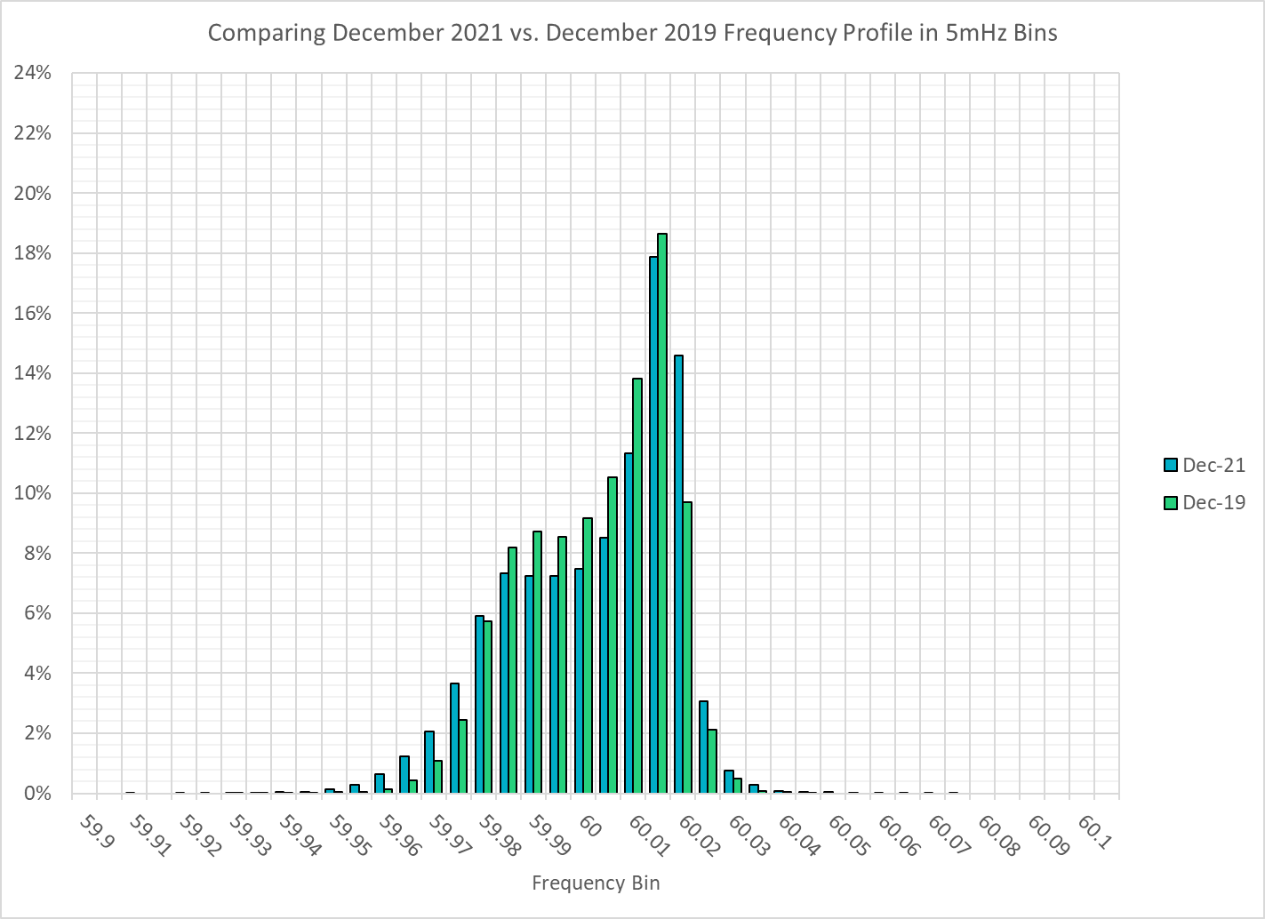
Frequency Profile Comparison

Slide 14
Time Error Correction

Slide 15
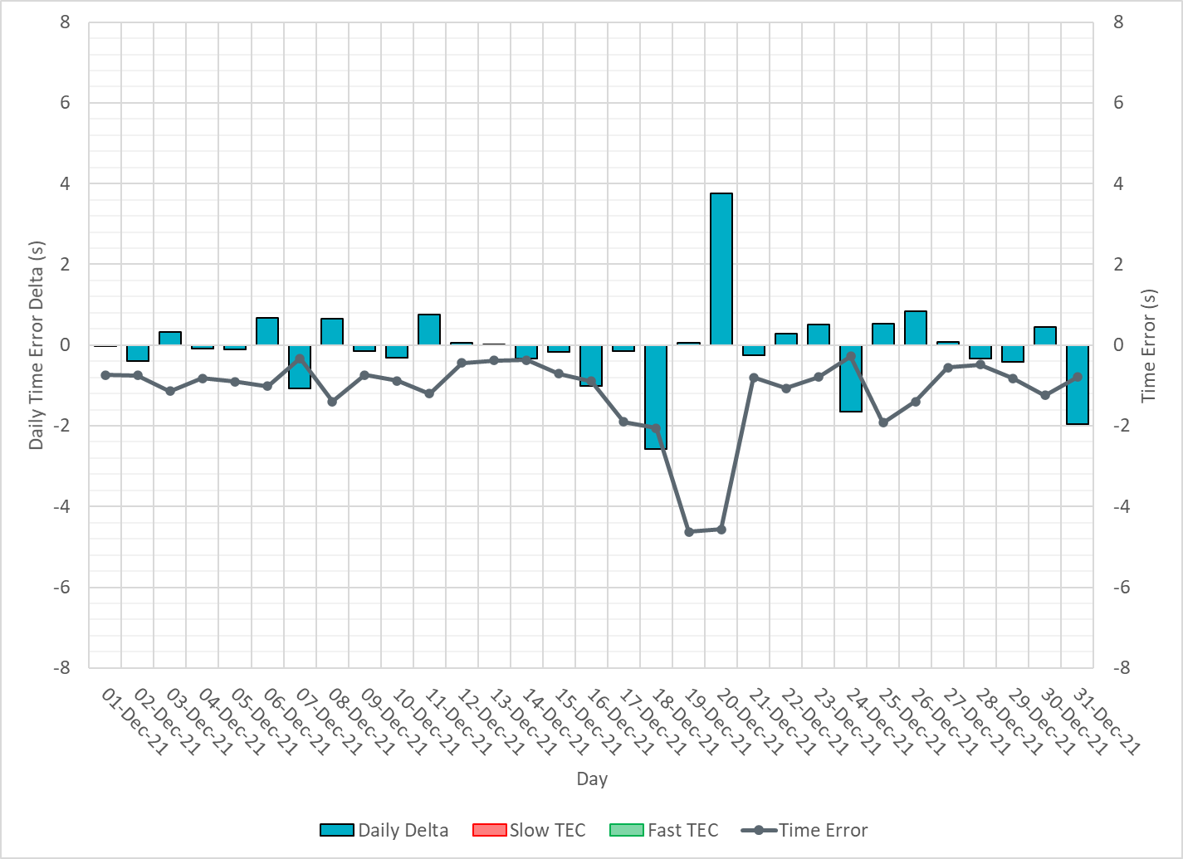
ERCOT Daily Time Error

Slide 16
Time Error Corrections Log Summary
There have been no time error corrections since December 2016

Slide 17
BAL-003 Performance

Slide 18
Op. Year 2020 BAL-003 Selected Events – Update
Notes:
BAL-003

Slide 19
Op. Year 2020 BAL-003 FRM Performance - Update
Notes:
OP2018: FRO = -381.0, FRM_median = -843.17, FRM_average = -959.7
OP2019: FRO = -381.0, FRM_median = -811.14, FRM_average = -892.5
OP2020: FRO = -425.0, FRM median = -789.34, FRM average = -879.0
OP2021: FRO =

Slide 20
ERCOT Energy Statistics

Slide 21
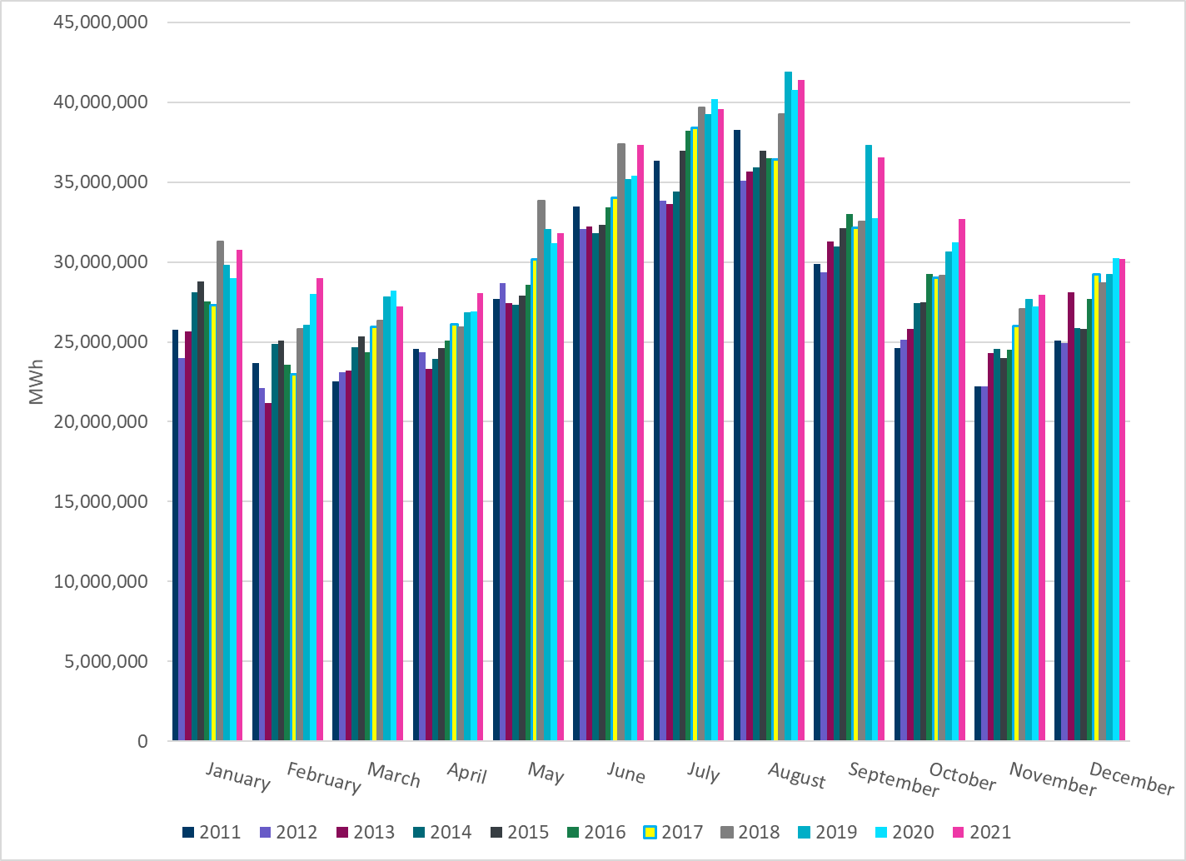
Total Energy
Notes:
30,205,131 MWh

Slide 22
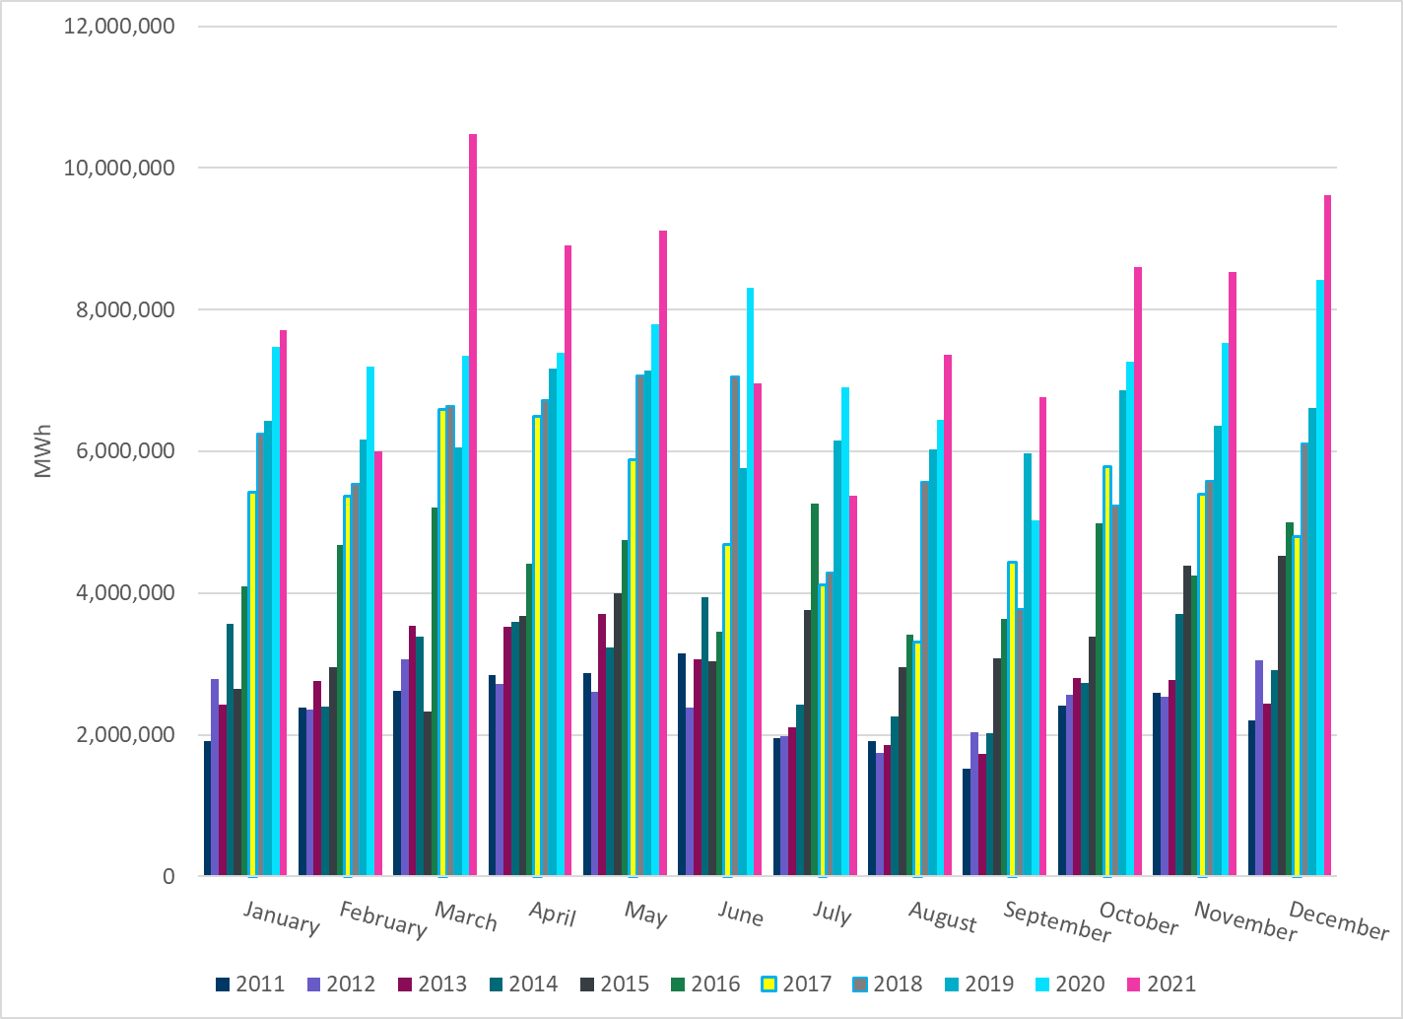
Total Energy from Wind Generation
Notes:
9,617,446 MWh

Slide 23
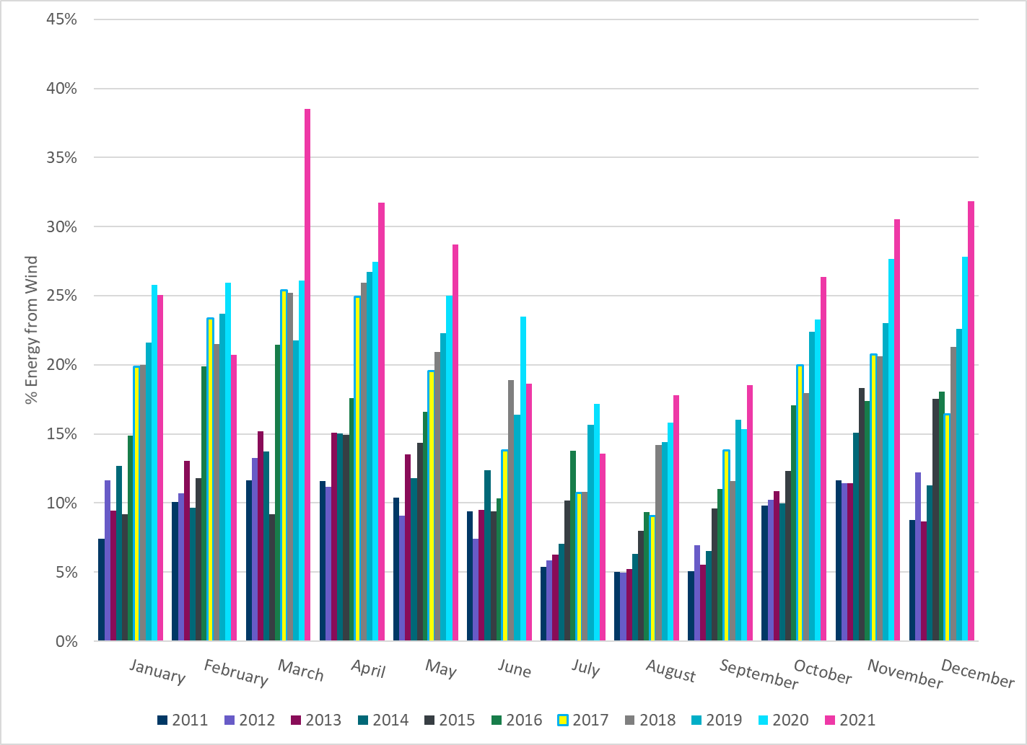
% Energy from Wind Generation
Notes:
31.84%

Slide 24
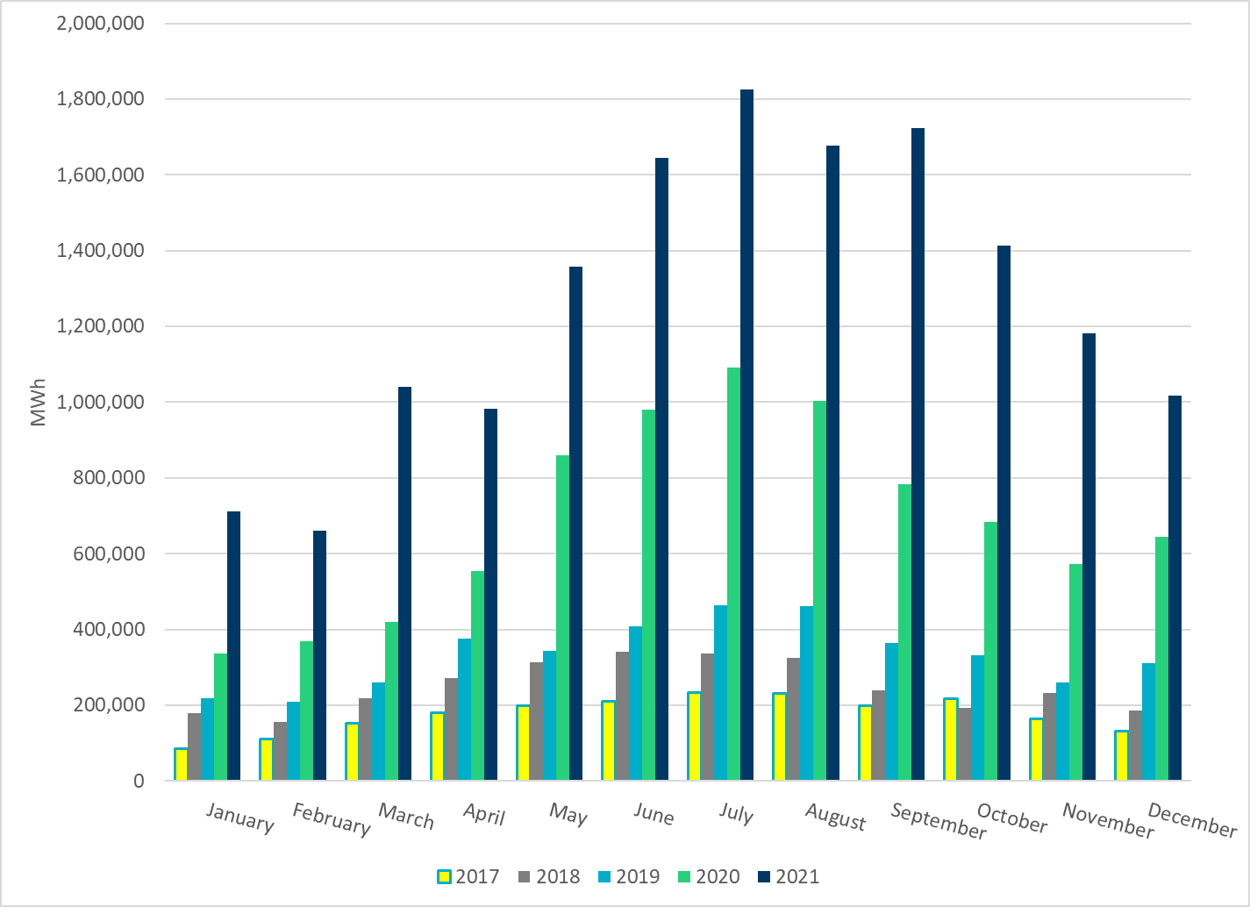
Total Energy From Solar Generation
Notes:
1,016,276 MWh

Slide 25
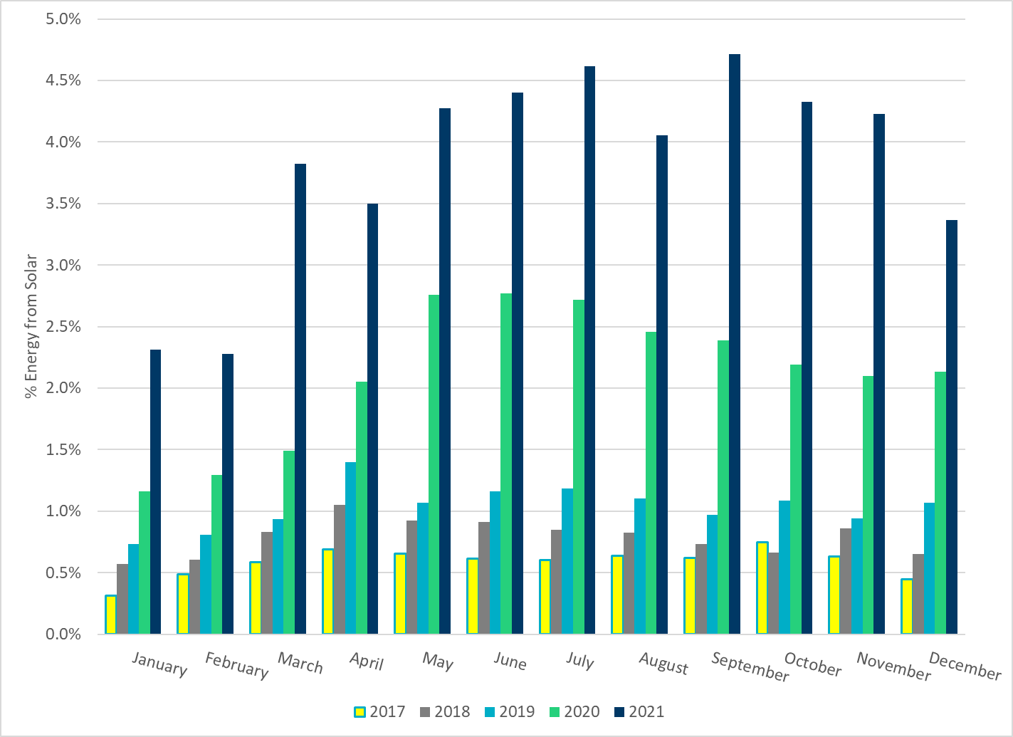
% Energy from Solar Generation
Notes:
3.36%

Slide 26
ERCOT System Inertia

Slide 27
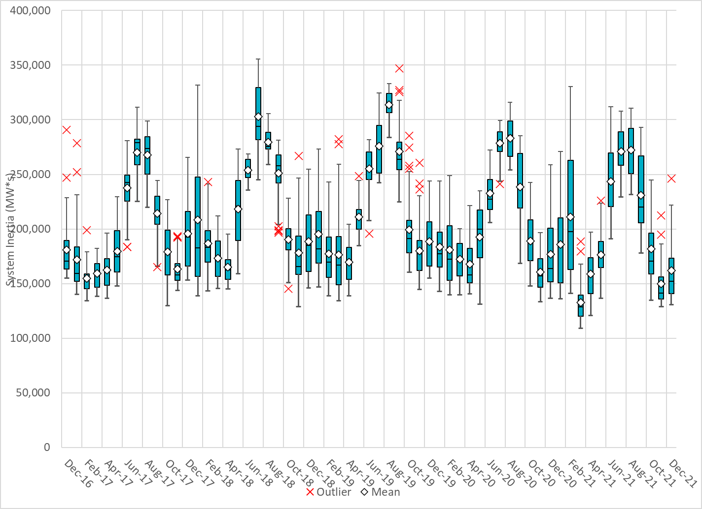
Daily Minimum System Inertia
Notes:
Minimum Inertia = 130,757 MW*s on 12/24/2021
Previous Minimum was 109,029 MW*s on 3/22/2021
Data:
Mean: 162,176 MW*s
Max: 246,027 MW*s on Dec 20th
Min: 130,757 MW*s on Dec 24th

Slide 28
Questions?
Thank you!

