Slide 1
ERCOT Frequency Events
December 2021
ERCOT
Operations Planning
PDCWG | January 19th, 2022

Slide 2
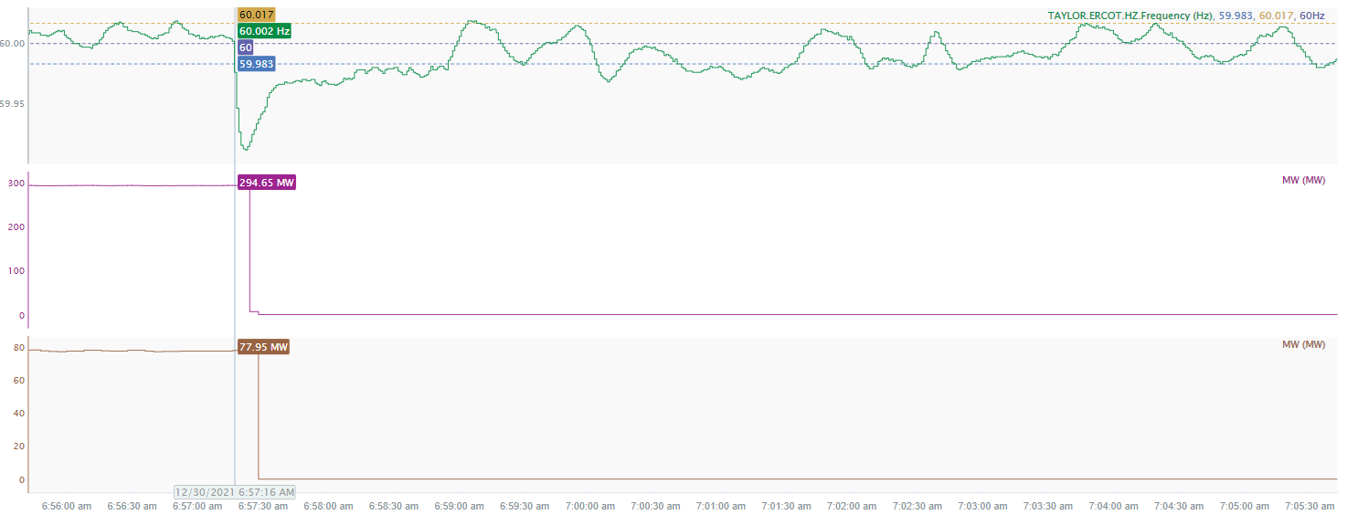
12/30/2021 6:57:16 (Non - FME)
Notes:
Two units tripped offline for a combined loss of 373 MW
Starting Frequency: 60.002 Hz
Minimum Frequency: 59.911 Hz
A-C Time: 6 seconds
Recovery Time (back to deadband): 1 minute and 40 seconds
RRS Deployed: 0 MW
Trip Reason: Unknown at this time
Contextual Information: A total of 342 MW of regulation up was deployed during the event.
No Selection Reason: Did not meet the MW loss criteria

Slide 3
Questions?
Thank you!

