Slide 1
Credit Exposure Update
Spoorthy Papudesi
Credit Work Group
ERCOT Public
January 19, 2022

Slide 2
Monthly Highlights Dec 2021 – Nov 2021
Market-wide average TPE decreased from $ 795.3 million in November to $ 782.5 million in December
TPE decreased mainly due to lower Real-Time and Day-Ahead Settlement Point prices in December than in November
Discretionary Collateral is defined as Secured Collateral in excess of TPE,CRR Locked ACL and DAM Exposure
Average Discretionary Collateral increased from $1,759.3 million to $1,787.4 million
The increase in Discretionary Collateral is largely due to increase in Secured Collateral, and decrease in TPE
No unusual collateral call activity

Slide 3
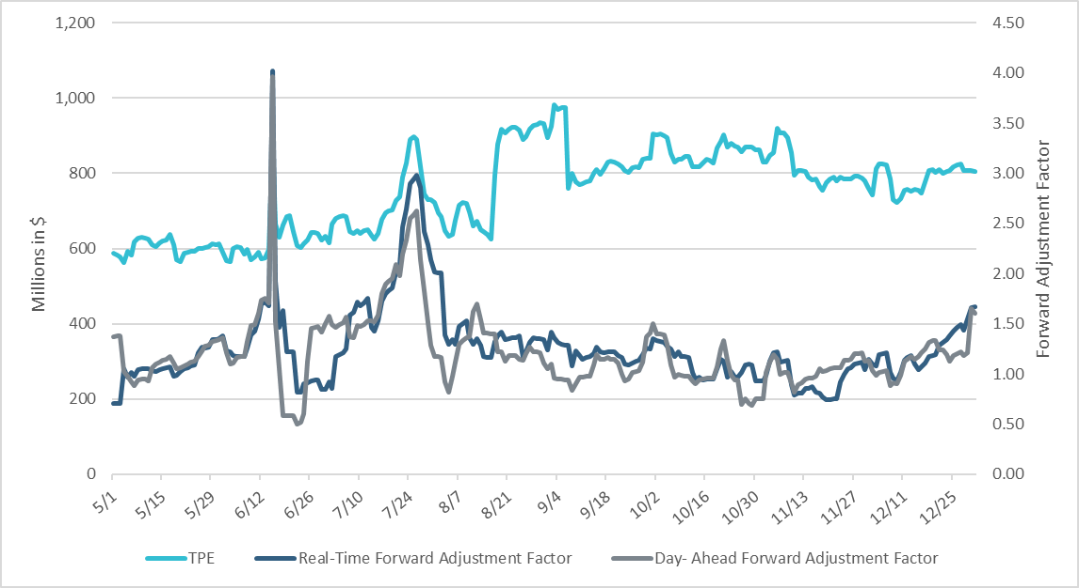
TPE and Forward Adjustment Factors May 2021- Dec 2021
*TPE adjusted to exclude short pay entities eliminating data skew

Slide 4
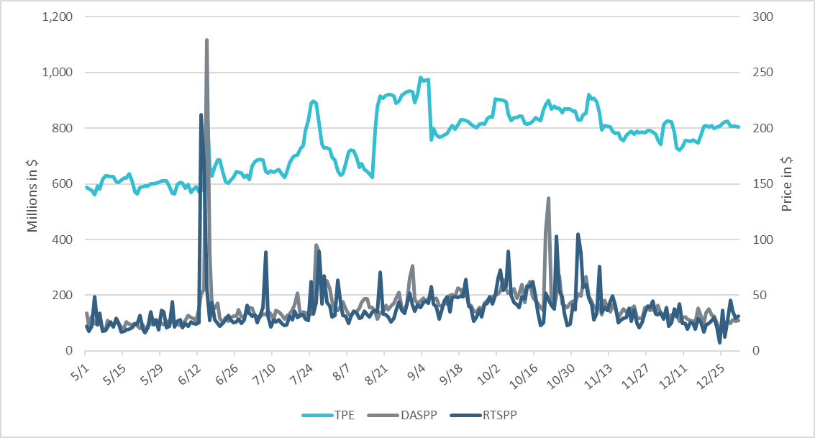
TPE/Real-Time & Day-Ahead Daily Average Settlement Point Prices for HB_NORTH May 2021- Dec 2021
* TPE adjusted to exclude short pay entities eliminating data skew

Slide 5
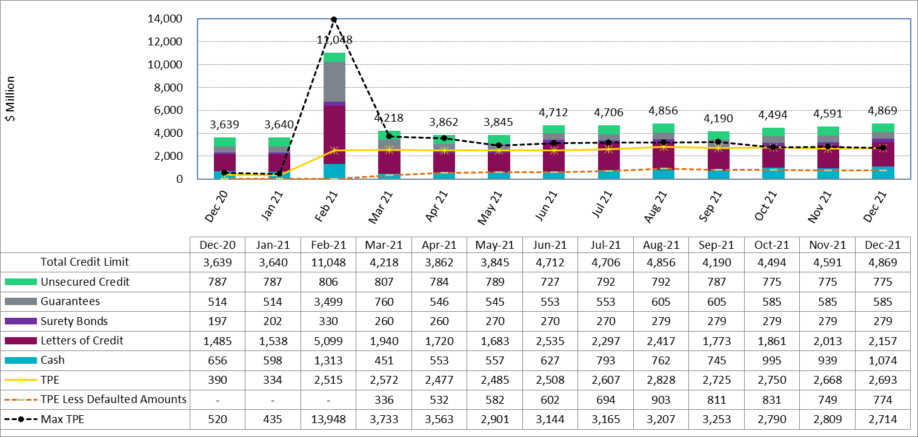
Available Credit by Type Compared to Total Potential Exposure (TPE) Dec 2020- Dec 2021
Numbers are as of month-end except for Max TPE
Max TPE is the highest TPE for the corresponding month
TPE less Defaulted Amounts: TPE – Short-Paid Invoices

Slide 6
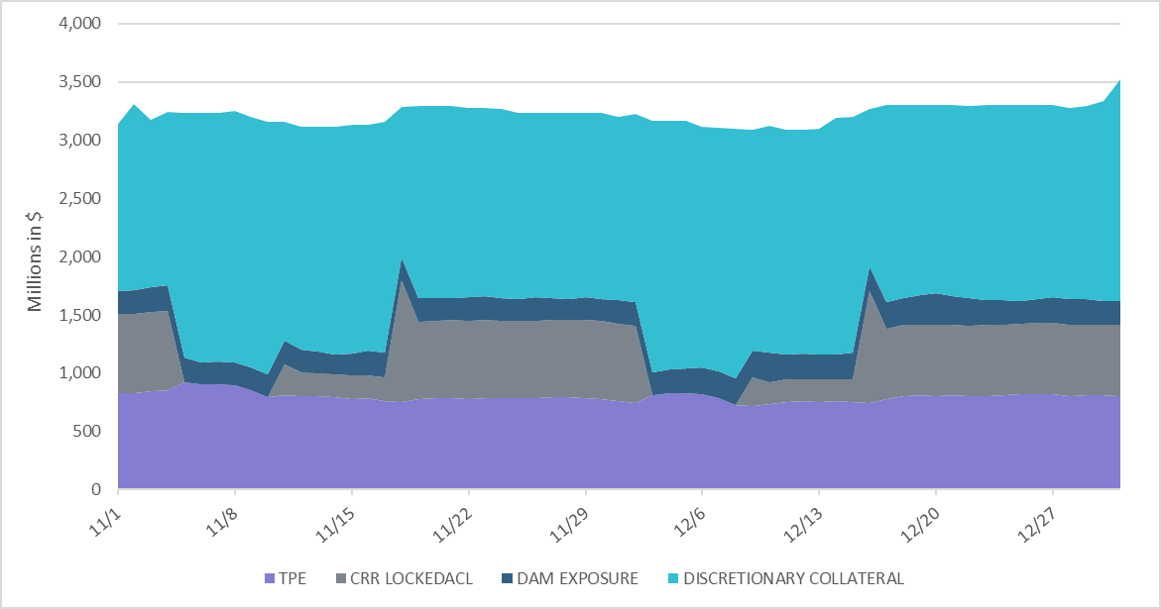
Discretionary Collateral Nov 2021 - Dec 2021
* Discretionary collateral doesn’t include Unsecured Credit Limit or parent guarantees
* TPE adjusted to exclude short pay entities eliminating data skew

Slide 7
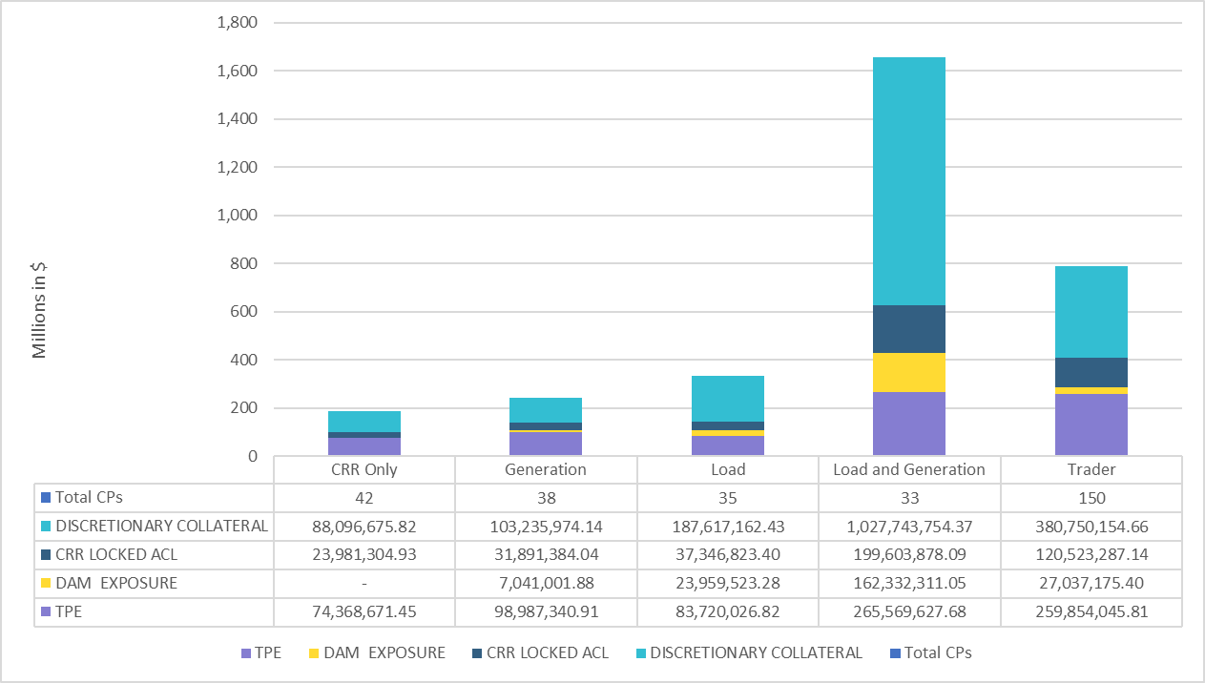
TPE and Discretionary Collateral by Market Segment- Dec 2021*
Load and Generation entities accounted for the largest portion of discretionary collateral
*Discretionary collateral doesn’t include Unsecured Credit Limit or parent guarantees
* TPE adjusted to exclude short pay amounts eliminating data skew

Slide 8
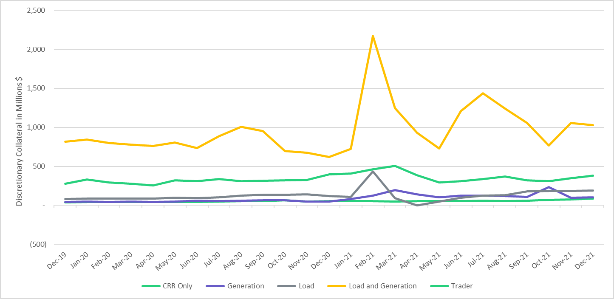
Discretionary Collateral by Market Segment Dec 2019- Dec 2021
* Discretionary Collateral adjusted to exclude short pay amounts eliminating data skew

Slide 9
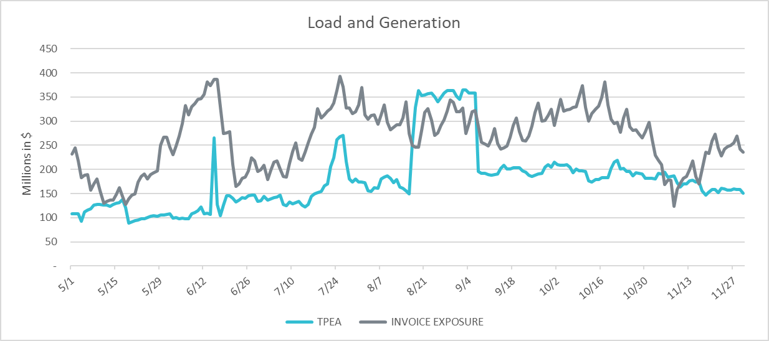
TPEA Coverage of Settlements May 2021– Nov 2021
Invoice exposure generally exceeds TPEA
TPEA adjusted to exclude short pay entities eliminating data skew

Slide 10
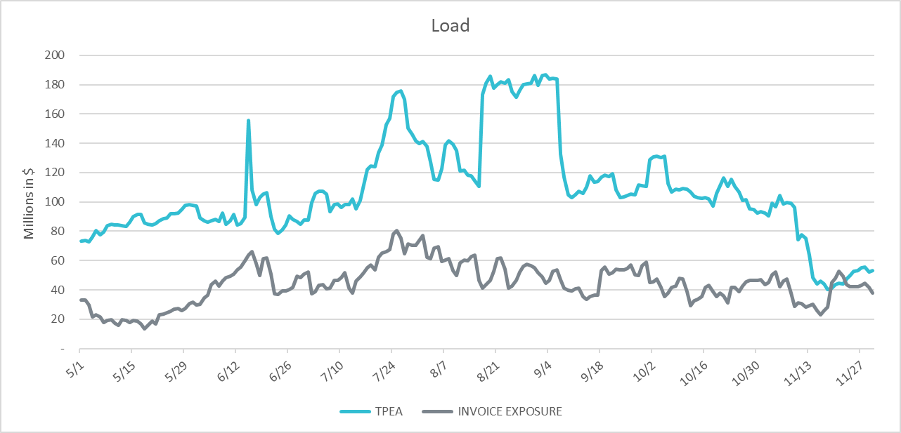
TPEA Coverage of Settlements May 2021– Nov 2021
*TPEA exceeds invoice exposure
*TPEA adjusted to exclude short pay entities eliminating data skew

Slide 11
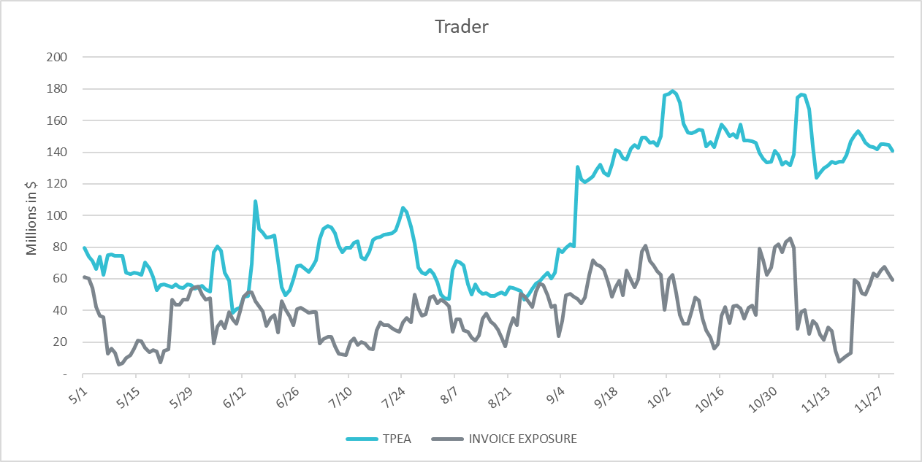
TPEA Coverage of Settlements May 2021– Nov 2021
*TPEA generally exceeds invoice exposure

Slide 12
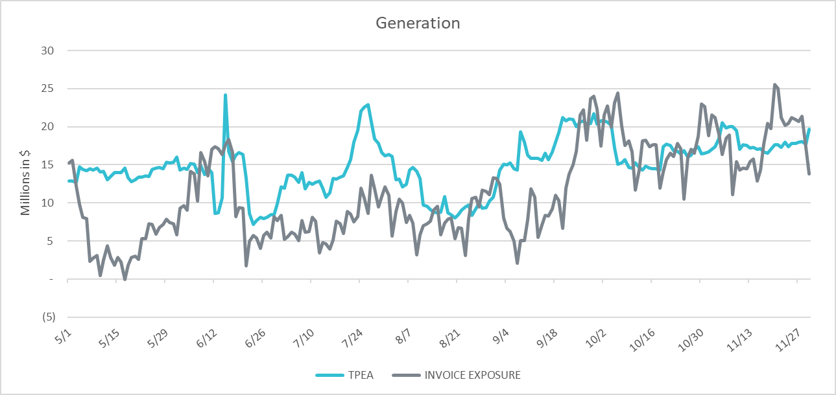
TPEA Coverage of Settlements May 2021– Nov 2021
* TPEA generally exceeds Invoice exposure

Slide 13
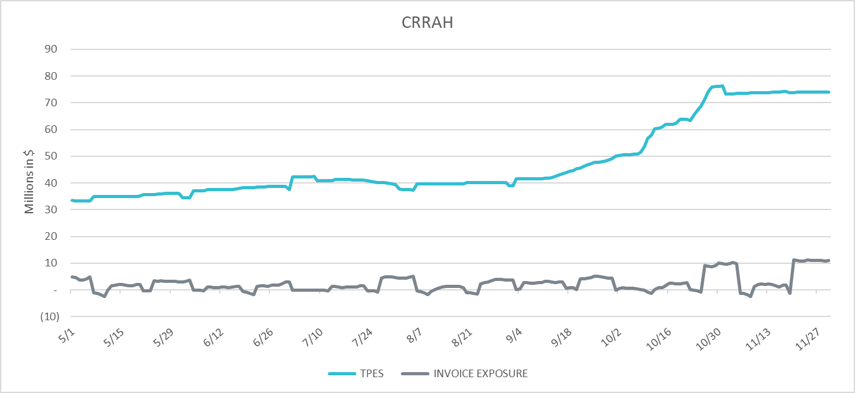
TPEA Coverage of Settlements May 2021– Nov 2021
*TPES exceeds actual/invoice exposure

Slide 14
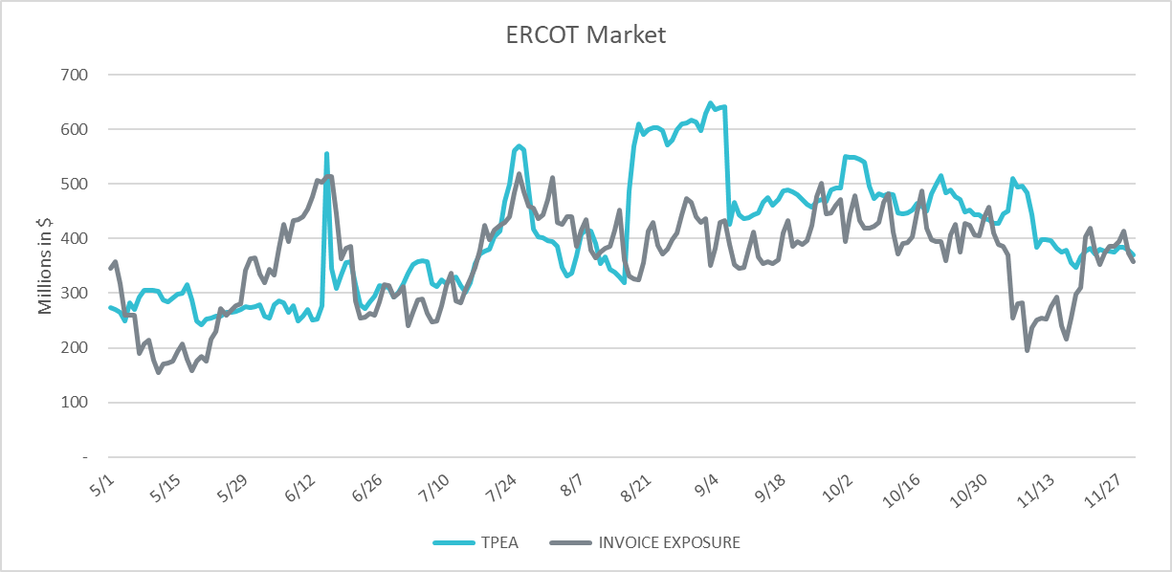
TPEA Coverage of Settlements May 2021– Nov 2021
*TPEA closely approximates actual/invoice exposure
*TPEA adjusted to exclude short pay entities eliminating data skew

Slide 15
Appendix

Slide 16
Summary of Distribution by Market Segment*
* Excess collateral doesn’t include Unsecured Credit Limit and is defined as Collateral in excess of TPE
* TPE adjusted to exclude short pay amounts eliminating data skew

Slide 17
Summary of Distribution by Rating Group*
* TPE adjusted to exclude short pay amounts eliminating data skew

Slide 18
Distribution of TPE by Rating and Category*
* TPE adjusted to exclude short pay amounts eliminating data skew

Slide 19
Distribution of Excess Collateral by Rating and Category*
*Excess collateral doesn’t include Unsecured Credit Limit
* TPE adjusted to exclude short pay amounts eliminating data skew

Slide 20
TPEA Coverage of Settlements
TPEA covers Settlement/Invoice exposure and estimated Real-Time and Day- Ahead completed but not settled activity (RTLCNS and UDAA)
The analysis was performed for the period, Nov 2020 - Nov 2021
Only Settlement invoices due to ERCOT are considered in the calculation
Example
For business date 2/1/2020, if a Counter-Party has M1 value of 20, then all the charge invoices till 2/21/2020 including RTLCNS and UDAA as of 2/1/2020 is summed up to arrive at “Invoice Exposure”

Slide 21
Questions

