Slide 1
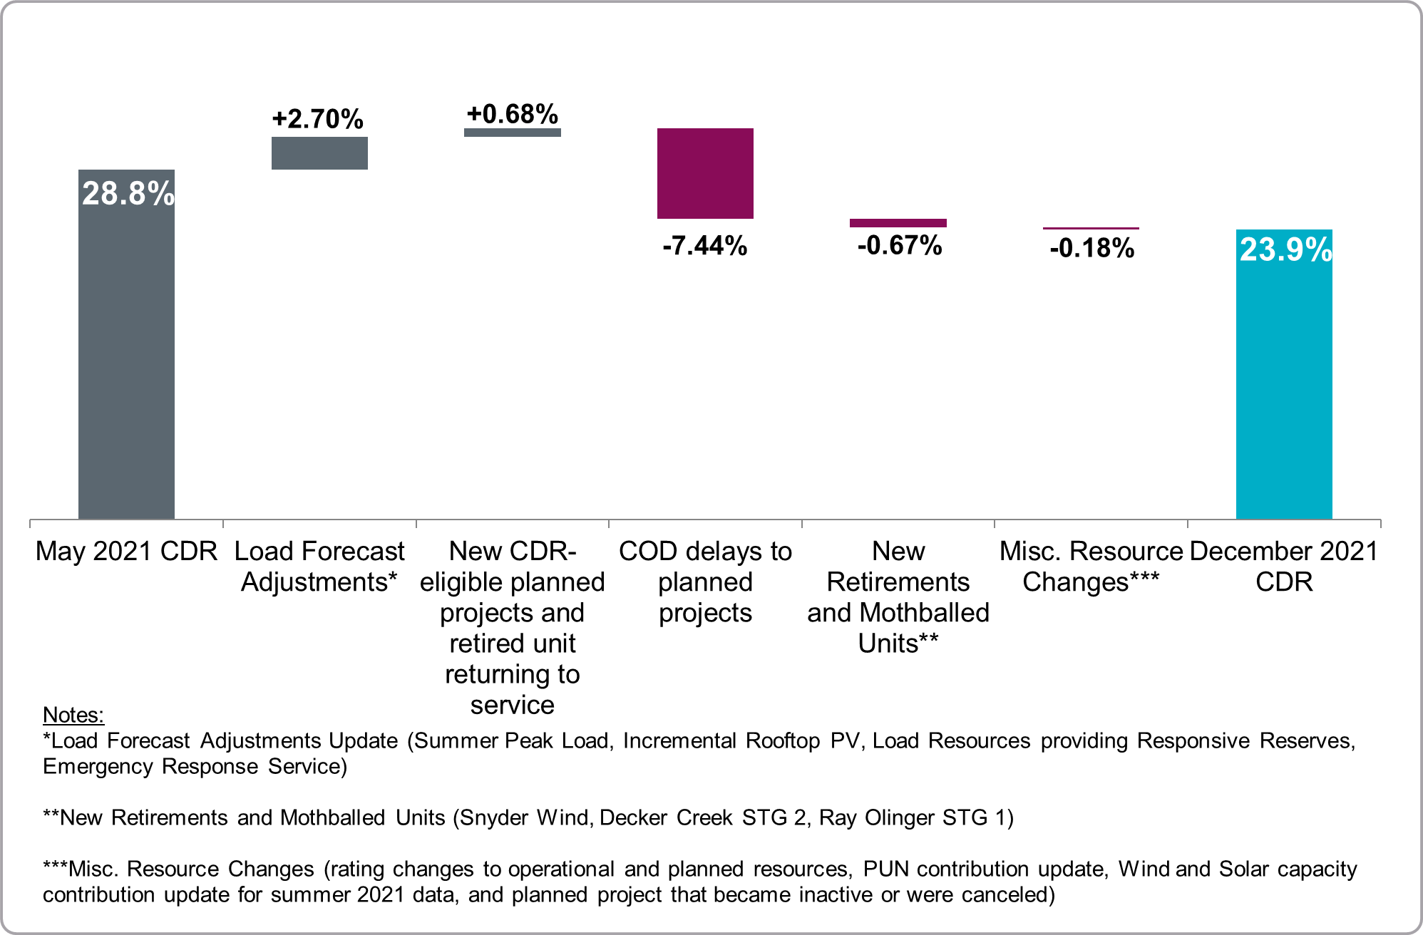
Summer 2022 Reserve Margin Waterfall Chart, May to December CDR

